Slide 1
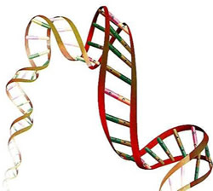

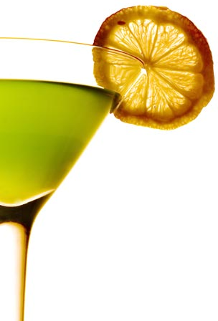
Bipartite Networks - I
Monojit Choudhury
Microsoft Research India

Slide 2
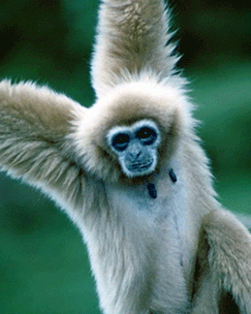
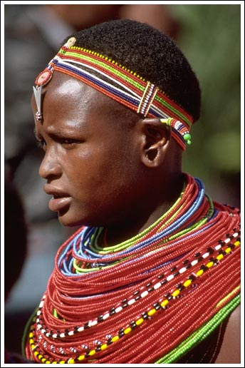
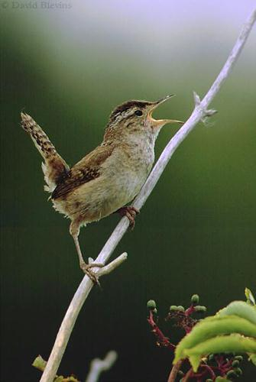
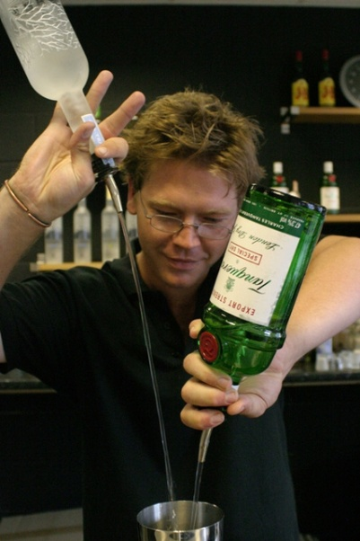
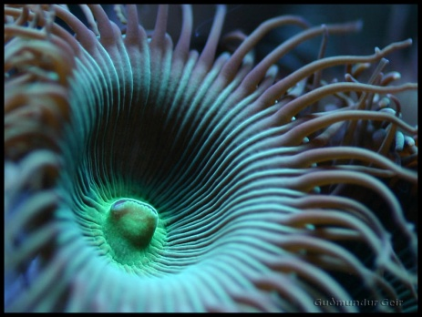
Evolution: Biological, Cognitive and Cultural
Words
Genes
Cocktails

Slide 3
What’s common?
Words: Sequences of letters
Genes: Sequences of codons
Cocktails: Combinations of liquors
They are all Combinatorial Systems
Discrete Combinatorial System: genes, words
Blending System: colors, cocktails

Slide 4
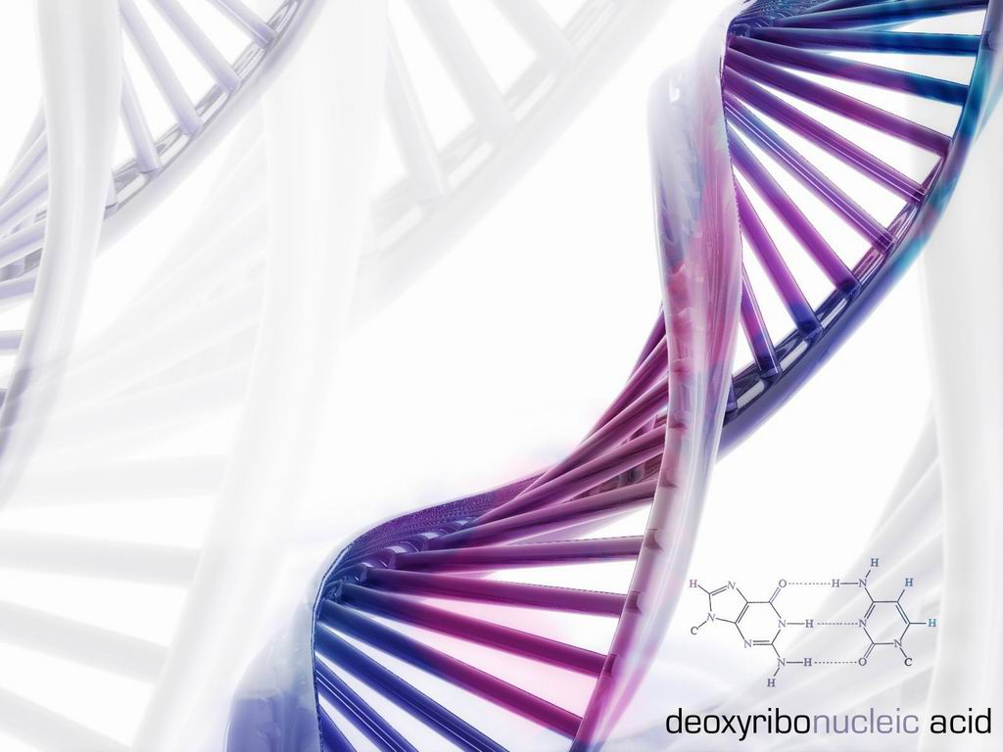
A Model of DCS
AAU ACG ACC AAU UGC AUA AAU GAA UGA ACG …
…
…
…
V: genes
…
ACG
AGA
GAA
AUA
UGC
ACC
UGA
AAU
U: codons

Slide 5
More Examples
Letters
Words
Sentences
c
cat likes rat
n
cat
a
rat likes cat
t
likes
r
cat eats rat
l
rat
rat eats cat
i
k
the cat likes rat
eats
e
s
cat eats the rat
h
the
z
the cat likes the rat

Slide 6
A Bipartite World
Movie-Actor
Article-Author
Team-Player
Board-Director
Train-Station
Metabolic pathway-Protein
Antibody-Antigen
Language-Phoneme, …

Slide 7
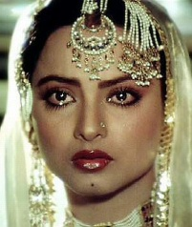
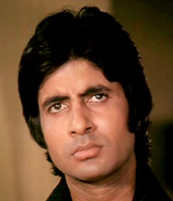
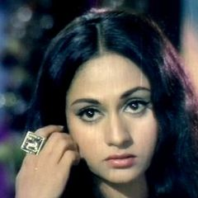


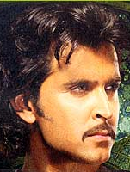
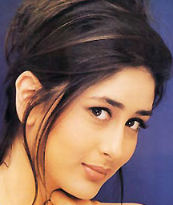


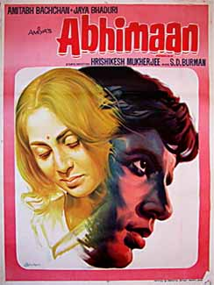

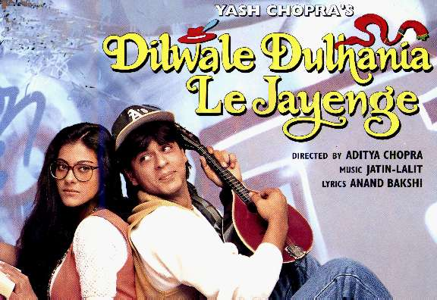



Secrets of Bollywood
How many actors does a movie have and why?
How many movies an actor acts in and why?

Slide 8
BNWs: What’s so Special?
BNW ⬄ 2-colorability ⬄ Triangle free
Aka Two-mode graphs
Generalization: k-partite graphs
  k = 1: unipartite (nothing special)
  k = 2: BNW
  k > 2: not very interesting
Relationship between chromatic number and k

Slide 9
Analysis of BNWs: Degree
Degree distribution
  Two separate distributions: one for each partition
Degree Centrality
  Do we need any modification?
  Yes! Need different normalizations

Slide 10
Analysis of BNW: Centrality
What about
  Closeness centrality?
  Betweenness centrality
  Eigenvector centrality
M. Everett and S.P. Borgatti (2005) Extending Centrality. In Models and Methods in Social Network Analysis. Ed. Carrington et al. CUP

Slide 11

Analysis of BNW: Clustering
What is the clustering coefficient of a BNW?
Basic Idea: Count the squares instead of triangles
Zhang et al (2008) The clustering coefficient and community structure of bipartite networks.

Slide 12
One-mode Projection
/s/
/s/
1
1
l₂
l₁
/p/
/k/
1
/n/
1
1
3
l₂
One-mode projection
2
One-mode projection
/k/
1
l₃
1
l₁
2
1
1
l₃
/t/
1
/t/
2
/d/
2
1
1
l₄
l₄
/d/
2
1
/p/
/n/
LangGraph
PlaNet
PhoNet
A
l₁ l₂ l₃ l₄
B
/s/ /p/ /k/ /t/ /d/ /n/
B′
l₁ l₂ l₃ l₄
/s/
/p/
/k/
/t/
/d/
/n/
1
0
1
0
0
0
0
1
1
1
0
0
1
0
0
1
0
1
0
1
1
1
1
1
/s/
/p/
/k/
/t/
/d/
/n/
0
0
1
0
0
1
0
0
2
2
1
1
1
2
0
2
1
1
0
2
2
0
1
2
0
1
1
1
0
1
1
1
1
2
1
0
l₁
l₂
l₃
l₄
0
1
1
1
1
0
1
3
1
1
0
2
1
3
2
0
A^{T}A – D′
AA^{T} – D

Slide 13
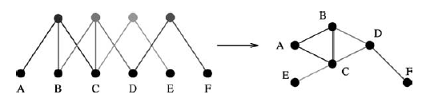
Bipartite Structure of all Complex Networks
Jean-Loup Guillaume, Matthieu Latapy (2004) Bipartite structure of all complex networks. Information Processing Letters 90

