Slide 1
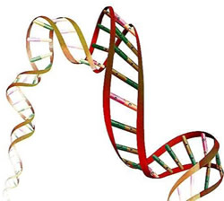

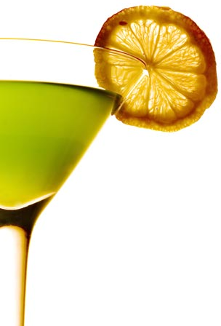
Bipartite Networks - III
Monojit Choudhury
Microsoft Research India

Slide 2

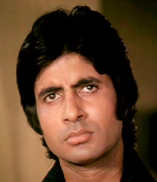









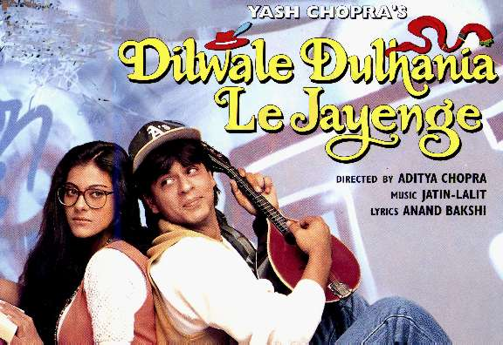



Secrets of Bollywood
How many actors does a movie have and why?
How many movies an actor acts in and why?

Slide 3
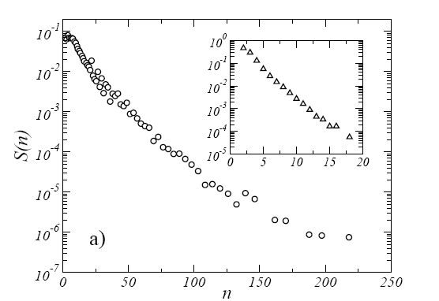
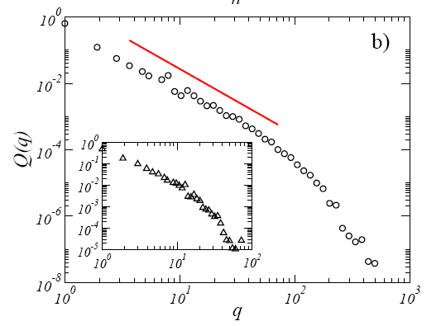
Empirical Observations
Ramasco et al (2004) Self-organization of collaboration networks. Phy. Rev. E 70.
Results are for scientific collaboration network

Slide 4
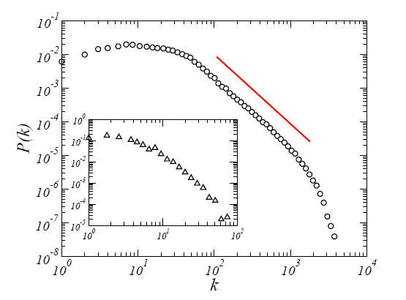
Empirical Observations
One-mode DD

Slide 5
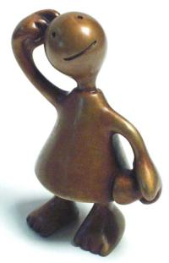
How SRK became famous?
Rules of the game:
At every time step, a new movie comes in and decides to choose n actors
of them m are new.
n - m are chosen preferentially from the set of old actors.
Actors
Movies
Debuts

Slide 6
Analysis of the model
Number of movies: t
Number of actors: N ← N + m
  For large t, N(t) = mt
Under the assumption that n = μ
  Total number of edges = μt
  Therefore, average degree of actor = μ/m
  ⟨k⟩ = (μ-1)μ/m

Slide 7

Analytical Solution
Similar to the Simon Model
= 2+ m/(μ - m)
P(k) ~ [k+(γ-1/2)(μ-1)]^{-γ}

Slide 8
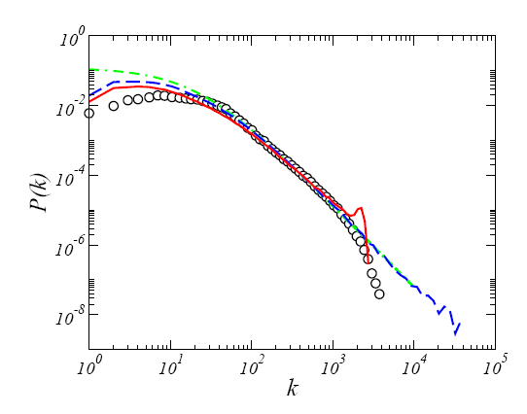
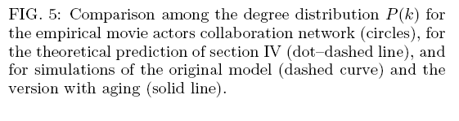
How good is the solution

Slide 9
Why genes aren’t cocktails?
Doubly-unbounded BiNs
  What goes into a cocktail is limited only by your creativity
  Other Ex.: Movie-actor, article-author
αBiNs: Alphabetic BiNs
  Poor genes can have only 64 codons
  Other Ex.: Word-letter, train-station, language-phonemes, …

Slide 10
Alphabetic Bipartite Networks
Letters
Words
Sentences
c
cat likes rat
n
cat
a
rat likes cat
t
likes
r
cat eats rat
l
rat
rat eats cat
i
k
the cat likes rat
eats
e
s
cat eats the rat
h
the
z
the cat likes the rat

Slide 11
Evolution of αBiN
Peruani et al. 2007 EPL
Rules of the game:
A new word is born
Chooses from the set of existing letters preferentially based on the degree
k + ε
letters
Words
∑ (k + ε)
all letters

Slide 12
Subcases
Sequential Attachment
  One edge at every step (μ = 1)
Parallel Attachment with replacement
  μ > 1, letters can repeat in words
Parallel Attachment without replacement
  μ > 1, letters cannot repeat

Slide 13
The Case of Sequential Attachment
t – #nodes in growing partition
N – #nodes in fixed partition
p_{k,t} – p_{k} after adding t nodes
What is the average degree of the BNW?
What is the average degree of the one-mode?

Slide 14

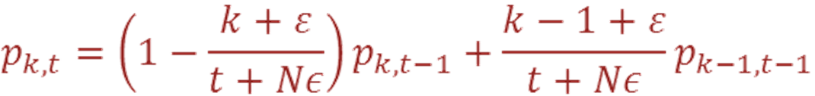
Markov Chain Formulation
Initial Condition
Markov Equation

Slide 15
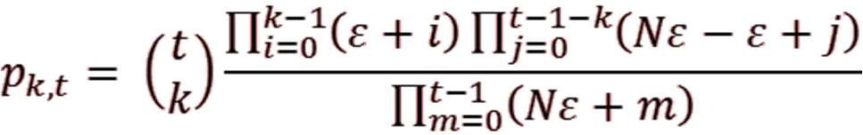
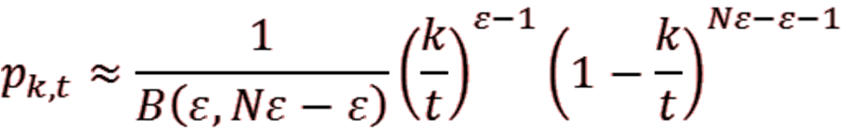
The Hard part
Average degree of the fixed partition diverges
Methods based on steady-state and continuous time assumptions fail
Closed-form Solution

Slide 16
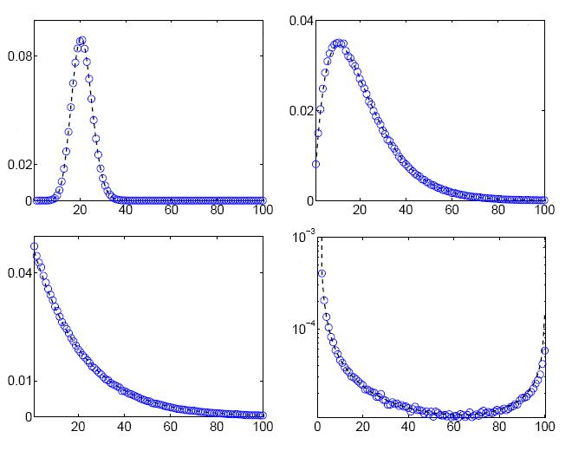
The four regimes
ε = ∞
ε = 2
1< ε < ∞
p_{k} (probability that randomly chosen node has degree k)
ε = 1
ε = 4e-4
ε < (N/μ-1)⁻¹
k (degree)

Slide 17
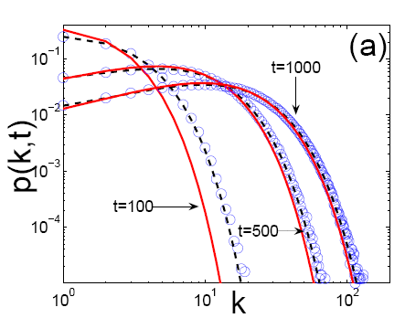
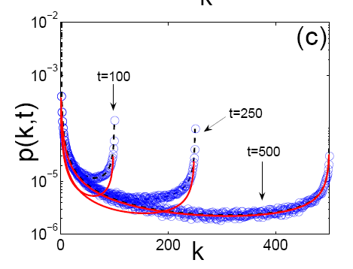
Evolution with time
t = ?
t = ?
t = ?

Slide 18
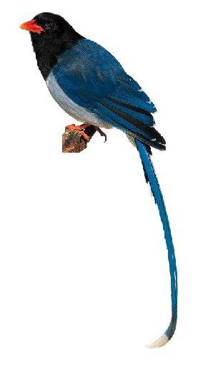
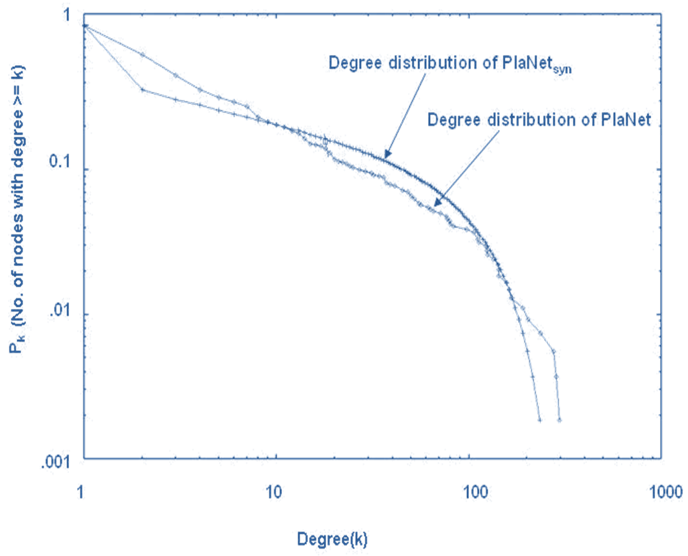
All Tails aren’t Fat

Slide 19
Back to Real Life
What is the physical significance of ε?
Depends on the underlying system
Higher ε → higher randomness → fairer system
Hands-on Experiments
Speakers and languages (sequential)
Genomes (parallel with replacement)
Linguistic divergence (parallel w/o replacement)

Slide 20
Questions

Slide 21
Wealth of Languages
Probability of a new node (language) entering the system: ε/(μt + Nε)
Distribution | ε | t | Probability of new language
Wiki Byte | 2e-3 | 1.2e10 | 1.5e-13
Parallel Data | 1e-4 | 6.2e8 | 1.6e-13
Web | 5e-4 | 7.0e9 | 1.9e-13
Speaker | 3e-3 | 4.7e9 | 6.5e-13
Annotated | 1e-4 | 4.2e7 | 2.4e-12
LDC Word | 3e-4 | 7.7e9 | 6.2e-08
Wiki Article | 3e-3 | 3.2e6 | 1.2e-07
LDC Item | 5e-4 | 4.9e2 | 1.1e-06

Slide 22
Genomes
Organism | ε | Origin Time (M years)
Myxococcus xanthus | 0.433 | 3200
Dictyostelium discoideum | 0.429 | 2100
Plasmodium falciparum | 0.571 | 542
Saccharomyces cerevisae | 2.941 | 488
Xenopus laevis | 8.333 | 416
Drosophila melanogaster | 3.571 | 270
Danio rerio | 3.333 | 145
Homo sapiens | 5.000 | 2
Randomness (& Complexity) increases with time (i.e. evolution)?

Slide 23
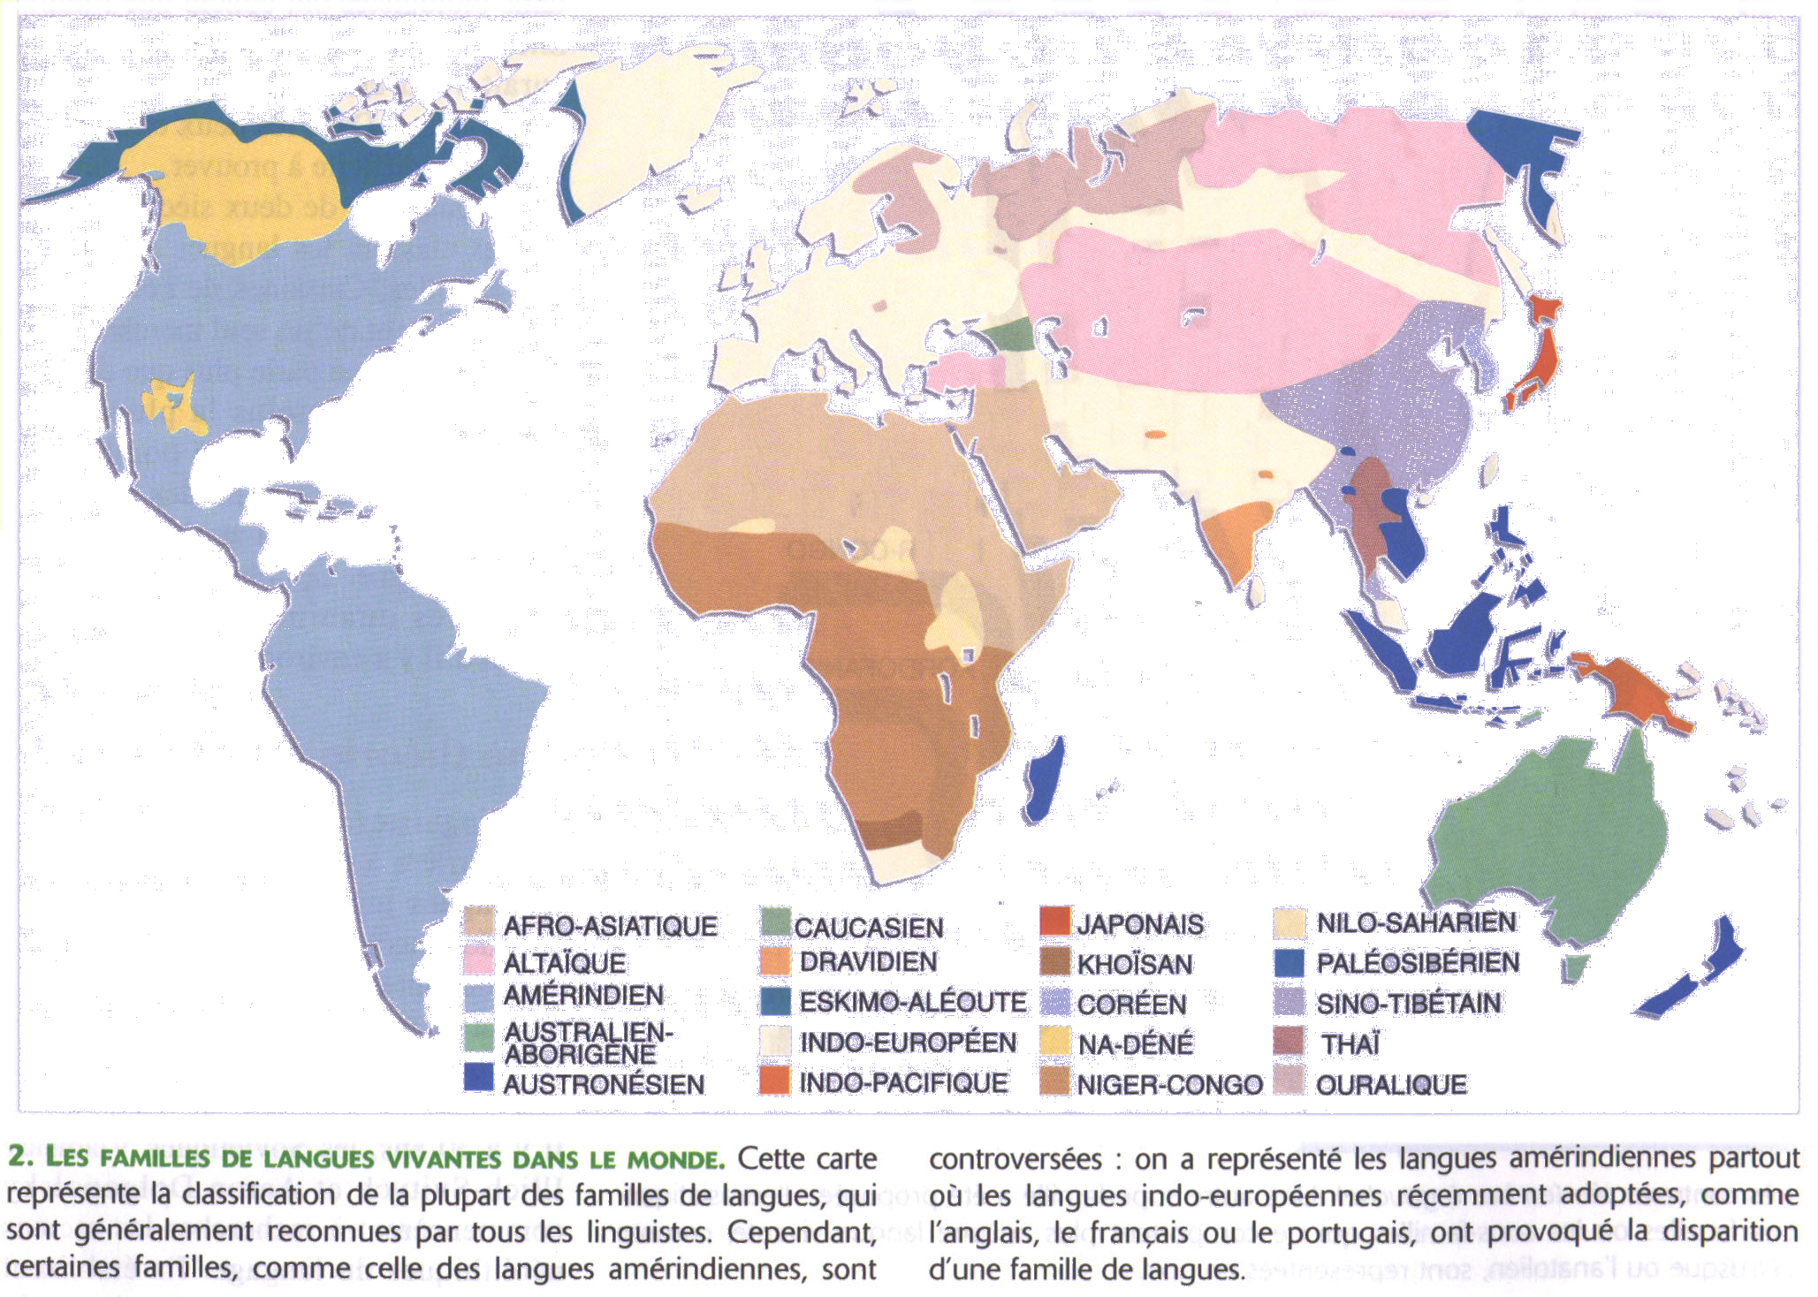
Linguistic Divergence
0.3 [4000y]
0.5 [6000y]
0.6 [6000y]
0.05 [5000/3000y]
0.3 [4000y]

