Slide 1
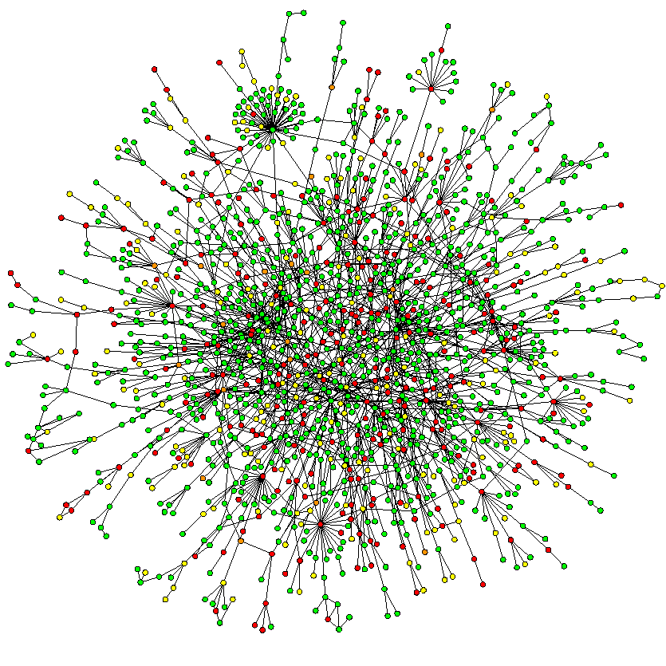
Complex Network Theory – An Introduction
Niloy Ganguly

Slide 2
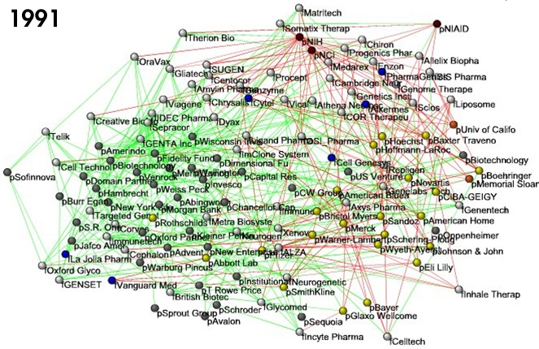
Business ties in US biotech-industry
Nodes: companies: investment
pharma
research labs
public
biotechnology
Links: financial
R&D collaborations
http://ecclectic.ss.uci.edu/~drwhite/Movie

Slide 3
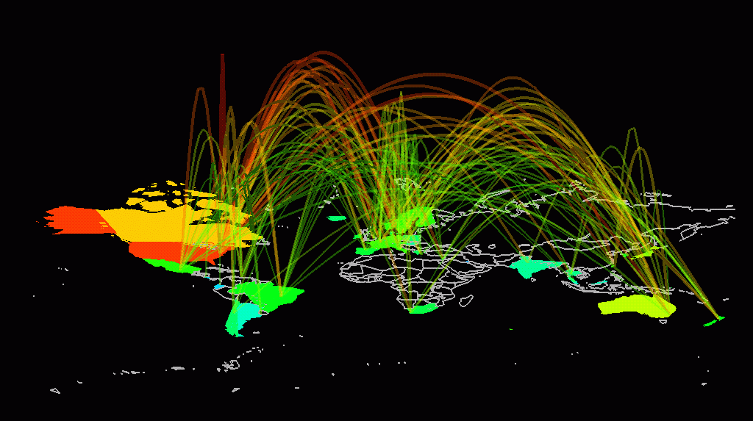
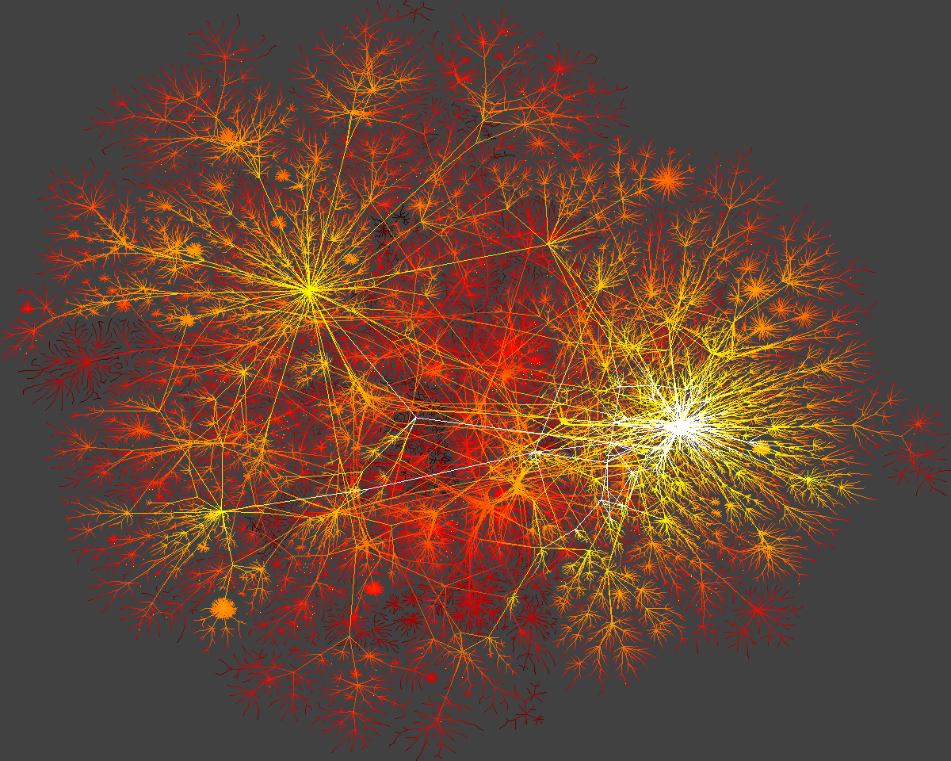
Internet

Slide 4
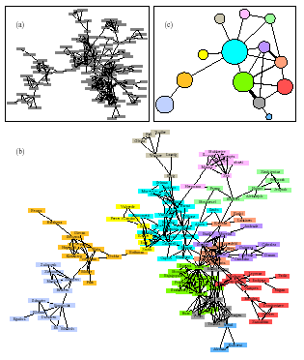
Network Collaboration Network

Slide 5
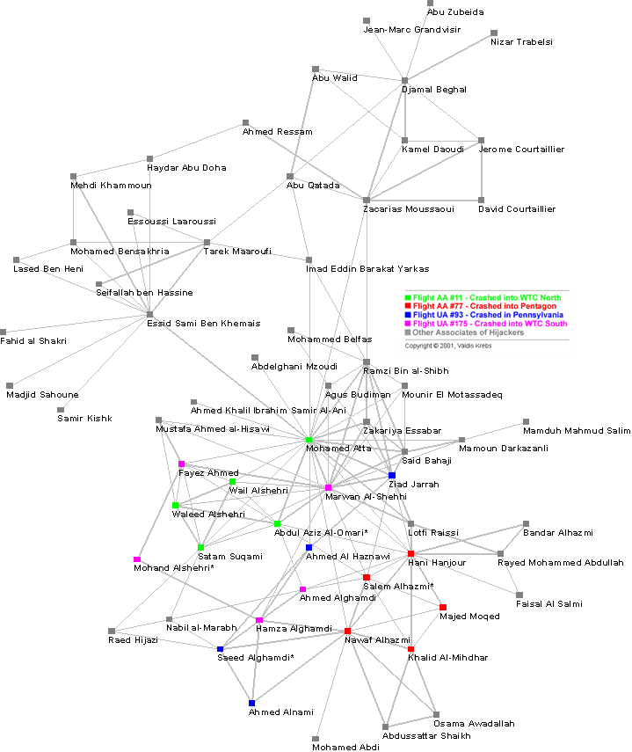
9-11 Terrorist (?) Network
Social Network Analysis is a mathematical methodology for connecting the dots -- using science to fight terrorism. Connecting multiple pairs of dots soon reveals an emergent network of organization.

Slide 6
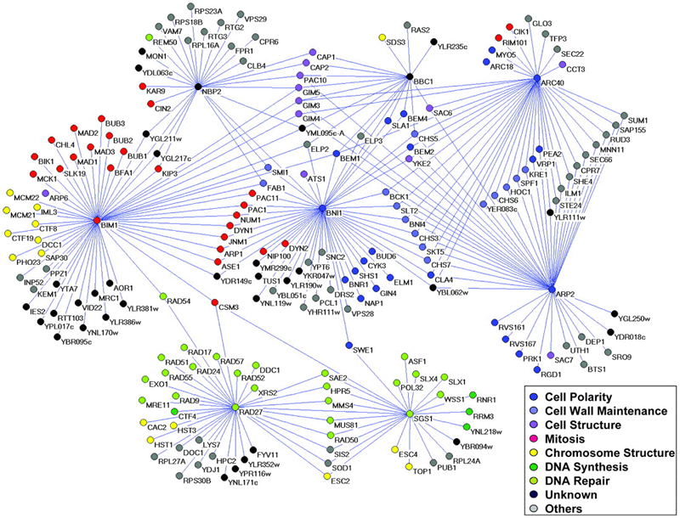
Genetic interaction network

Slide 7
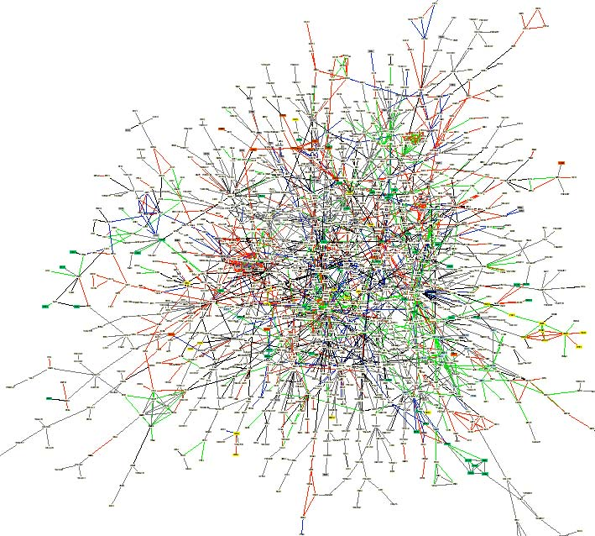
Yeast protein-protein interaction network
Notes:
An interaction map of the yeast proteome assembled from published interactions. The map contains 1,548 proteins (boxes)
and 2,358 interactions (connecting lines). Proteins are colored according to their functional role: proteins involved in
membrane fusion (blue), chromatin structure (gray), cell structure(green), lipid metabolism (yellow), and cytokinesis (red).

Slide 8
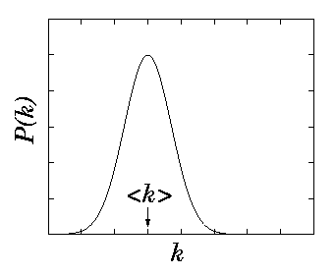
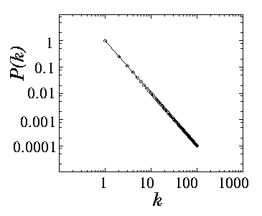
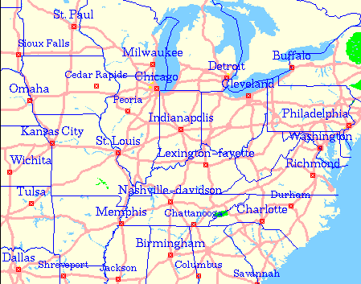
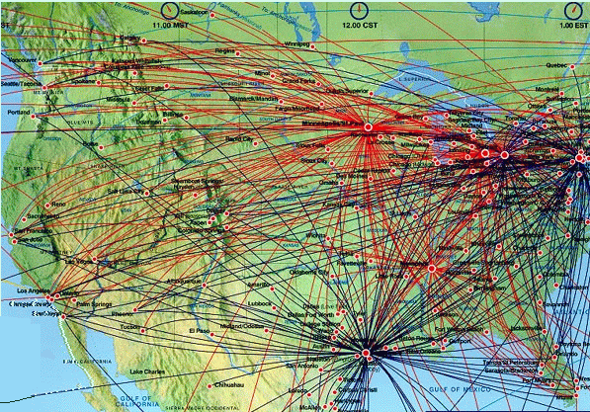
Symmetry
Poisson distribution
Power
-
law distribution
Scale
free Network
Exponential Network

Slide 9
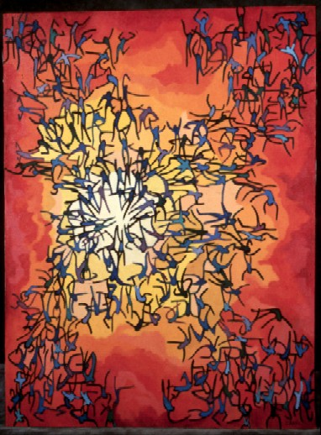
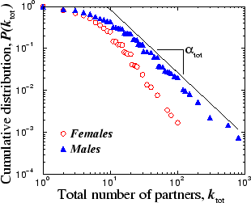
Swedish sex-web
Nodes: people (Females; Males)
Links: sexual relationships
4781 Swedes; 18-74;
59% response rate.
Liljeros et al. Nature 2001

Slide 10
9-11 Terrorist (?) Network
How to conduct investigation

Slide 11
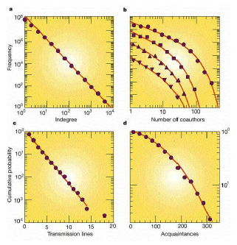
Degree distributions for various networks
World-Wide Web
Coauthorship networks: computer science, high energy physics, condensed matter physics, astrophysics
Power grid of the western United States and Canada
Social network of 43 Mormons in Utah

Slide 12
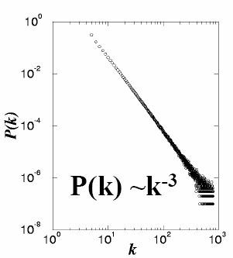
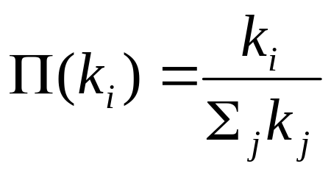
How do Power law DDs arise?
Barabási-Albert Model of Preferential Attachment
(Rich gets Richer)
(1) GROWTH : Starting with a small number of nodes (m₀) at every timestep we add a new node with m (<=m₀) edges (connected to the nodes already present in the system).
(2) PREFERENTIAL ATTACHMENT : The probability Π that a new node will be connected to node i depends on the connectivity k_{i} of that node
A.-L.Barabási, R. Albert, Science 286, 509 (1999)

