Slide 1
No Escape From Reality:
Security and Privacy of Augmented Reality Browsers
WWW '15

Slide 2
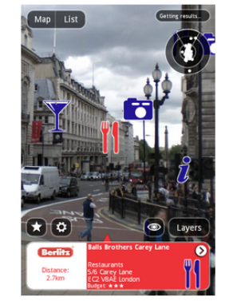
Introduction
Augmented reality (AR) browsers add interactive virtual objects to the user’s view of the physical world
Popular AR browsers are Junaio, Layar, Wikitude

Slide 3
AR applications have three stages -
  access sensors on mobile device (GPS, camera)
  create and manipulate a variety of 2D and 3D interactive virtual objects
  display virtual objects on top of the camera feed

Slide 4
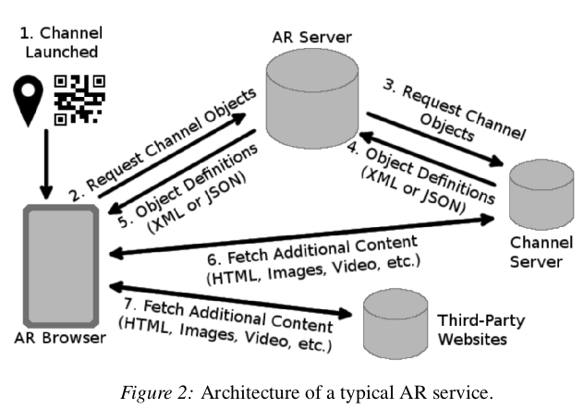
Architecture of AR Service
Users access third-party AR content through dedicated AR servers.
AR content providers host it in their servers and register their content with AR service-providers
AR content are channels

Slide 5
AR functional requirements
Access to native resources on the user's device
  access to onboard camera and GPS location
Support of interactive AR content
  channels include service specific XML or JSON
Image-triggered code execution
  automatically recognize picture and launch channels
Outsourced image processing
  send images from phone's camera to provider for processing
Visual composition of AR conent
Indirect retrieval of AR content

Slide 6
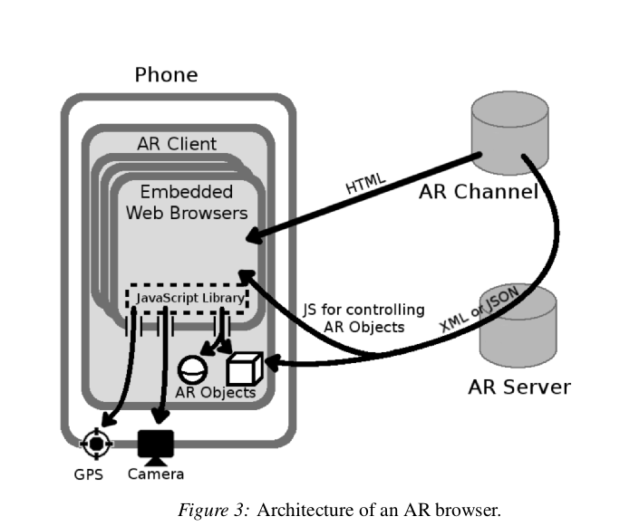
Components of AR services
AR browsers
AR channels
  specify AR content for display and how to display it
  specify actions to take
AR servers

Slide 7
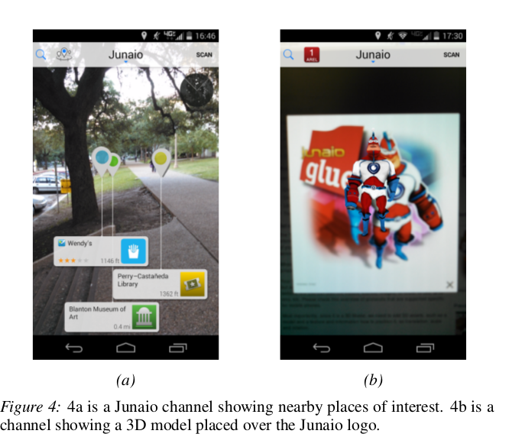
Specific AR browers

Slide 8
Threat model
AR attackers
  controls malacious contents and trick users into visiting them
Ad attackers
  tricks AR channels into incorporating malacious content
Web attackers
  controls own website and lure users to it via ads
Curious AR services
  privacy risks caused by user-specific visual data
Network attackers
  man-in-the-middle attacks

Slide 9
Out-of-sandbox Native access
Access network device resources
Can be accessed by any web content regardless of origin
Launching AR browsers through custom URLs
execute native commands directly without user permission.

Slide 10
Risks
Conventional Web content breaking out of the sandbox.
Malicious ads breaking out of the sandbox
Malicious AR content abusing native access

Slide 11
How to do it right
Interfaces to native resources must be prtected by origin-based access control
AR browsers should be re-designed to support native-access permissions
users should be asked for permission whenever AR browser is invoked automatically

Slide 12
Support for Non-HTML AR content
AR objects such as 2D, 3D models, animations cannot be described in HTML alone and hence AR browsers rely on XML or JSON definitions
AR browsers may combine contents from different origins
Conventional web browsers follow same-origin policy (SOP)
Difficult to implement as objects must be described in XML or JSON which are not governed by SOP

Slide 13
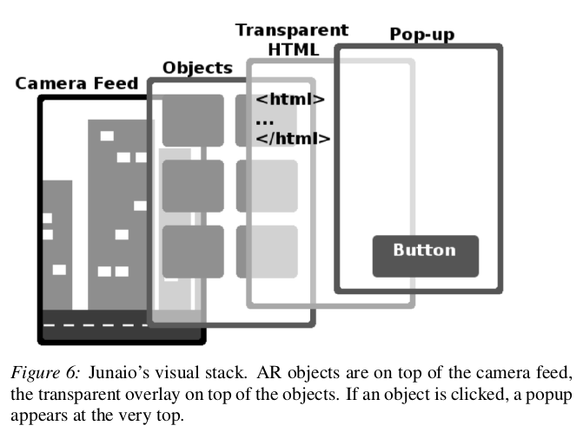
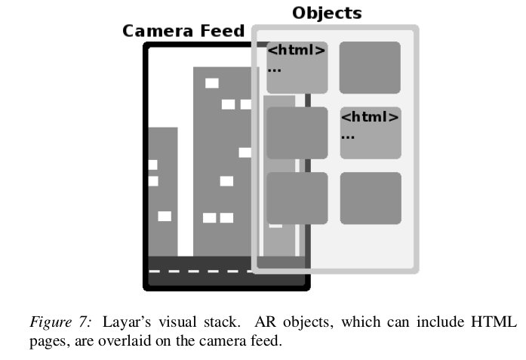
Doing it wrong
AR objects defined in XML
Transperant overlay provides GUI functionality
overlay may belong to a different origin

Slide 14
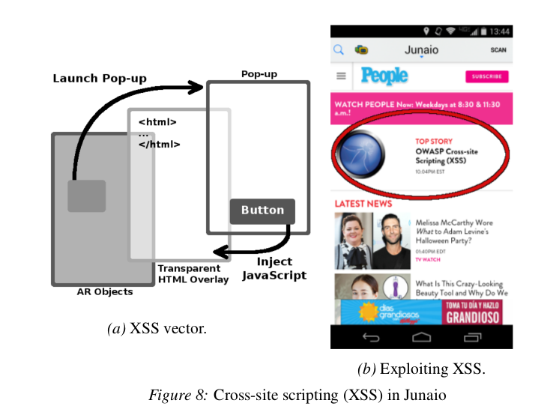
Risks
Cross-site scripting
  A malacious channel can specify any origin for the transparent page and associate arbitrary script with button
  Clicking this button allows unrestricted access to all contents from page's origin

Slide 15
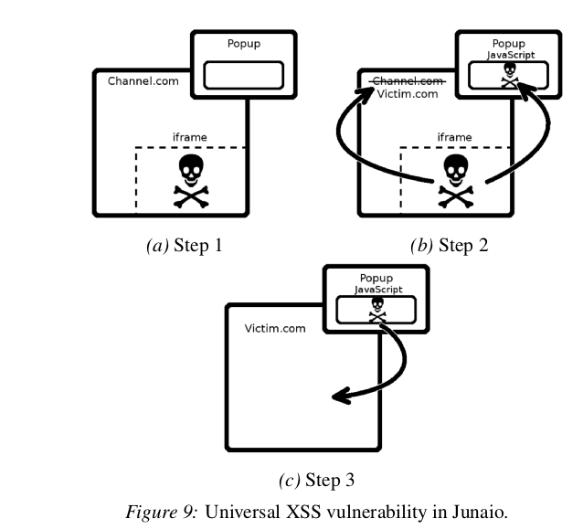
Risks
Universal cross-site scripting
  Malacious Java-script hidden in ad can change script associated with pop-up
  change URL of the transperant overlay

Slide 16
How to do it right
Quick patches
  Ensure that the origin of the HTML is same
  sanitize XML so that it does not contain scripts
Principled solutions
  AR browsers must use custom mechanisms to enable HTML content to control these objects
  Extend same origin policy to AR tags

Slide 17
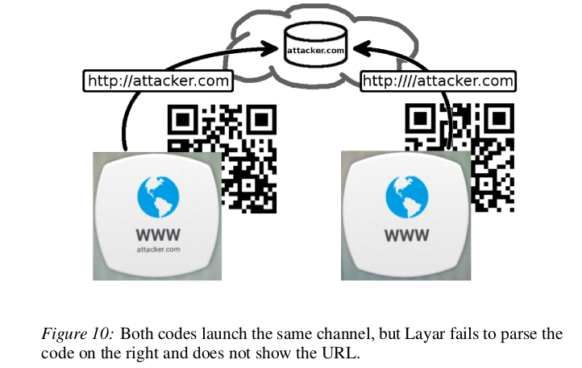
Image-Triggered Code Execution
AR service continuously analyze camera feed
On recognizing an image associated with a channel it automatically launches channel conent
User cannot preview the URL or any other information

Slide 18
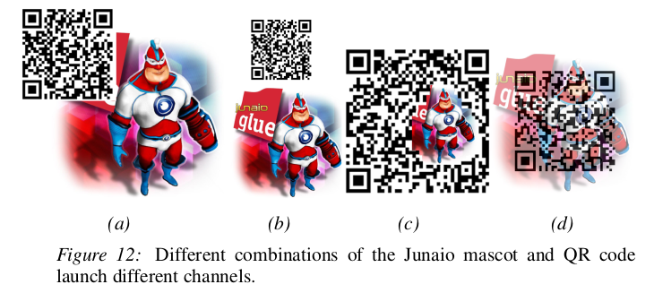
Risks
Fully automated, stealthy, large-scale tracking
  used for automated stalking and tracking
Automatically launching malicious content
  attacker registers an image trigger similar to that of a trusted channel
  AR browser may be tricked into automatically launching the malicious channel
  same picture may be asssociated with multiple channels

Slide 19
How to do it right
Filter out images during channel registration but requires deep semantic analysis of submitted image
AR browser should inform the user about the origin of AR content
image triggered code execution should be used only with trusted channels

Slide 20
Outsourced image processing
AR browsers do not process the cptured image on the device and send them to AR servers
  to inject ads, charging content providers
  to facilitate image based channel launching, recognition of triggered images
  computationally intensive and hence unsuitable for execution in low-powered mobile devices

Slide 21
Risks
network attackers who observe network traffic device and the provider's AR
  raw images are sent over unencrypted HTTP
  combining images and location data is a serious privacy concern
AR services
  tremendous amount of raw data collected (screens, credit cards, license plates etc)
  user has no way to learn which data is sent

Slide 22
How to do it right
A secure protocol to prevent accidental leakage of irrelevant information
If a server is attempting to recognize a channel trigger on a magazine page there is no need to see physical objects surrounding the page
  difficult to implement
  Some prototype systems available in the domain of computer vision which can be directly used

Slide 23
Visual decomposition
To render 2D and 3D images and HTML content from multiple origins AR browsers mantain complex visual stacks
AR browsers have to deal with both HTML and non-HTML content
  conventional defence based on framebusting does not work
  maicious AR channel can overlay content from other origin on top of itself.

Slide 24
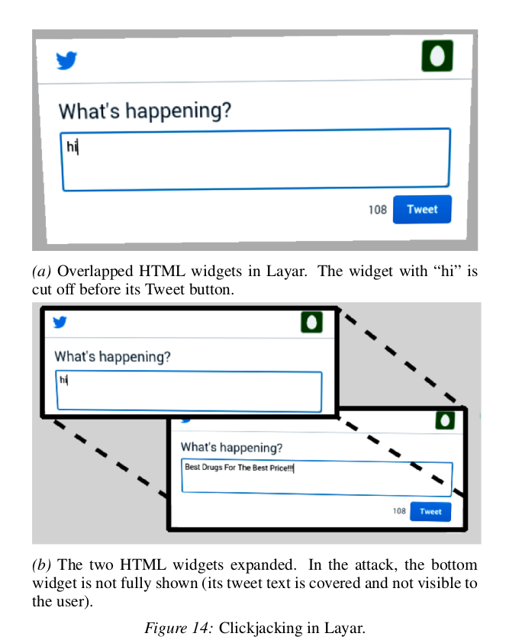
Risks
By cleaverly overlaying HTML widgets from different origins a malicious channel can hijack user's clicks

Slide 25
How to do it right
A whole-browser equivalent of X-Frame-Option
Layar already prevents non-widget objects from covering widgets
using conventional browsers to render AR content is dangerous
A principled solution should involve a clean-slate redesign of user interfaces

Slide 26
Indirect retrieval of AR content
Content requests must pass through the AR provider's own server
Some AR browsers enable third-party channels to authenticate users or keep track of preferences
When the browser first loads the channel, the cookies are set by the channel’s authentication page and thus correctly bound to the channel’s origin at that time
If the origin changes, the server notes the change and forwards requests accordingly
server does not notify the browser of the change

Slide 27
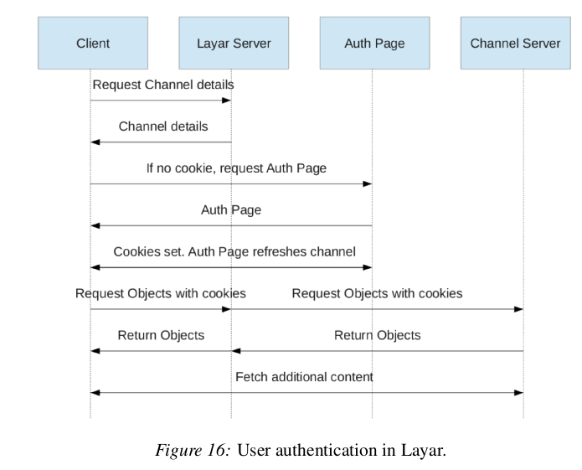
User authentication

Slide 28
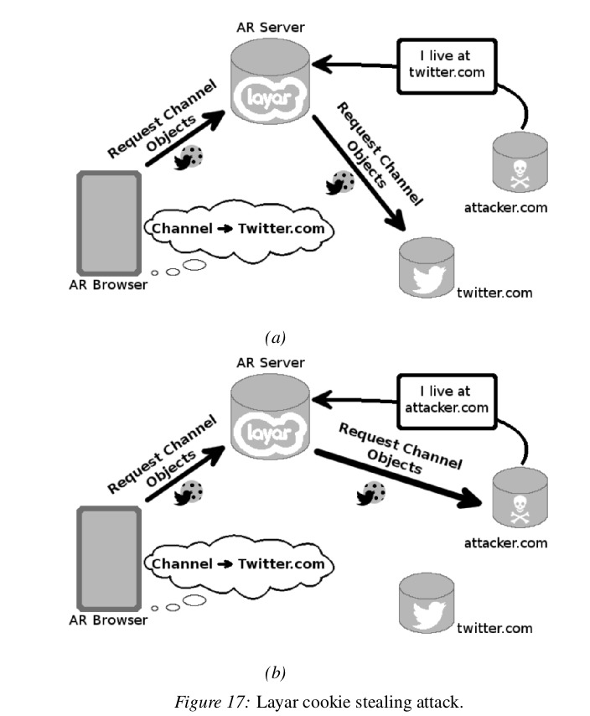
Risks
AR attackers lie about their channel's URL
By “desynchronizing” the Layar browser’s and the Layar server’s understanding of the channel’s origin, a malicious channel can steal cookies from any origin

Slide 29
How to do it right
Avoid replicating the state of the browser on the Layar server.
Layar server to ensure that it agrees with the browser about the channel server’s URL
use an authentication protocol that supports delegation

