Slide 1
Dejavu:An accurate Energy-Efficient Outdoor Localization System
SIGSPATIAL '13

Slide 2
Dejavu
Outdoor localization system
Provides accurate and energy-efficient outdoor localization
Uses only energy-efficient sensors or sensors which are already running
leverages road landmarks like moving over potholes, bumps, tunnels etc

Slide 3
Introduction
GPS considered as de facto standard for outdoor localization
  but it is energy hungry and accuracy limited in areas like tunnels
Dejavu's approach is based on low-energy sensors (accelerometer,gyroscope,compass)
Using array of sensors it identifies landmarks (anchors)
crowdsourcing to build database

Slide 4
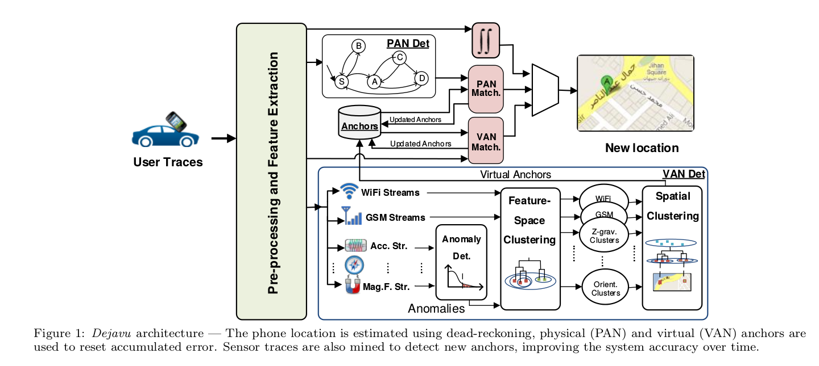
System overview

Slide 5
Raw sensor information
System collects raw sensor information
cellular network information (RSS and associated cell tower ID)
opprtunistically leverags the Wifi chip to collect surrounding Wifi APs

Slide 6
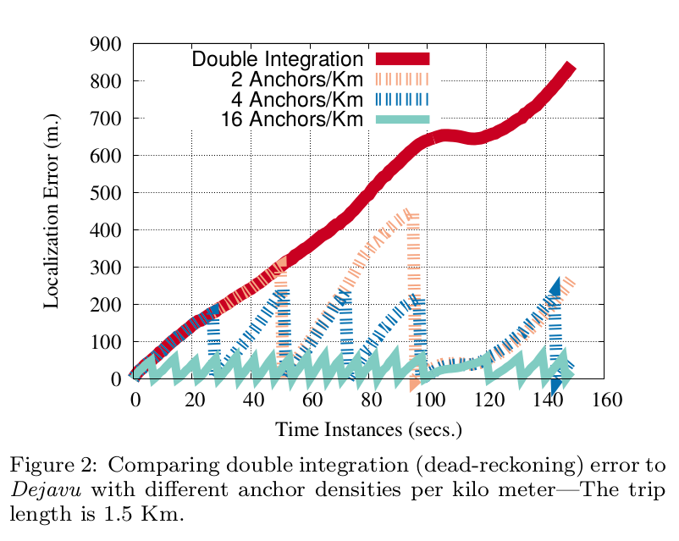
Error Resetting
uses linear accelaration combined with direction of motion to compute displacement
uses Vincenty's formula
to limit accumulated error system uses physical and virtual anchors

Slide 7
Physical and virtual anchors
Dejavu uses two types of anchors
physical anchors mapped to road features like bridges, tunnels, speed-bumps
extracted from map or through pror knowledge
virtual anchors detected automatically
includes points with unique GSM or Wifi RSS
learned through crowd-sourcing

Slide 8
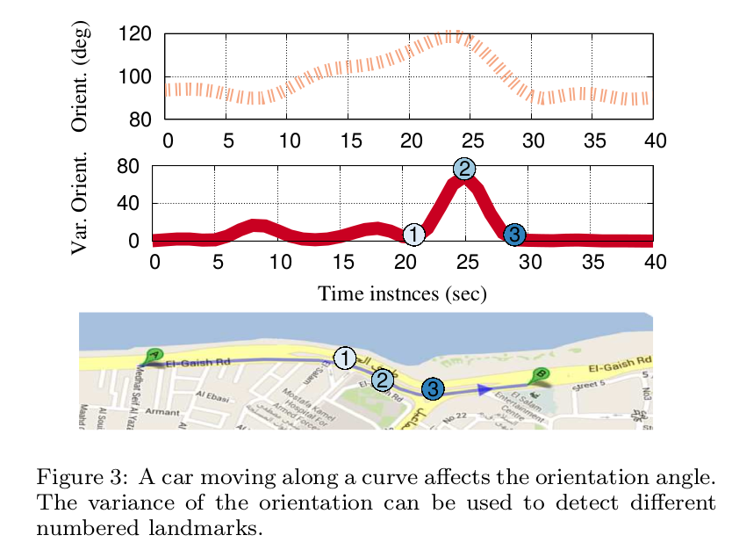
Anchor detection
large number of road features can be identified on their unique signature

Slide 9
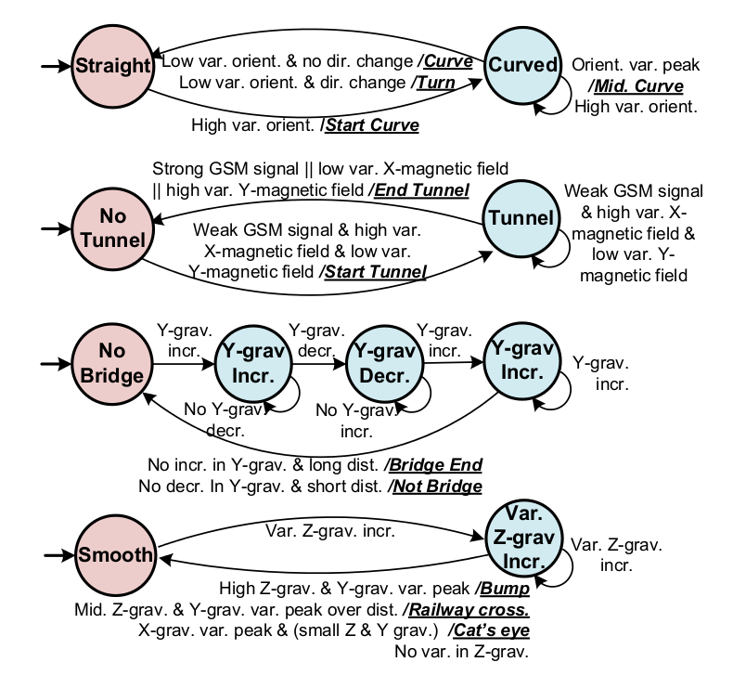
Physical anchors
used to seed the anchor database
identified from maps or by prior knowledge of the location
different classes of physical anchors

Slide 10
Physical anchors
Curves and turns -
  road curvature forces car to change its direction which results in big variance of phone's orientation
Tunnels -
  drop in cellular signal
  large variance in the ambient magnetic field in x-direction
Bridges -
  cars go up at the start of the bridge and go down at the end
  reflected in x-gravity or y-gravity acceleration
Road anomalies-
  cat's eye does not cause high variance in y or z-axis gravity accleration
  speed bumps usually have highest variance
  railway crossing leads to medium variance

Slide 11
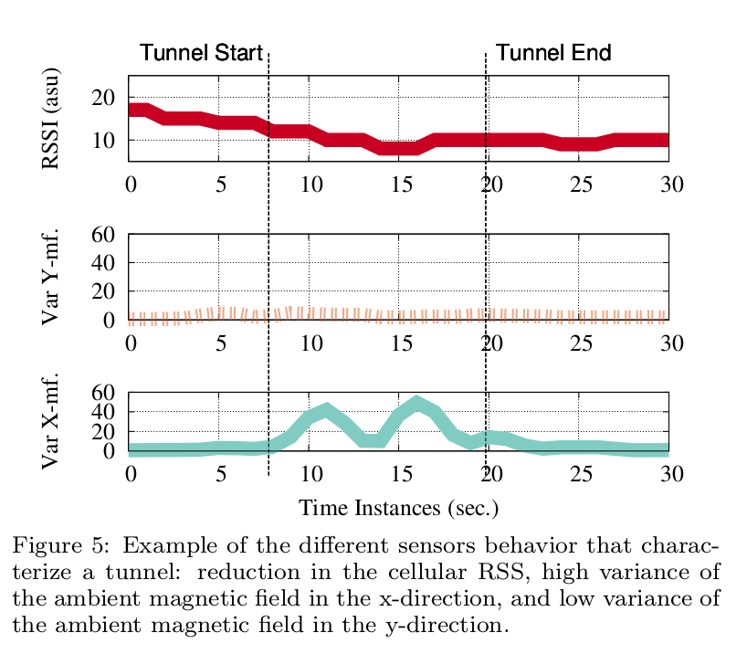

Slide 12
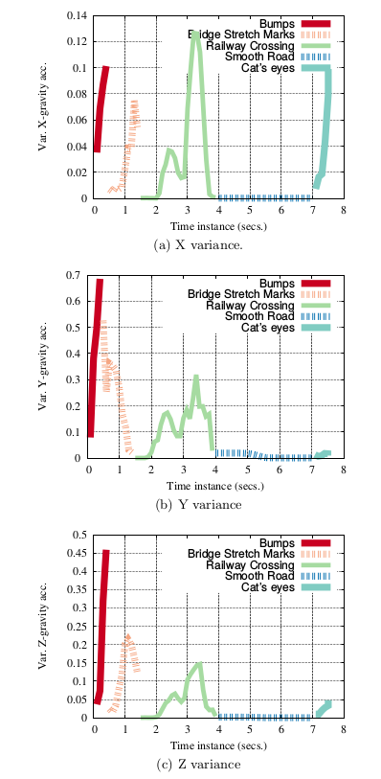

Slide 13
Virtual anchors
uses un-supervised learning techniques to identify virtual anchors
anomaly detection techniques are used to identify anomalies in sensor readings.
they are clustered into sensor space to identify candidate clusters
points of each cluster are spatially clustered to identify the location of each anchor

Slide 14
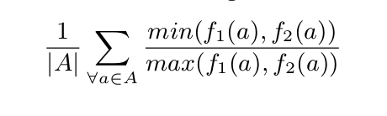
Feature selection
Cellular and Wifi anchors correspond to points in RSS signal space with unique signature

Slide 15
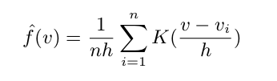
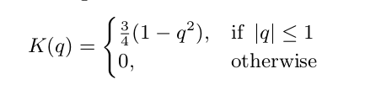

Anomaly detection
h - bandwidth
n - sample size
K - kernel function
optimal bandwidth can be estimated as -

Slide 16
Two stage clustering
Cluster feature space using hierarchical clustering in vector feature space
Clustering will group similar anomalies
spatial clustering of points in clusters obtained previously
cluster is accepted if the number of points is above a threshold

Slide 17
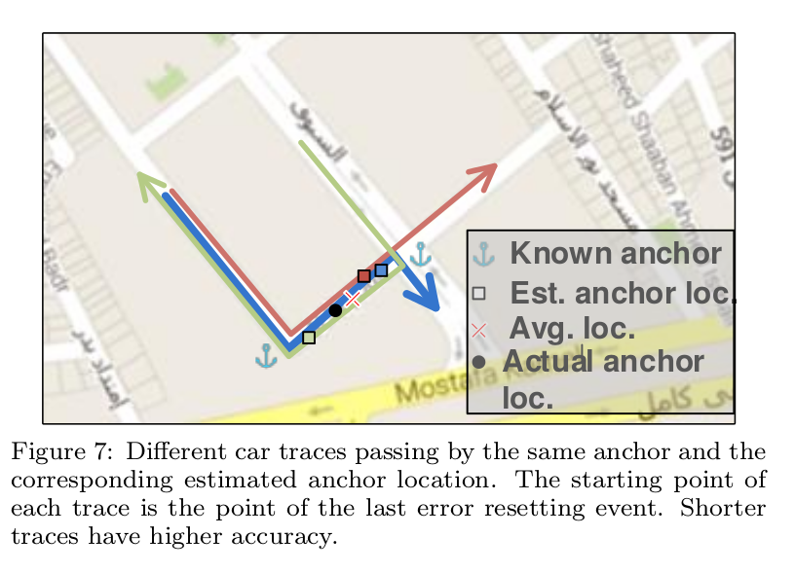
Computing anchor location

Slide 18
Discussion
Anchors aliasing
  classes of anchors can be confused with other anchors
  leverages map context information
Efficient matching
  limits search space to small area around the user location
Processing location
  can be split into a client-server architecture
Other sensors
  other sensors of the phone such as camera, mic could be used
Handling heterogeneity

Slide 19
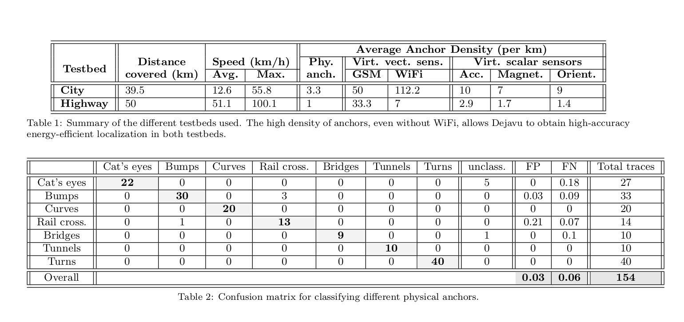
Evaluation

Slide 20
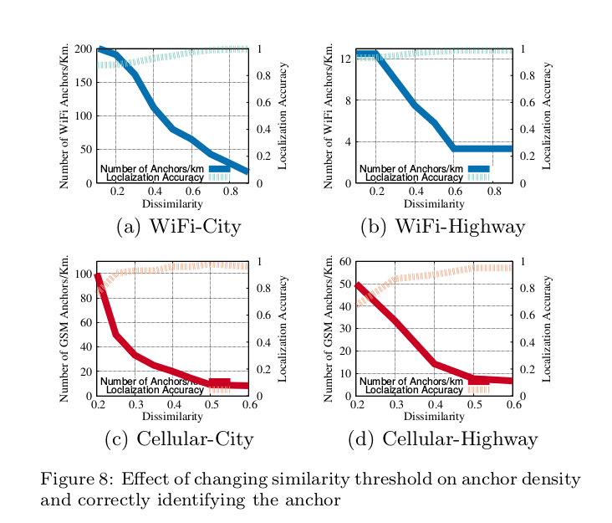
Virtual anchor detection accuracy

Slide 21
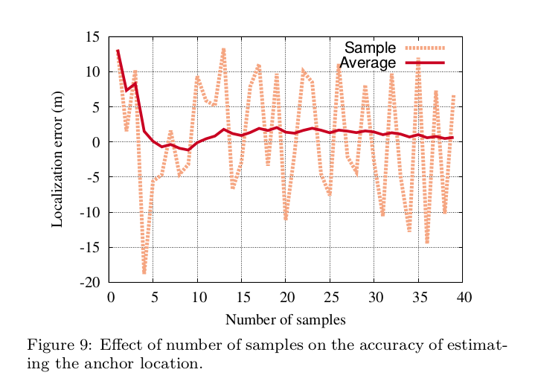
Anchor localization accuracy

Slide 22
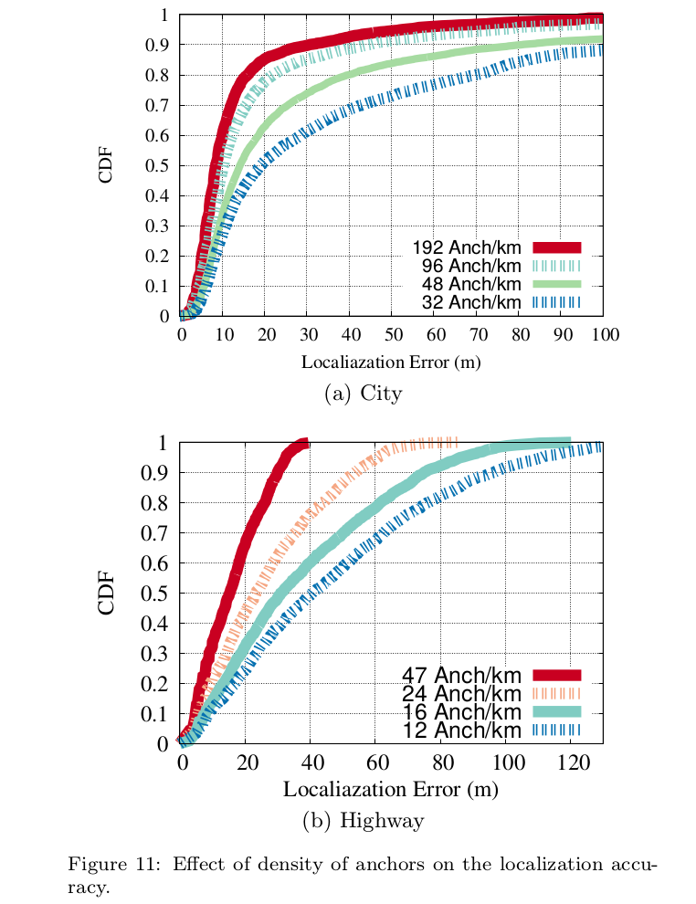
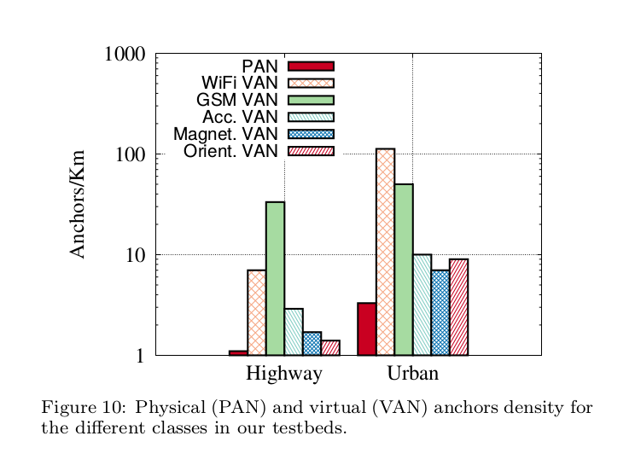
Effect of anchor density on accuracy

Slide 23
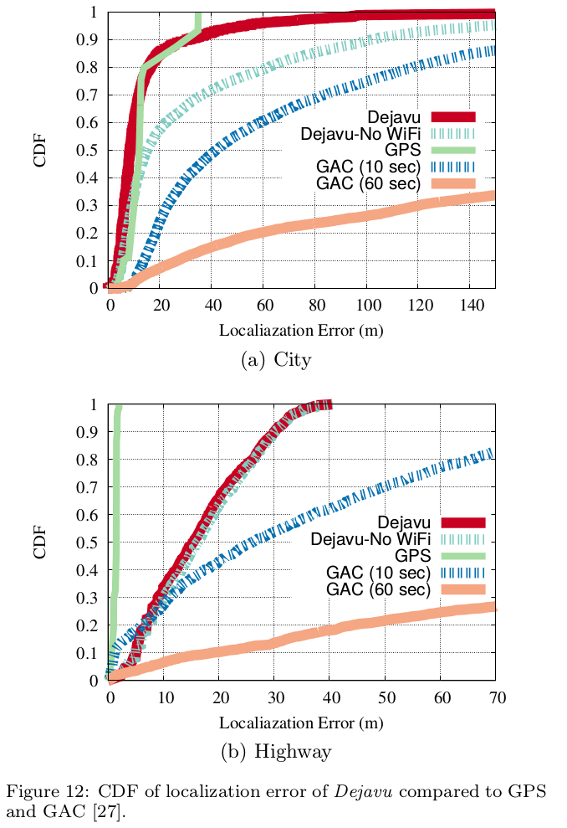
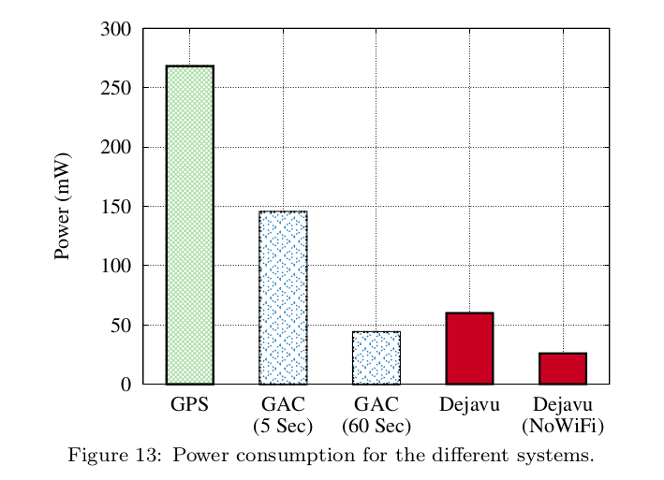
Dejavu against other systems

