Slide 1
Energy-efficient Scheduling policy for collaborative execution in mobile cloud computing
INFOCOM '13

Slide 2
Introduction
Mobile devices are inherently resource-poor
Cloud-computing offers a natural solution to extend the capabilities of mobile devices
A mobile application is represented as a sequence of tasks
A collaborative application execution between mobile devices and cloud to conserve energy
Each task can be executed on the mobile device or cloud.

Slide 3
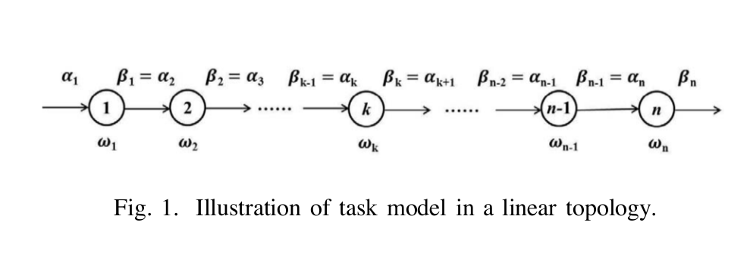
System model
Each task is sequentially executed, with output data generated by one task as the input of the next one.
entire application is associated with deadline T_{d}
computing workload for task k is w_{k}

Slide 4
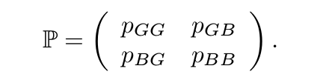
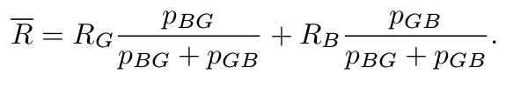
Channel model
there are two states: “good” and “bad” channel conditions for each discrete time slot
Denote g_{G} and g_{B} channel gain for “good” state and “bad” state
Data rate takes two values R_{G} and R_{B} corresponds to the two states

Slide 5
Execution model
Mobile execution
task is executed in the mobile device
Cloud execution
task is executed in the cloud
Sending input data
task is uploaded to cloud for execution
Receiving output data
next task is executed in the mobile device and the previous task is executed in the cloud

Slide 6
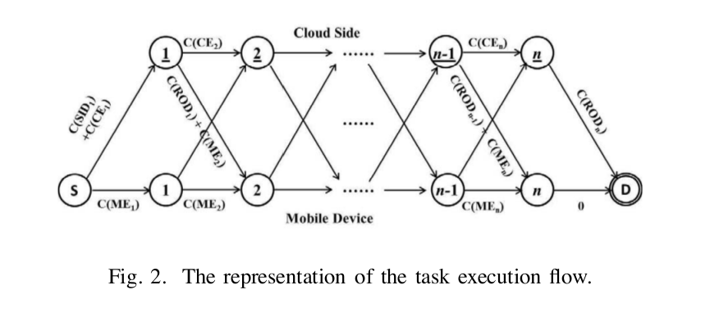
Problem formulation
collaborative execution between the mobile device and the cloud can be modeled by a directed acyclic graph
transform the task scheduling problem to finding the shortest path in terms of energy consumption between S and D in the graph

Slide 7
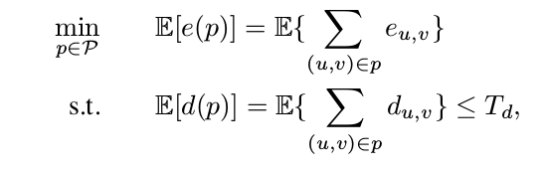
Problem formulation
path should be less than or equal to the time deadline, T_{d}
A feasible path p∗ with the minimum energy consumption is the optimal solution among all the feasible paths

Slide 8
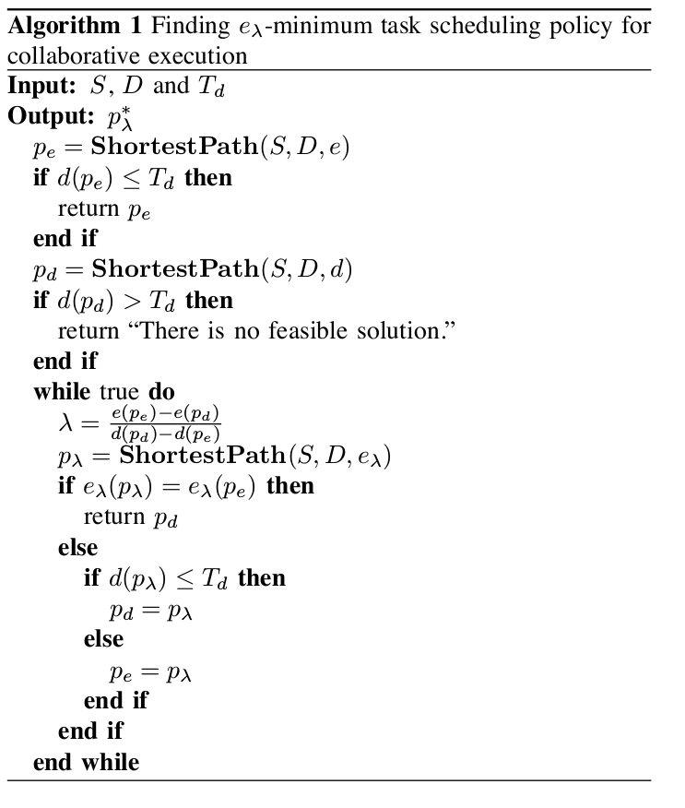
Optimal task scheduling policy

Slide 9
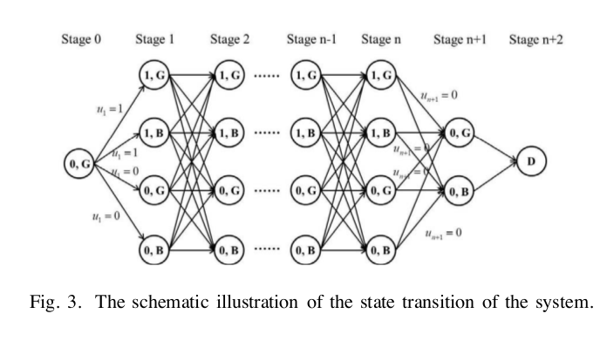
Task scheduling policy

Slide 10
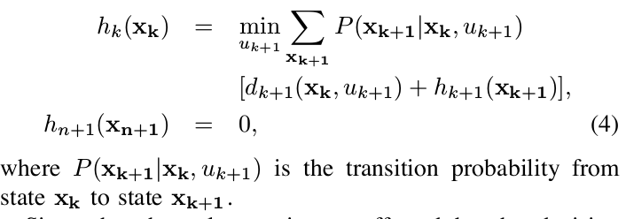
Expected execution time

Slide 11
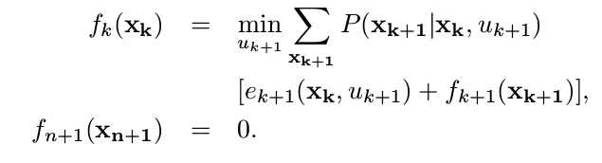
Deadline

Slide 12
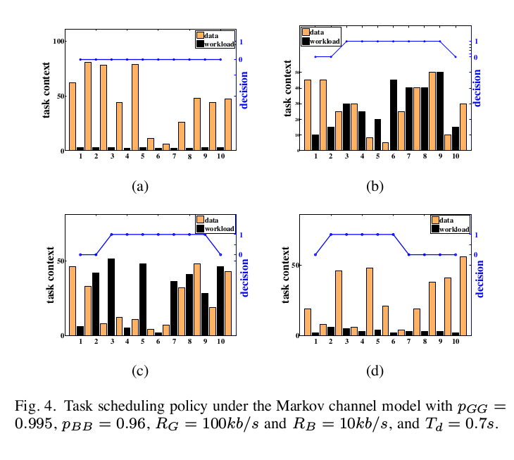
Task scheduling

Slide 13
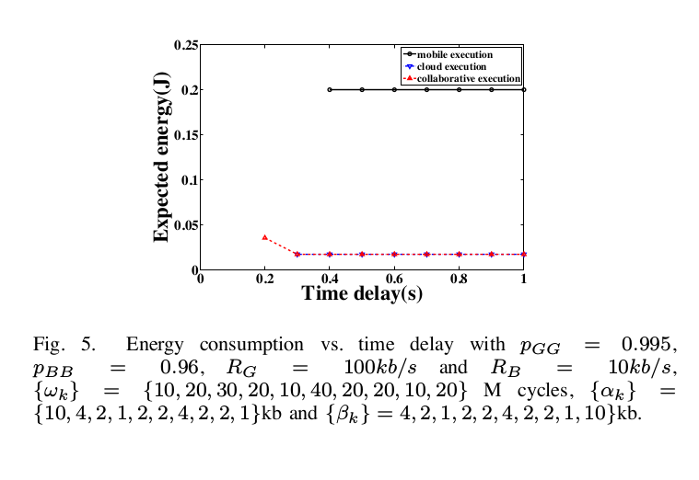
Energy consumption

