Slide 1
MAUI: Making Smartphones Last Longer With Code Offload
Eduardo Cuervo – Duke University
Aruna Balasubramanian - University of Massachusetts Amherst
Dae-ki Cho - UCLA
Alec Wolman, Stefan Saroiu, Ranveer Chandra, Paramvir Bahl – Microsoft Research

Slide 2
Battery is a scarce resource
CPU performance during same period: 246X
A solution to the battery problem seems unlikely
Just 2X in 15 years

Slide 3
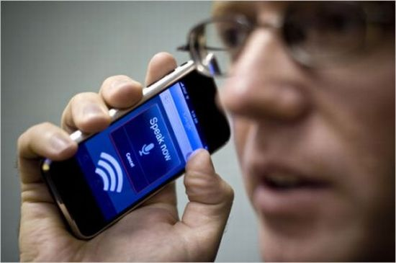
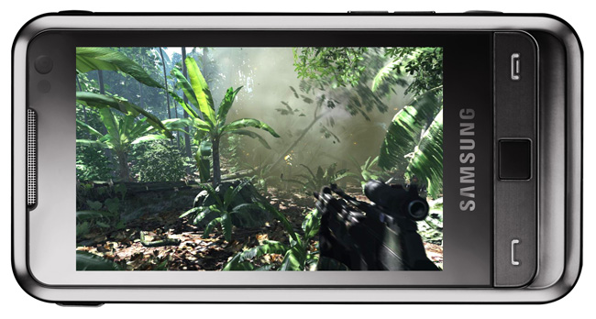
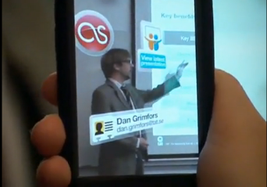
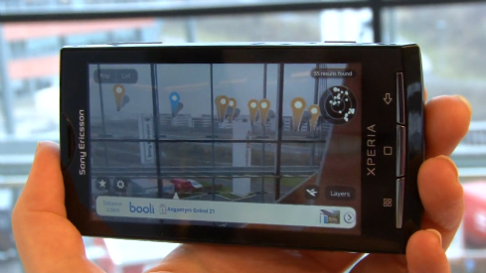
Mobile apps can’t reach their full potential
Slow, Limited or Inaccurate
Not on par with desktop counterparts
Power Intensive
Speech Recognition and Synthesis
Interactive Games
Too CPU intensive
Limited
Augmented Reality

Slide 4
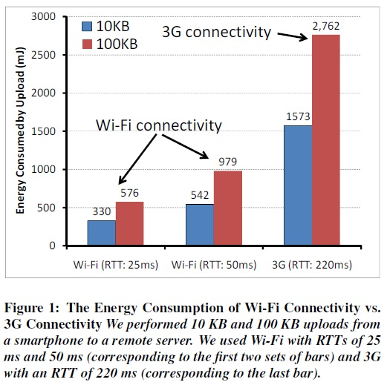
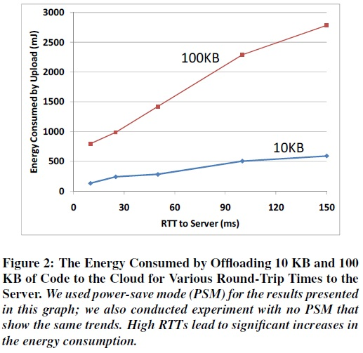
How Energy Efficient is 3G for Code Offload?

Slide 5
One Solution: Remote Execution
Remote execution can reduce energy consumption
Challenges:
What should be offloaded?
How to dynamically decide when to offload?
How to minimize the required programmer effort?

Slide 6
MAUI: Mobile Assistance Using Infrastructure
MAUI Contributions:
Combine extensive profiling with an ILP solver
Makes dynamic offload decisions
Optimize for energy reduction
Profile: device, network, application
Leverage modern language runtime (.NET CLR)
To simplify program partitioning
Reflection, serialization, strong typing

Slide 7
Roadmap
Motivation
MAUI system design
MAUI profiler
MAUI solver
Evaluation
Conclusion

Slide 8
MAUI Architecture
Application
Application
Maui Runtime
Maui Runtime
Client Proxy
Server Proxy
RPC
Profiler
Profiler
RPC
Solver
Solver
Maui Controller
Smartphone
Maui server
Figure 3: High-level view of MAUI’s architecture.

Slide 9
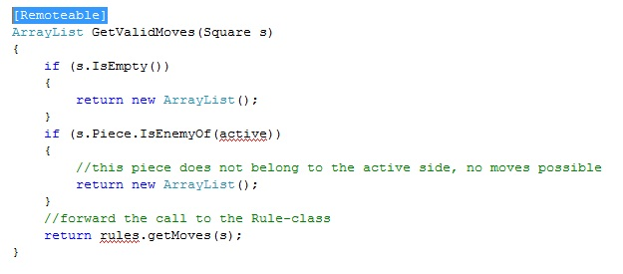
How Does a Programmer Use MAUI?
Goal: make it dead-simple to MAUI-ify apps
Build app as a standalone phone app
Add .NET attributes to indicate “remoteable”
Follow a simple set of rules

Slide 10
Language Run-Time Support For Partitioning
Portability:
Mobile (ARM) vs Server (x86)
.NET Framework Common Intermediate Language
Type-Safety and Serialization:
Automate state extraction
Reflection:
Identifies methods with [Remoteable] tag
Automates generation of RPC stubs

Slide 11
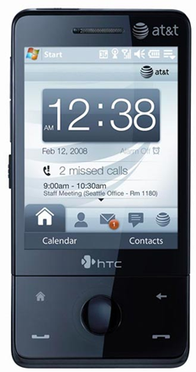
MAUI Profiler
CPU Cycles
State size
Device Profile
Execution Time
Network Latency
Profiler
Callgraph
Network Bandwidth
Computational Power Cost
Computational Delay
Annotated Callgraph
Network Power Cost
Network Delay
Computational Delay

Slide 12
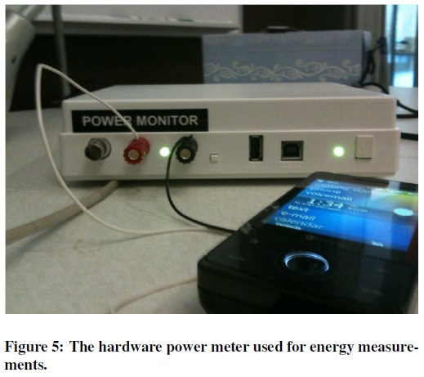
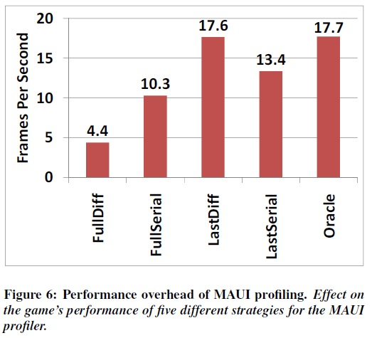
MAUI Profiler

Slide 13
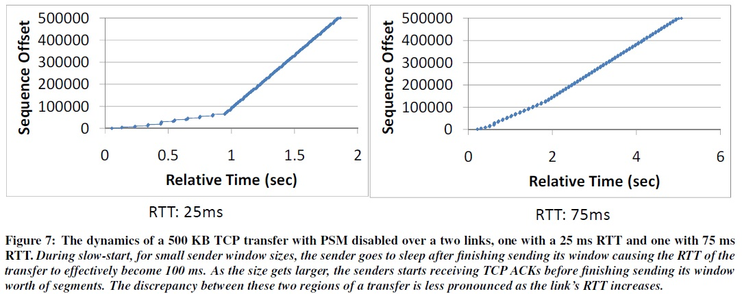
Network Profiling

Slide 14
MAUI Solver
A sample callgraph
C
5000 mJ
3000 ms
10000 mJ
A
1000mJ
B
900 mJ
15ms
Energy and delay for state transfer
Computation energy and delay for execution
25000 mJ
D
15000 mJ
12000 ms

Slide 15
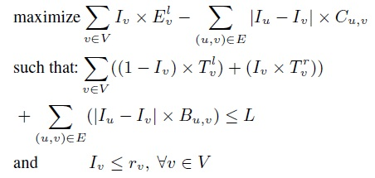
MAUI Solver

Slide 16
Roadmap
Motivation
MAUI system design
MAUI profiler
MAUI solver
Evaluation
Conclusion

Slide 17
MAUI Implementation
Platform
Windows Mobile 6.5
.NET Framework 3.5
HTC Fuze Smartphone
Monsoon power monitor
Applications
Chess
Face Recognition
Arcade Game
Voice-based translator

Slide 18
Questions
How much can MAUI reduce energy consumption?
How much can MAUI improve performance?
Can MAUI Run Resource-Intensive Applications?

Slide 19
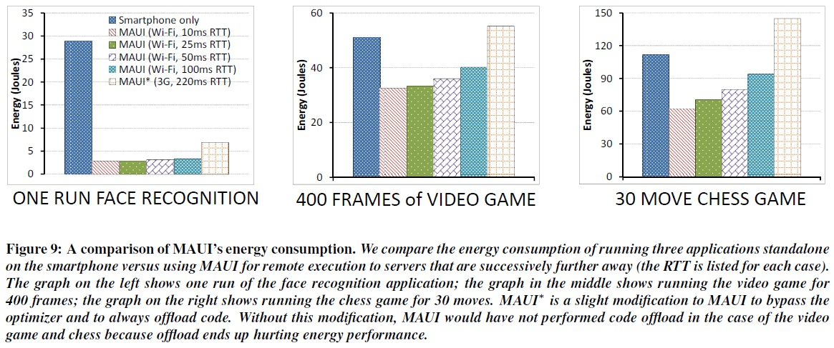
Evaluation

Slide 20
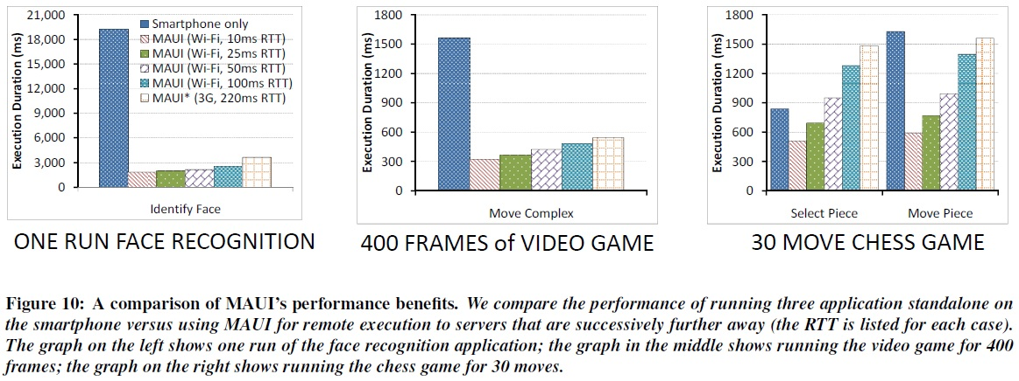
Evaluation

Slide 21
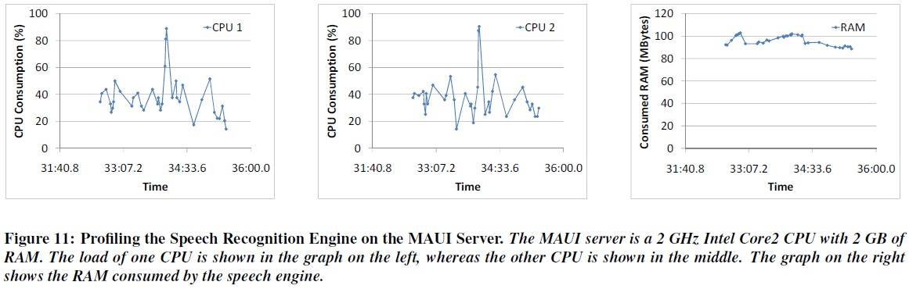
Can MAUI Run Resource-Intensive Applications?

Slide 22
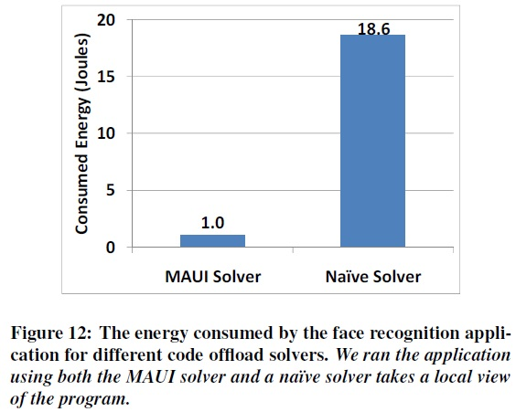
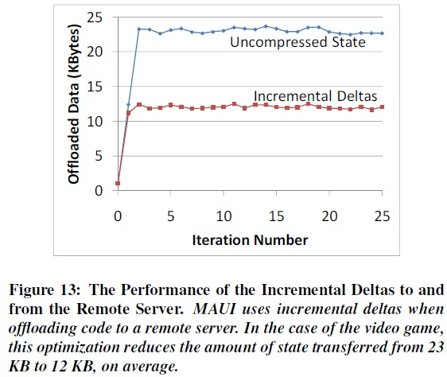
Can MAUI Run Resource-Intensive Applications?

Slide 23
Roadmap
Motivation
MAUI system design
MAUI proxy
MAUI profiler
MAUI solver
Evaluation
Conclusion

Slide 24
Conclusions
MAUI enables developers to:
Bypass the resource limitations of handheld devices
Low barrier entry: simple program annotations
For a resource-intensive application
MAUI reduced energy consumed by an order of magnitude
MAUI improved application performance similarly
MAUI adapts to:
Changing network conditions
Changing applications CPU demands

Slide 25
Questions?
http://research.microsoft.com/en-us/projects/maui/
ecuervo@cs.duke.edu

Slide 26
Back-UP

Slide 27
MAUI Proxy
Application
Application
Maui Runtime
Maui Runtime
Handles Errors
Client Proxy
Server Proxy
Provides runtime information
RPC
Intercepts Application Calls
Synchronizes State
Profiler
Profiler
RPC
Solver
Solver
Chooses local or remote
Maui Controller
Smartphone
Maui server

Slide 28
Is Global Program Analysis Needed?
Yes! – This simple example from Face Recognition app shows why local analysis fails.
InitializeFace Recognizer
5000 mJ
10000 mJ
User Interface
1000mJ
FindMatch
900 mJ
Cheaper to do local
25000 mJ
DetectAndExtract Faces
15000 mJ

Slide 29
Is Global Program Analysis Needed?
Yes! – This simple example from Face Recognition app shows why local analysis fails.
InitializeFace Recognizer
5000 mJ
10000 mJ
Cheaper to do local
User Interface
1000mJ
FindMatch
900 mJ
25000 mJ
DetectAndExtract Faces
15000 mJ
Cheaper to do local

Slide 30
Is Global Program Analysis Needed?
InitializeFace Recognizer
User Interface
1000mJ
FindMatch
25900mJ
Cheaper to offload
DetectAndExtract Faces

Slide 31
Can MAUI Adapt to Changing Conditions?
Adapt to:
Network Bandwidth/Latency Changes
Variability on method’s computational requirements
Experiment:
Modified off the shelf arcade game application
Physics Modeling (homing missiles)
Evaluated under different latency settings

Slide 32
Can MAUI Adapt to Changing Conditions?
HandleEnemies
11KB + missiles
11KB + missiles
DoFrame
DoLevel
HandleBonuses
11KB + missiles
missiles
Required state is smaller
HandleMissiles
Complexity increases with # of missiles
*Missiles take around 60 bytes each

Slide 33
Case 1
HandleEnemies
Zero Missiles
Low latency (RTT < 10ms)
DoFrame
DoLevel
HandleBonuses
Offload starting at DoLevel
HandleMissiles
Computation cost is close to zero
*Missiles take around 60 bytes each

Slide 34
Case 2
HandleEnemies
5 Missiles
Some latency (RTT = 50ms)
DoFrame
DoLevel
HandleBonuses
Very expensive to offload everything
Little state to offload
HandleMissiles
Only offload Handle Missiles
Most of the computation cost
*Missiles take around 60 bytes each

Slide 35
How much can MAUI reduce energy consumption?
Face Recognizer
An order of magnitude improvement on Wi-Fi
Big savings even on 3G

Slide 36
How much can MAUI improve performance?
Face Recognizer
Improvement of around an order of magnitude

Slide 37
Latency to server impacts the opportunities for fine-grained offload
Solver would decide not to offload
Arcade Game
Up to 40% energy savings on Wi-Fi

