Slide 1
Bartendr: A Practical Approach to Energy-aware Cellular Data Scheduling
Aaron Schulman, Vishnu Navday, Ramachandran Ramjeey, Neil Spring, Pralhad Deshpandez, Calvin Grunewald, Kamal Jain, Venkata N. Padmanabhan

Slide 2
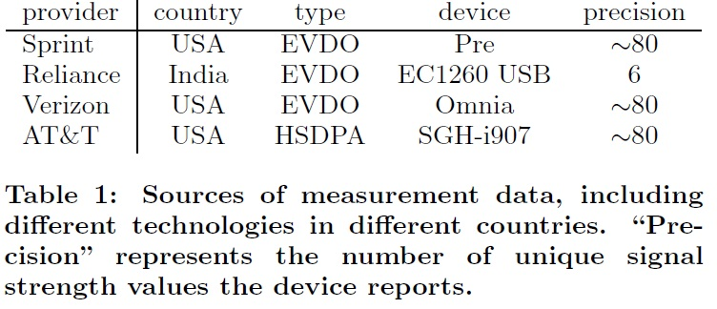

Slide 3
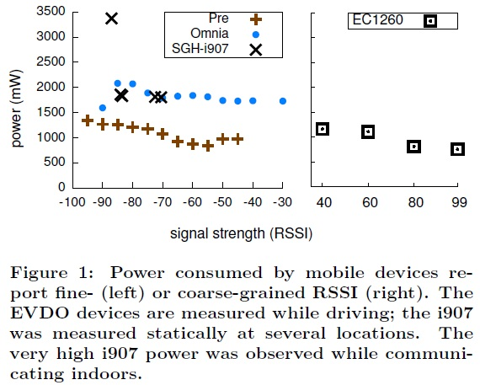

Slide 4
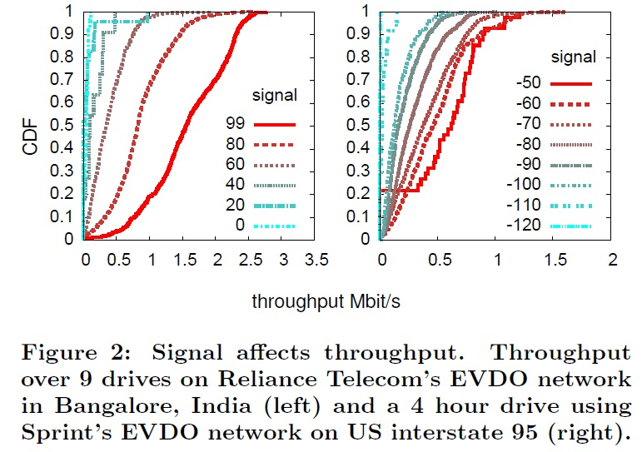

Slide 5
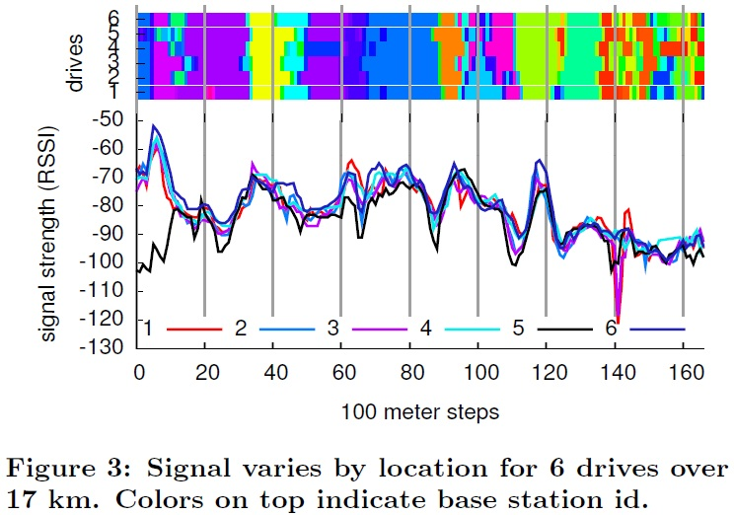

Slide 6
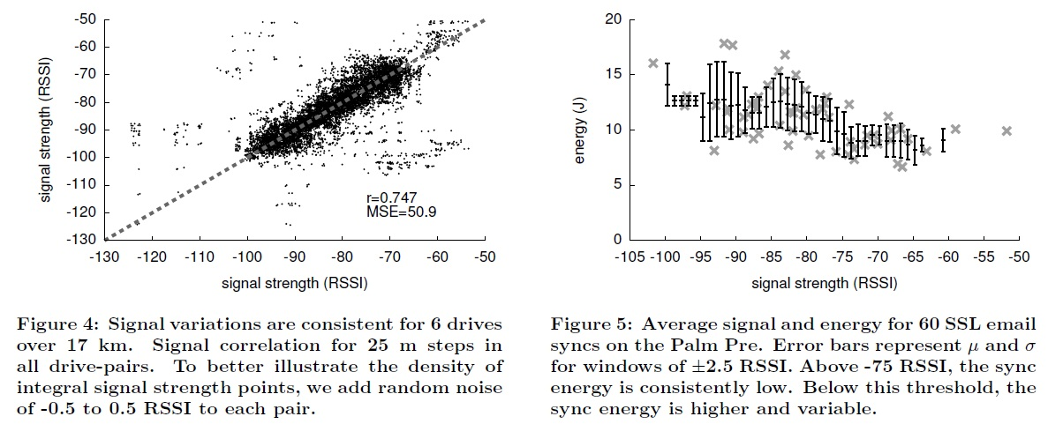

Slide 7
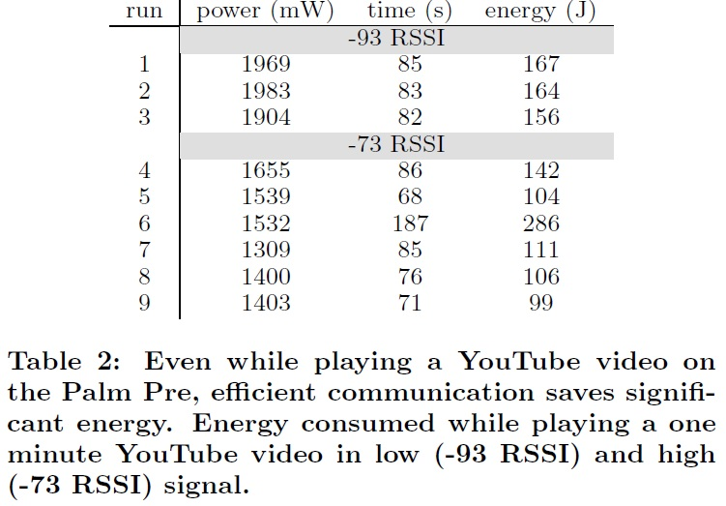

Slide 8
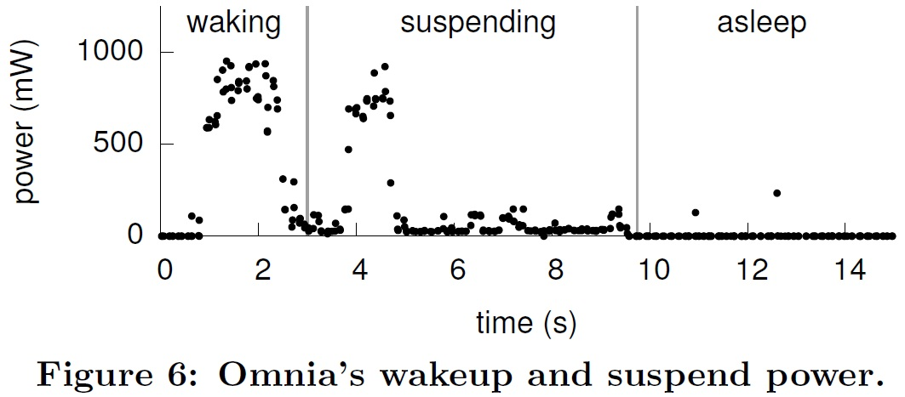

Slide 9
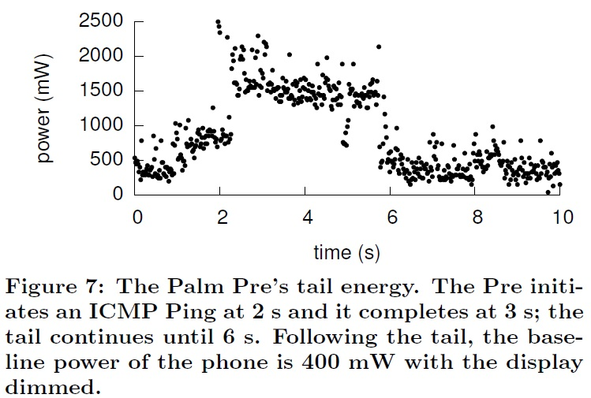

Slide 10
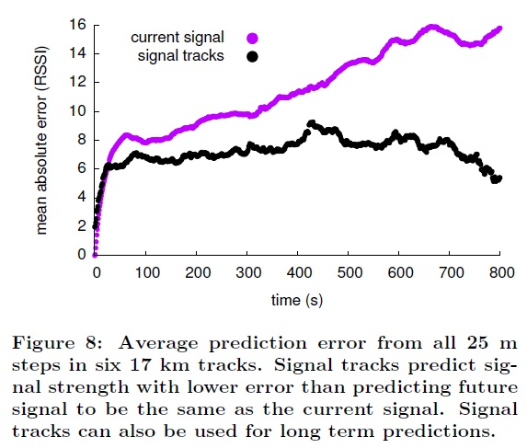

Slide 11
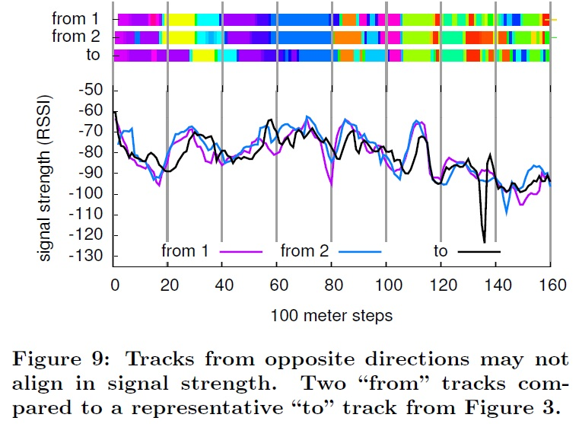

Slide 12
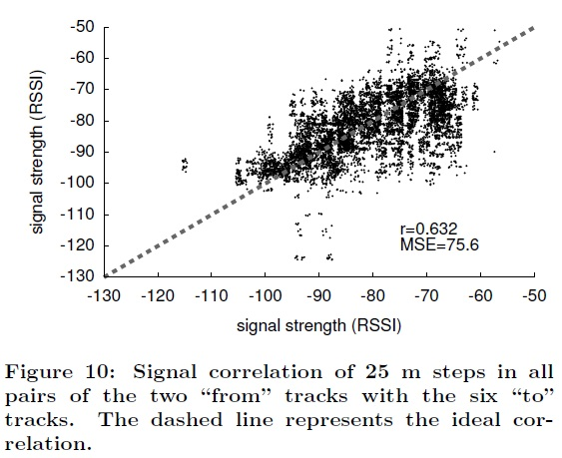

Slide 13
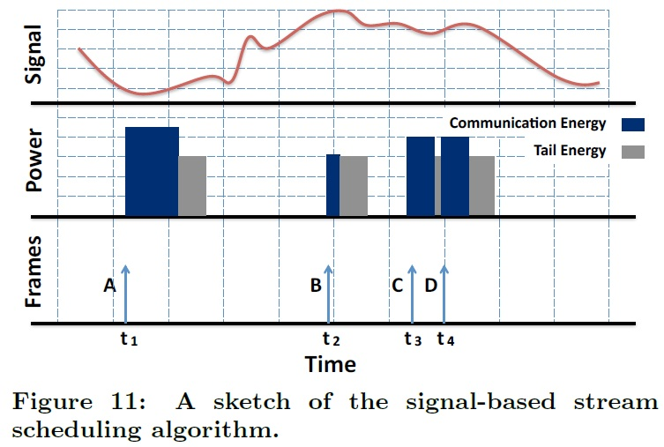

Slide 14
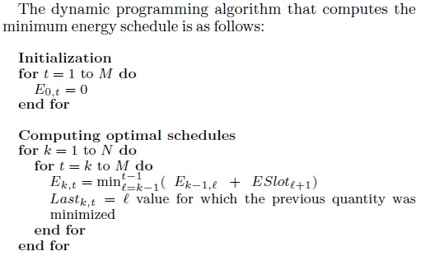

Slide 15
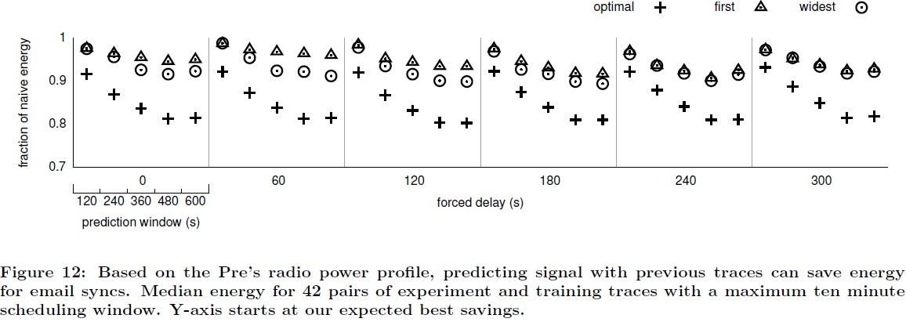

Slide 16
