Slide 1
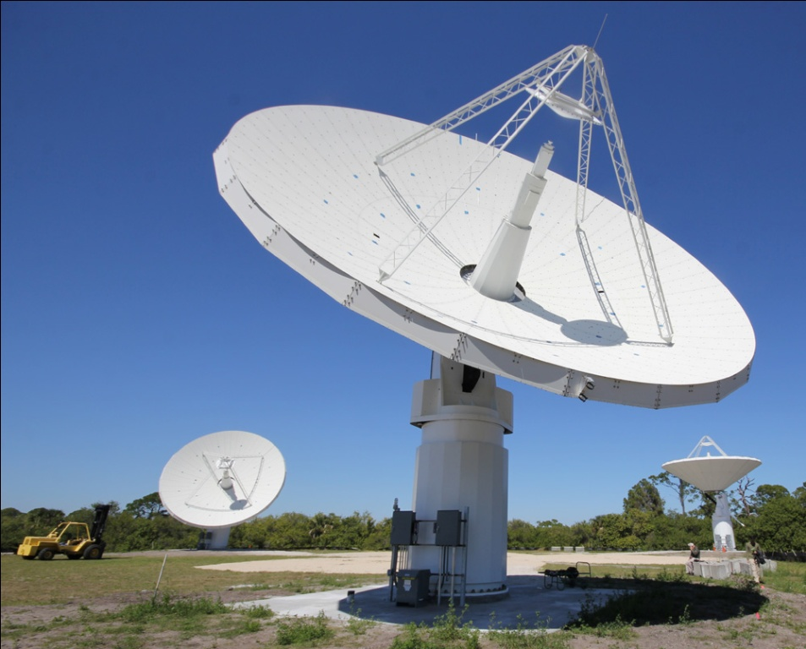
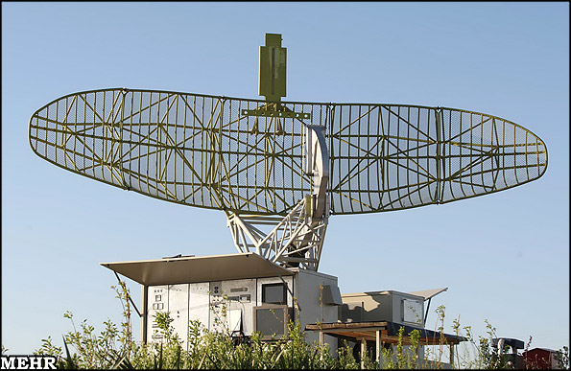
RADAR: An In-Building RF-based User Location and Tracking System

Slide 2
The Idea

Slide 3
Overview
Main Goal:
Locate/Track users INSIDE a building
Method:
Recording/Processing signal strength
Overlapping Coverage → triangulation
Motivation:
Location aware services/applications

Slide 4
Previous Work
Focused on IR
Limited range
Does not allow for traditional transmitting of data (aka limited to just locating people)
Scales poorly
Installation/maintenance limitations
Authors argue that RF solves problems above
(range, scalability, deployment, maintenance)

Slide 5
Testing Process

Slide 6
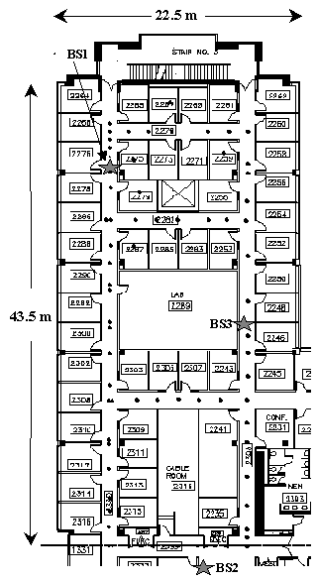
Building Floor Layout
Figure 1: Floor Layout
Figure Notation
Black Dots = locations where empirical signal strength info was collected
Large Stars = Base Stations (BS)
Orientation – North (up); East (right)
Ranges
Open along hallways w/ base stations (200m)
Closes elsewhere (25m)
Base stations overlap in parts and cover the entire floor

Slide 7
Information Collected
Use signal information
Off-Line Phase
Construct/validate models for signal propagation
Real-Time Phase
Infer location of user
Information Passed
Signal strength (SS)
Signal-to-noise ratio (SNR)
SS is a stronger function of location; therefore authors do not use SNR

Slide 8
Collection Process
Synchronize clocks on mobile host (MH) & BS
MH broadcasts UDP packets
BS records SS at (t, x, y, d)
Time stamp (t); direction user is facing (d); location (x,y)
If off-line, user indicates location by clicking map on floor
Signal strength varies w/i a single location based on d
Offline phase: SS in each of the 4 d’s at 70 (x,y)

Slide 9
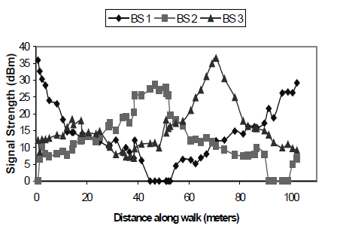
Signal Strength
Why?
Need accurate SS to help determine location
How?
Stronger signal = closer to BS Modeling (see next slide)
Figure 2: Signal strength recorded at the BS as the user walks around the floor.

Slide 10
Model 1: Empirical

Slide 11
The Empirical Method
Empirical
Use the data points gathered from off-line phase to construct search space for NNSS
Nearest Neighbor (NNSS)
User sends SS and t
Search previous data for (x,y,d) that corresponds
assumes user is stationary

Slide 12
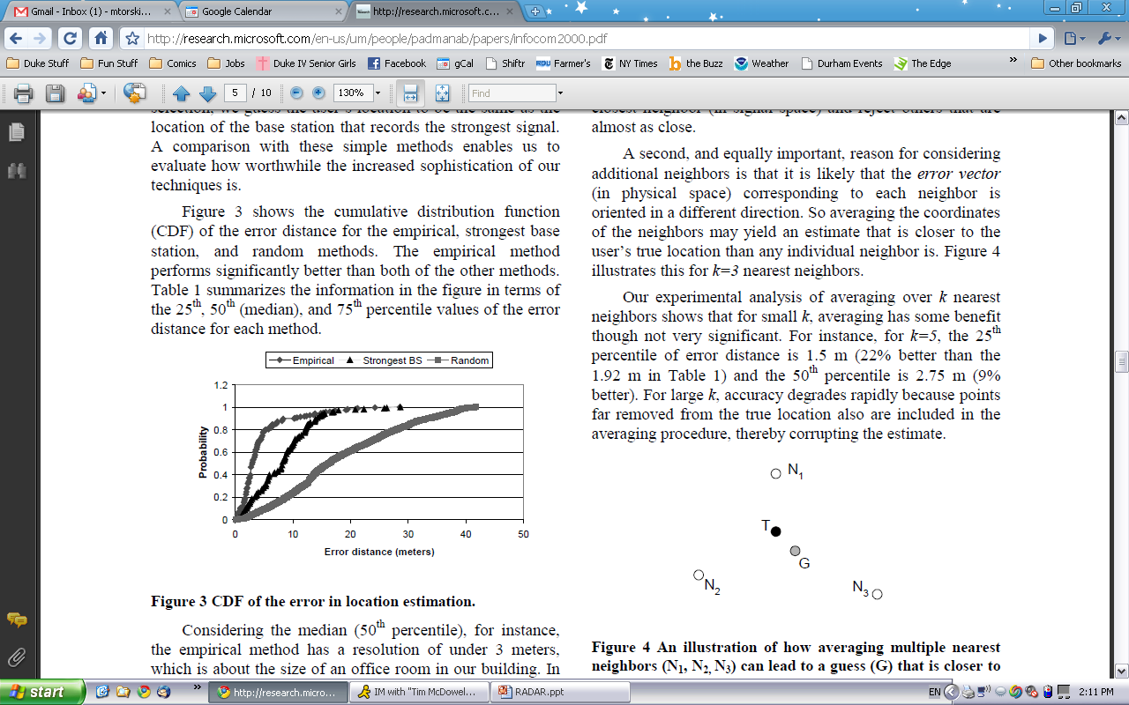
Location Estimate Error
Figure 3: CDF of error distance for different location methods

Slide 13
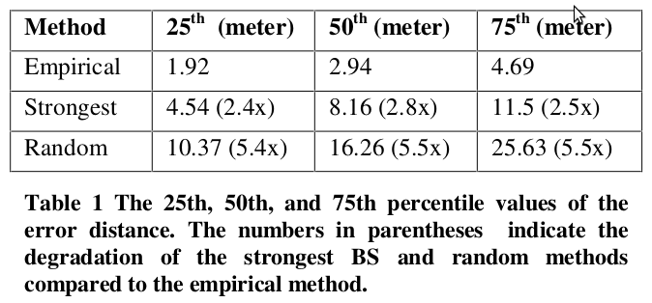

Slide 14
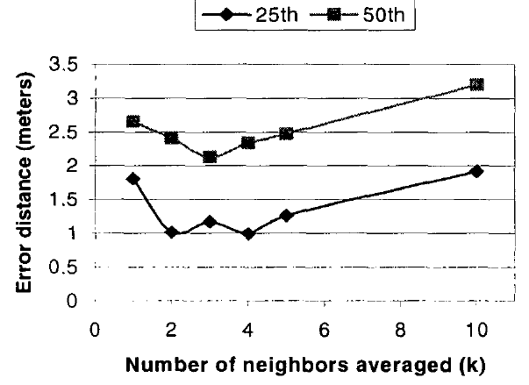
Multiple Nearest Neighbors
Do not limit to just nearest data point (neighbor)
Expand to k neighbors
Figure 4: Example of how multiple nearest neighbors can be more accurate (k=3)
May not work well
Next closest “neighbors” may be same (x,y) but different d
Small k → <2m change
Big k → bad estimate

Slide 15
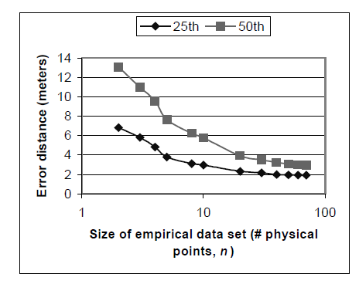
Number of Data Points
Accuracy of 40 points ~= that of 70 points
Also better if points are uniformly distributed
Figure 6: Error Distance as a function of data points
x-axis scaled logarithmically

Slide 16
Tracking
4 SS samples/second
Sliding window of 10 samples to compute mean SS
19% worse than that of stationary

Slide 17
Limitations of Empirical Method
Long time to gather all the empirical data
1 floor*= (70 locations) · (4 directions) · (20 samples)
No one wants to collect all that data for a whole office building
If BS moves, have to recollect all the data
~=*1000 square meters

Slide 18
Model 2: Radio Propagation

Slide 19
The Radio Propagation Method
Create a search space for NNSS (to be used in the same way as before)
Reduce dependency on empirical data
How?
Model of indoor signal propagation
Compute (theoretically) SS data (similar to empirical) for locations (x,y) spaced uniformly along the floor
Performance of method dependent of accuracy of model

Slide 20
Challenges to Create Model
Have to account for free-space loss / loss due to obstructions
Multipath Phenomenon
Signal arrives at user through multiple paths
Depends on layout of building, construction material, number/type of objects in the building
Each building is different
If a wall (etc) moves, has to be recalculated

Slide 21
Chosen Model
Floor Attenuation Factor propagation models
Accommodates different building layouts
Accounts for large-scale path loss
Adaptations
Do not care about attenuation due to floors
Instead focus on walls
Esp. between transmitter and receiver
Wall Attenuation Factor (WAF)
Testing “suggests that the entire system can be relocated to a different part of the building, but the same parameter values can be used”

Slide 22
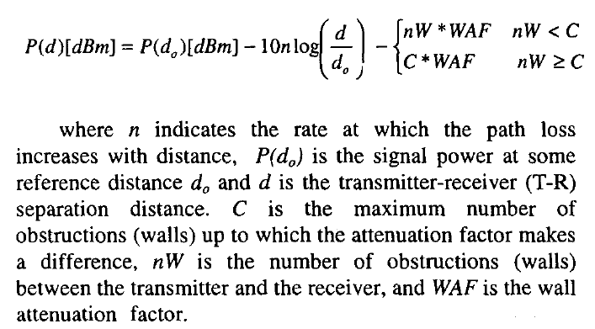

Slide 23
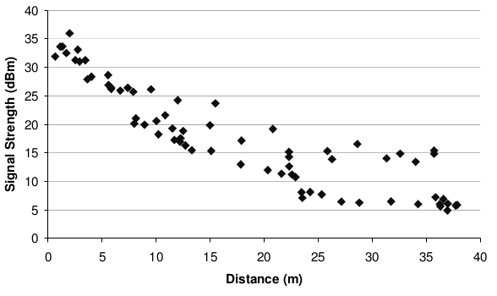
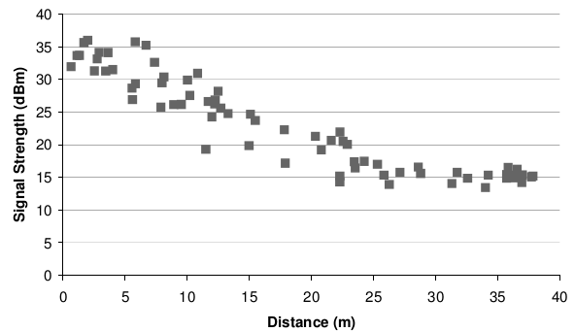
SS as a function of T-R separation derived from the empirical data collected in Section 3.2
Effect of applying correction for intervening walls between the base station & the mobile user

Slide 24
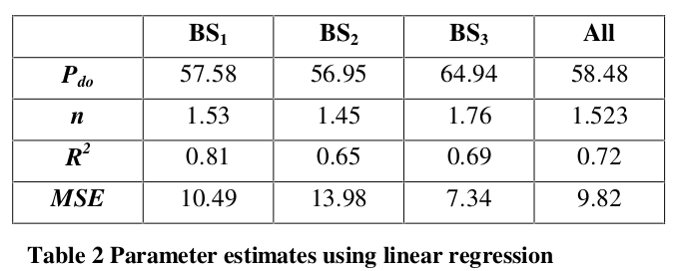

Slide 25
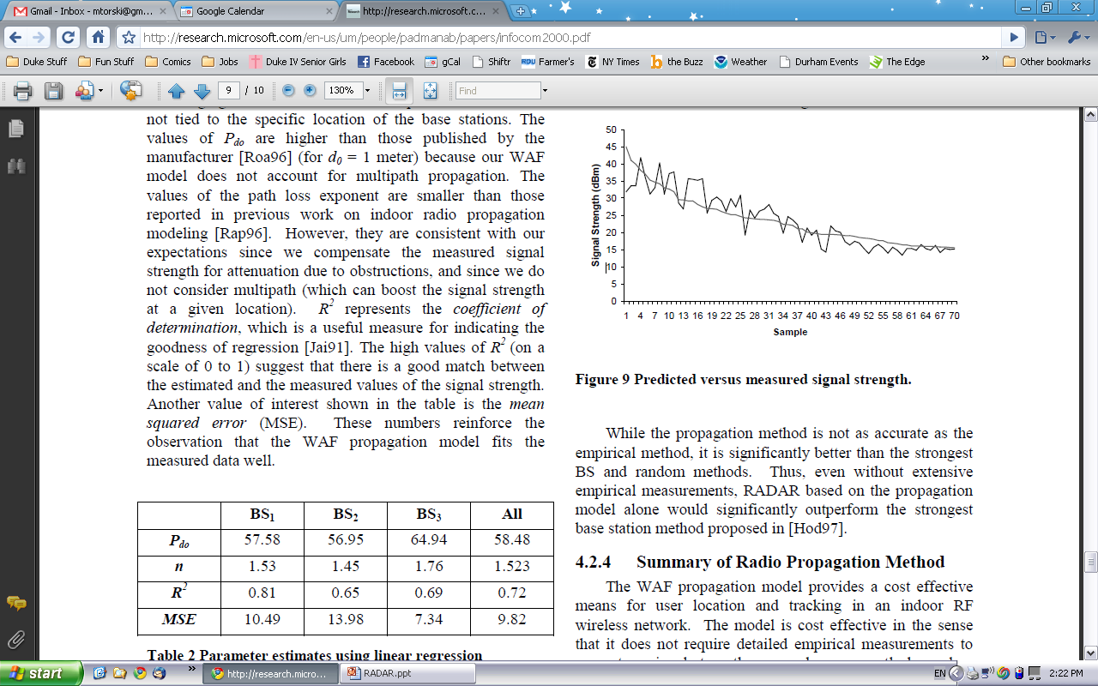
Propagation Model v. Empirical
Not as good as empirical
Better than Strongest BS and Random Methods
Figure 9: Predicted verses measured signal strength

