Slide 1
A SURVEY OF MOBILITY MODELS in Wireless Adhoc Networks
Fan Bai and Ahmed Helmy University of Southern California,U.S.A

Slide 2
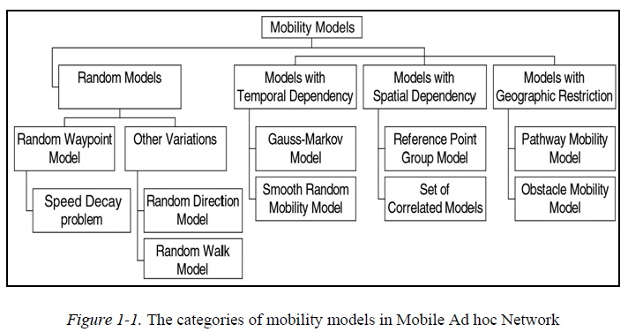

Slide 3
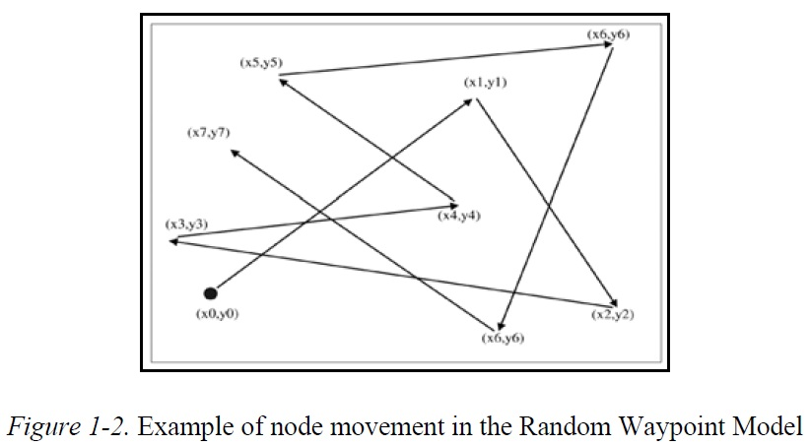

Slide 4
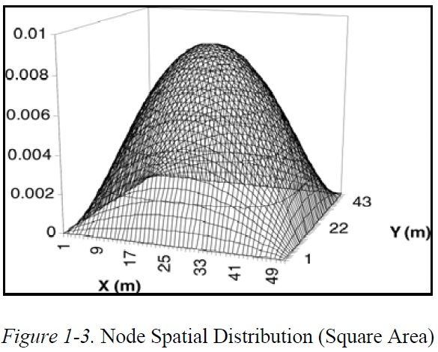

Slide 5
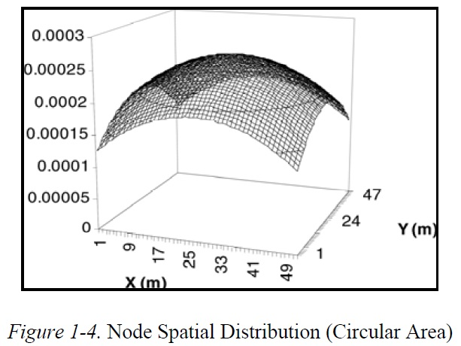

Slide 6
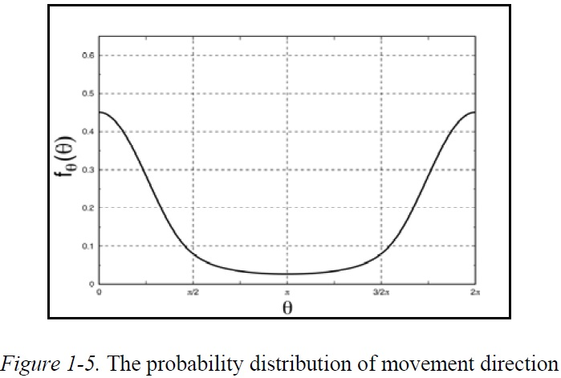

Slide 7
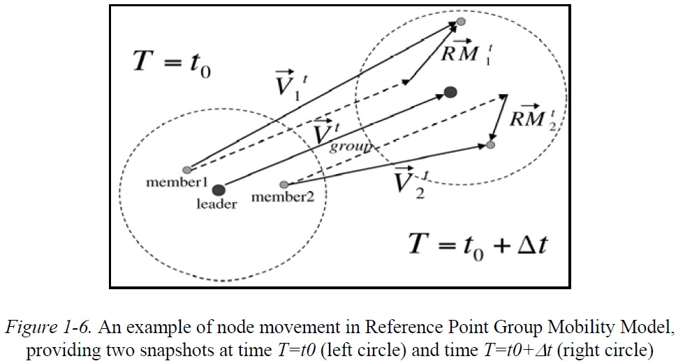

Slide 8
