Slide 1
TARGET CODE GENERATION
Prepared By:
DHEERAJ KUMAR JAIN-04CS3015

Slide 2
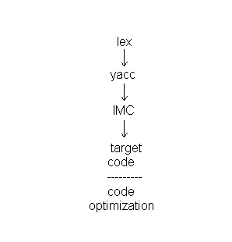
INTRODUCTION

Slide 3
FACTORS EFFECTING THE GENERATION OF TARGET CODE
Form of Input-How Complex/Simple is the IMC
Absolute code
  Relocatable code
    Hardware facility to do the translation
    Compiler book marking
Assembly code
  Assembler

Slide 4
FACTORS EFFECTING THE GENERATION OF TARGET CODE
Dynamicity
Mk independent
It is still readable
Intermediate code → Target Code
Instruction selection : For each type of three address statement, we can design a code skeleton that outlines the target code to be generated for that construct.

Slide 5
FACTORS EFFECTING THE GENERATION OF TARGET CODE
Eg.
x=y+z ➔
mov R1, y #y -> R1
mov R2, z #z -> R2
ADD R2, R1 #R2+R1->R2
mov x, R2 #R2->x
OR
mov R1,z # z->R1
ADD R1,y #R1+y->R1
mov x,R1 #R1->x

Slide 6
FACTORS EFFECTING THE GENERATION OF TARGET CODE
Register allocation : Instructions involving register operands are usually shorter and faster than those involving operands in memory. Therefore, efficient utilization of registers is particularly important in generating good code. The use of registers is often subdivided into two sub problems:
1. During register allocation, we select the set of variables that will reside in registers at a point in the program.

Slide 7
FACTORS EFFECTING THE GENERATION OF TARGET CODE
2.During a subsequent register assignment phase, we pick the specific register that a variable will reside in.
Evaluation order
if(a>b) goto L1 if(a<=b) goto L2
goto L2 L1:
L1: = = L2:
L2:

Slide 8
BASIC BLOCKS
IDENTIFYING BASIC BLOCKS:A basic block is a sequence of consecutive statements in which flow of control enters at the beginning and leaves at the end without halt or possibility of branching except at the end.
1. We first determine the set of leaders, the first statements of basic blocks. The rules we use are the following :

Slide 9
BASIC BLOCKS
I) The first statement is a leader.
II) Any statement that is the target of a conditional or unconditional goto is a leader.
III) Any statement that immediately follows a goto or conditional goto statement is a leader.
2.For each leader, its basic block consists of the leader and all statements up to but not including the next leader or the end of the program.

Slide 10
BASIC BLOCKS
Egs.
1. location = -1
2. i=0
3. if (i<100) goto 5
4. goto 13
5. t1 = 4*1
6. t2 = A[t1]
7. if t2 = x goto 9
8. goto 10
9. location = i
10. t3 = i+1
11. i = t3
12. goto 3
13. ..

Slide 11
BASIC BLOCKS
Leaders : 1,3,4,5,8,9,10,13
Basic Blocks are :
B1 = 1,2
B2 = 3
B3 = 4
B4 = 5,6,7
B5 = 8
B6 = 9
B7 = 10 , 11 , 12
B8 = 13

Slide 12
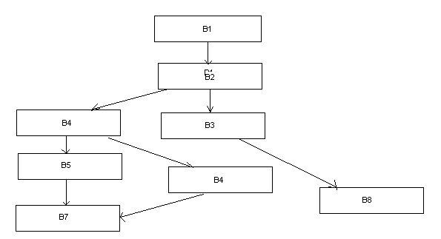
BASIC BLOCKS

Slide 13
Visit:
http://www.facweb.iitkgp.ernet.in/~niloy/COURSE/Autumn2006/Compiler/main.html#Lecture

