Slide 1

Introduction (continued ) lecture 3

Slide 2
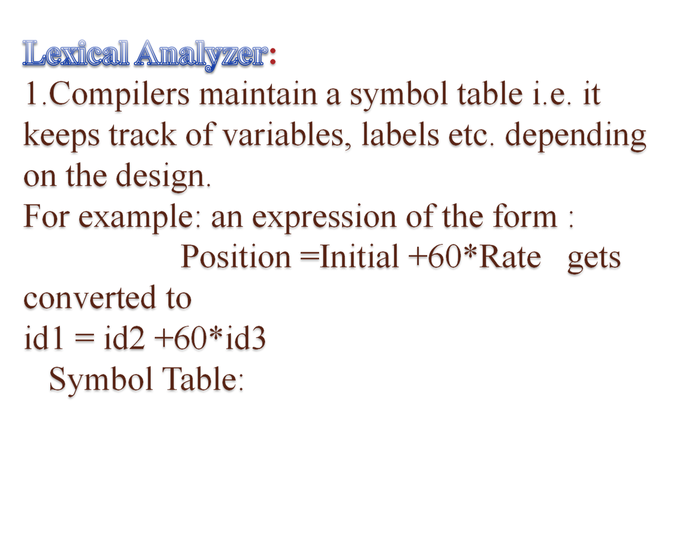
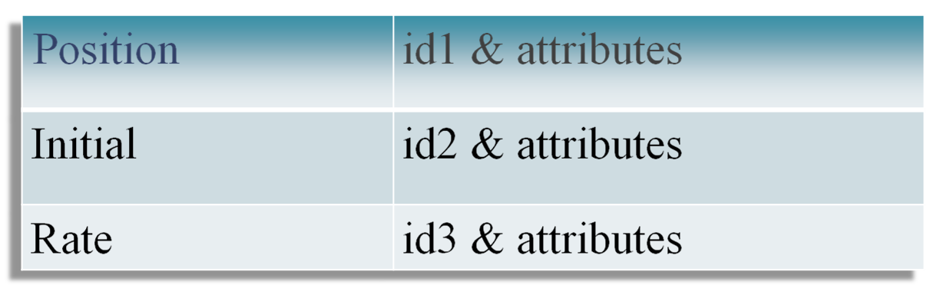

Slide 3
2. So the lexical analyzer converts symbols to an array of easy to use symbolic constants (TOKENS).
3.Also, it removes spaces and other unnecessary things like comments etc.

Slide 4
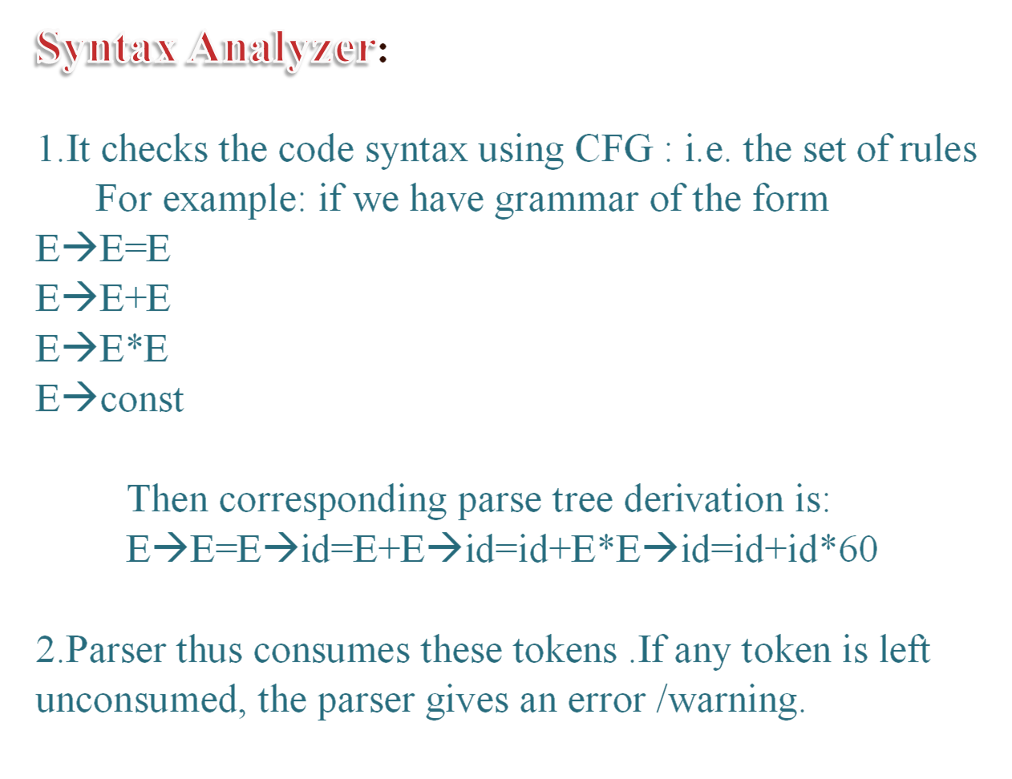

Slide 5
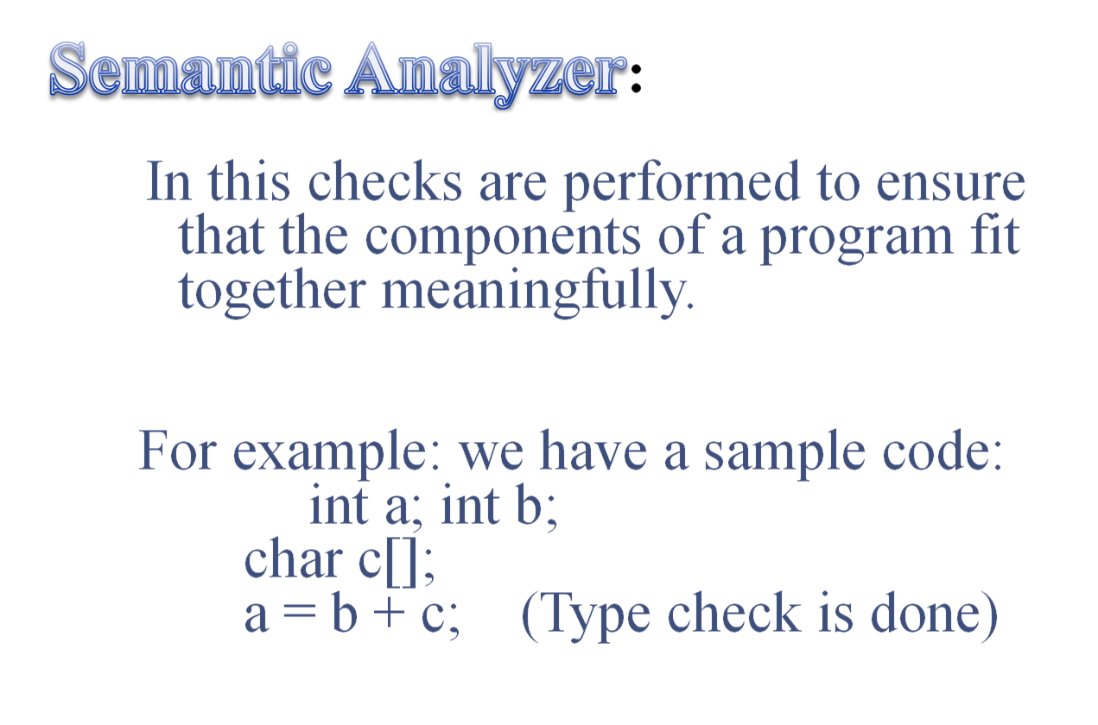

Slide 6
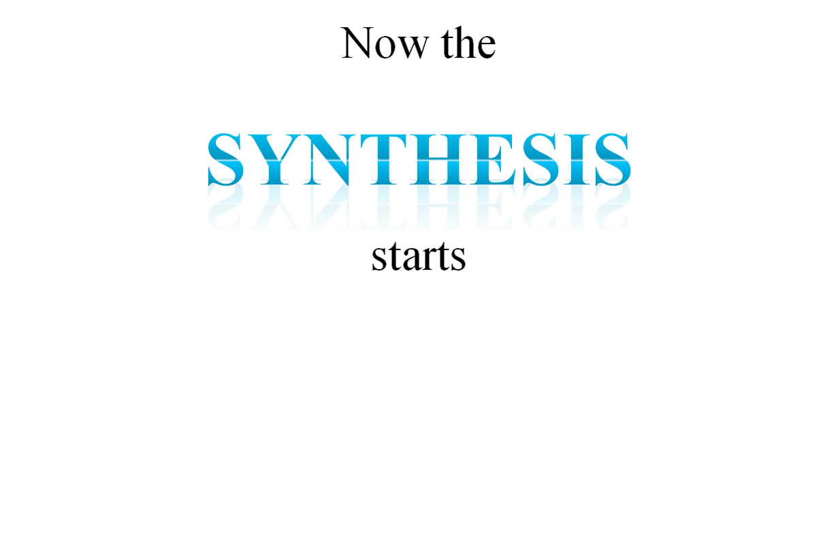

Slide 7
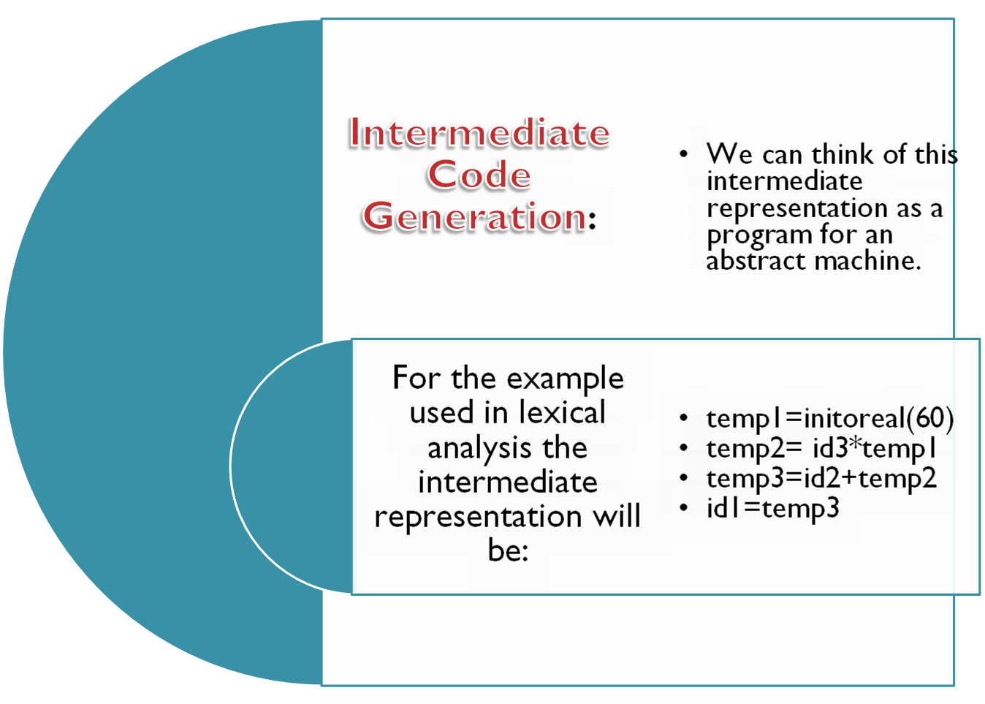

Slide 8
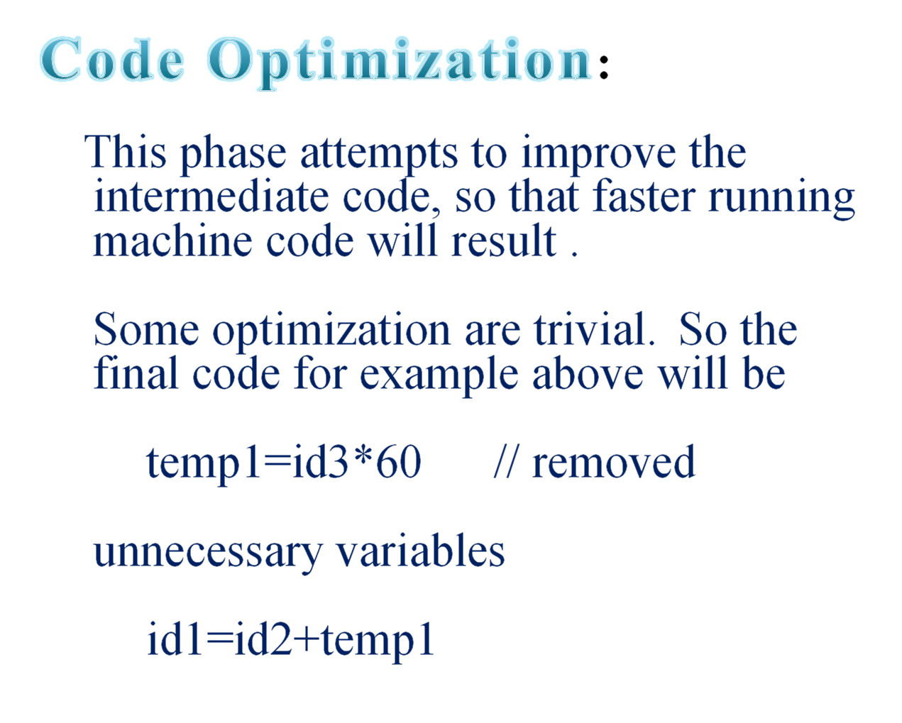

Slide 9
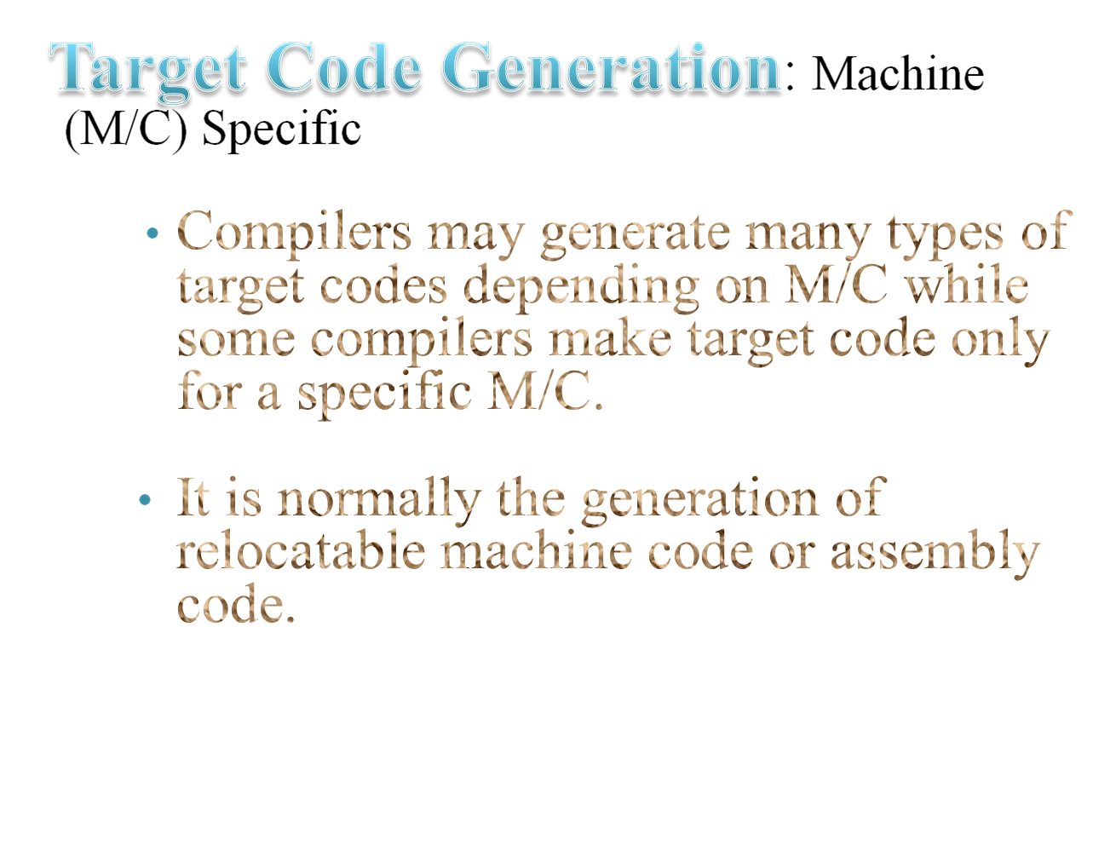

Slide 10
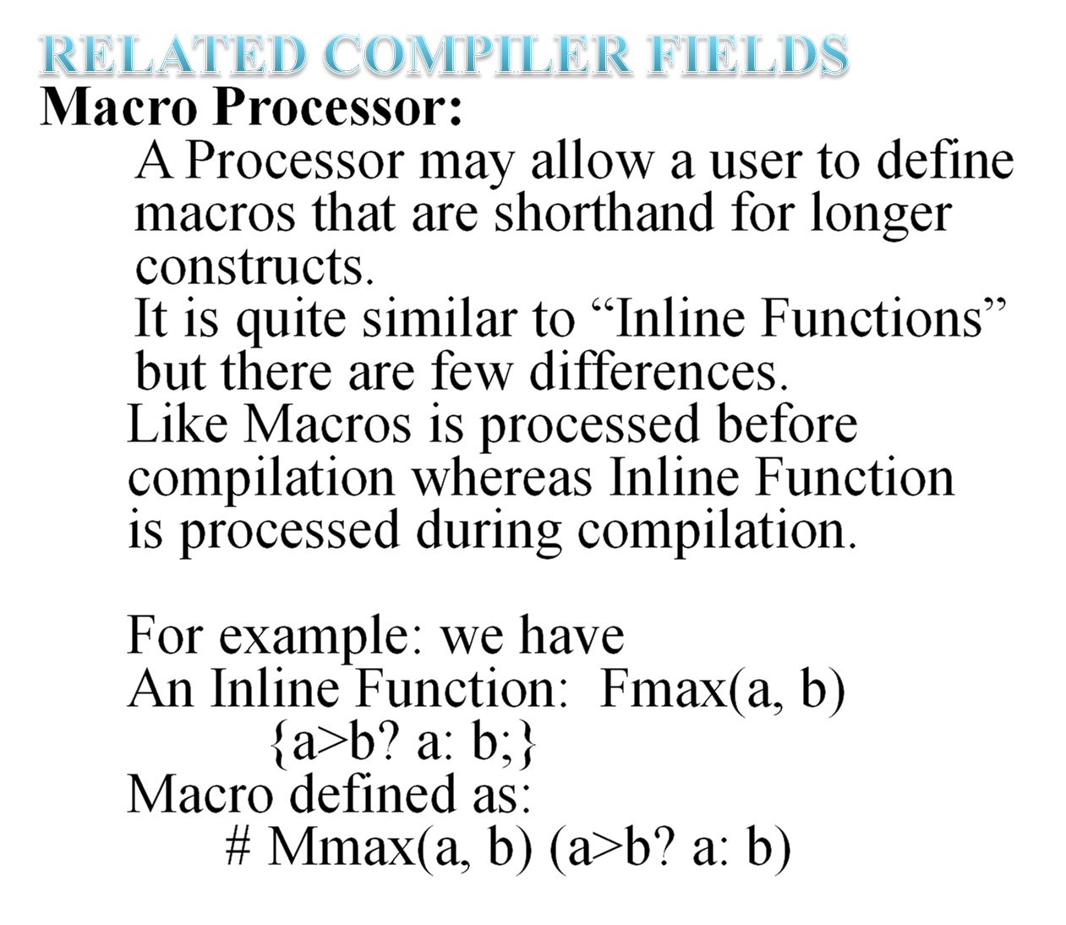

Slide 11
And main function:
main ()
{a=1; b=3;
Fmax(++a, ++b) // this calls the inline function
with incremented
//values of a and during
compilation
Whereas instead of this if we have a call like
Mmax(++a, ++b) // this leads to two increments
in value of b
// as expression replaced is (++a>++b? ++a: ++b)
This just takes the passed arguments and replaces
them in the expression. Then compilation evaluates it.
PRO-C: C+SQL
Acts as a translator

Slide 12


