Slide 1

COMET: Code Offload by
Migrating Execution Transparently
OSDI'12
Mark Gordon, Anoushe Jamshidi,
Scott Mahlke, Z. Morley Mao, and Xu Chen
University of Michigan, AT&T Labs - Research

Slide 2
Overview
Introduction
Distributed Shared Memory
COMET Design
Evaluation
Summary

Slide 3


What is offloading?
Mobile devices
Have limited resources
Are well connected
Can we bring network resources to mobile?
Can a system transparently make this available?

Slide 4
Related Work
MAUI and CloneCloud
Utilize server resources
Computation, energy, memory, disk
'Capture and migrate' method level offloading
Areas for improvement
Thread and synchronization support
Offload part of methods

Slide 5
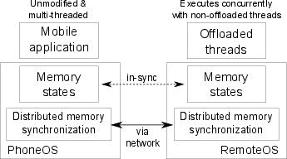
COMET's Goals
Improve mobile computation speed
Require no programmer effort
Generalize well with existing applications
Resist network failures

Slide 6
Overview
Introduction
Distributed Shared Memory
COMET Design
Evaluation
Summary

Slide 7

Distributed Shared Memory
COMET is offloading + DSM
Offloading bridges computation disparity
DSM provides logically shared address space
DSM usually applied to cluster environments
Low latency, high throughput
Mobile relies on wireless communication

Slide 8
DSM (continued)
Conventional DSM (Munin)
X=?
X=555
X=123
X=555
X=?
X=555
X=123
X=123
Waited an RTT for a write
Read could take RTT also

Slide 9
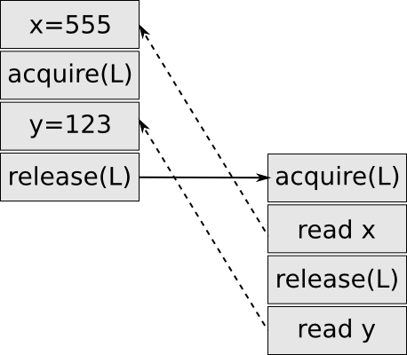
Java Memory Model
Dictates which writes a read can observe
Specifies 'happens-before' partial order
Access in single thread totally ordered
Lazy Release Consistency locking
Fundamental memory unit is the field
Known alignment, known width
Notes:
More about happens-befoer

Slide 10
Field DSM
Track dirty fields locally
Need 'happens-before' established?
Transmit dirty fields! (mark fields clean)
Not clear it scales well past two endpoints
Not important to our motivation
Use classic cluster DSM on server

Slide 11
Overview
Introduction
Distributed Shared Memory
COMET Design
Evaluation
Summary

Slide 12
VM-synchronization
Used to establish 'happens-before' relation
Directed operation between pusher and puller
Synchronizes
Bytecode sources
Java thread stacks
Java heap

Slide 13
Bytecode Update (Step 1 of 3)
Operation begins by sending any new code
I loaded file xyz.dex
[xyz.dex]
I have xyz.dex cached
Send xyz.dex
Pusher
Puller

Slide 14
Stack Update (Step 2 of 3)
Next we send over thread stacks
Thread id: 2
job2::run
pc:5
registers[42, 555, 0]
workLoop
pc:6
registers[0, [obj:9]]
start
pc:3
Registers[101, [obj:9]]
Pusher
Puller

Slide 15
Heap Update (Step 3 of 3)
Finally send over heap update
We send updates to any changed (or new) field
Only send updates of 'shared' heap
[obj:2].y = 1
[obj:4].z = [obj:3]
...
Pusher
Puller

Slide 16




Lock ownership
Annotate with lock ownership flag
Establish 'happens-before' with VM-sync

Slide 17
Thread Migration
Thread migration trivial
Push VM-sync
Transfer lock ownership
Pusher
Puller
Notes:
Need slide about locking

Slide 18
Native Methods
Written in C with bindings for Java
Math.sin(), OSFileSystem.write(), VMThread.currentThread()
Native methods exist to
Access device resources (file system, display, etc)
For performance reasons
To work with existing libraries
Not generally safe to run on either endpoint
Manually white list safe native methods

Slide 19

Failure Recovery
VM-synchronization is recovery safe
Always leave enough information on client
If server is lost resume threads running locally!
A few caveats (native methods)

Slide 20
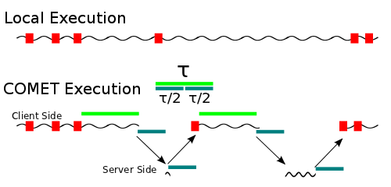
Tau-Scheduler
Τ = 2 * VM-synchronization time
Notes:
TOE=COMET

Slide 21
Implementation
Built from gingerbread CyanogenMod source
~5000 lines of C code
JIT not included
Engine.c:offMigrateThread()
offWriteU1(self, OFF_ACTION_MIGRATE);
deactivate(self);
offThreadWaitForResume(self);

Slide 22
Overview
Introduction
Distributed Shared Memory
COMET Design
Evaluation
Summary

Slide 23
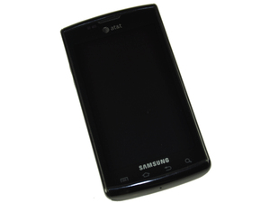
Evaluation Setup
Samsung Captivate (1 GHz Hummingbird)
2 x 3.16GHz quad core Xeon X5460 cores

Slide 24
Benchmarks
8 applications from Google Play
Average speed-up of 2.88X on WiFi / 1.28X on 3G
Average energy saving of 1.51X on WiFI / 0.84X on 3G
2 computation benchmark applications
10.4X speed-up w/ WiFi on Linpack
500+X speed-up w/ multi-threaded factoring

Slide 25
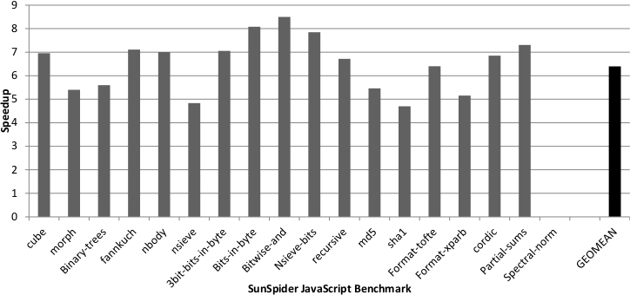
Rhino
Java JavaScript Interpreter
Ran with SunSpider JavaScript benchmark

Slide 26
Overview
Introduction
Distributed Shared Memory
COMET Design
Evaluation
Summary

Slide 27
Summary
Offloading+DSM=COMET
Improve computation speed
No programmer effort
Generalize well
Resist network failures

Slide 28
Contributions
Design/Impl. with four simultaneous goals
Fine granularity offloading
Mutli-threading support
Field based DSM coherency

