Slide 1

RiskRanker: Scalable and Accurate Zero‐day Android Malware Detection

Slide 2
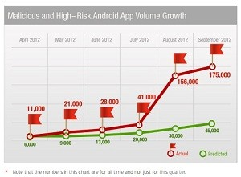

Introduction/Motivation:
What was the main problem addressed?
● Mobile devices have become popular targets for malware
authors, threatening privacy, security, and finances.
  The growth in the number of malicious and high risk Android apps has far exceeded predictions.

Slide 3
Introduction/Motivation:
What was the main problem addressed?
From Wiki:
● Traditionally, antivirus software relies upon signatures to identify malware. This can be very effective, but cannot defend against malware unless samples have already been obtained, signatures generated and updates distributed to users. Because of this, signature‐based approaches are not effective against zero‐day viruses.
● A Zero day virus is a previously unknown computer virus or
other malware for which specific antivirus software signatures
are not yet available.

Slide 4

Introduction/Motivation:
What was the main problem addressed?
● Traditional signature based Reactive malware detection
is
too
slow
to
respond
to
rate
of
new
threat
generation.
● Malware is only
operating.
detected after
it has been installed
and
● GooglePlay and alternative stores make distributing
malware
simple. (Apple’s review process has prevented approving malware at its store. So far).

Slide 5

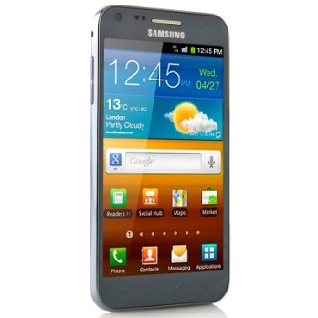


Introduction/Motivation:
What was the main problem addressed?
● The authors proposed and implemented a proactive
prototype zero‐day malware detection scheme, called
RiskRanker, which flags malware while it is still at the
app store. Store curators can then remove the app from
distribution.

Slide 6
Introduction/Motivation:
What will be learned?
  The authors wish to demonstrate that a proactive approach can detect zero‐day malware.
● Their system does not require prior recognition of
malware threat and updating of remote devices
a new
● Their system can detect the threat while still in the app
store

Slide 7

Related Work:
What else has been done to solve this problem?
● Reactive malware detection systems
  ProfileDroid (week 10 paper). Detected various system calls, network access, and resource utilization. Could potentially detect malware in operation.
  Stowaway. Static analysis tool to detect over‐privilege access in Droid apps.
  TaintDroid. Dynamic analysis to detect information leaks on phones.

Slide 8
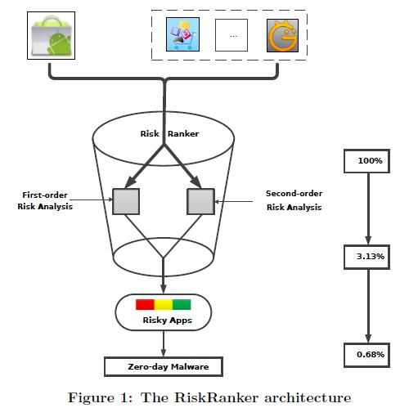
Methodology
Approach and Design
● The prototype system was designed to be scalable, paralizable, and accurately sift through a large number of apps from various Android markets
● The goal was to reduce and rank suspected apps by risk, from a large list to one that was
short enough to verify manually.
● RiskRanker sends apps through 2 sets
of analyzers:
● A set of first order modules evaluate straightforward risks (malware not hiding malicious elements)
● A set of second order modules looks for techniques that indicate malicious code is being purposely hidden from detection.

Slide 9
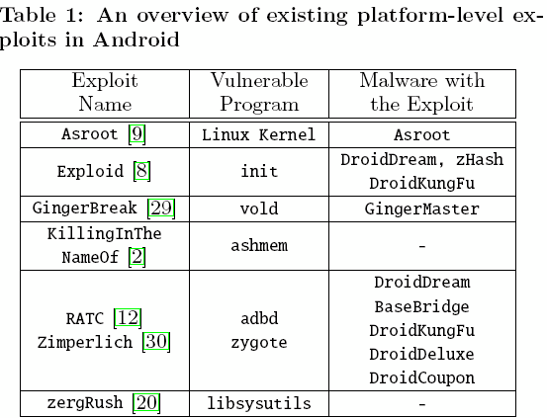
Methodology
Approach and Design
● First Order analysis
● Detecting high‐risk apps
● Look for known exploits (see table 1) which leverage platform level vulnerabilities from use of native Android code
● Can reduce search set by finding presence of native code.
● Such exploits bypass built in security measures
● Identify vulnerability specific signature of exploit (Exploid utilizing init daemon).

Slide 10
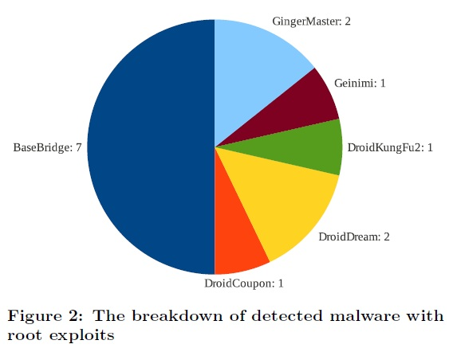
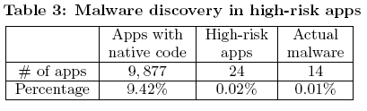
Results
Verification experiments
● First Order Analysis Results
● High‐risk apps found (Table
3)
● 24 High risk apps using known root exploits
● Only 3 Table 1 exploits in use (Exploid, RATC, GingerBreak)
● Found some exploits repackaged into popular legit apps
● System also detected legit (??) jail break tool

Slide 11

Methodology
Approach and Design
● First Order analysis
● Detecting medium‐risk apps
●
Look for behaviors that result in surreptitious charges
Sending SMS to premium phone numbers (and earn malware authors $$$)
Need to distinguish legitimate use of such functions
Assume legitimate actions initiated actions which invoke callbacks (button press callback)
Perform static data‐flow and control‐flow of Dalvik bytecode to see that money charging operations trace back to callbacks
Such analysis complicated by concurrent operations, code obfuscation, reflection, and actions initiated in external threads.
Minimize such issues by employing backward and forward slicing.
▪ Slicing is technique of identifying reachable code or data
●
●
●
●
●
●

Slide 12
Methodology
Approach and Design
● First Order analysis
● Detecting medium‐risk apps
Sources of Ambiguity:
Class Hierarchy
Possible values each term in a comparison can take
Native Code
Reflection language Feature

Slide 13
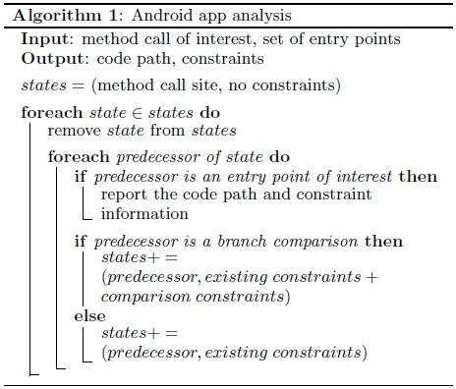
Methodology
Approach and Design
● First Order analysis

Slide 14
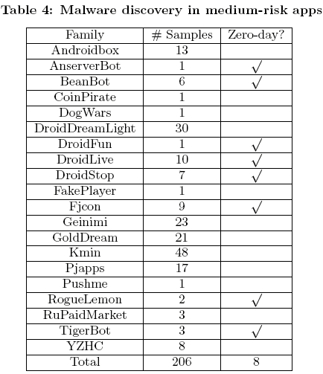
Results
Verification experiments
● First Order Analysis Results
● Medium‐risk apps found (Table
● 2437 apps were found to send background SMS
● Of these, only 1223 distinct paths
4)
● A person manually analyzed these in 2
days. Of these, 94 paths were malicious
● Overall of 2437 medium‐risk apps, 206 were infected, including 8 zero‐day malware families.

Slide 15

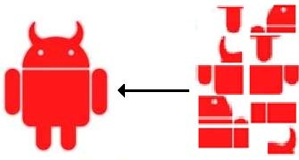
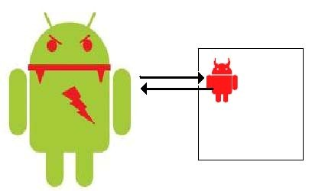
Methodology
Approach and Design
● Second Order analysis ‐ Look for patterns common
and rare in legitimate apps
to
malware,
●
Pre‐processing
● Look for secondary (child) apps within host app.
● Look for apk or jar files saved in assets or res directorie
s.
●
Encrypted native code execution
● Hides signature of malevolent code
● Look for calls to decryption routines
●
Unsafe Dalvik code loading
● Load malevolent code at runtime
● Bypasses discovery during static analysis
● Look for use of DexClassLoader

Slide 16
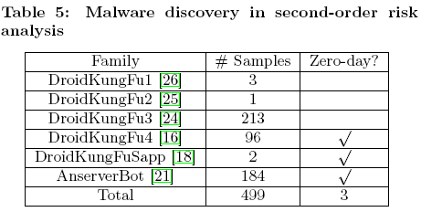
Results
Verification experiments
● Second Order Analysis Results
● Medium-risk apps found (Table
● 328 apps encrypt native code
5)
● 4257 apps feature dynamic code loading, 1655 contain a
child package, there are 492 apps in common.
● Some are legit. These signatures were white listed to reduce the number of apps being considered.
● They found one very nasty zero-day app (AnserverBot, removes mobile security software, and other things), and released a security alert.

Slide 17
Methodology :
Prototyping and Evaluation
● RiskRanker implemented as Linux application, using 3.6 K lines of Python,
and 8.7 K of Java.
● Contains high‐risk root exploit detection module aware of 7 kinds of
known exploits (see Table 1, which only shows 6?).
● Contains medium‐risk detection module which scans for
1.
Sending background SMS
Making background phone calls
Uploading call logs
Uploading received SMS messages
2.
3.
4.
●
Apps were preprocessed and data placed into MySQL to allow quick
indexing and lookup.

Slide 18
Methodology :
Prototyping and Evaluation
● 118,318 apps were collected over 2 months from GooglePlay
(49.8%) and 14 alternate markets. Due to overlap in markets, this
came to 104,874 distinct apps
● RiskRanker analyzed apps on a local 5 node cluster, with each
node having 8 cores and 8GB of memory
● On this system, RiskRanker could process 3500 apps per hour
● Collected apps were processed in 30 hours.

Slide 19
Results
Verification experiments
● From this collection, RiskRanker identified:
● 718 malicious apps from 29 malware families
● Of these, 322 were zero‐day from 11 new families
● First order risk analysis revealed 220 malware samples from 25 families
● Second order risk analysis found 499 samples from 6 families
● Summary of results in Table 2

Slide 20
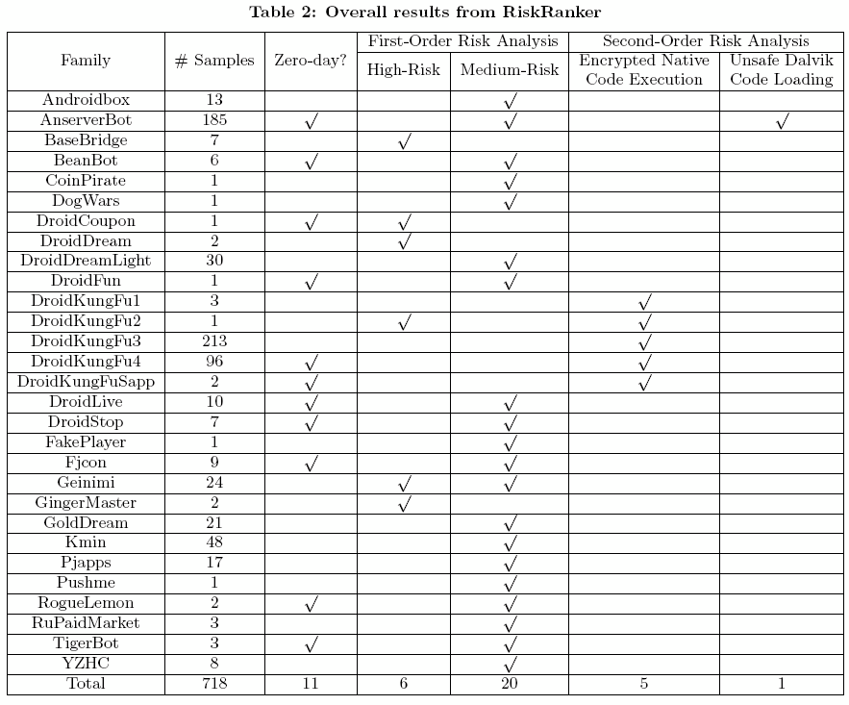
Results
Verification experiments

Slide 21
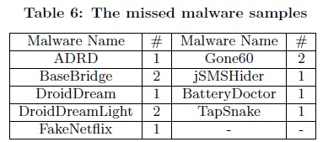
Results
Verification experiments
● False Negative Measurements
● The authors demonstrated the effectiveness of
RiskRanker in finding new (zero‐day) threats.
  They then downloaded a set of known malware from a public contagion repository (exists for research?)
  After removing duplicates, the set consisted of 133 apps from 31 families.
● RiskRanker identified 121 of the 133 malevolent apps.
  Analysis determined that the detection failures were out of scope of the detection modules of RiskRanker.

Slide 22
Results
Verification experiments
● Malware Distribution Breakdown:
● Malware could be detected in all of the markets
(GooglePlay included)
  At one market, 220 apps, or 3% of their offerings were infected.
● 4 alternative markets offered at least 90 malware apps.
  Google only had 2 out of 52,208 apps infected. This may be due to adoption of GoogleBouncer (its approach to cleansing their market is unknown)

Slide 23
Discussions/Conclusions/Future Work
● The authors found that their RiskRanker system
detected previously unknown malware from various
stores.
● The system, even in a limited prototype stage, was very effective
● They discuss some weaknesses:
● obfuscation complicates path analysis
  a malware author could write their own crypto routine, so the known call used for detection is skipped.
  Can hide malicious code as a large array of innocent looking bytes.

Slide 24
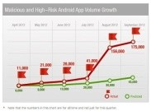

References
● Wiki (http://en.wikipedia.org/wiki/Zero‐day_virus)
● http://www.pcmag.com/article2/0,2817,2411240,00.asp , Trend Micro Warns of Increased
Android Malware, Stephanie Mlot, For malware growth figure and broken android art.
● RiskRanker: Scalable and Accurate Zero‐day Android Malware Detection ,
Michael Grace †, Yajin Zhou †, Qiang Zhang , Shihong Zou , Xuxian Jiang †
†North Carolina State University NQ Mobile Security Research Center
{mcgrace, yajin zhou, xjiang4}@ncsu.edu {zhangqiang, zoushihong}@nq.com
● A Survey of Mobile Malware in the Wild,
Adrienne Porter Felt, Matthew Finifter, Erika Chin, Steven Hanna, and David Wagner
University of California, Berkeley
{apf,finifter,emc,sch,daw}@cs.berkeley.edu

Slide 25

Thank You

