Slide 1
Clone-Cloud

Slide 2
Motivation
With the increasing use of mobile devices, mobile applications with richer functionalities are becoming ubiquitous
But mobile devices are limited by their resources for computing and power consumption
Cloud – the place for abundant resources
Clouds provide opportunity to do huge computations quickly and accurately
So why not use cloud for mobile computations??

Slide 3
CloneCloud
CloneCloud envisions at an architecture that uses cloud to do computations that consume resources badly on mobiles.
It uses the “connectivity” abilities of the mobile devices as a substitute for computational abilities.
It believes in the intuition that “as long as execution on the cloud is significantly faster than execution on the mobile device, paying the cost for sending the relevant data and code from the device to the cloud and back may be worth it.”
It aims at finding the right spots in an application automatically where the execution can be partitioned and migrated to the cloud.

Slide 4
CloneCloud
This model is primarily applicable to application layer VMs (virtual machines) since the instruction sets in it are bytecodes and hence provide hardware and OS independence
It exhibits opportunistic but conservative consistency
The partitioning component for finding migration points uses – static analysis to find the constraints and the dynamic profiling for building the cost model for execution and migration
It finally uses an optimizer that uses the above constraints and cost models to derive the partitions

Slide 5
Partitioning
The partitioning mechanism yields the partitions in the application that are optimal at execution time and energy consumption
It is run multiple time under different conditions and objective functions – stores all partitions in a database
At run time, the execution picks a partition among these and modifies the executable before invocation
It has three components – static analyzer, dynamic profiler and optimization solver

Slide 6
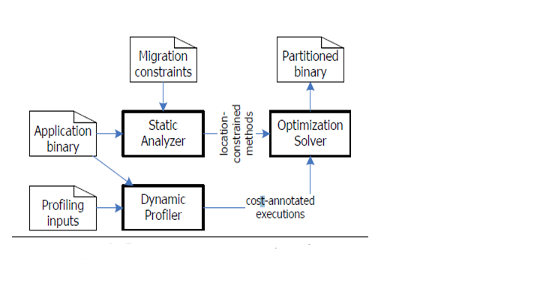
Partitioning
Fig 5: Partitioning Analysis Framework

Slide 7
Static Analyzer
The static analyzer identifies the legal partitions of the application executable according to a set of constraints
Migration is restricted to the method entry and exit points
Two more restrictions for simplicity
Migration is allowed only at the boundaries of application methods but not core system library methods
Migration is allowed at the VM-layer method boundaries but not native method boundaries
Example…

Slide 8
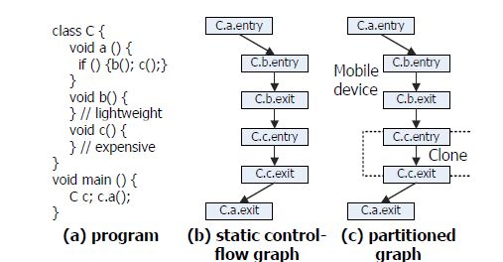
Static Analyzer - example
Fig 6: Flow Diagram in a Static Analyzer

Slide 9
Static Analyzer - constraints
Three properties of any legal partition
Methods that access specific features of a machine must be pinned to the machine [V_{M}]
Static analysis marks the declaration of such methods with a special annotation M
Done once for each platform, not repeated for each application
Methods that share native state must be collocated at the same machine [V_{Natc}]
When an image processing class has initialize, detect and fetchresult methods that access native state, they need to be collocated
Prevent nested migration
Static analysis of the control flow graph to identify the set of methods called directly by a method (DC) and transitively (TC)

Slide 10
Dynamic Profiler
Profiler collects data that will be used to construct the cost model
Currently using randomly chosen set of inputs
Future work is to explore symbolic-execution-based techniques since randomly chosen inputs may not explore all execution paths
Each execution is run once on mobile device and once on the clone in the cloud
Profiler outputs set of executions S and a “profile tree”, for both mobile device and the clone
Example…

Slide 11
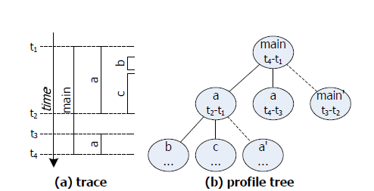
Dynamic Profiler- example
Fig 7: Example of Dynamic Profiler

Slide 12
Profile tree
One node for each method invocation
Every non-leaf node also has a leaf child called its residual node
Residual node holds residual cost which represents the cost of running the body of code excluding the costs of the methods called by it
Each edge is annotated with the state size at the time of invocation of the child node, plus the state size at the end of that invocation
Amount of data that the migrator needs to capture and transmit in both directions if the edge were to be a migration point
Computation cost Cc(i, l); l=0 on mobile device and filled from T, l=1 on the clone and filled from T’
Migration cost Cs(i); sum of a suspend/resume cost and the transfer cost

Slide 13
Dynamic Profiler
For energy consumption model, we do the energy measurements with off-board equipment.
CPU activity (processing/idle), display state (on/off), and network state (transmitting or receiving/idle), and translate them to a power value using func P
Cc(i, 0)= P(CPUOn, ScrOn, NetIdle)* T[i]
Cc(i,1)= P(CPUIdle, ScrOn, NetIdle)
Cs(i) = <Cs(i) value from time model> * P(CPUOn, ScrOn, NetOn)

Slide 14
Optimization Solver
It aims at picking up application methods to migrate to the clone from the mobile device, so as to minimize the expected cost of the partitioned application.
Decision variable R(m) m= method in the application.
R(m)=1 -> partitioner places a migration point at the entry point of the method.
But not all partitioning choices for R(.) are legal

Slide 15
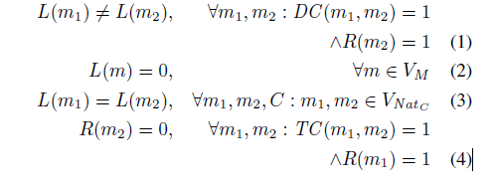
Optimization problem
Using the decision variables R(.), the auxiliary decision variables L(.), the method sets V_{M} and V_{NatC} for all classes C defined during static analysis, and the relations I, DC and TC

Slide 16
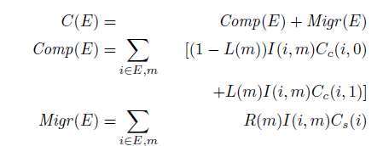
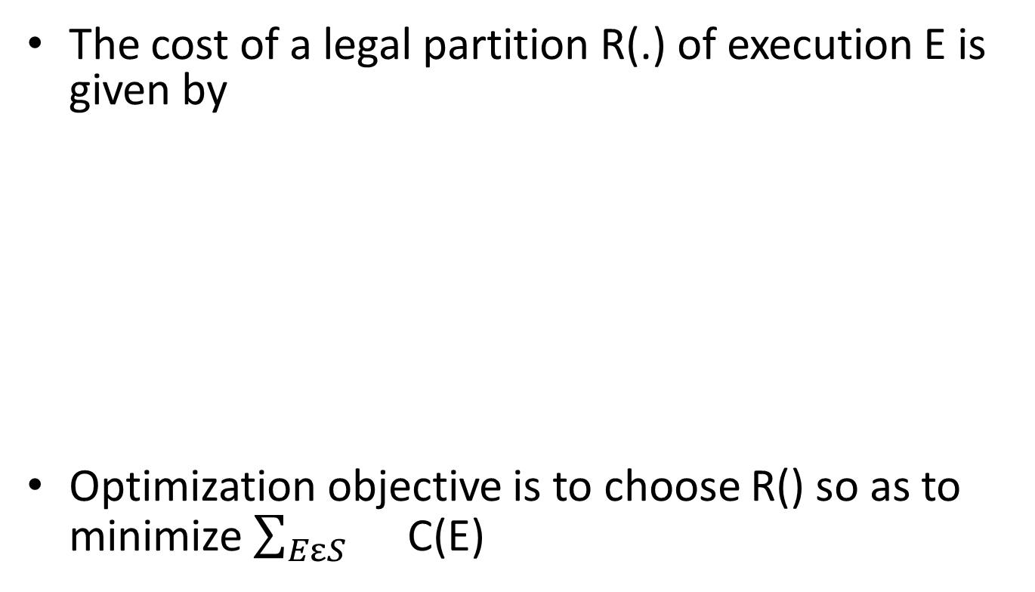
Cost of a partition
The cost of a legal partition R(.) of execution E is given by
Optimization objective is to choose R() so as to minimize $\sum_{EεS}{}$ C(E)

Slide 17
Distributed Execution
Two unique features of CloneCloud
Thread granularity migration:
migration operates at the granularity of a thread
Native-Everywhere:
enables migrated threads to use native non-virtualized hardware(GPUs, Cryptographic accelerators etc.)

Slide 18
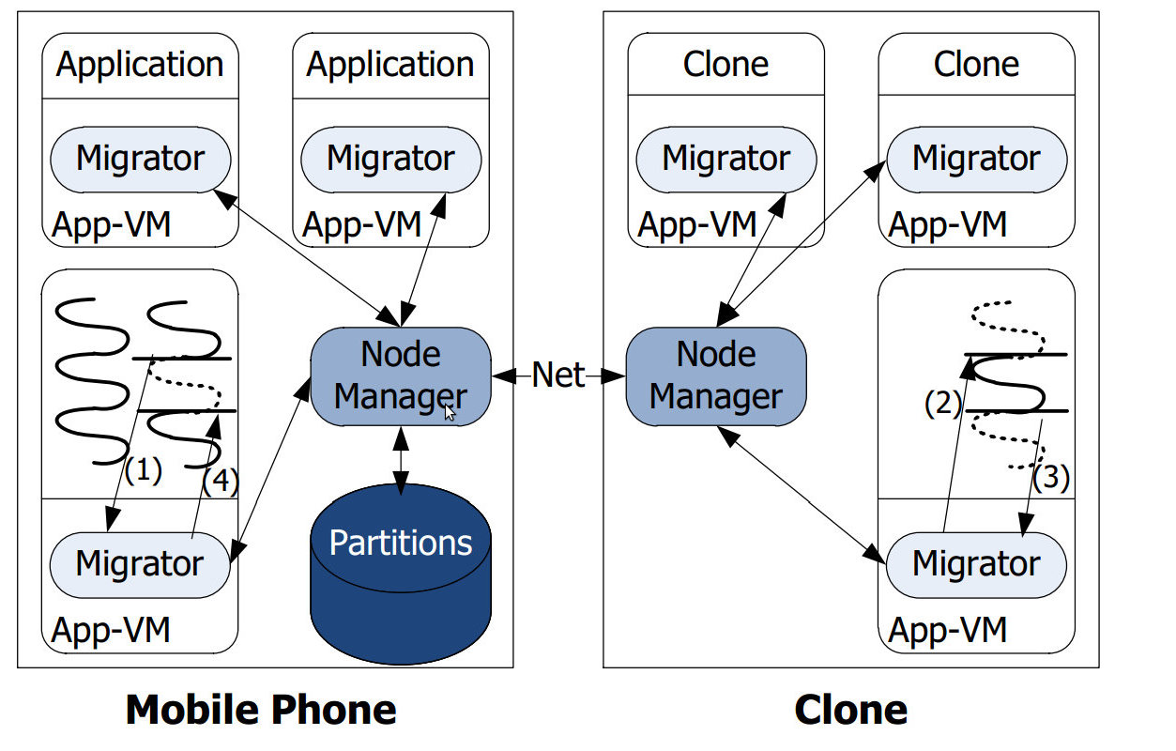
Migration Overview

Slide 19
Suspend and capture
Thread migrator suspends migrant thread
Captures its state, passes it to node manager
Node manager transfers the capture to clone

Slide 20
Resume and Merge
Clone's thread migrator captures and packages the thread state
Node manager transfers the capture back to the mobile device
Migrator in the original process is given the capture for resumption

Slide 21
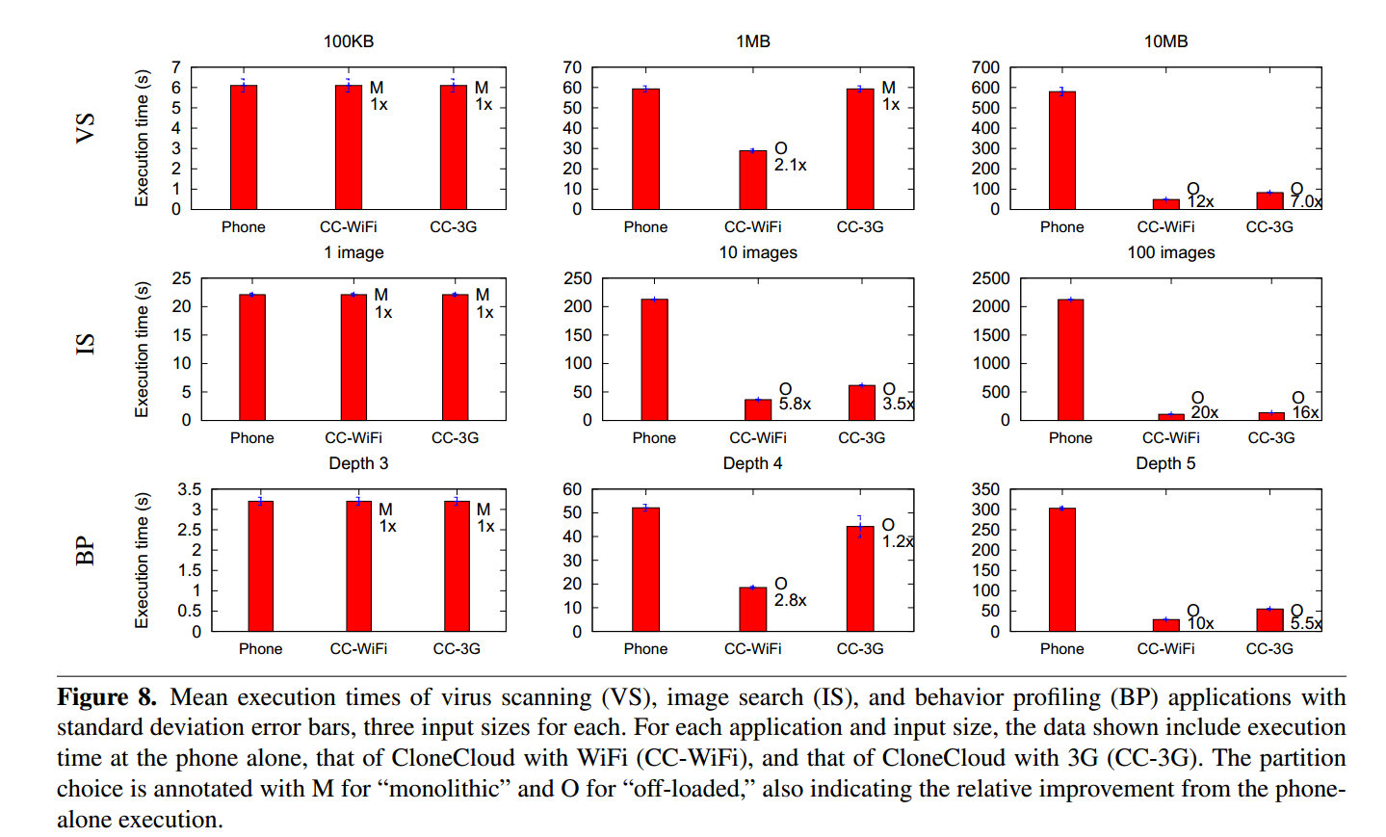
Evaluation

Slide 22
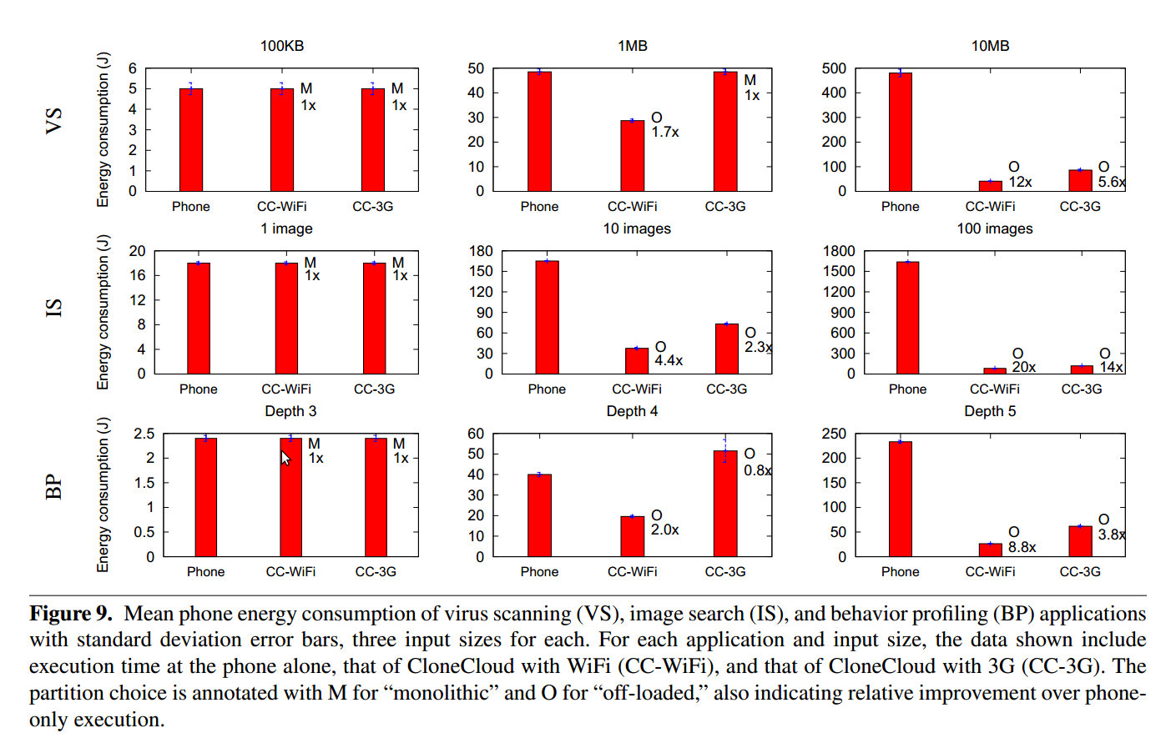
Evaluation

Slide 23
Conclusion
A design that achieves basic augmented execution of mobile applications on the cloud
Prototype delivers up to 20x speed up and 20x energy reduction
Programmer involvement is not required
Opens up a path for a rich research agenda in hybrid mobile-cloud systems

