Slide 1
Mobile Cloud Computing
Slide Courtesy: Prof. Pradipta De, SUNY Korea

Slide 2
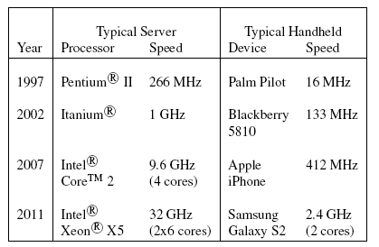
What is Mobile Cloud Computing
Cloud Computing – A paradigm of web-based computing where shared resources are provided on demand
Mobile Computing – Using portable devices to run standalone applications or use wireless media to access services
Mobile Cloud Computing – Augment mobile devices with content and processing capabilities using cloud

Slide 3
MCC: Different Perspectives
Cyber-foraging: A name coined in 2001 by Mahadev Satyanarayan (CMU)
  Cyber foraging is a pervasive computing technique where resource poor, mobile devices offload some of their heavy work to stronger surrogate machines in the vicinity.
Mobile Cloud Computing: Mobile cloud computing was defined in a 5 March 2010 entry in the Open Gardens blog as "the availability of cloud computing services in a mobile ecosystem.
  Mobile Cloud Computing is the state-of-the-art mobile distributed computing paradigm comprises three heterogeneous domains of mobile computing, cloud computing, and wireless networks aiming to enhance computational capabilities of resource-constrained mobile devices towards rich user experience

Slide 4
MCC: Different Perspectives
Mobile as an Interface
  Traditional view of augmenting resource constrained device by leveraging cloud resources
  Examples:
    Storage augmentation: Apple iCloud
    Compute Augmentation: Apple Siri, Amazon Silk Browser
Mobile as a Resource
  Alternate view where mobile devices supplement cloud storage and computation

Slide 5
Key Questions
What are the benefits of MCC?
  Save battery power
  Faster execution (on cloud servers)
Why not a purely thin-client approach ?
  Native code execution cannot be offloaded
  Wireless links are unreliable
Optimal way to achieve execution efficiency and energy savings
  Write a client-server code ➔ static partition
  Ask programmer to annotate which methods can be offloaded if required ➔ labor intensive
  Automatically find out the optimal way to partition ➔ requires profiling the execution time and energy consumption of code blocks

Slide 6
MAUI: Mobile Assistance Using Infrastructure (2010)
Goal: Mobile device energy optimization
Programmer marks each method as “remote” or “local” ➔ marks offloading potential
MAUI uses the .NET framework to execute code, but implements state migration, not code migration
Dynamic Profiling of Device, Program and network behavior
Profiling data is fed to a solver to determine the correct code partition
MAUI: Making Smartphones last longer with Code offload, MobiSys 2010

Slide 7
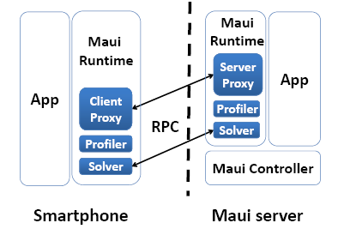
MAUI: Limitations
Continuous profiling is expensive
Development effort to use MAUI requires program annotation by the developer

Slide 8
CloneCloud (2011)
Goal: device energy savings, but without programmer involvement
  Automatic program partitioning by dynamic profiling
Converts a single machine execution into a distributed execution optimized for network connection, device processing capabilities and app computing patterns

Slide 9
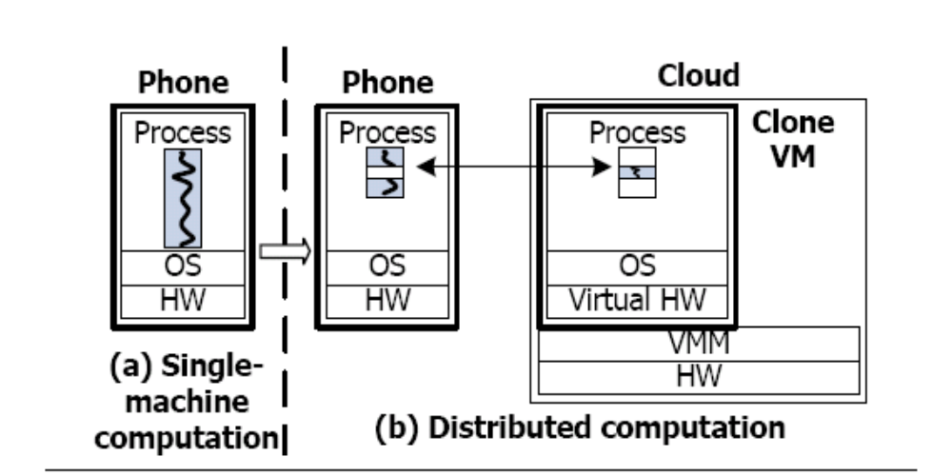
Clone Cloud is Mobile Distributed Computing
Offline partitioning: no source code needed, no programmer annotation, uses static analysis of the executable (bytecode)
Profiler collects data for the cost model
Optimize for network, CPU speeds, energy consumption vs. execution time
CloneCloud: Elastic Execution between Mobile Devices and Cloud – EuroSys 2011

Slide 10
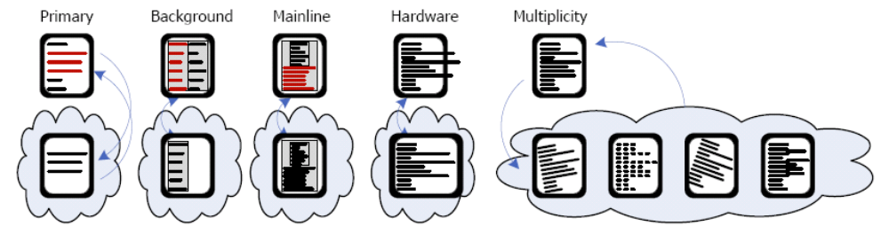
Clone Cloud Applications
Speech Processing
Video Indexing
Multiple copies of system image for data parallel applications
Private data leak detection
Virus scan (files)
Analyzing photos
Overcome hardware limitation, like memory caps
“Augmented Smartphone Applications Through Clone Cloud Execution” -- HotOS 2009

Slide 11
CloneCloud: Limitations
Cannot offload native code
Works at the thread level, but supports limited concurrency
  Local threads can read existing objects or create new objects, but may get stalled waiting for the migrated thread

Slide 12
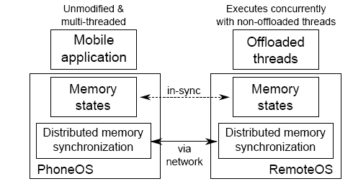
Further Improvement
Distributed Shared Memory Implementation (2012 OSDI)
The code partitioning
is moved to the thread
level ➔finer granularity
Optimization objective
remains energy saving

Slide 13
Further enhancements
State migration (heap objects, stack, other state variables) leads to data transfer during offload
Focus is to reduce the data migration overhead
Identify heap objects which are modified ➔ reduced data transfer leads to lower network energy costs

Slide 14
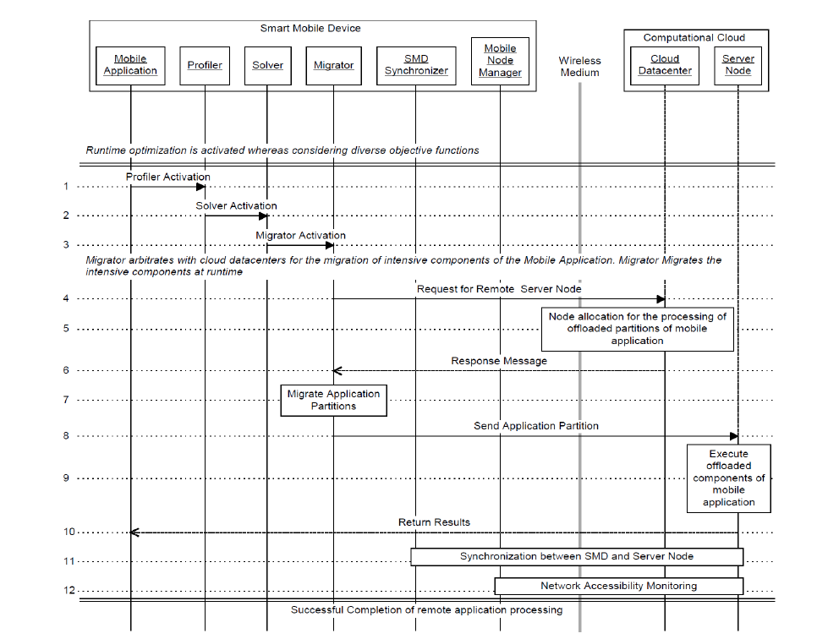

Slide 15
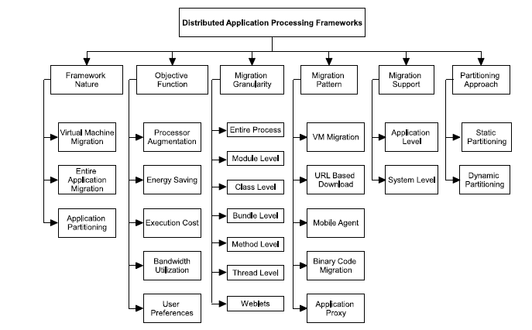
MCC App Processing Framework

Slide 16
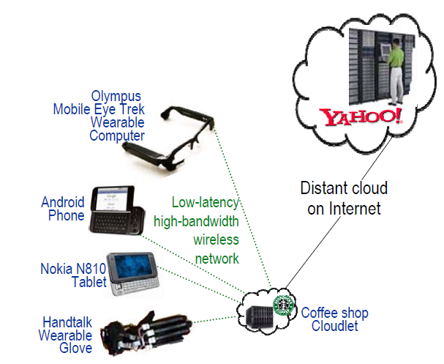
Bandwidth Issue
MCC often assumes seamless network access to the cloud ?
Cloud infrastructure could be geographically distributed
The access network from device uses wireless connections
Cloudlet: A cloudlet is a trusted, resource-rich computer or cluster of computers that is well-connected to the Internet and is available for use by nearby mobile devices
A thin-client paradigm with a cure for WAN latency issue
“The Case for VM-based Cloudlets in Mobile Computing” -- IEEE Pervasive Computing Oct, 2009

Slide 17
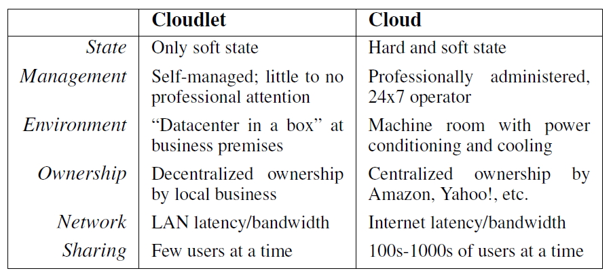
Cloudlet vs Cloud

Slide 18
Streaming or Perception Apps
Definition: Type of applications where continuous data stream must be processed and results obtained with low latency to satisfy the user experience
Requirements:
  Interactive (low response times ~10 to 20ms)
  High Data Rate (video rate of 30 fps)
  Compute intensive (computer vision, ML algos)
Examples:
  Face Recognition
  Speech Recognition
  Object and Pose Identification
  Mobile Augmented Reality
Can MCC efficiently support these apps ?

Slide 19
MCC for Perception Apps
Structure the application workflow to identify opportunities for parallelization
Use stream processing abstractions for fast processing
Combine offloading to cloud and parallel execution opportunity

Slide 20
What is Mobile BaaS
Cloud-based server-side mobile services
  Object Store, File Store, Data Compression, Security, custom code execution
    CloudMine, Kinvey, mobDB
    http://apievangelist.com/2012/08/22/mobile-backend-as-a-service-roundup-and-the-future-of-web-apis/
    http://blogs.forrester.com/michael_facemire/12-04-25-mobile_backend_as_a_service_the_new_lightweight_middleware

Slide 21
Mobiles as a Resource

Slide 22
Key Concept
Smartphone computing capability is increasing
Number of devices is large providing a large aggregate compute capability
Untethered characteristic provide additional benefits
  Use as context collector, like location, other sensor inputs

Slide 23
Mobile-as-a-Resource Framework
Hyrax, MISCO: Implements data parallel application framework using idle mobile devices
Serendipity: Presents a concurrent job model execution on a collection of mobile devices, called mobile device cloud
Recent work at Sigcomm 2013 workshop – Extends the Serendipity work to maximize the lifetime of the MDC
  Devices belonging to same user
  Highly collaborative app (consider a sensor network like scenario)
Solves a scheduling problem with a goal of overall energy maximization

Slide 24
Open questions
Challenges
  Energy consumption
  User behavior
  Network characteristics

Slide 25
Design Consideration in MCC app
Resource Optimization
  Minimize resource consumption
    Energy, computation, memory
Performance Optimization
  Optimize performance metrics
    Throughput, latency

Slide 26
Take-Home Points
Frameworks for Mobile Cloud Computing
  Mobile as an Interface
  Mobile as a Resource
Moving beyond compute intensive apps
  Perception apps, like gaming, social networking, instant messaging ➔ high throughput, low latency, high compute requirements
  Explore opportunities for parallelization using cloud offloading
Application space
  Exploit the inherent capabilities of mobile devices
    Sensor logs, location information
  Careful orchestration of the workflow

