Slide 1
SLAW: A Mobility Model for Human Walks
Lee et al.

Slide 2
Overview
performance of networking application depends on the movement patterns of device holders
wireless devices are mostly connected to humans
understanding human mobility patterns leads to accurate performance prediction of the protocols

Slide 3
Statistical behavior of human mobility
Truncated power-law flights and pause-times. (F1)
Heterogenously bounded mobility areas. (F2)
Truncated power-law inter-contact times. (F3)
Fractal waypoints. (F4)

Slide 4
Advantages
SLAW is the first mobility model that produces synthetic mobility traces containing all these features.
Requires a small number of input parameters
Does not require any real walk traces for generating synthetic traces.

Slide 5
SLAW overview
Input parameters:
  size of the walk-about area
  number of walkers
  Hurst value used for generating fractal way points.

Slide 6
Fractal waypoints
First SLAW generates fractal waypoints using technique similar to fractional gaussian noise or Brownian motion generation technique
It then leverages fundamental properties of fractal points to generate power-law flights on top of them.
fractal points induce power-law gaps.(interspacing among neighboring fractal points)

Slide 7
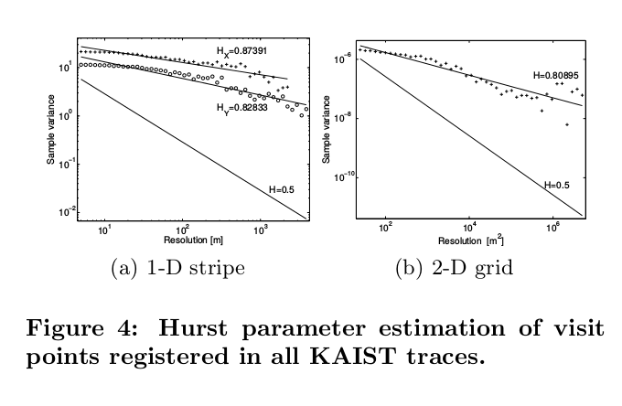
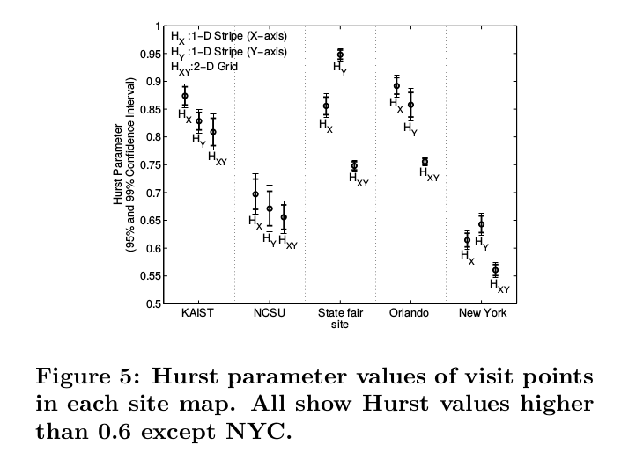
Hurst parameter

Slide 8
Trip planning
People plan their trips over known destinations in a gap-preserving manner.
Least action principle: Trying to minimize discomfort (distance in case of human walk)
Least Action Trip Planning (LATP)
SLAW combines LATP with an individual walker model to restrict the mobility of each walker to a predefined sub-section of the total area.

Slide 9
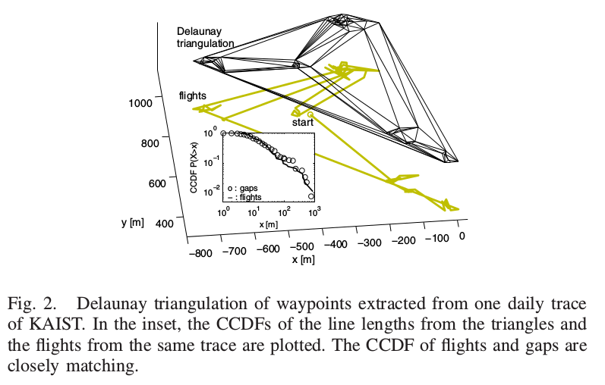
Fractal points and power-law gaps
Fractal points over one dimensional space induce power-law gaps.

Slide 10
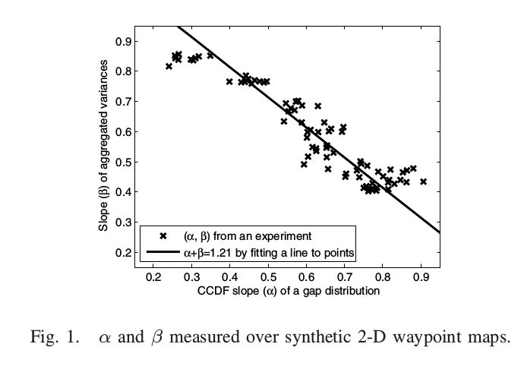

Slide 11
Least-Action trip planning
We always try to minimize the traveling distance.
If we are given a-priori multiple destinations, we strive to minimize the total distance by first visiting the nearby locations before visiting farther ones.

Slide 12
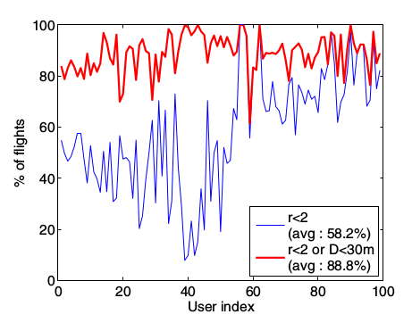
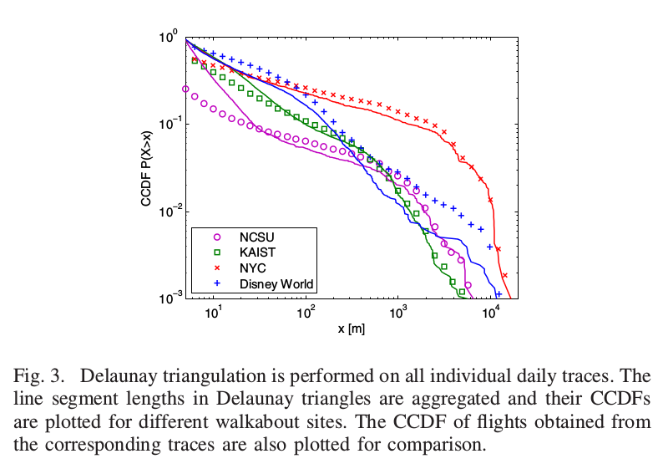
Do real human traces follow the least action principle

Slide 13
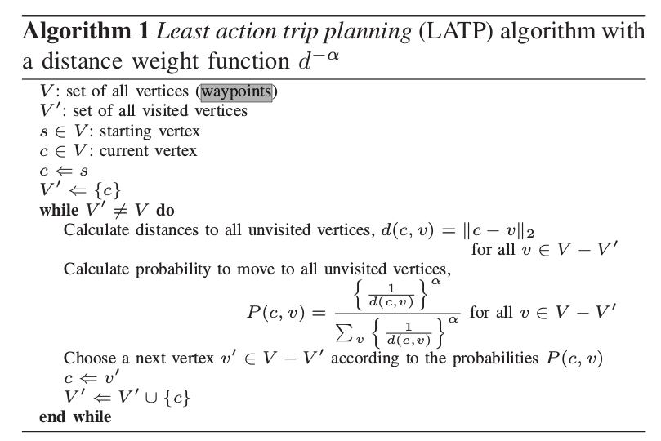

Slide 14
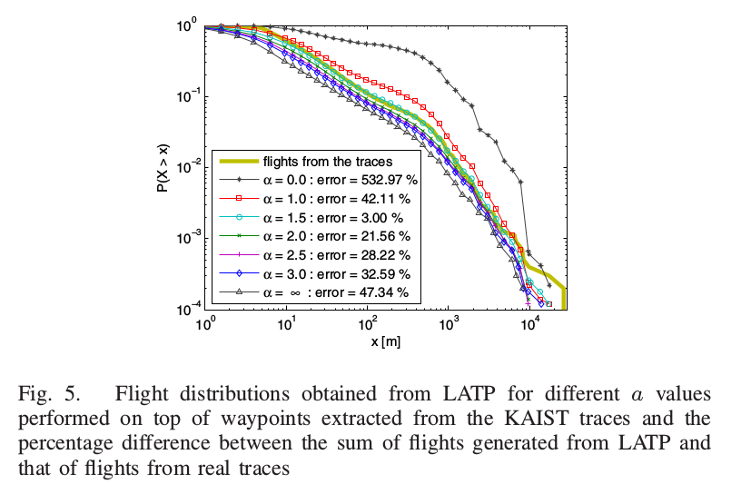
Flight distributions obtained for various values of α

Slide 15
Individual walker model
W -> set of way points
S -> input area
model selects a subset of W and specifies the order in which those selected way points are traversed.

Slide 16
The algorithm
First build clusters of waypoints by transitively connecting waypoints within a radius of 100 mts. Cluster set is denoted by C={c_{i},i=1,n} c_{i} is the number of waypoints.
If T is the total number of waypoints then assign a weight |c_{i}|/T to each cluster.
Each walker chooses 3 to 5 clusters randomly based on the weights.

Slide 17
The walker then chooses 5 to 10% of waypoints from each of these clusters randomly
It then selects a starting from these set of waypoints.
To add randomness it selects randomly one new cluster and then selects 5 to 10% of waypoints from this new cluster.

Slide 18
Each day the walker makes a round trip visiting all the selected waypoints using LATP.
It uses a truncated power-law pause-time distribution to decide the amount of time to stay at each point.

Slide 19
Simulations
50 nodes are simulated for 200 hours
The speed of every user is set to 1m/s
The pause time varies between 30 secs to 700 mins

Slide 20
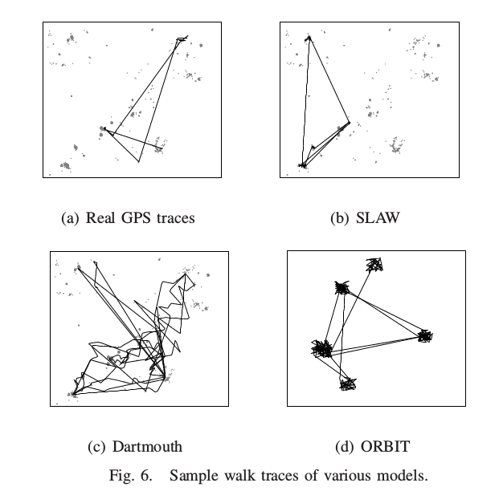
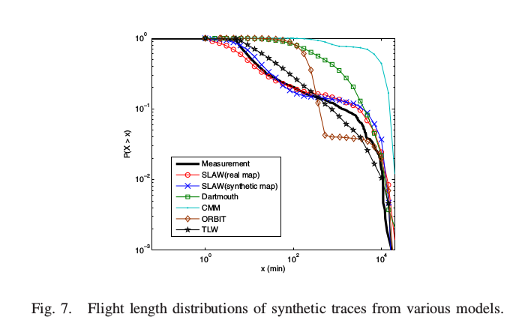
Experimental validation

Slide 21
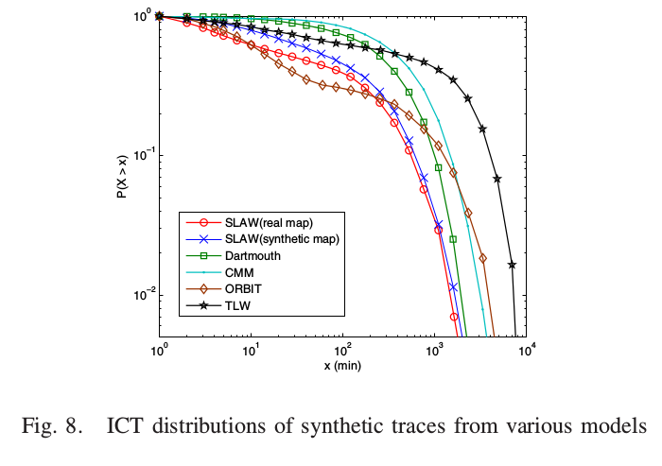
ICT distributions

Slide 22
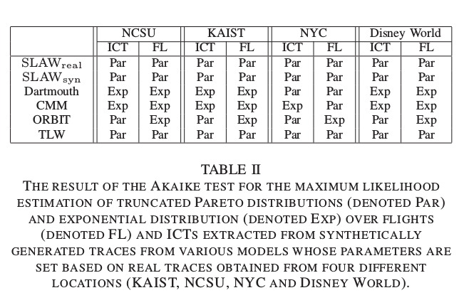
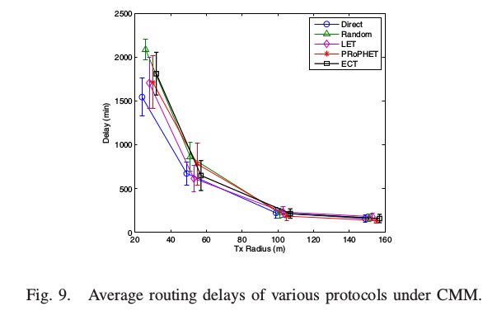
Results

Slide 23
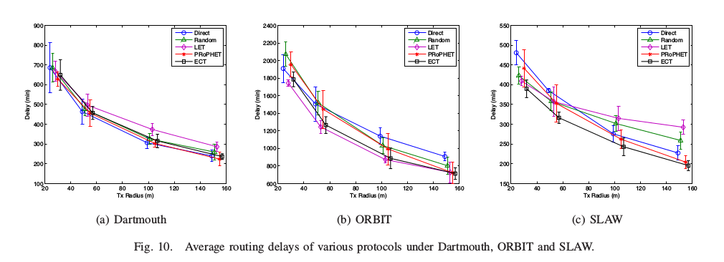
Routing delays

Slide 24
Thank you

