Slide 1
TagSense: A Smartphone-based Approach to Automatic Image Tagging
Notes:
1.TagSense: a mobile
phone based collaborative system that senses the people, activity, and context in a picture, and merges them carefully to
create tags on-the-ﬂy.
2. TagSense is an attempt
to embrace additional dimensions of sensing

Slide 2
Overview
Introduction
Scope
System Overview
Design and Implementation
Performance Evaluation
Limitations
Future of TagSense

Slide 3
Introduction
sensor-assisted tagging.
tags are systematically organized into a “when-where-who-what” format.
better than image processing/face recognition???
Challenges faced?
Identify individuals in the picture.
mine the gathered sensor data.
energy-budget

Slide 4
Contributions
Envisioning an alternative, out-of-band opportunity towards automatic image tagging.
Designing TagSense, an architecture for coordinating the mobile phone sensors, and processing the sensed information to tag images.
Implementing and evaluating TagSense on Android phones.

Slide 5
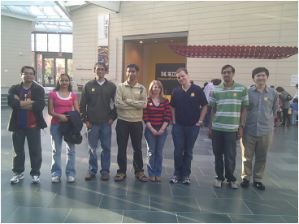
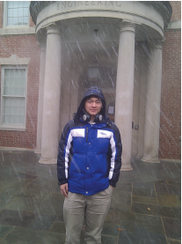
Picture 1: November 21st afternoon, Nasher Museum, in-door, Romit, Sushma, Naveen, Souvik, Justin, Vijay,Xuan, standing, talking.
Picture 2: December 4th afternoon, Hudson Hall, out-door, Xuan, standing, snowing.

Slide 6
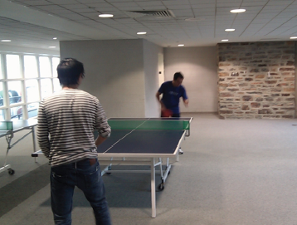
Picture 3: November 21st noon, Duke Wilson Gym, indoor,Chuan, Romit, playing, music.
Tags extracted using Location services, light-sensor readings, accelerometers and sound.
TagSense tags each picture with the time, location, individual-name, and basic activity.

Slide 7
Scope of TagSense
TagSense requires the content in the pictures to have an electronic footprint that can be captured over at least one of the sensing dimensions.
Images of objects (e.g., bicycles, furniture, paintings), of animals, or of people without phones, cannot be recognized.
TagSense narrows down the focus to identifying the individuals in a picture, and their basic activities.

Slide 8
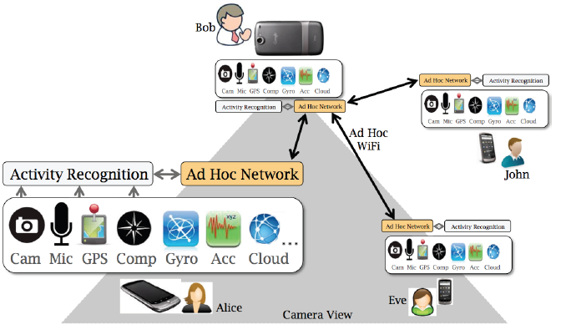
System Overview
TagSense architecture – the camera phone triggers sensing in participating mobile phones and gathers the sensed information. It then determines who is in the picture and tags the picture with the people and the context.

Slide 9
SYSTEM OVERVIEW
the application prompts the user for a session password.
password acts as a shared session key.
Phone to phone communication is performed using the WiFi ad hoc mode.
phones perform basic activity recognition on the sensed information, and send them back.

Slide 10
Mechanisms
Pause signature from the accelerometer readings.
compass directions
multiple snapshots.

Slide 11
Design and implementation
Who are in the picture
What are they doing
Where is the picture taken
When is the picture taken

Slide 12
Who are in the picture?
Accelerometer based motion signatures
Complementary compass directions
Moving objects
Combining the opportunities

Slide 13
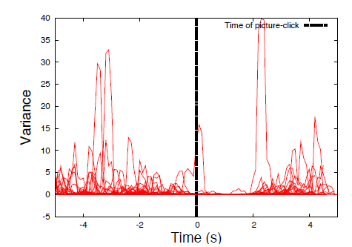
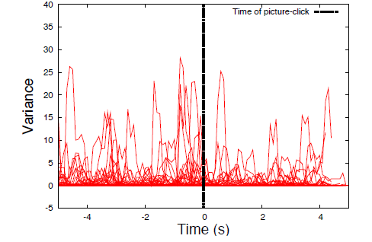
Accelerometer based motion signatures
subjects of the picture often move into a specific posture in preparation for the picture, stay still during the picture click, and then move again to resume normal behavior.

Slide 14
Complementary compass directions
Posing signature may be a sufficient condition but is obviously not necessary.
people in the picture roughly face the direction of the camera, and hence, the direction of their compasses will be roughly complementary to the camera’s facing direction.
User and phone may not be facing the same direction.
UserFacing=(CameraAngle + 180) mod 360
PCO=((UserFacing + 360) - CompassAngle) mod360

Slide 15
Periodically recalibrates the PCO
If TagSense identifies Alice in a picture due to her posing signature, her PCO can be computed immediately.
In subsequent pictures, even if Alice is not posing, her PCO can still reveal her facing direction, which in turn identifies whether she is in the picture
This can continue so long as Alice does not change the orientation of her phone

Slide 16
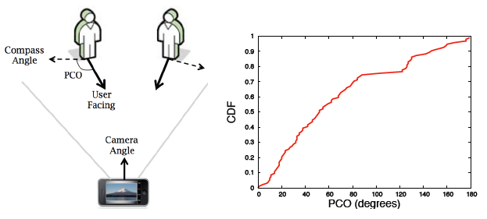
Figure 4: (a) Personal Compass Offset (PCO) (b) PCO distribution from 50 pictures where subjects are facing the camera. PCO calibration is necessary to detect people in a picture using compass.

Slide 17
Moving Subjects
The essential idea is to take multiple snapshotsfrom the camera, derive the subject’s motion vector from these snapshots, and correlate it to the accelerometer measurementsrecorded by different phones.
The accelerometer motion that matches best with the optically derived motion is deemed to be in the picture

Slide 18
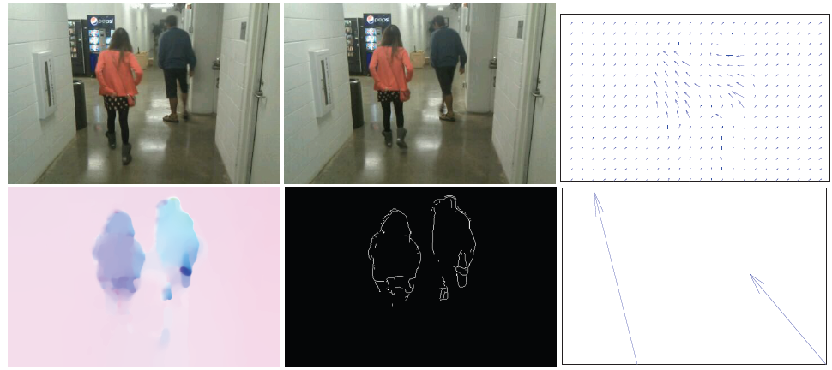
Figure 5: Extracting motion vectors of people from two successive snapshots in (a) and (b): (c) The optical flow field showing the velocity of each pixel; (d) The corresponding color graph; (e) The result of edge detection; (f) The motion
vectors for the two detected moving objects.

Slide 19
Velocity of each pixel is computed by performing a spatial correlation across two snapshots. (Optical flow)
the average velocity for the four corner pixels are computed, and subtracted from the object’s velocity-compensates for jitter.
Color of each pixel is redefined based on velocity.
Edge-finding algorithm identifies the objects in the picture.
the average velocity of one-third of the pixels, located in the center of each object, is computed and returned as the motion vectors of the people in the picture.
TagSense assimilates the accelerometer readings from different phones and computes their individual velocities
TagSense then matches the optical velocity with each of the phone’s accelerometer readings.

Slide 20
Combining the opportunities
First search for the posing signature and compute the user's facing direction.
If present the person is deemed to be present in the picture and her PCO is caibrated.
In the absence of the posing signature check whether the person is reasonably static
If so and her facing direction makes less than 45º , name is added to the tag.
If the person is not static compute the pictures's optical motion vectors and correlate with accelerometer/compass readingss.

Slide 21
Discussion
Cannot pinpoint people in a picture
cannot identify kids in a picture
compass based method assumes people are facing the camera.

Slide 22
What are they doing
Accelerometer: Standing, Sitting, Walking, Jumping, Biking, Playing.
Acoustic: Talking, Music, Silence.

Slide 23
Where is the picture taken
Place - derived from the GPS coordinates
Indoor/Outdoor-light sensor on the phone
Combine location information and phone compass to tag picture backgrounds.

Slide 24
When is the picture taken
Time inherited from the device.
Contact internet weather service to fetch weather information.

Slide 25
Performance evaluation
Tagging People
Tagging activities and context
Tab based image search

Slide 26
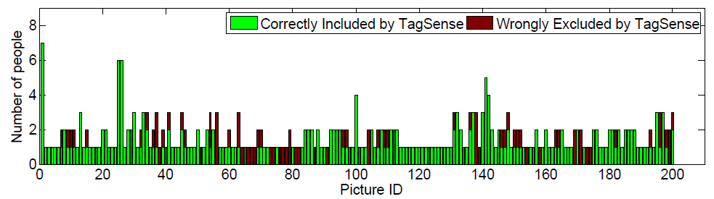
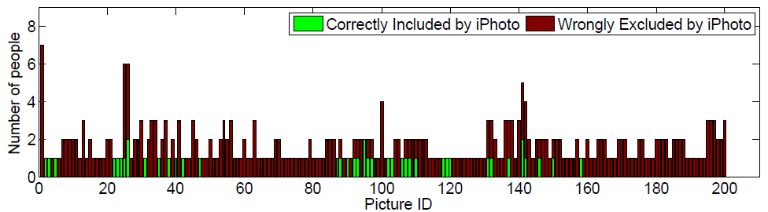
Tagging People

Slide 27
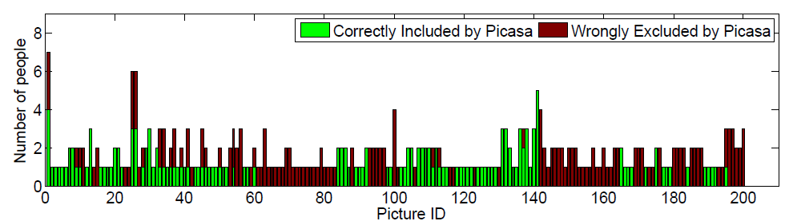
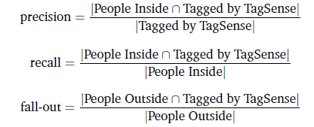

Slide 28
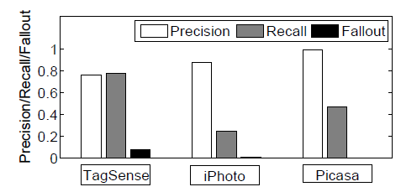
Overall Performance
Figure 10: The overall precision of TagSense is not as high as iPhoto and Picasa, but its recall is much better, while their fall-out is comparable

Slide 29
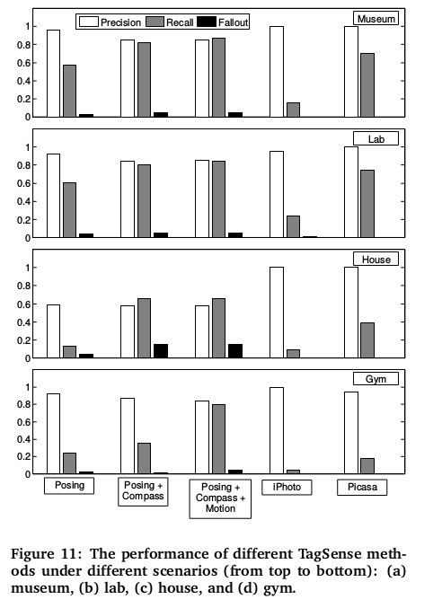
Method-wise and Scenerio-wise performance

Slide 30
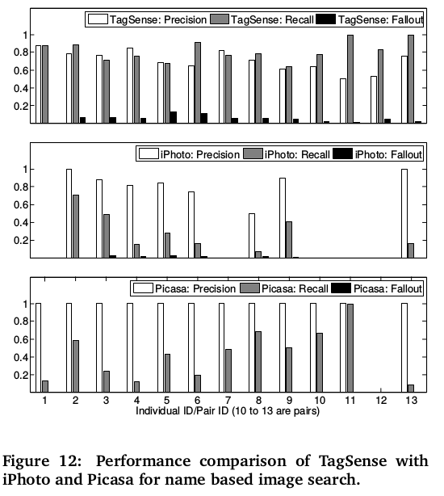
Searching images by name

Slide 31
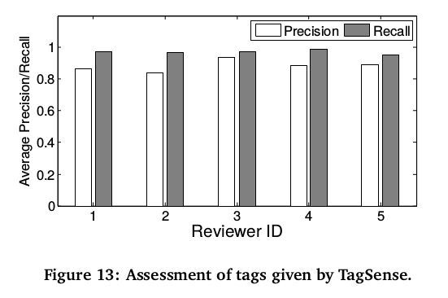
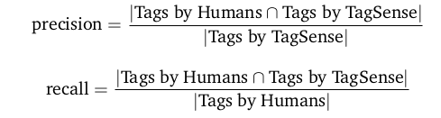
Tagging activities and Context

Slide 32
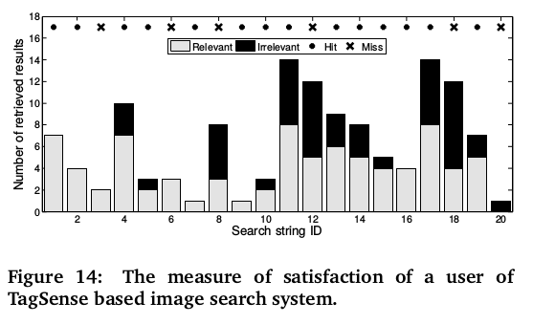
Tag based image search

Slide 33
LIMITATIONS OF TAGSENSE
TagSense vocabulary of tags is quite limited.
TagSense does not generate captions.
TagSense cannot tag pictures taken in the past.
TagSense requires users to input a group password at the beginning of a photo session.

Slide 34
FUTURE OF TAGSENSE
Smartphones are becoming context-aware with personal sensing.
The granularity of localization will approach a foot.
Smartphones are replacing point and shoot cameras.

Slide 35
Conclusion
Mobile phones are becoming inseparable from humans and are replacing traditional cameras.
TagSense leverages this trend to automatically tag pictures with people and their activities.
TagSense has somewhat lower precision and comparable fall-out but significantly higher recall than iPhoto/Picasa.

