Slide 1
Accuracy Characterization of Cell Tower Localization
Jie Yang†, Alexander Varshavsky‡, Hongbo Liu†, Yingying Chen†, Marco Gruteser♯

Slide 2
Data Description
We obtained access to a wardriving trace that covers three areas in the greater Los Angeles area.
The Downtown trace covers an area of 3.5km×4.2km in the downtown Los Angeles.
The Residential trace covers an area of 6.3km×17km in the southern part of the Los Angeles County.
The Rural trace covers an area of 35.4km×36km in the Victor Valley of San Bernardino County.

Slide 3
Data Description
The wardriving trace was collected over a period of 2 months in February and March of 2009.
The GSM signal strength measurements and their locations were recorded every 2 seconds and the speed of the car averaged about 32kmph.
In total, we have 2,613,465 received signal strength (RSS) readings from 105,271 unique locations, resulting, on average, in 24.8 RSS readings from different cells per location.
Each cell tower has 2, 3 or 6 cells attached to it, depending on the characteristics of the area and the coverage requirements.
We know which cells belong to which cell tower and the actual location of each cell tower.

Slide 4
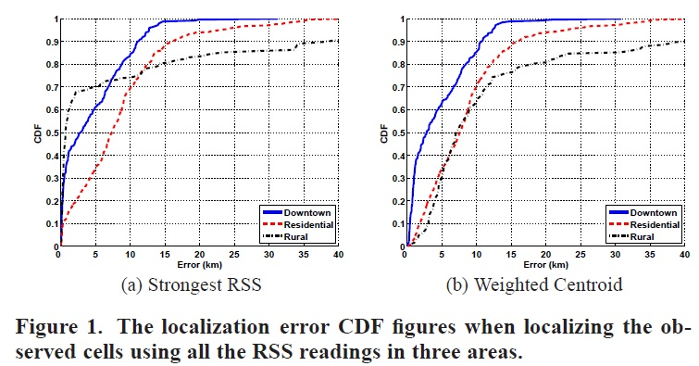

Slide 5
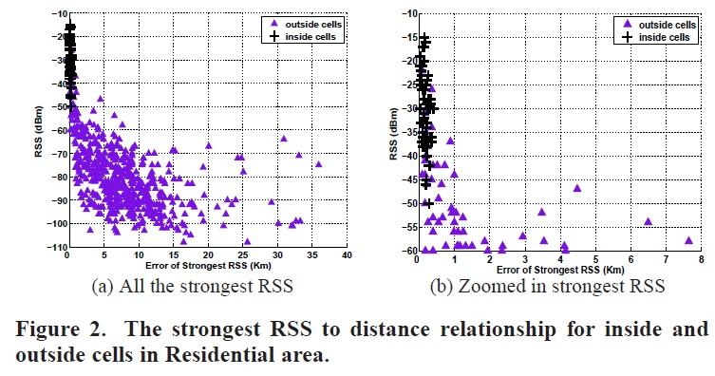

Slide 6
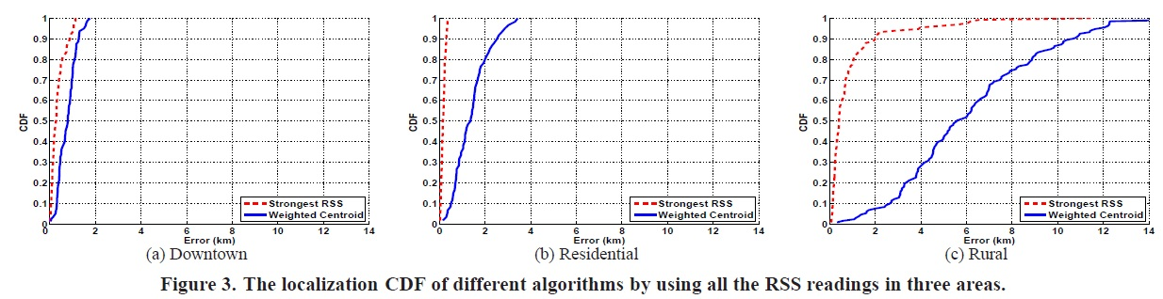

Slide 7
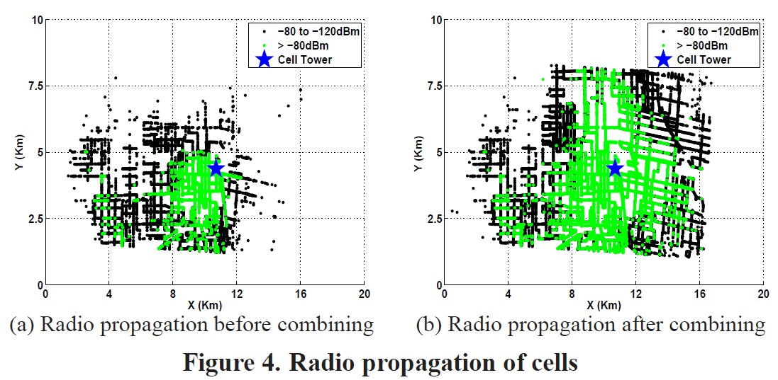

Slide 8
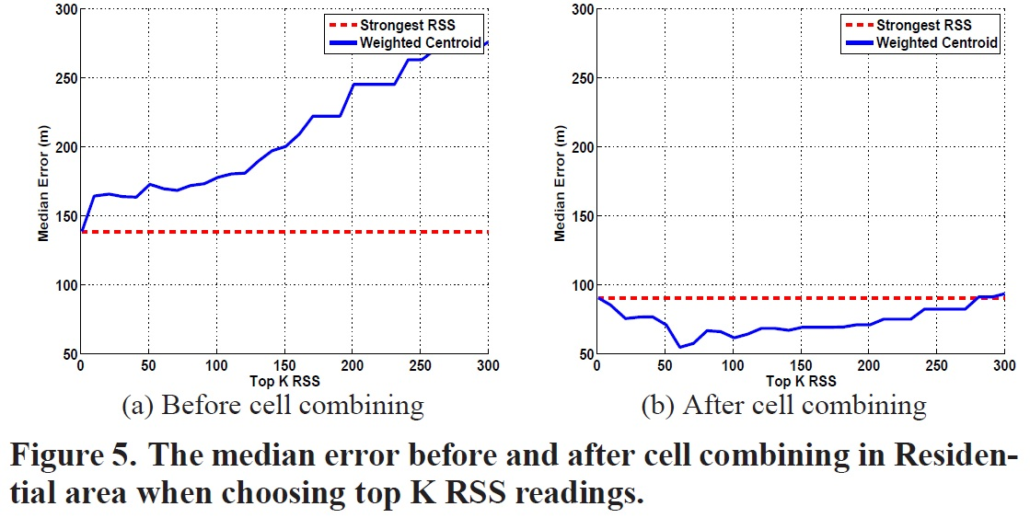

Slide 9
