Slide 1
COMBINE:Leveraging the power of wireless peers through Collaborative downloading
Ganesh A. et. al.

Slide 2
Introduction
Mobile devices are equipped with multiple wireless network interfaces
WLAN interaces.(802.11,Bluetooth)
WWAN interfaces.(GPRS)
WLAN offers much higher speeds than WWAN

Slide 3
COMBINE
A system for collaborative downloading that uses both WLAN and WWAN in combination in an attempt to bridge the range-speed dichotomy
Nodes in close vicinity use high speed WLAN to discover each other,form collaborative group and stripe traffic across the WWAN links.
increases effective WAN download speed,

Slide 4
Contributions
Cost modeling
By contributing its WWAN bandwidth for the benefit of other peers, a node both monetary and energy cost which needs to be accounted for.
Accounting
The cost computed forms the basis of a market wherein nodes buy and sell WWAN bandwidth resources. Need to keep track of the credits earned or debits incurred.
Collaboration group formation
Striping protocol
a workload distribution algorithm to farm out work across the participants in the collaboration group

Slide 5
Overview
Setting
A requester seeks to utilize the WWAN links of one or more collaborators.
A collaborator contributes its WWAN bandwidth only when it is not in use.
need for incentives
Each collaborator estimates its cost of providing help and communicates it to the initiator.
Initiator compares the bids from the collaborators and chooses the best one and proceed to form a collaboration group.
COMBINE includes accounting mechanism where initiator issues signed IOUs to the collaborators.

Slide 6
Once a collaboration group is formed COMBINE uses a work-queue algorithm to distribute work across collaborators.
COMBINE uses HTTP byte-range requests to stripe traffic across multiple WAN links.

Slide 7
Modeling cost
Appropriately model the cost of sharing bandwidth so that the offered price ishigh enough to compensate the collaborator but not high enough to be unattractive to the initiator.
Two principal costs that a collaborator incurs
cost of transferring data on the WWAN link.
depends on the tariff structure imposed by the service
opportunity cost of expending battery energy on behalf of a peer

Slide 8
Unifying monetary and energy cost
Both energy and money are valuable resources but are quantified in different units that need to be reconciled.
Opportunity cost would be lower for a user who is idling compared to a user who needs to use the device at any cost.
modeled as the function of the fraction of battery energy remaining (BR)
Monetary cost (MC) of performing a data transfer is unified with the opportunity cost and toatal cost TC is expressed as MC/BR

Slide 9
Estimating battery depletion
battery depletion (BD)
BD=(time_elapsed*BD_{t})+(bytes_sent_or_recd*BD_{d})
energy characteristics of WLAN and WWAN are likely to be different.
BD=(time_elapsed*BD_{t})+(bytes_sent_or_recd_{WLAN}*BD_{d_WLAN})+(bytes_sent_or_recd_{WWAN}*BD_{d_WWAN})

Slide 10
Accounting
Requirements
Storing credits
Cheat-proof
Privacy
Flexibility
Efficiency

Slide 11
Accounting in COMBINE
Central authority
issues public/private key pairs upon presentation of a proof of identity.
Accounting server
keeps track of credits/debits accrued by each user.
If an initiator finds the a collaborator's bid to be acceptable,it initiates the process of having the collaborator download content for it
Initiator issues a signed note of credit termed an IOU
The collaborator transmits the IOUs to the accounting server for redemption.
IOU={key_{pub},amount,h(x),seq,exp,sign_{kpriv}}

Slide 12
Group formation algorithm
Each node i periodically wakes up its WLAN card and broadcast I-am-alive message which includes-
TC_{i}- cost of downloading one unit of data
B_{i}- WWAN speed it can offer
On receiving a an I-am-alive message the initiator responds with a CCHECK message containing-
The URL of the file that needs to be downloaded
The time after which it will reply to the node with a collaboration acknowledgement.
On receiving CCHECK, the device checks its local cache for the URL mentioned in the message and if it is there and up-to-date then it informs the initiator of the availability.
Initiator evaluates all the I-am-alive message and selects the group of collaborators.
Initiator sends out CACK message to all selected collaborators

Slide 13
Group selection criteria
Assume the user wants to download a file of size F and he is willing to incur a cost of C to do so.
Threshold-based group selection:
Initiator calculates TC' = C/F
All nodes whose bids contain TC value less than TC' are selected and sorted in descending order and the first n nodes are selected.
Opportunistic group selection
each collaborator i, working in parallel, downloads x_{i} with bandwidth B_{i}
Total ttime taken to download the file -
max(x₁/B₁,x₂/B₂,....,x_{N}/B_{N})

Slide 14
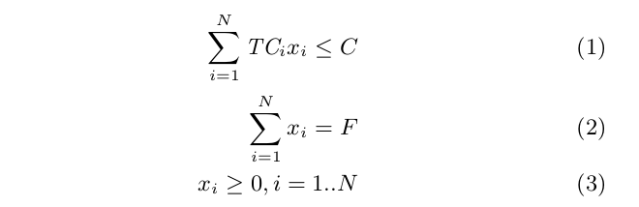
Determine optimal values of x_{i}, i=1....Nso as to minimize the total time subject to the constraints

Slide 15
Work distribution
Work-Queue algorithm
Initiator gets the total file size to be downloaded and forms a work queue with fixed equal size byte ranges of the file
Collaborators query the initiator and pick up the next available item from the work-queue, download the amount of data as specified in its work-item and return it to the initiator.
Each collaborator picks up more work when it is done with its current work item, and keeps working until the queue is empty.

Slide 16
Opportunistic algorithm
follows directly from the opportunistic group selection.
rather than solve the optimization and compute the work allocation just once for the entire file, it is solved repeatedly over smaller partitions of the file.
The initiator divides the file of size F into fixed-size partitions of size p bytes each and apportions to each partition a cost budget of (C/F )p

Slide 17
Experimental evaluation
Group formation
collaborators overload the SSID field of wi-fi beacons with cost and WWAN speed information
initiator listens to I-am-alive beacons for 4 secs
total time for group formation on average takes less than 8 secs.

Slide 18
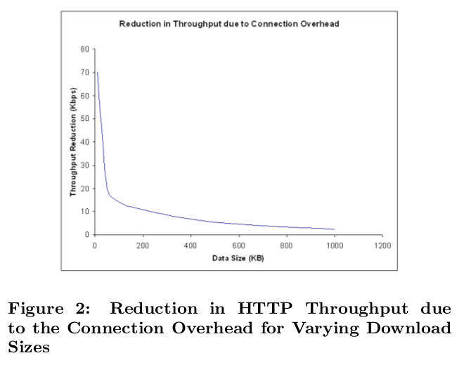
Optimal chunk size

Slide 19
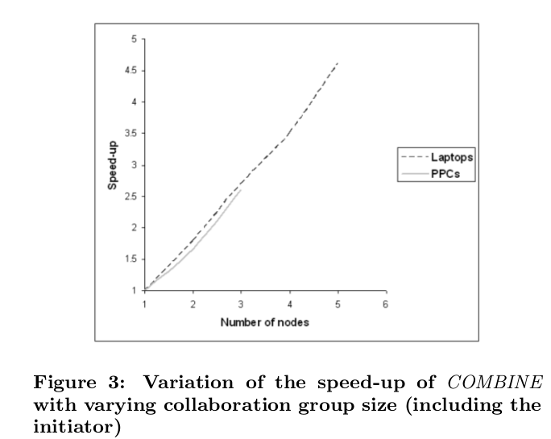
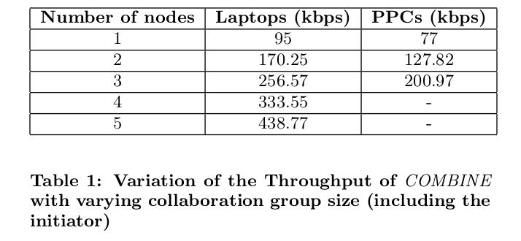
HTTP throughput and speed-up

Slide 20
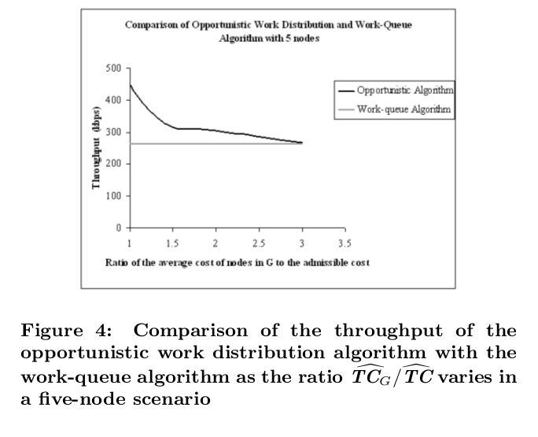
Work-queue vs Optimized work distribution

Slide 21
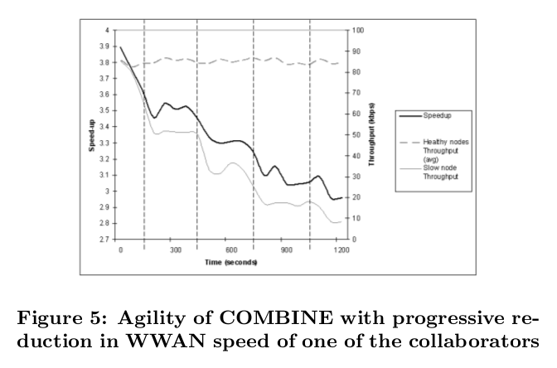
Agility and adaptation

Slide 22
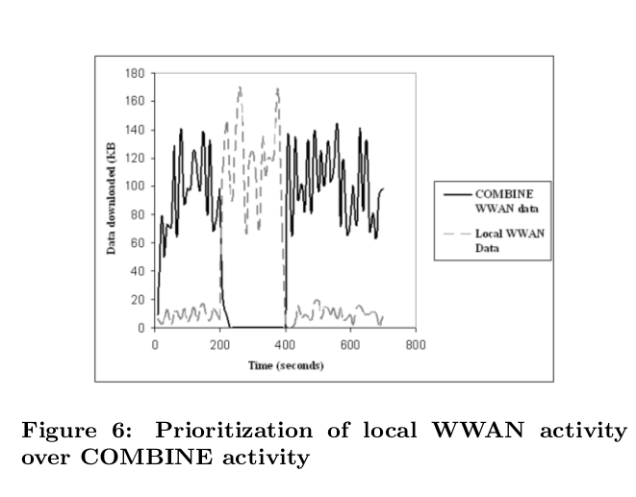

Slide 23
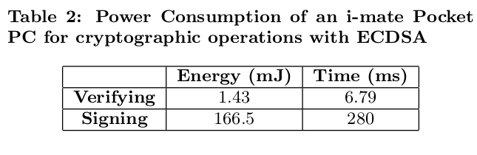
Impact of cryptography
Elliptic curve digital security algorithm(ECDSA) has better performance than RSA for mobile systems.

Slide 24
Estimation of battery depletion
estimate BD_{t} and BD_{d} using controlled calibration experiments.

Slide 25
Discussion
Security
issue of privacy
issue of confidentiality
ensuring authenticity
User interface
WWAN service providers

