Slide 1
COMBINE:Leveraging the power of wireless peers through Collaborative downloading
Mobisys '07

Slide 2
Introduction
Mobile devices are equipped with multiple wireless network interfaces
  WLAN interaces.(802.11,Bluetooth)
  WWAN interfaces.(GPRS)
WLAN offers much higher speeds than WWAN

Slide 3
COMBINE
A system for collaborative downloading that uses both WLAN and WWAN in combination in an attempt to bridge the range-speed dichotomy
Nodes in close vicinity use high speed WLAN to discover each other,form collaborative group and stripe traffic across the WWAN links.
  increases effective WAN download speed,

Slide 4
Contributions
Cost modeling
  By contributing its WWAN bandwidth for the benefit of other peers, a node both monetary and energy cost which needs to be accounted for.
Accounting
  The cost computed forms the basis of a market wherein nodes buy and sell WWAN bandwidth resources. Need to keep track of the credits earned or debits incurred.
Collaboration group formation
Striping protocol
  a workload distribution algorithm to farm out work across the participants in the collaboration group

Slide 5
Overview
Setting
  A requester seeks to utilize the WWAN links of one or more collaborators.
  A collaborator contributes its WWAN bandwidth only when it is not in use.
  need for incentives
Each collaborator estimates its cost of providing help and communicates it to the initiator.
Initiator compares the bids from the collaborators and chooses the best one and proceed to form a collaboration group.
  COMBINE includes accounting mechanism where initiator issues signed IOUs to the collaborators.

Slide 6
In the process of exchanging bids, a key challenge is doing this is in energy-efficient manner. (low-power (bluetooth) + periodic wakeups).
Once a collaboration group is formed COMBINE uses a work-queue algorithm to distribute work across collaborators.
COMBINE uses HTTP byte-range requests to stripe traffic across multiple WAN links.

Slide 7
Modeling cost
Appropriately model the cost of sharing bandwidth so that the offered price is high enough to compensate the collaborator but not high enough to be unattractive to the initiator.
Two principal costs that a collaborator incurs
  cost of transferring data on the WWAN link.
    depends on the tariff structure imposed by the service
    (assumed – uniform rate per unit time)
  opportunity cost of expending battery energy on behalf of a peer

Slide 8
Unifying monetary and energy cost
Both energy and money are valuable resources but are quantified in different units that need to be reconciled.
Opportunity cost would be lower for a user who is idling compared to a user who needs to use the device at any cost.
  modeled as the function of the fraction of battery energy remaining (BR)
Monetary cost (MC) of performing a data transfer is unified with the opportunity cost and total cost TC is expressed as MC/BR

Slide 9
Estimating battery depletion
battery depletion (BD)
BD=(time_elapsed*BD_{t})+(bytes_sent_or_recd*BD_{d})
energy characteristics of WLAN and WWAN are likely to be different.
Both the NICs are on when BD_t is calculated
BD=(time_elapsed*BD_{t})+(bytes_sent_or_recd_{WLAN}*BD_{d_WLAN})+(bytes_sent_or_recd_{WWAN}*BD_{d_WWAN})
The value obtained through multi-variate equation.

Slide 10
Accounting
Requirements
  Storing credits
  Initiator immediately cannot return favor.
  real-time tit-for-tat scheme as BitTorrent would not work
  Cheat-proof
  Initiator should not cheat
  Privacy
  Initiator collaborator should not know each other
  Flexibility
    Real money or artificial money
  Efficiency

Slide 11
Accounting in COMBINE
Central authority
  issues public/private key pairs upon presentation of a proof of identity.
Accounting server
  keeps track of credits/debits accrued by each user.
If an initiator finds a collaborator's bid to be acceptable, it initiates the process of having the collaborator download content for it
Initiator issues a signed note of credit termed an IOU
The collaborator transmits the IOUs to the accounting server for redemption.
IOU={key_{pub},amount,h(x),seq,exp,sign_{kpriv}}

Slide 12
Accounting in COMBINE
At the start of the session thecollaborator sends a nonce with a one-way hash function
IOU={key_{pub}, amount, h(x), seq, exp,sign_{kpriv}}
IOU – generated by payer’s private key.

Slide 13
Refinements
Payee accumulate large number of IOU. Get it replaced by a single IOU
When Payee redeems the IOU, both Payee and Payeer gets identified to the 3rd party. Can stopped if it is exchanged with C

Slide 14
Two attacks
Identification by collaborator
Since public key gets exposed, therefore a collaborator can identify the initiator… Each initiator can be alloted a fixed number of keys
Identification by Server
IOU(A) forward to IOU(C) and exchange

Slide 15
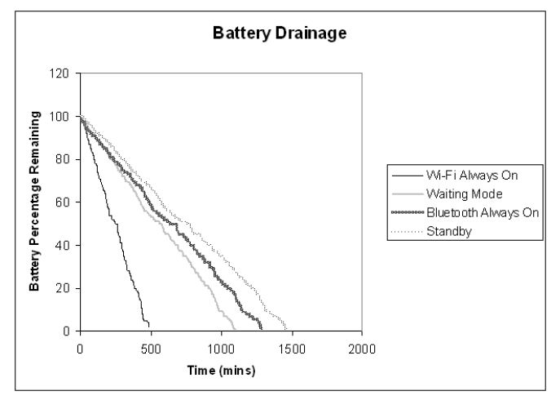
Group formation
Figure 1: Power depleted over time by an i-mate PocketPC with Bluetooth and 802.11 networks in varying power states. Standby refers to the condition where both networks are completely shutdown but the device is otherwise powered on. Wi-Fi Always On refers to the condition when the 802.11 alone is powered on. Bluetooth refers to the condition when the Bluetooth network alone is powered on. Waiting Mode refers to the condition when the 802.11 network interface alone is powered up once every 500 milliseconds and stays on for 50 milliseconds.

Slide 16
Group formation algorithm
Each node i periodically wakes up its WLAN card and broadcast I-am-alive message which includes-
  TC_{i}- cost of downloading one unit of data
  B_{i}- WWAN speed it can offer
On receiving a an I-am-alive message the initiator responds with a CCHECK message containing-
  The URL of the file that needs to be downloaded
  The time after which it will reply to the node with a collaboration acknowledgement.
  (Depending upon this the collaborator puts WLAN NIC off)
On receiving CCHECK, the device checks its local cache for the URL mentioned in the message and if it is there and up-to-date then it informs the initiator of the availability.
Initiator evaluates all the I-am-alive message and selects the group of collaborators.
Initiator sends out CACK message to all selected collaborators

Slide 17
Group Formation Algorithm
If the initiator does not receive I-am-Alive, it resets its times and starts over.

Slide 18
Group selection criteria
Assume the user wants to download a file of size F and he is willing to incur a cost of C to do so.
Threshold-based group selection:
  Initiator calculates TC' = C/F
  All nodes whose bids contain TC value less than TC' are selected and sorted in descending order and the first n nodes are selected.
Opportunistic group selection
  each collaborator i, working in parallel, downloads x_{i} with bandwidth B_{i}
  Total ttime taken to download the file -
    max(x₁/B₁,x₂/B₂,....,x_{N}/B_{N})

Slide 19
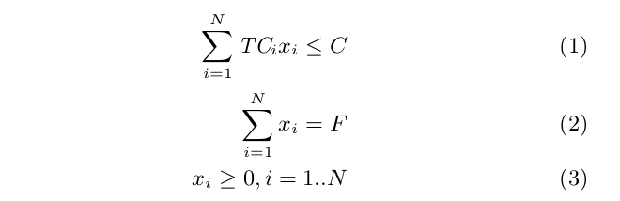
Opportunistic Group Selection
Determine optimal values of x_{i}, i=1....N so as to minimize the total time subject to the constraints

Slide 20
Work distribution
Work-Queue algorithm
  Initiator gets the total file size to be downloaded and forms a work queue with fixed equal size byte ranges of the file
  Collaborators query the initiator and pick up the next available item from the work-queue, download the amount of data as specified in its work-item and return it to the initiator.
  Each collaborator picks up more work when it is done with its current work item, and keeps working until the queue is empty.
  (can work only with threshold-based group selection)

Slide 21
Opportunistic algorithm
  follows directly from the opportunistic group selection.
  rather than solve the optimization and compute the work allocation just once for the entire file, it is solved repeatedly over smaller partitions of the file.
  The initiator divides the file of size F into fixed-size partitions of size p bytes each and apportions to each partition a cost budget of (C/F )p

Slide 22
Failure Handling and Adaptation
COMBINE seeks to utilize unused bandwidth at the collaborator’s nodes. Detect when a previously idle WWAM link has become busy
On failure – work-queue algorithm – automatically other nodes take up
Initiator estimates – and accordingly reallocates – Opportunistic algorithm

Slide 23
HTTP
ADVANTAGE – Byte Range Request processing
Session establishment – Proxy, session-level secret, limited time cookie

Slide 24
Experimental evaluation
Group formation
  collaborators overload the SSID field of wi-fi beacons with cost and WWAN speed information
  initiator listens to I-am-alive beacons for 4 secs
  total time for group formation on average takes less than 8 secs.

Slide 25
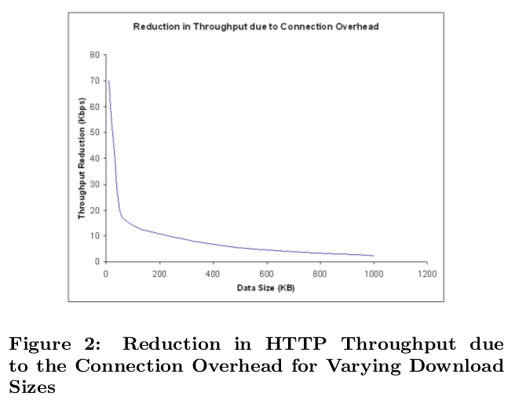
Optimal chunk size
Time taken to download without initial connection phase and total time taken

Slide 26
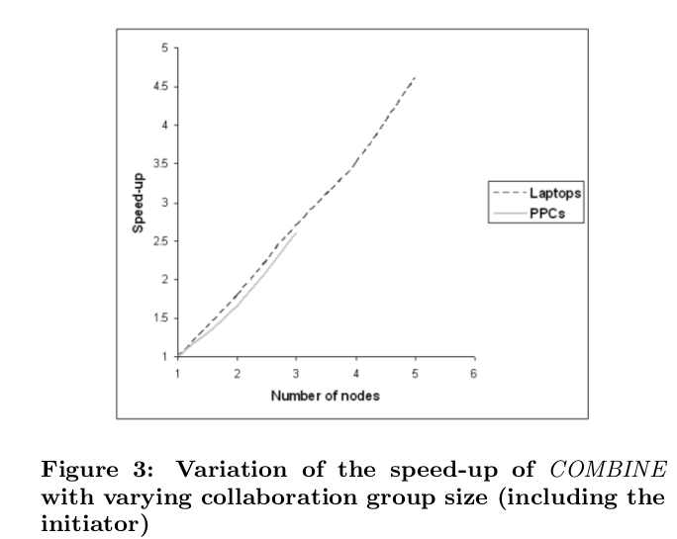
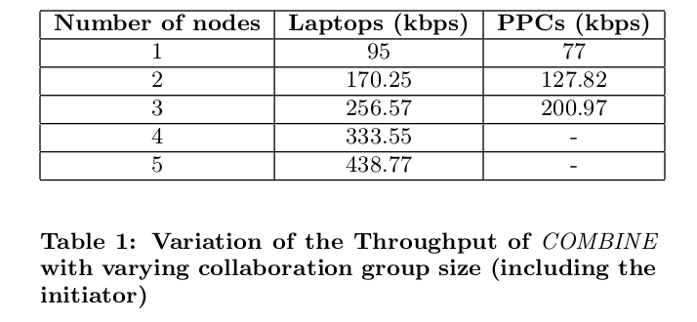
HTTP throughput and speed-up

Slide 27
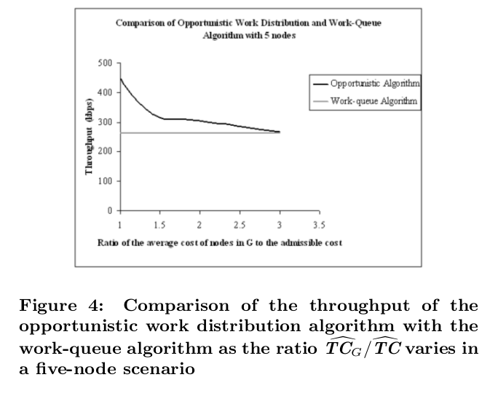
Work-queue vs Optimized work distribution
G = 1, 2

Slide 28
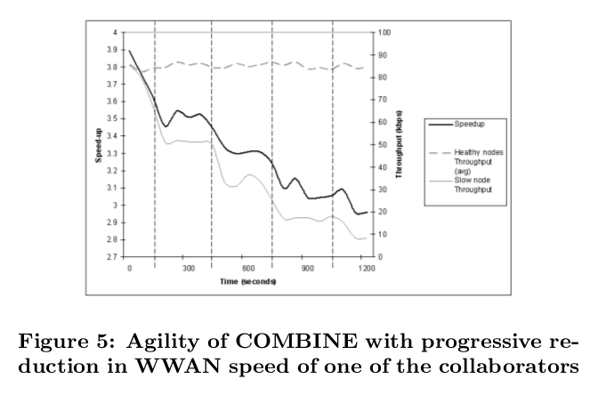
Agility and adaptation

Slide 29
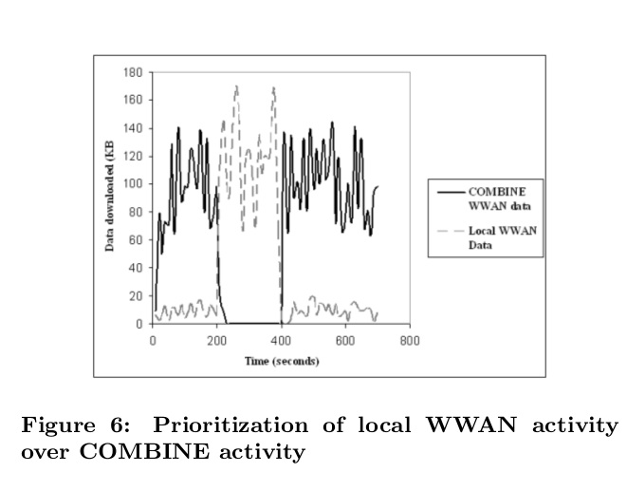

Slide 30
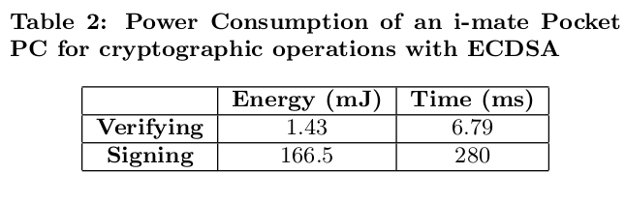
Impact of cryptography
Elliptic curve digital security algorithm(ECDSA) has better performance than RSA for mobile systems.

Slide 31
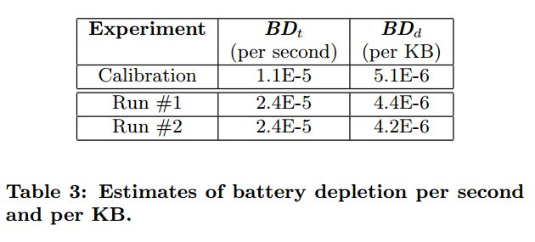
Estimation of battery depletion

Slide 32
Estimation of battery depletion
estimate BD_{t} and BD_{d} using controlled calibration experiments.

Slide 33
Discussion
Security
  issue of privacy
  issue of confidentiality
  ensuring authenticity
User interface
WWAN service providers

