Slide 1
Bartendr: A Practical Approach to Energy-aware Cellular Data Scheduling
Aaron Schulman, Vishnu Navday, Ramachandran Ramjeey, Neil Spring, Pralhad Deshpandez, Calvin Grunewald, Kamal Jain, Venkata N. Padmanabhan

Slide 2
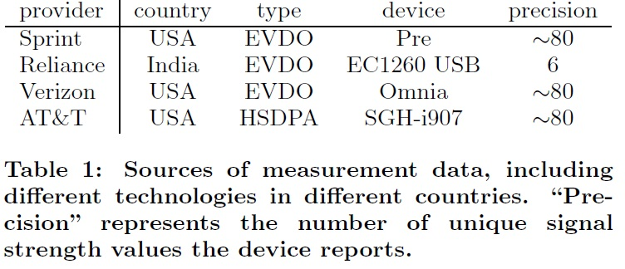

Slide 3
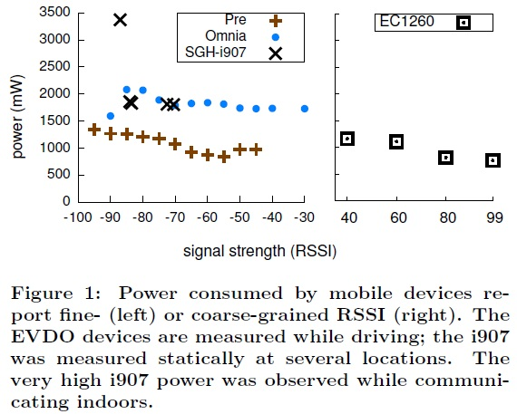

Slide 4
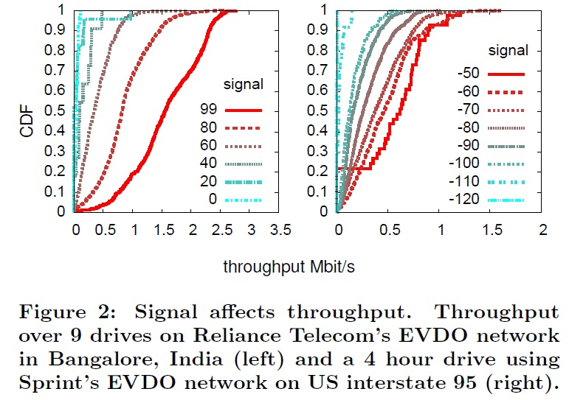

Slide 5
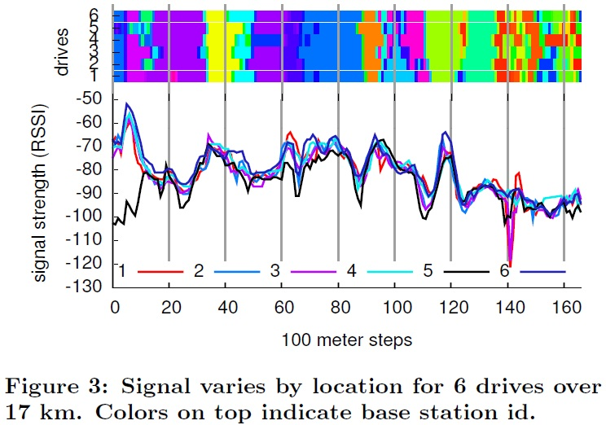

Slide 6
Figure 3 shows that the variation of the signal strength along the drive is also significant. The highest and lowest strength values are -50 and -120 RSSI and there are frequent signal strength variations between -90 and -70 RSSI.
The cost of communicating at -90 instead of at -70 RSSI entails the use of about 20% additional power (Figure 1) and a median throughput that is 50% lower (Figure 2)
This results in an energy per bit on the Pre that is 2.4 times higher at -90 RSSI compared to at -70 RSSI

Slide 7
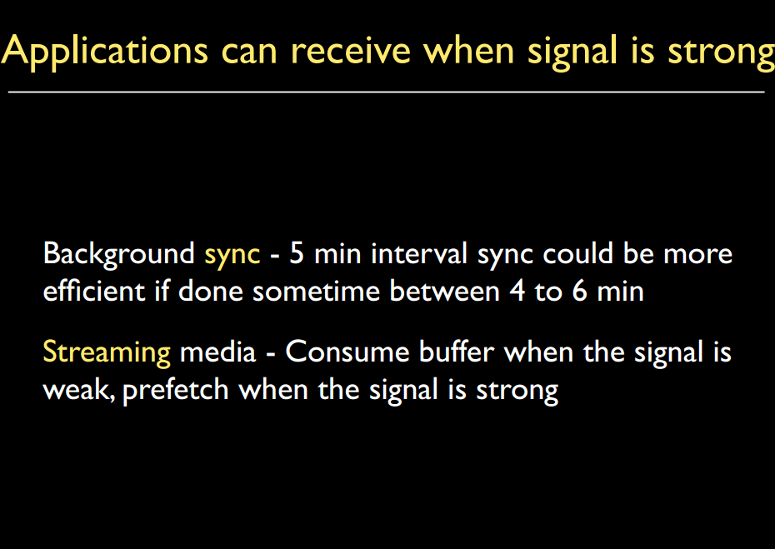

Slide 8
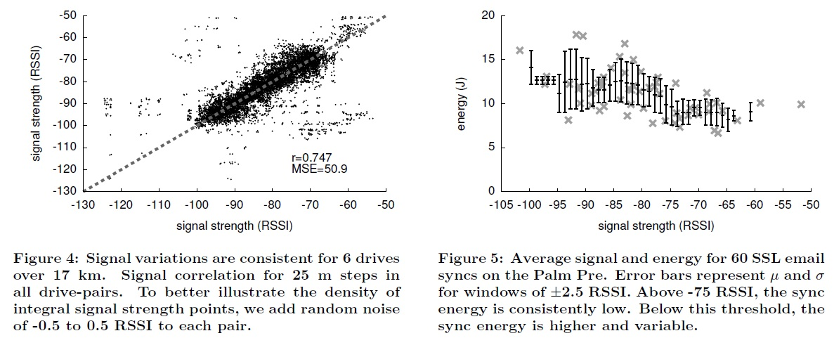

Slide 9
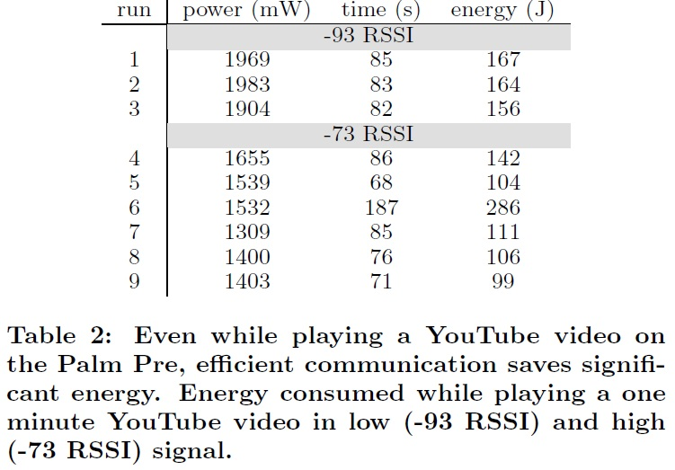

Slide 10
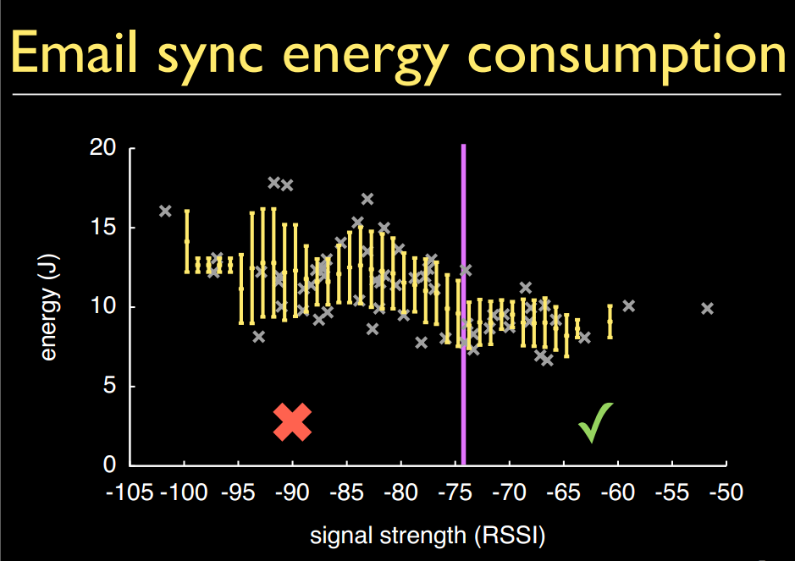

Slide 11
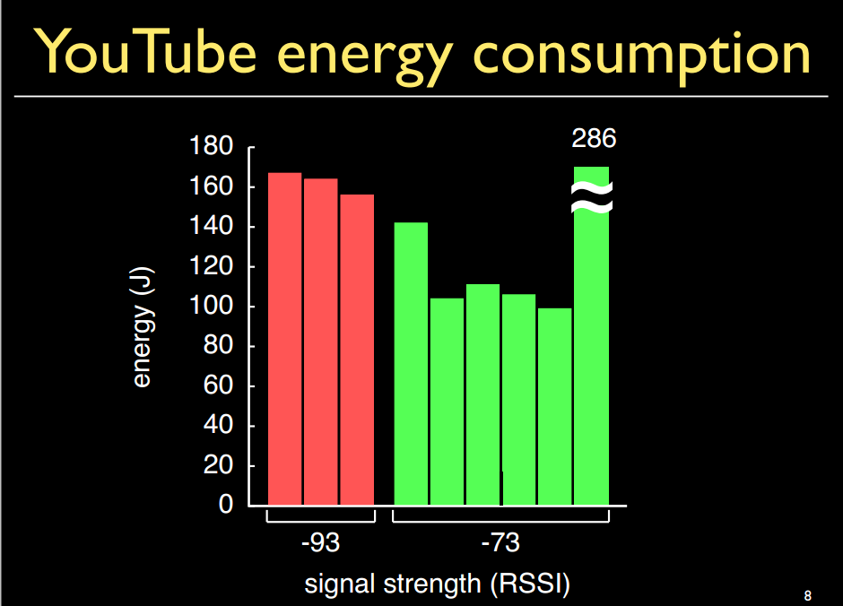

Slide 12
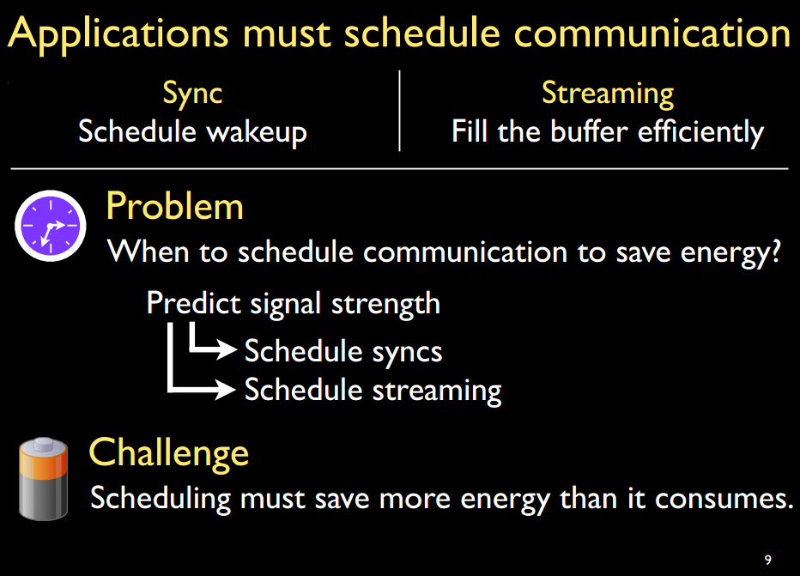

Slide 13
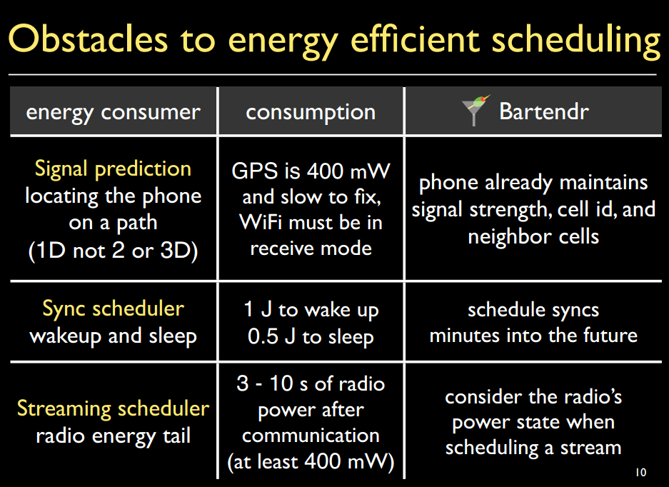

Slide 14
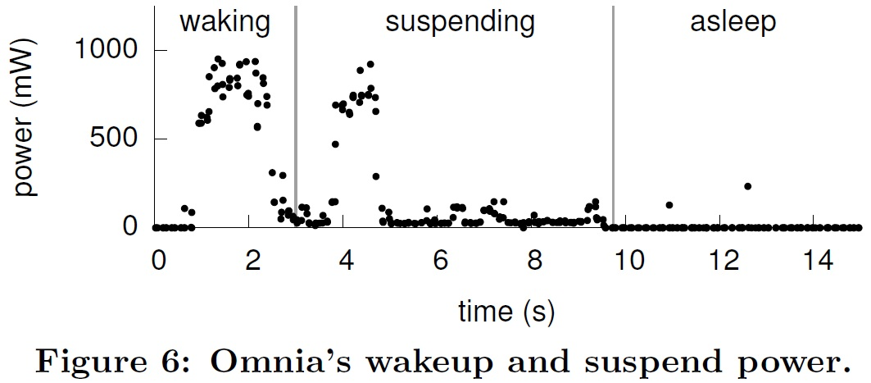

Slide 15
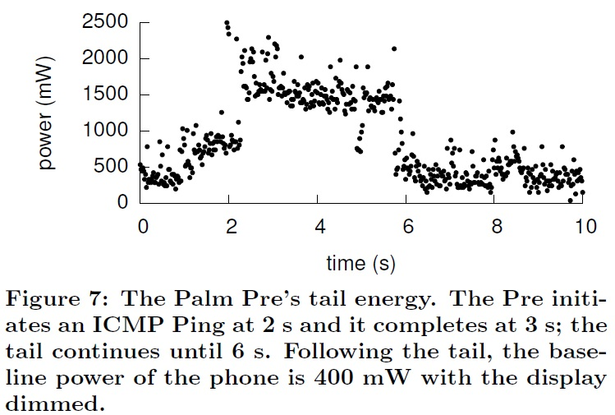

Slide 16
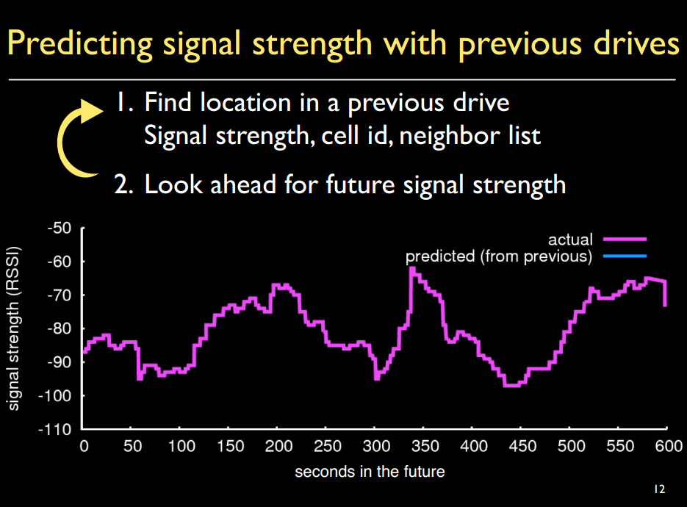

Slide 17
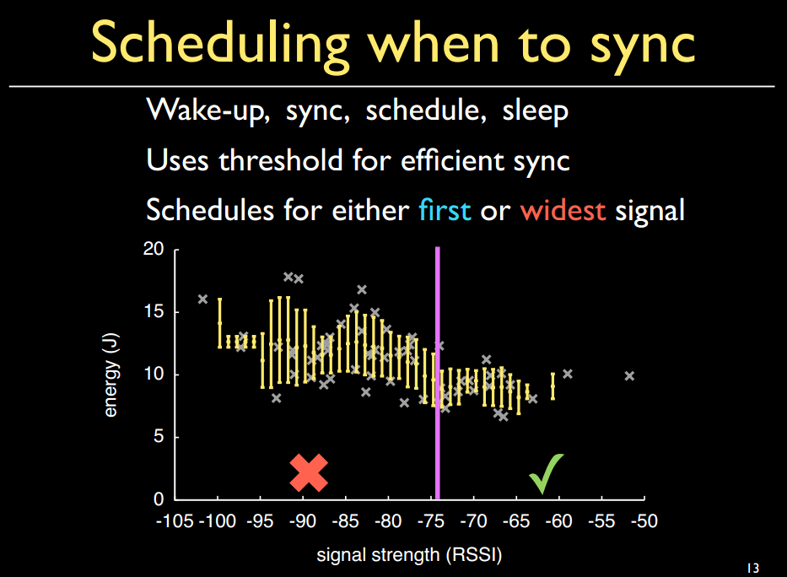

Slide 18
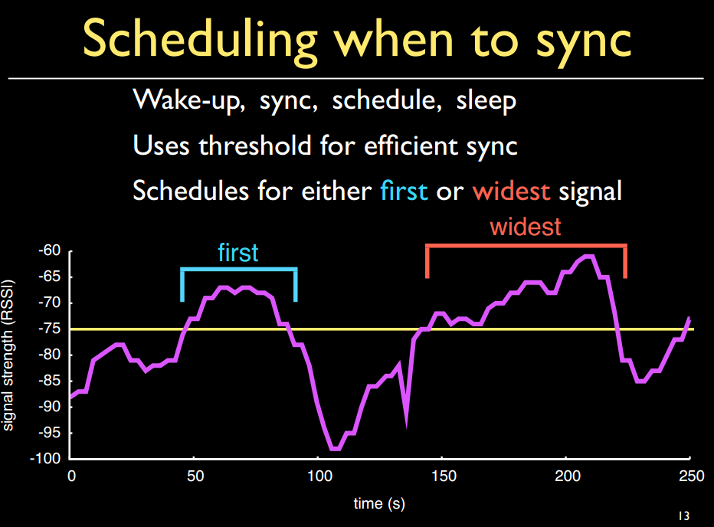

Slide 19
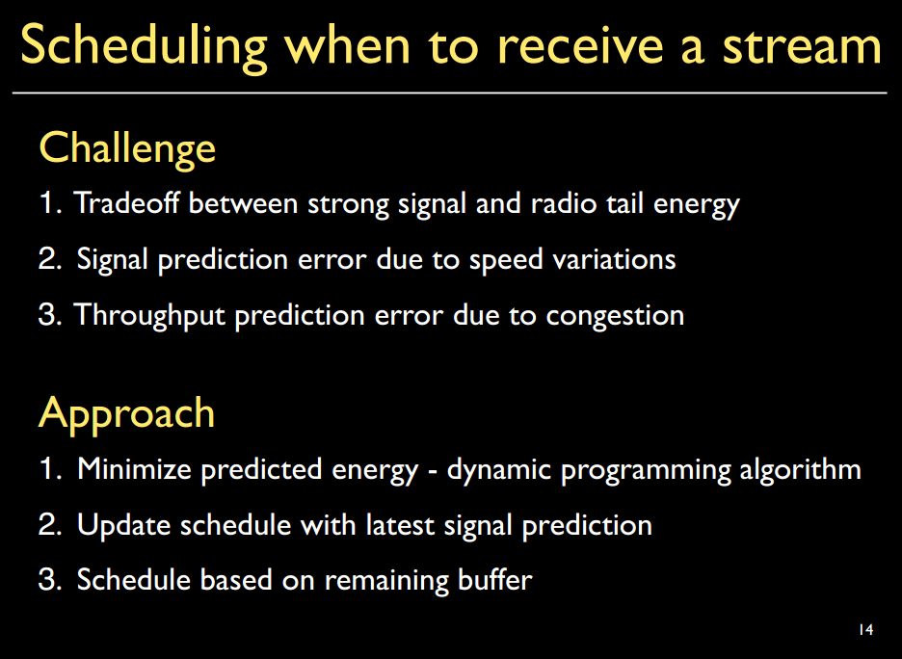

Slide 20
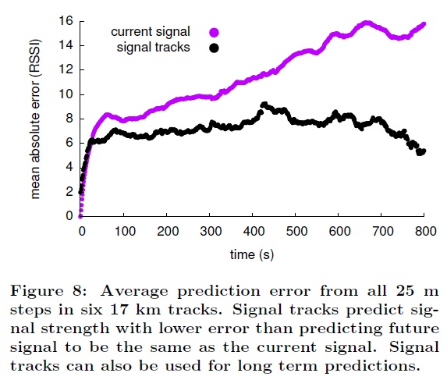

Slide 21
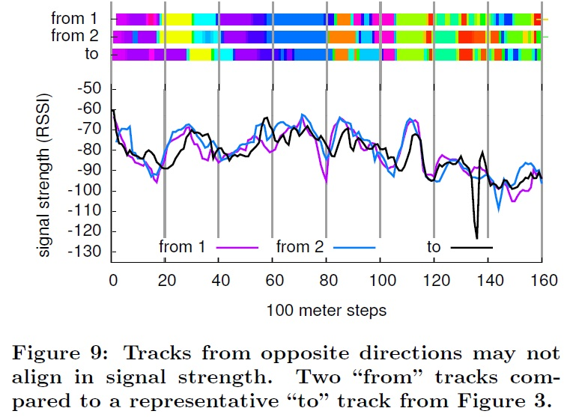

Slide 22
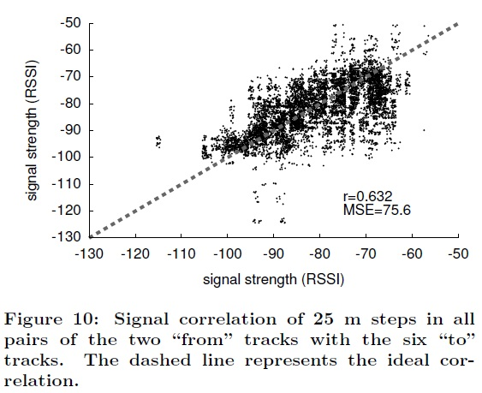

Slide 23
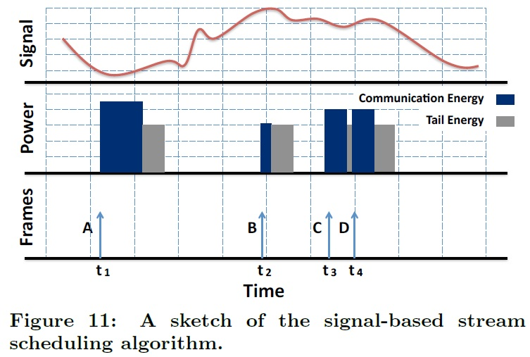

Slide 24
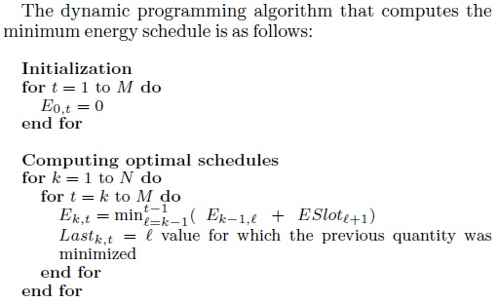

Slide 25
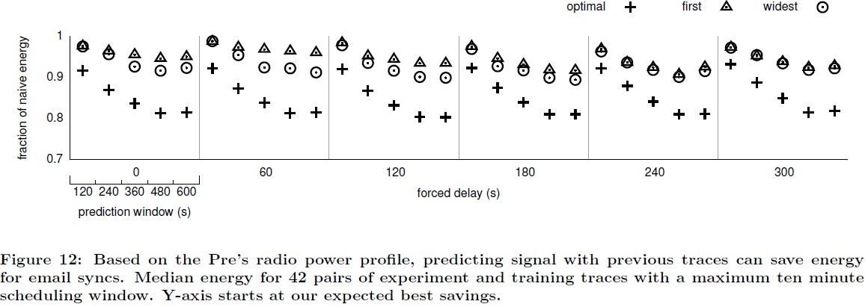

Slide 26
