Slide 1
EndRE: An End-System Redundancy Elimination Service
Bhavish Aggarwal, Aditya Akella, Ashok Anand, Athula Balachandran,
Pushkar Chitnis, Chitra Muthukrishnan, Ramachandran Ramjee and George Varghese

Slide 2
Identify and remove redundancy
Implemented either at IP or socket layer
Accomplished in two steps:
  Fingerprinting
  Matching and encoding

Slide 3
Fingerprinting
Selecting a few “representative regions” for.
the current block of data handed down
by application(s)

Slide 4
Matching and encoding
Approaches for identification of redundant content (given representative regions have been identified)
  Chunk-Match
  Max-Match
These two approaches differ in the trade-off between the memory overhead imposed on the server and the effectiveness of RE

Slide 5
Fingerprinting: Balancing Server
Computation with Effectiveness

Slide 6
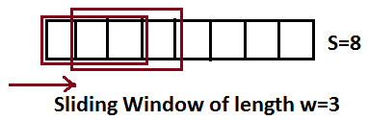
Notation and terminology
Data block(S): certain amount of data handed down by an application
w(S>>w) represent the size of the minimum redundant string (contiguous bytes) that is to be identified
Number of potential candidates?

Slide 7
1/p representative candidates are chosen. P is varied based on load.
Markers : The first byte of these chosen
candidate strings
Chunks: The string of bytes between two markers
Fingerprints: a pseudo-random hash of fixed w-byte strings beginning at each marker
Chunk-hashes: hashes of the variable sized chunks

Slide 8
Fingerprinting algorithms
MODP
MAXP
FIXED
SAMPLEBYTE

Slide 9
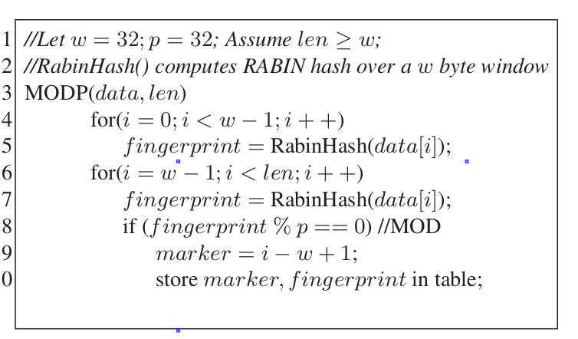
MODP
Marker identification and fingerprinting both handled by same hash function
per block computational cost is independent of the sampling period, p

Slide 10
MAXP
markers are chosen as bytes that are local-maxima over each region of p bytes of the data block
Once the marker byte is chosen, an efficient hash function such as Jenkins Hash can be used to compute the fingerprint
By increasing p, fewer maxima-based markers need to be identified

Slide 11
FIXED
A content-agnostic approach.
Select every pth byte as a marker. (incurs no computational cost)
Once markers are chosen, S/p fingerprints are computed using Jenkins Hash as in MAXP.

Slide 12
SAMPLEBYTE
uses a 256-entry lookup table with a few predefined positions set
a byte is chosen as a marker if the corresponding entry in the lookup table is set
fingerprint is computed using Jenkins Hash , and p/2 bytes of content are skipped before the process repeats

Slide 13
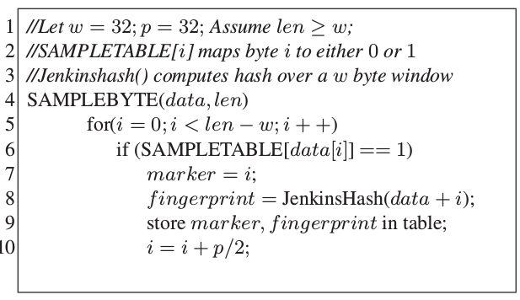
SAMPLEBYTE

Slide 14
SAMPLEBYTE
Lookup Table Creation:
Used network traces from one of the enterprise sites
Sort the characters by decreasing order of their presence in the identified redundant content
Setting the corresponding entries in the lookup table to 1 until compression gain diminishes
The intuition behind this approach is that we would like to increase the probability of being selected as markers to those characters that are more likely to be part of redundant content.

Slide 15
Matching and Encoding: Optimizing
Storage and Client Computation

Slide 16
Matching and encoding
Accomplished in two ways-
  Chunk match: data that repeat in full across data blocks
  Max-Match: maximal matches around fingerprints that are repeated across data blocks

Slide 17
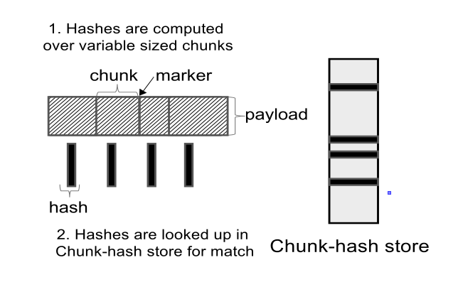
Chunk match
Chunk-hashes from payloads of future data blocks are looked up in the Chunk-hash store to identify if one or more chunks have been encountered earlier.
Once matching chunks are identified, they are replaced by meta-data.

Slide 18
EndRE optimization
Offloads all storage management and computation to servers
Client simply maintains a fixed-size circular FIFO log of data blocks
For each matching chunk, the server encodes and sends a four-byte <offset, length> tuple of the chunk in the client’s cache
The client “de-references” the offsets sent by the server and reconstructs the com-pressed regions from local cache

Slide 19
Drawbacks of chunk match
  can only detect exact matches in the chunks computed for a data block
  could miss redundancies that span contiguous portions of neighboring chunks or redundancies that only span portions of chunks

Slide 20
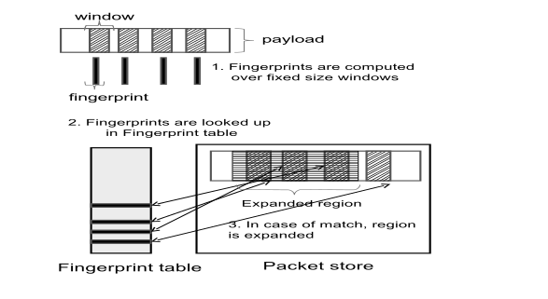
Max-Match
For each matching fingerprint, the corresponding matching data block is retrieved from the cache and the match region is expanded byte-by-byte in both directions to obtain the maximal region of redundant bytes.
Matched regions are then encoded with <offset, length> tuples.

Slide 21
EndRE optimization
Max-Match relies on byte-by-byte comparison, any collision will be recovered.

Slide 22
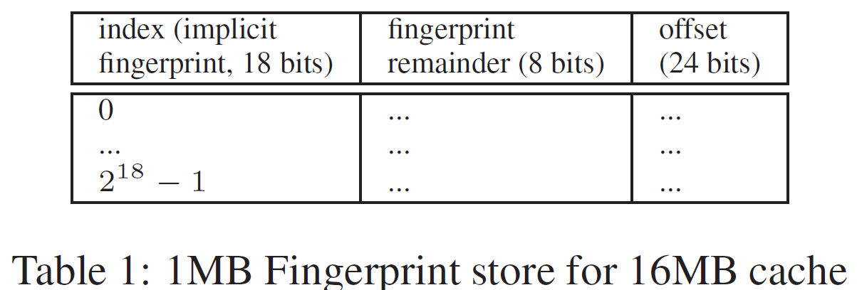
EndRE optimization
Simple hashing used as byte-by-byte storage is anyways needed.
Optimize the representation of the fingerprint hash table to limit storage needs
  fingerprint table is a contiguous set of offsets, indexed by the fingerprint hash value
  16 MB (2^24 bits) cache, p=64 -> 2^24/64 = 2^18 fingerprints

Slide 23
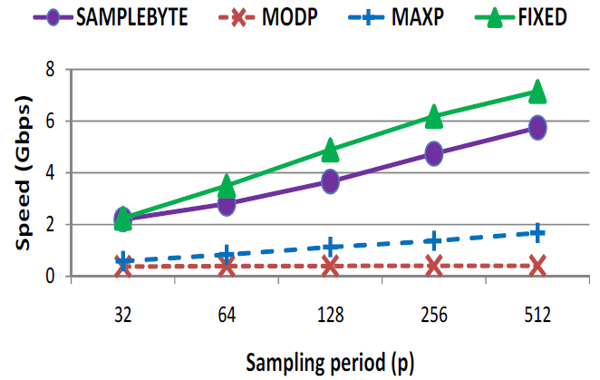
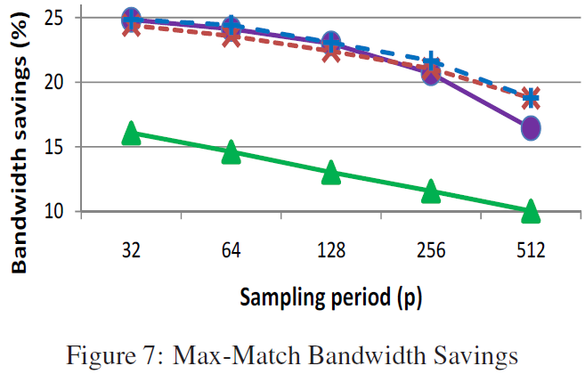
Evaluation

