Slide 1
Accuracy Characterization of Cell Tower Localization
Jie Yang†, Alexander Varshavsky‡, Hongbo Liu†, Yingying Chen†, Marco Gruteser♯
UbiComp’10

Slide 2
Data Description
We obtained access to a wardriving trace that covers three areas in the greater Los Angeles area.
The Downtown trace covers an area of 3.5km×4.2km in the downtown Los Angeles.
The Residential trace covers an area of 6.3km×17km in the southern part of the Los Angeles County.
The Rural trace covers an area of 35.4km×36km in the Victor Valley of San Bernardino County.

Slide 3
Data Description
The wardriving trace was collected over a period of 2 months in February and March of 2009.
The GSM signal strength measurements and their locations were recorded every 2 seconds and the speed of the car averaged about 32kmph.
In total, we have 2,613,465 received signal strength (RSS) readings from 105,271 unique locations, resulting, on average, in 24.8 RSS readings from different cells per location.
Each cell tower has 2, 3 or 6 cells attached to it, depending on the characteristics of the area and the coverage requirements.
We know which cells belong to which cell tower and the actual location of each cell tower.

Slide 4
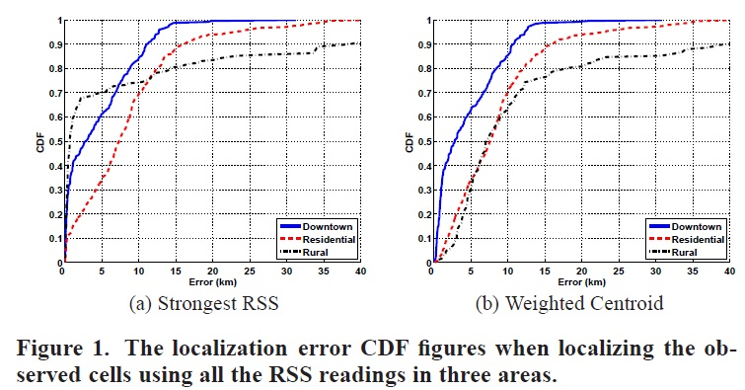

Slide 5
TABLE
 | Downtown | Residential | Rural
Strongest RSS | 2.75 KM | 7.5 KM | 0.7 KM
Weighted Centroid | 2.83 KM | 8 KM | 7 KM

Slide 6
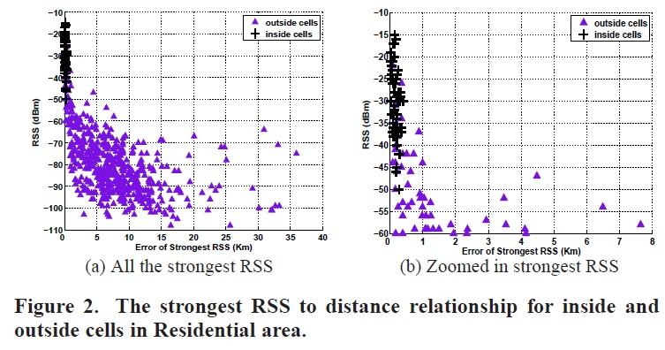

Slide 7
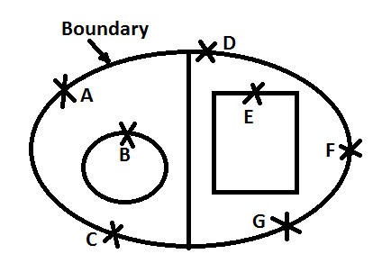
BOUNDING TECHNIQUE
A – G are War-driving Points
Suppose, there is 1 Cell-Tower with 2 cells
 | X | Y | C1 | C2
A | 5 | 15 | -65 | -50
B | 8 | 10 | -70 | -60
C | 7 | 2 | -90 | -80
D | 11 | 18 | -70 | -55
E | 14 | 13 | -80 | -70
F | 19 | 7 | -100 | -85
G | 16 | 3 | -100 | -85

Slide 8
STEPS IN BOUNDING Technique
RSS Thresholding
Filter out all cells whose strongest RSS is lower than a certain cutoff threshold
Boundary Filtering
Applying the observation that the outside cells will have their strongest RSS values on the boundary or the perimeter of the wardriving area.
Tower-based Regrouping
Decide a cell-tower is inside / outside based on whether most of its cells are inside / outside

Slide 9
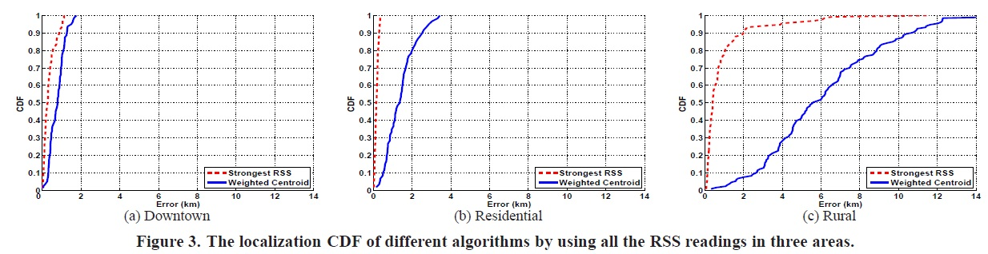

Slide 10
TABLE
 | Downtown | Residential | Rural
Strongest RSS (before Bounding) | 2.75 KM | 7.5 KM | 0.7 KM
Strongest RSS (after Bounding) | 267 M | 139 M | 414 M
Weighted Centroid (before Bounding) | 2.83 KM | 8 KM | 7 KM
Weighted Centroid (after Bounding) | 785 M | 1357 M | 5536 M

Slide 11
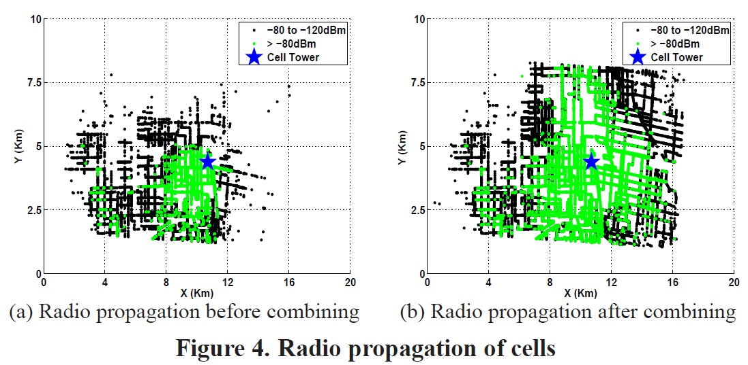
CELL TOWER OPTIMIZATION

Slide 12
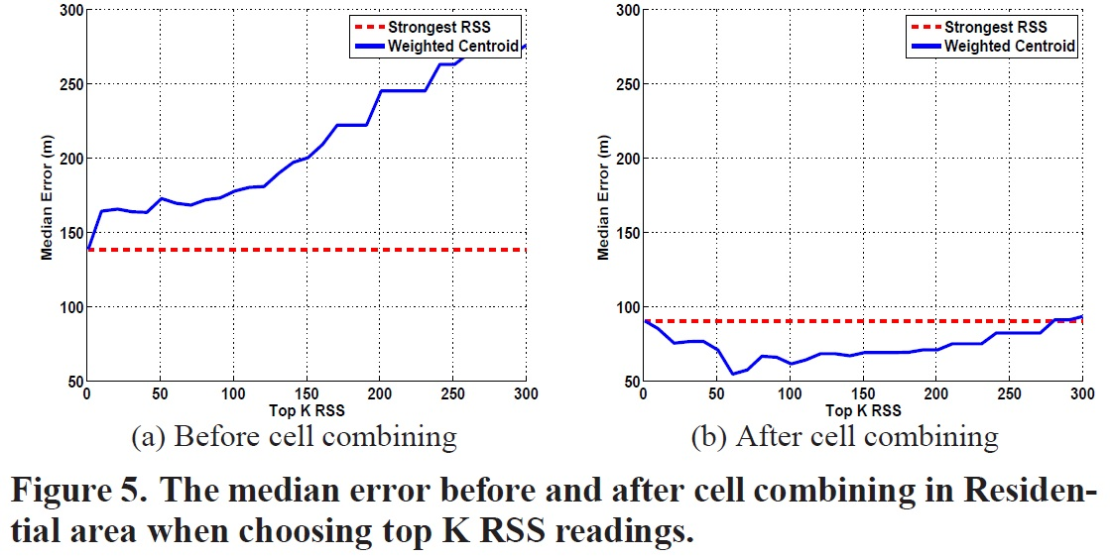

Slide 13
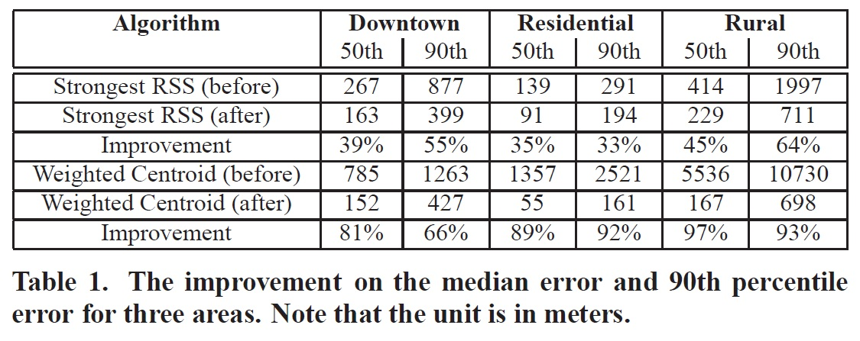

Slide 14
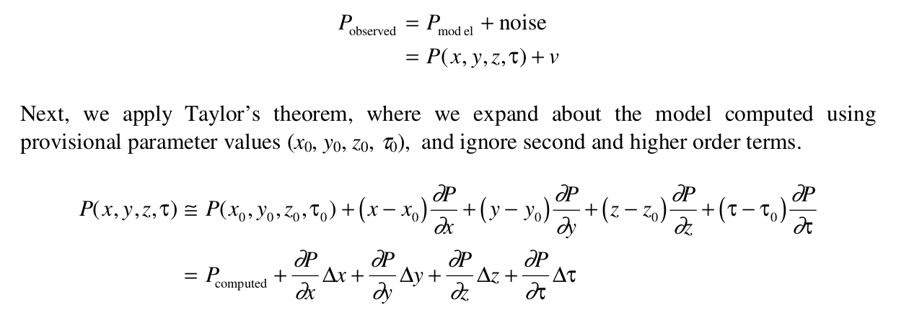
Point positioning using pseudocode
9/2/2016

Slide 15
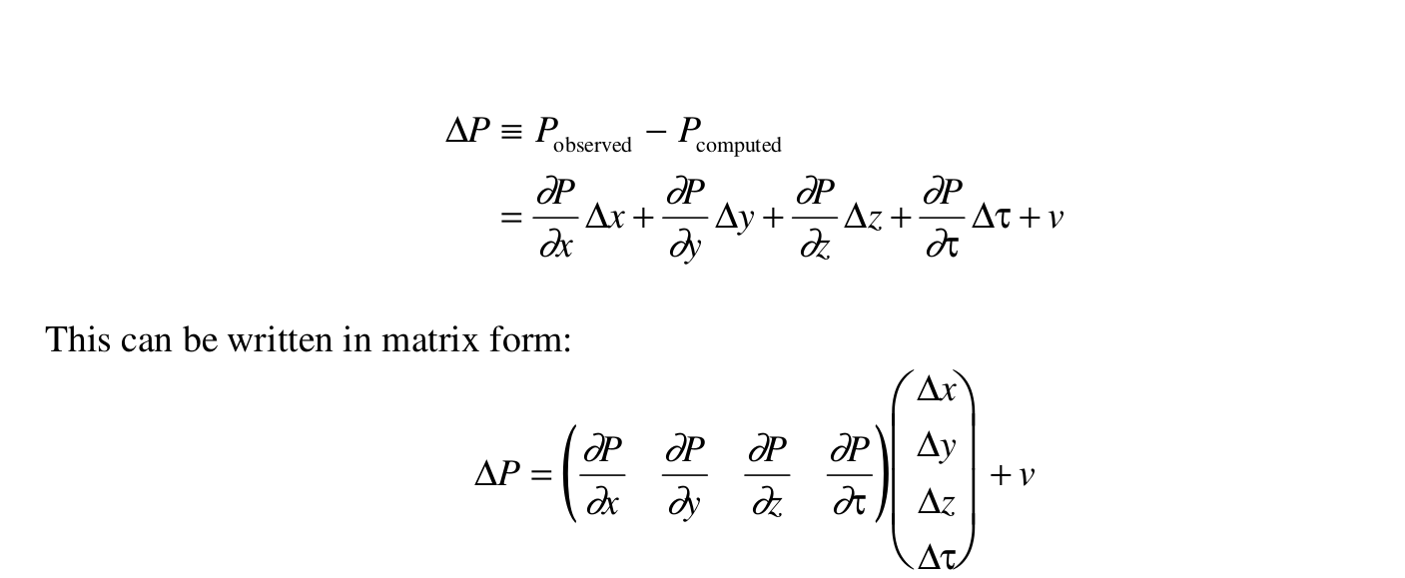
9/2/2016

Slide 16
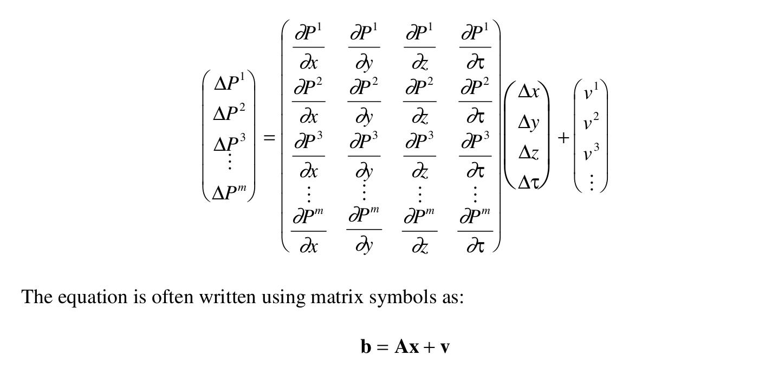
We can generalize for m satellites as
9/2/2016

Slide 17
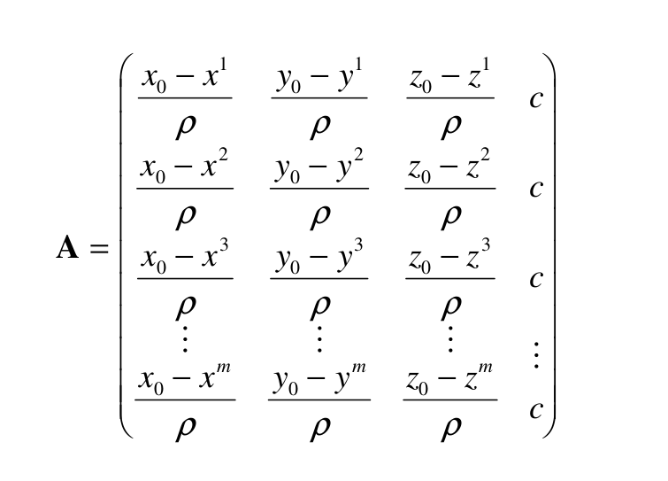
Design matrix
9/2/2016

Slide 18
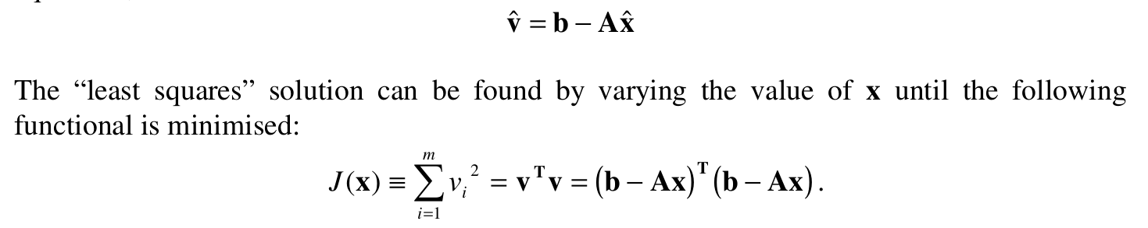
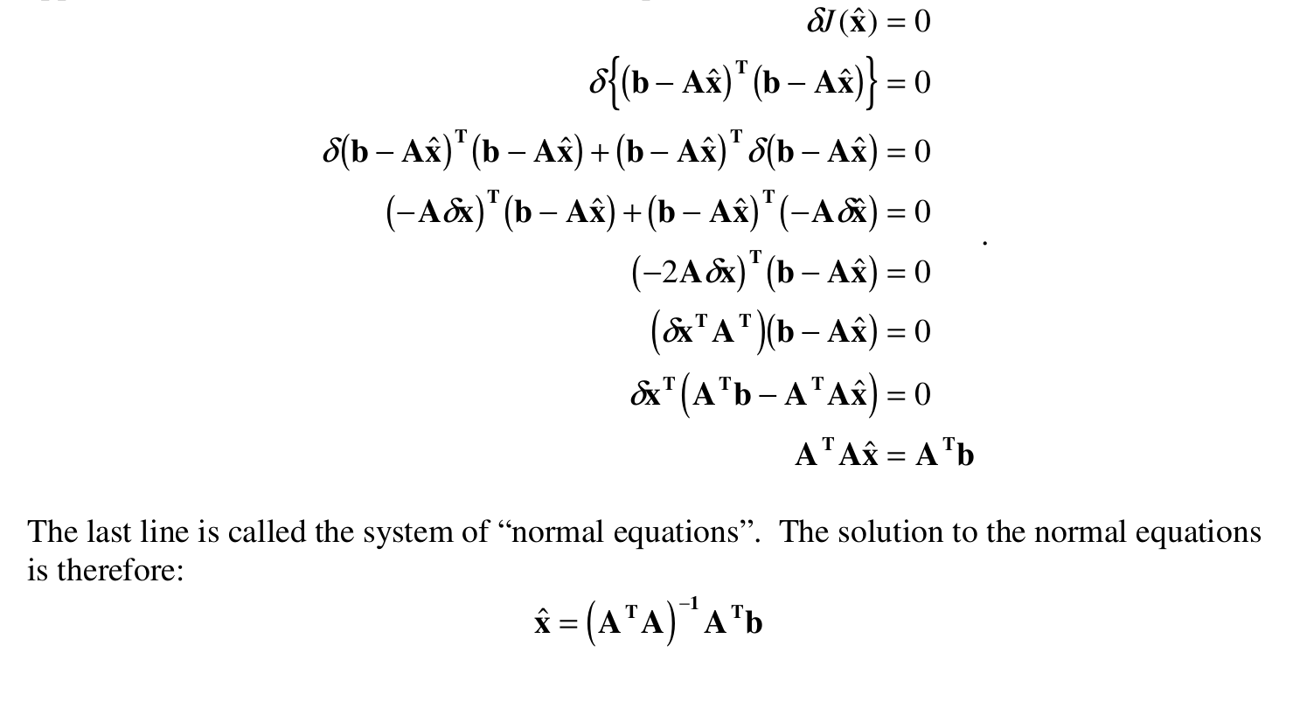
Least squares solution
9/2/2016

