Slide 1
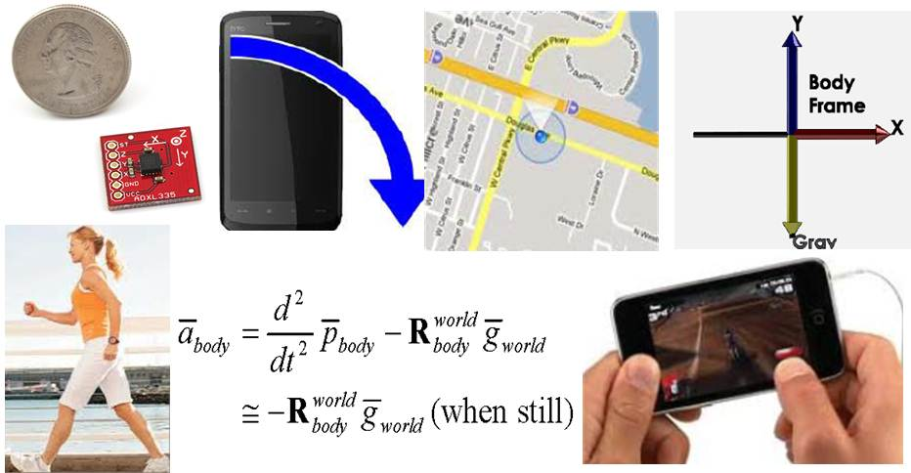
Introduction to Smart-Phone Sensing

Slide 2
Reference
Shamelessly lifted from the following paper :
A Survey of Mobile Phone Sensing
By Nicholas D. Lane, Emiliano Miluzzo, Hong Lu, Daniel Peebles, Tanzeem Choudhury, and Andrew T. Campbell
Dartmouth College

Slide 3
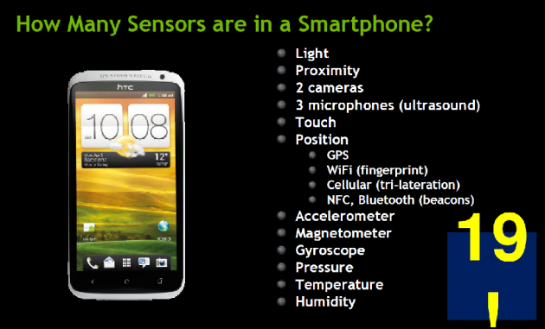
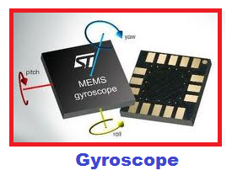
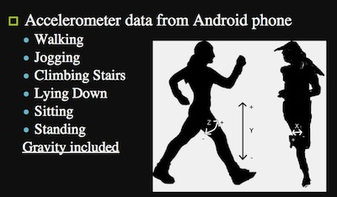
Devices use sensors to drive user experience:
Phone usage:
Light sensor – Screen dimming
Proximity – Phone usage, inadvertent cheek
Content capture:
Camera – Image/video capture
Microphone – Audio capture
Location, mapping:
GPS – Global location
Compass – Global orientation
Device orientation:
Accelerometer & Gyroscope – Local orientation

Slide 4
Classifying Activities
Sensors can also collect data about users and their surroundings.
Accelerometer data can be used to classify a user’s movement:
Running
Walking
Stationary
Combining motion classification with GPS tracking can recognize the user’s mode of transportation:
Subway, bike, bus, car, walk…

Slide 5
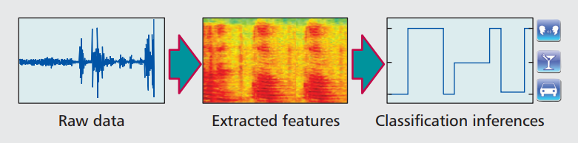
Classifying Activities
Phone cameras can be used to track eye movements across the device for accessibility
Microphone can classify surrounding sound to a particular context:
Using an ATM
Having a conversation
Driving
Being in a particular coffee shop

Slide 6
Research Applications – Social Network
Users regularly share events in their lives on social networks. Smart devices can classify events automatically.
Dartmouth’s CenceMe project (2008)
Audio classifier recognizes when people are talking.
Motion classification to determine standing, sitting, walking, running.
Server side senses conversations, combines classifications.

Slide 7
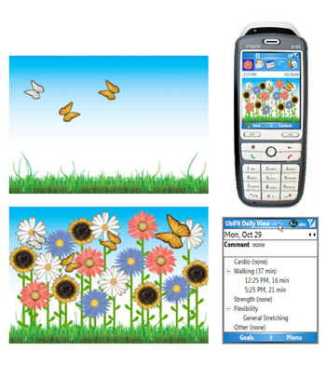
Research Applications – Health
Sensors can be used to track health and wellness.
UbiFit Garden
(2007, 3 months)
App paired with wearable motion
sensor
Physical activity continuously logged
Results represented on phone’s
background as a garden
This “Glanceable display” improved
user participation dramatically

Slide 8
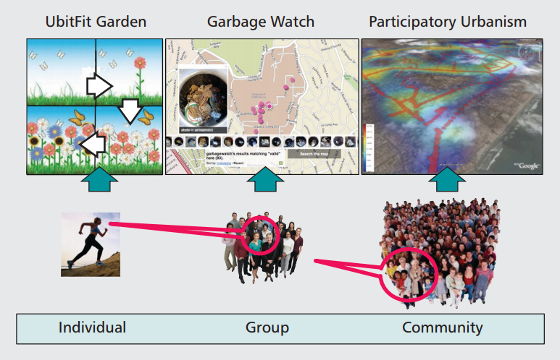
Sensing Scale and Paradigms
Sensing Scale
Personal sensing
Group sensing
Community sensing
Sensing Paradigms
Participatory sensing
User takes out phone to take a reading
Users engaged in activity, requires ease of use and incentive
Opportunistic sensing
Minimal user interaction
Background data collection
Constantly uses device resources

Slide 9
Sensing Scale – Personal Sensing
Personal Sensing
Tracking exercise routines
Automated diary collection
Health & wellness apps
Sensing is for sole benefit of the user.
High user commitment
Direct feedback of results

Slide 10
Sensing Scale – Group Sensing
Group Sensing
Sensing tied to a specific group
Users share common interest
Results shared with the group
Limited access
Example: UCLA’s GarbageWatch (2010)
Users uploaded photos of recycling bins to improve recycling program on campus

Slide 11
Sensing Scale – Community Sensing
Community Sensing
Larger scale sensing
Open participation
Users are anonymous
Privacy must be protected
Examples:
Tracking bird migrations, disease spread, congestion patterns
Making a noise map of a city from user contributed sound sensor readings

Slide 12
Sensing Paradigms
User involvement has its own scale:
Manual (participatory) collection
Better, fewer data points
User is in the loop on the sensing activity, taking a picture or logging a reading
Users must have incentive to continue
Automatic (opportunistic) collection
Lots of data points, but much noisy/bad data
Users not burdened by process, more likely to use the application
Application may only be active when in foreground

Slide 13
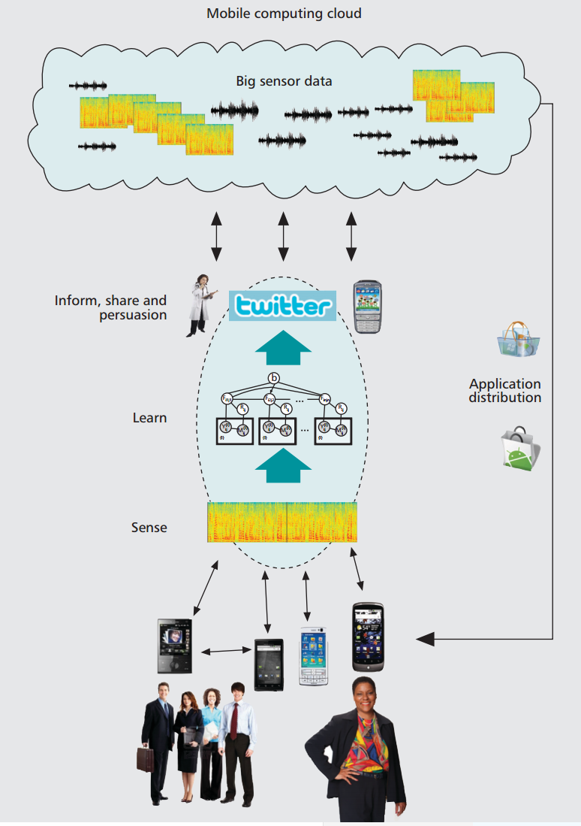
Mobile Phone Sensing Architecture
Sensing applications share common general structure:
Sense – Raw sensor data collected from device by app
Learn – Data filtering and machine learning used
Inform – Deliver feedback to users, aggregate results

Slide 14
Inform, Share, Persuade
Once data is analyzed, how are results shared with users?
How to close the loop with users and keep them engaged
Sharing - Connecting with web portals to view and compare data
Personalized Sensing – Targeting advertising to your habits
Persuasion – Showing progress towards a common goal, encouraging users
Privacy – Treating user data mindfully

Slide 15
MORE

Slide 16
Custom Sensors
Device sensors are becoming common, but lack special capabilities desired by researchers:
Blood pressure, heart rate, EEG
Barometer, temperature, humidity
Air quality, pollution, Carbon Monoxide
Specialized sensors can be embedded into peripherals:
Earphones
Dockable accessories / cases
Prototype devices with embedded sensors

Slide 17
Research Applications - Transportation
Fine grained traffic information collected through GPS enabled phones
MIT VTrack (2009)
25 GPS/WiFi equipped cars, 800 hours
Mobile Millenium Project (2008)
GPS Mobile app: 5000 users, 1 year
Google Maps keeps GPS history of all users
Real time traffic estimates
Route analysis (19 minutes to home)
Navigation / route planning

Slide 18
Research Applications Environmental Monitoring
UCLA’s PEIR project (2008)
App uploads GPS signal and motion classification.
Server combines data sources:
GPS traces
GIS maps
Weather data
Traffic data
Vehicle emission modeling
Presents a Personal Environmental Impact Report
CO and PM2.5 emission impact analysis
PM2.5 exposure analysis

Slide 19
Research Applications – App Stores
3rd party distribution for each platform
Google Play (formerly Android Market)
Apple App Store
Nokia Ovi
Blackberry World (formerly Blackberry App World)
Windows Phone Store (formerly Windows Phone Marketplace, soon to be Windows Store)
App store popularity allows researchers to access large user bases, but brings questions:
Assessing accuracy of remote data
Validation of experiments
Selection of study group
Massive data overload at scale
User privacy issues

Slide 20
Sensing – Mobile Phone as a Sensor
Programmability
Mobile devices support 3rd party apps (2008+)
Mixed API and OS support to access sensor data
GPS sensor treated as black box
Sensors vary in features across devices (see 5S)
Unpredictable raw sensor reporting
Delivering raw data to cloud poses privacy risks

Slide 21
Sensing – Continuous Sensing
Sampling sensors continuously
Phone must support background activities
Device resources constantly used
CPU used to process data
High power sensors (GPS) polled
Radios frequently used to transmit data
Expensive user data bandwidth used
Degrading user’s phone performance will earn your app an uninstall
Continuous sensing is potentially revolutionary, but must be done with care
Balance data quality with resource usage
Energy efficient algorithms

Slide 22
Sensing – Phone Context
Mobile phones experience full gamut of unpredictable activity.
Phone may be in a pocket, in a car, no signal, low battery.. Sensing application must handle any scenario.
Phone and its user are both constantly multitasking, changing the context of sensor data
Some advances:
Using multiple devices in local sensing networks
Context inference (running, driving, in laundry)

Slide 23
Learning – Interpreting Sensor Data
Interpreting potentially flakey mobile data requires context modeling. Data may only valid during certain contexts (running, outdoors…)
Supervised learning: Data is annotated manually, these classifications improve machine learning.
Semi/unsupervised learning: Data is wild and unpredictable, algorithms must infer classifications.
Accelerometer is cheap to poll and helpful to classify general activity (moving/still)
Microphone can classify audio environments at cost of CPU resources and algorithm complexity
Involving the user in automatic classification can be helpful, but adds interaction complexity

Slide 24
Learning – Scaling Models
Many statistical analysis models are too rigid for use in mobile devices. Models must be designed flexible enough to be effective for N users.
Adaptive models can query users for classification if needed.
A user’s social network can help classify data, such as significant locations.
Hand annotated labels may be treated as soft hints for a more flexible learning algorithm.
Complex adaptive algorithms bring increased resource usage.

Slide 25
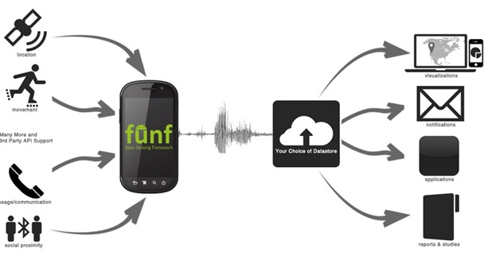
Share
The sensing application must share its findings with the user to keep them engaged and informed.
Can be tied with web applications (Nike+)
Form a community around the data
Allow users to compare and share their data
Nike+ collects a simple data set (run time and distance) but users are actively engaging in the web portal
Visualization
Notification
Applications
Reports & Studies

Slide 26
Personalized Sensing
A user’s phone can constantly monitor and classify their daily life; the data collected is highly personal.
Targeted advertising would love to know just when to show you a certain ad
Your phone can provide personalized recommendations targeted to your location and activity
A common sensing platform could feed classifications and data to other apps and services

Slide 27
Persuasion
Sensing applications usually involve a common goal, the reason the user is running the app.
The goal of a persuasive app is to encourage the user to change their behavior
Improve fitness and physical activity
Reduce smoking
Avoid traffic
Lower carbon emissions
Provide comparison data to give the user perspective
Present aggregated community data
Accurate models of persuasion are needed so that the user feels engaged and moved to change

Slide 28
Privacy
With your phone sensing you and your activity, user privacy is a major concern.
Advertising places high price on accurate ad target data, which the sensing app could provide.
User data may include personal details (GPS locations, habits, conversations).
Approaches
Personal sensing apps can store private data locally, and share selectively.
Group sensing apps gain privacy by limited trusted membership.
Community sensing apps must ensure user privacy is guaranteed.
Raw sensor data can be processed and filtered locally before uploading more anonymous data to the system.

