Slide 1
Optimizing Sensor Data Acquisition for Energy-Efficient Smartphone-based Continuous Event Processing
By
Archan Misra (School of Information Systems, Singapore Management University) &
Lipyeow Limy (Information and Computer Sciences Department, University of Hawai‘i at M¯anoa)

Slide 2
Key Idea
This work explores an approach to reduce the energy footprint of such continuous context-extraction activities, primarily by
reducing the volume of sensor data that is transmitted wirelessly over the PAN interface between a smart phone and its attached sensors, without compromising the fidelity of the event processing logic.
More specifically, the authors aim to replace the “push” model of sensor data transmission, where the sensors simply continuously transmit their samples to the smartphone, with a “phone-controlled dynamic pull” model, where the smartphone selectively pulls only appropriate subsets of the sensor data streams.

Slide 3
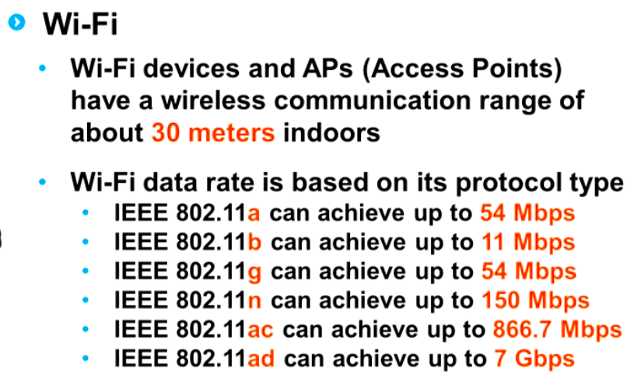
Introduction
Smartphones already have several on-board sensors (e.g., GPS, accelerometer, compass and microphone)
But, there are many situations where the smartphone aggregates data from a variety of other specific external medical (e.g., ECG, EMG, Sp02) or environmental (e.g., temperature, pollution) sensors, using a Personal Area Network (PAN) technology, such as BluetoothTM, IEEE 802.15.4 or even WiFi (IEEE 802.11).

Slide 4
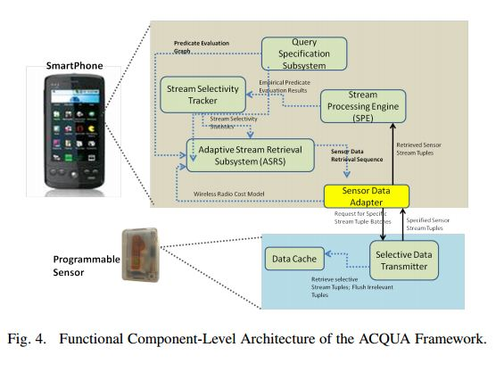
ACQUA
Introducing a new continuous stream processing model called ACQUA (Acquisition Cost-Aware Query Adaptation),
Which first learns the selectivity properties of different sensor streams and then utilizes such estimated selectivity values to modify the sequence in which the smartphone acquires data from

Slide 5
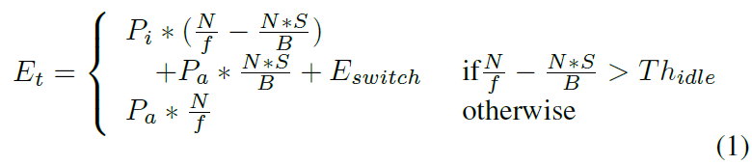
IEEE 802.11:
Et = Energy consumed in time interval t
Pa = Power consumption in Active Mode
Pi = Power Consumption in Idle Mode
B = Transmission Bandwidth (bps) of the radio link
f = Sampling Frequency (Hz)
S = Sampling size (number of bits)
N = Number of sample
Th_{idle} = Minimum Idle time
E_{switch} = Duration Independent Switching energy

Slide 6

Bluetooth:
Et = Energy consumed in time interval t
Pa = Power consumption in Active Mode
Pi = Power Consumption in Idle Mode
B = Transmission Bandwidth (bps) of the radio link
f = Sampling Frequency (Hz)
S = Sampling size (number of bits)
N = Number of sample
T_{switch} = Latency involved while switching from non associated low power mode to the associative active mode

Slide 7
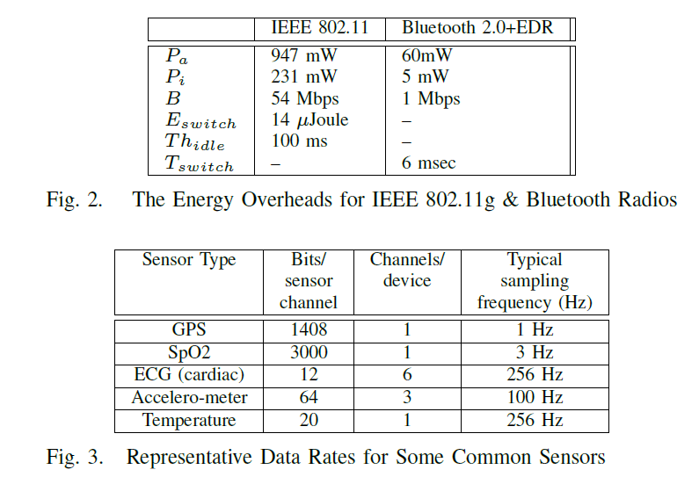

Slide 8
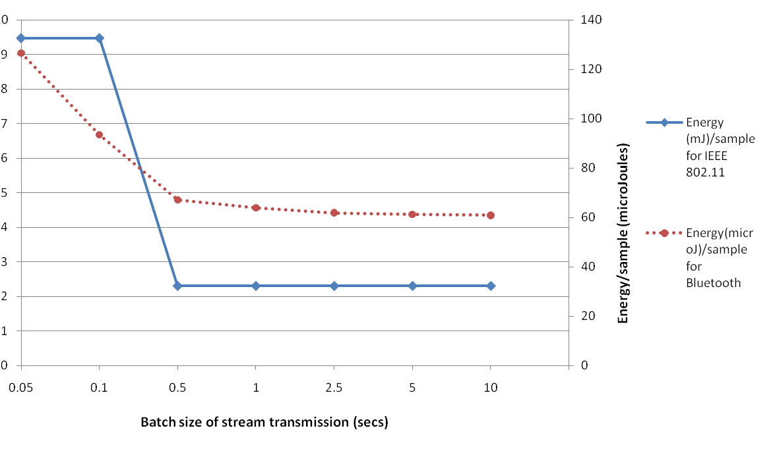

Slide 9
Query
Consider a hypothetical activity/wellness tracking application that seeks to detect an episode where an individual
walks for 10 minutes,
while being exposed to an ambient temperature (95th percentile over the 10 minute window) of greater than 80F,
while exhibiting an AVERAGE heart rate (over a 5 minute window) of > 80 beats/min.

Slide 10
Assume that this application uses an external wrist-worn device, equipped with
accelerometer (sensor S1, sampling at 100 samples/sec),
heart rate (sensor S2, sampling at 5 sample/sec) and
temperature (sensor S3, sampling at 10 sample/sec) sensors.

Slide 11
Query
Consider a hypothetical activity/wellness tracking application that seeks to detect an episode where an individual
walks for 10 minutes, -- 0.95
while being exposed to an ambient temperature (95th percentile over the 10 minute window) of greater than 80F, -- 0.05
while exhibiting an AVERAGE heart rate (over a 5 minute window) of > 80 beats/min. = 0.2

Slide 12
Query
Consider a hypothetical activity/wellness tracking application that seeks to detect an episode where an individual
walks for 10 minutes, -- 0.02nJ/sec
while being exposed to an ambient temperature (95th percentile over the 10 minute window) of greater than 80F, -- 0.02nj/sample
while exhibiting an AVERAGE heart rate (over a 5 minute window) of > 80 beats/min. = 0.01nJ/Sample

Slide 13
Query
Consider a hypothetical activity/wellness tracking application that seeks to detect an episode where an individual
walks for 10 minutes, -- 100 sample/sec
while being exposed to an ambient temperature (95th percentile over the 10 minute window) of greater than 80F, --5 samples/sec
while exhibiting an AVERAGE heart rate (over a 5 minute window) of > 80 beats/min. = 10 samples/sec

Slide 14
Calculation:
NAC (Normalized Acquisition Cost)
= Sample rate * Energy/Failure Rate
NAC(Si) = (SR(Si)*E(Si))/(1-P(Si))
SR(Si) = Sampling Rate of i^{th} sensor
E(Si) = Actuation Energy Cost of i^{th} sensor
P(Si) = probability of a specific reading shown by i^{th} sensor

Slide 15
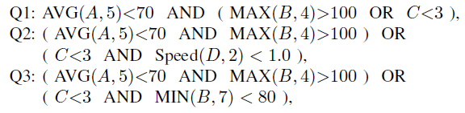
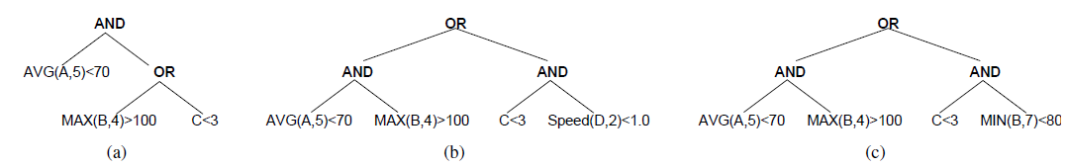
Query Trees

Slide 16
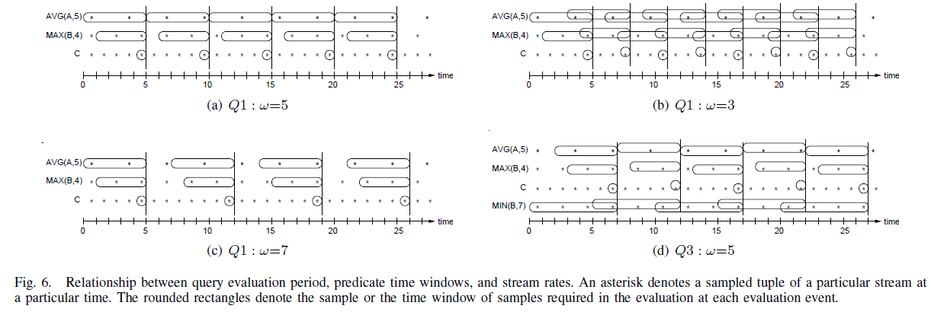

Slide 17
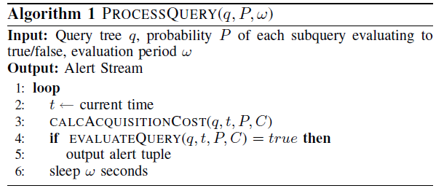
Algorithm:

Slide 18
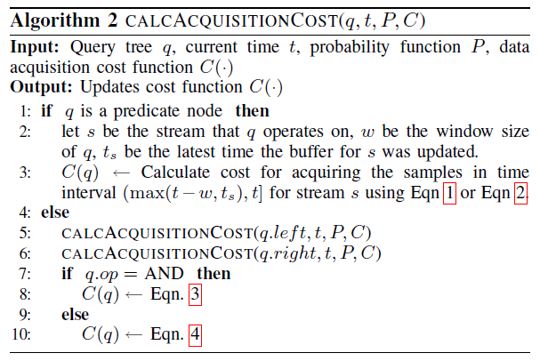

Slide 19
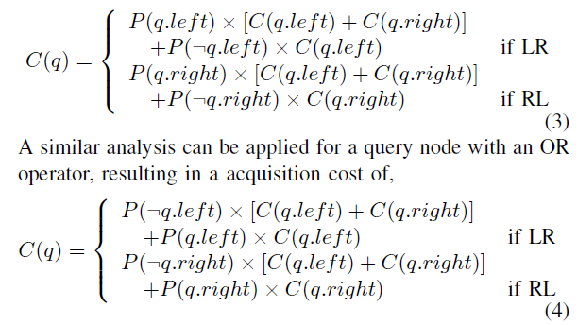

Slide 20
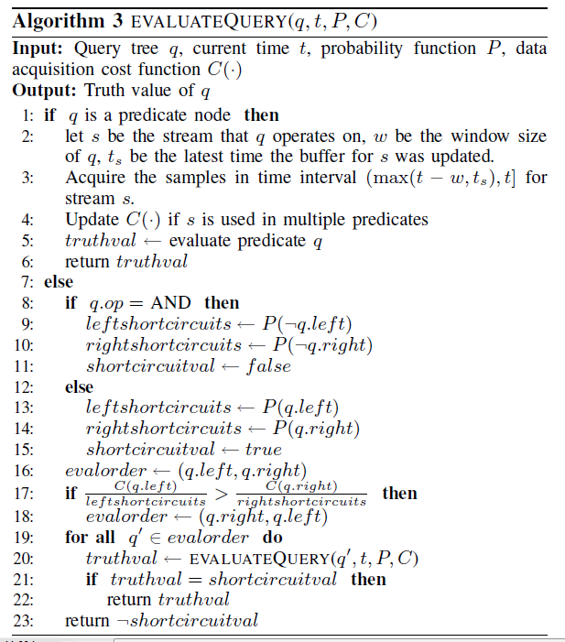

Slide 21
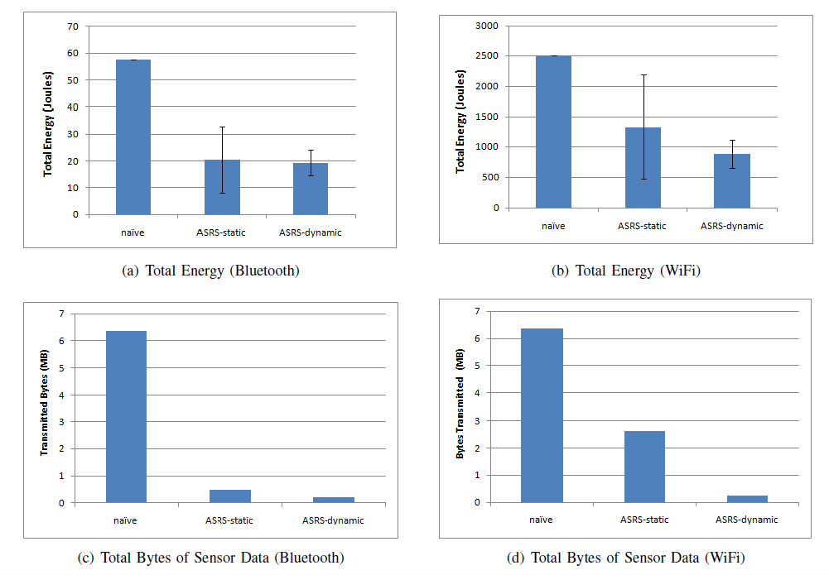
Evaluation

Slide 22
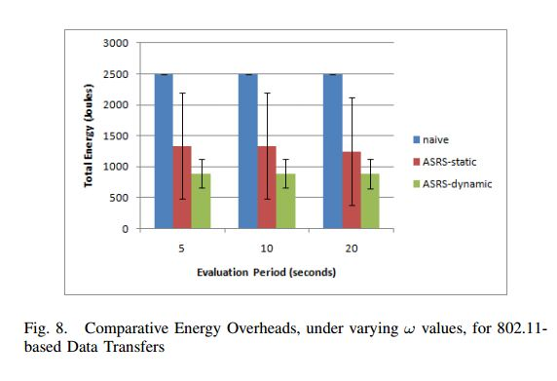
Evaluation

Slide 23
Accommodate Heterogeneity in Sensor Data Rates, Packet Sizes and Radio Characteristics
Adapt to Dynamic Changes in Query Selectivity Properties
Take into Account other Objectives Besides Energy Minimization
Support Multiple Queries and Heterogeneous Time Window Semantics

