Slide 1
Backup slides
What Factors Are Most Associated with Football Player Market Value?
Niloy Saha · DATA 400 Individual Mini-Project · for questions
Notes:
Separate file (DATA400_market_value_backup_slides.pptx). Open it only when a question needs one of these slides.

Slide 2
Backup A: how the dataset was cleaned
Step | Rows dropped | Rows remaining
Player-seasons in scope (14 leagues, 2020–2024) |  | 32,966
Missing position | 9 | 32,957
Missing date of birth | 5 | 32,952
No valuation by July 31 | 490 | 32,462
Valuation older than 365 days | 416 | 32,046
Zero minutes | 0 | 32,046
Final dataset | 920 | 32,046
23,328
rows with ≥450 minutes (72.8%) used for per-90 rates; others kept for everything else
Notes:
Exact exclusion counts in the order the rules were applied: 9 missing position, 5 missing birth date, 490 no valuation, 416 stale valuation. 23,328 rows (72.8%) have at least 450 minutes.
Remember: 920 excluded

Slide 3
Backup B: K-means details
k | Inertia | Silhouette
2 | 19,125 | 0.219
3 | 16,201 | 0.215
4 | 13,850 | 0.207
5 | 12,093 | 0.214
6 | 11,075 | 0.209
Cluster (k = 4) | n | Age | Min | G/90 | A/90 | Value
Regular high-minute starters | 1,576 | 25.9 | 2,308 | 0.37 | 0.15 | €8M
Creative attackers | 1,018 | 24.6 | 1,234 | 0.28 | 0.35 | €5M
Younger, lower output | 2,046 | 23.0 | 1,029 | 0.18 | 0.10 | €1.5M
Older, fewer minutes | 1,455 | 30.0 | 1,124 | 0.23 | 0.10 | €1M
scikit-learn KMeans, n_init = 20, random_state = 0; StandardScaler; per-90 rates capped at the 99th percentile.
Stability (adjusted Rand index vs the seed-0 fit): minimum 0.92, median 0.97 across 10 seeds; minimum 0.89, median 0.92 on 80% subsamples.
Clusters account for ~23% of log-value variance among these attackers.
Notes:
Silhouette and inertia for k = 2-6, cluster sizes and medians, stability. Stability means repeated runs give nearly the same groups (adjusted Rand index minimum 0.92, median 0.97); that is not the same as the groups being well separated.
Remember: Silhouette 0.207 at k = 4
Caution: Stable is not the same as well separated.

Slide 4
Backup C: rule-based segments (not clusters)
Segment | Rule (applied in order) | n | G/90 | A/90 | Median value
High scorers | Goals/90 ≥ 0.40 (top quarter) | 1,524 | 0.53 | 0.15 | €6M
Creative attackers | Assists/90 ≥ 0.23, not a high scorer | 1,074 | 0.21 | 0.31 | €4M
Young (under 24) | Everyone else, under 24 | 1,235 | 0.19 | 0.11 | €2M
Prime age (24-28) | Everyone else, 24 to 28 | 1,456 | 0.19 | 0.10 | €1.8M
Experienced (29+) | Everyone else, 29 or older | 806 | 0.20 | 0.10 | €900K
Defined by me with explicit cut-offs from the data; easier to explain than K-means, but capture less value variation (~14% vs ~23%).
Notes:
Rule-based segments: high scorers (goals/90 at least 0.40), creative (assists/90 at least 0.23), then age bands. I define these, so call them segments, not clusters.
Remember: High scorers €6M, creative €4M

Slide 5
Backup D: median market value by league
€4.5M
pooled median, top-five leagues
€600K
pooled median, other nine leagues
Every top-five median is €3M or more; every other league is €1M or less.
Notes:
All 14 league medians, highest to lowest.
Remember: Lowest top-five (€3M) is 3x the highest other league (€1M)

Slide 6
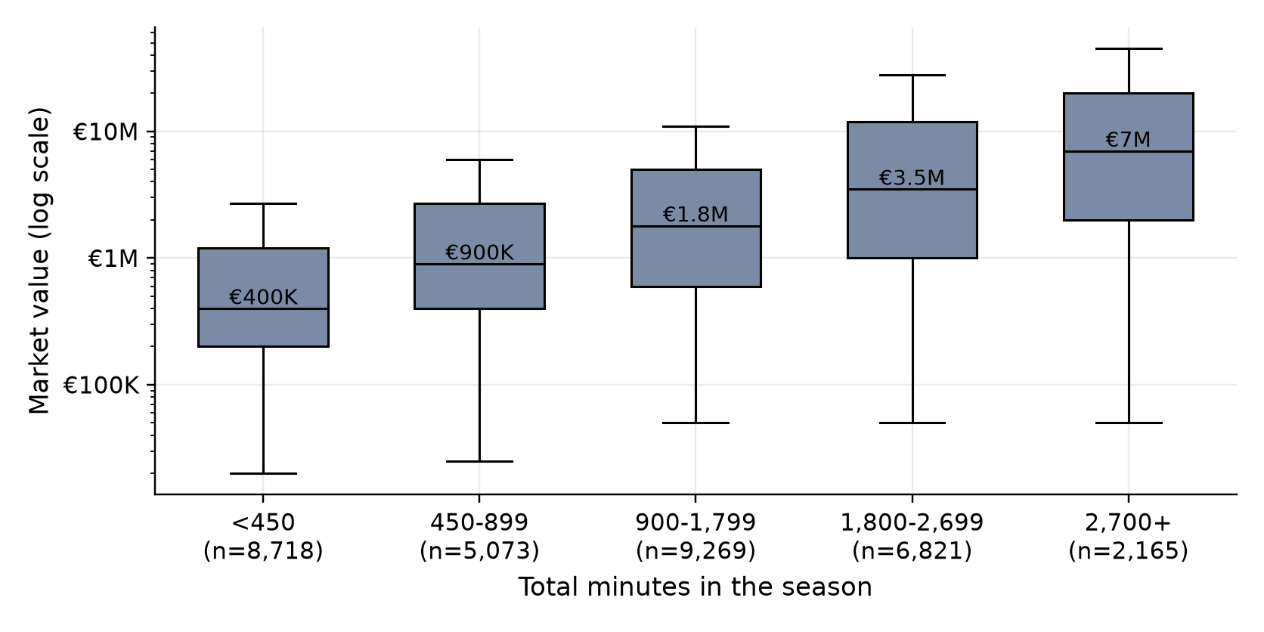
Backup E: playing time and value
0.51
Spearman, total minutes vs value (all players)
Likely runs both ways: valued players get picked, and playing raises visibility. Club level may drive both.
Notes:
Spearman 0.51 between minutes and value. Explain the two-way direction: clubs play players they value, and playing raises value.
Remember: 0.51
Caution: Do not say more minutes cause higher value.

