Slide 1
What Factors Are Most Associated with Football Player Market Value?
DATA 400 Individual Mini-Project
Niloy Saha · Dickinson College · Fall 2026
Notes:
Introduce yourself and the project in one sentence: I looked at five seasons of Transfermarkt data to see which player characteristics move together with a player's market value.
Next: "Let me start with the question and why it is worth asking."

Slide 2
Question and motivation
RESEARCH QUESTION
Market value ≠ transfer fee
Which player characteristics and performance statistics are most strongly associated with a football player's market value?
Transfermarkt's estimate at a point in time: not a price paid, not a true value.
Player valuations vary enormously, from tens of thousands to hundreds of millions of euros.
Players with similar output can carry very different values.
Goal: describe which characteristics move with value, not predict a "true price".
WHO CARES
Fans and journalists who quote values, analysts and recruiters who use them, players and agents affected by them.
Notes:
Read the research question. Then explain why it matters: values range from tens of thousands to hundreds of millions of euros, and players who produce similar numbers can be valued very differently. My goal is descriptive: which characteristics move with value, not predicting a 'true price'. Point at the dark box: market value is Transfermarkt's estimate, not a transfer fee. Mention who cares: fans and journalists quote these values, analysts and recruiters use them as a reference, players and agents are affected by them.
Remember: Market value is an estimate, not a fee.
Caution: Do not call it the player's 'price' or 'worth' as a fact.
Next: "To answer this I needed player-level data across several seasons."

Slide 3
Data: five seasons of Transfermarkt history
32,046
13,511
14
5
player-seasons
distinct players
domestic European leagues
seasons, 2020/21 to 2024/25
One row = one player in one season
Main variables
Source: David Caribou's public transfermarkt-datasets (CC0)
Match records summed into season totals
A player appears once for each season played
Age
Position
Minutes
Goals
Assists
Per-90 rates
League
Market value
Notes:
Source is David Caribou's public transfermarkt-datasets, which is scraped from Transfermarkt and released under CC0. Walk through the four numbers: 32,046 player-seasons, 13,511 different players, 14 domestic European leagues, five seasons from 2020/21 to 2024/25. Explain the unit: one row is one player in one season, so a player who played all five seasons appears five times. List the main variables quickly; do not read every one.
Remember: 32,046 player-seasons
Caution: Rows are not independent people: the same player can appear up to five times.
Next: "The raw data did not come in this shape, so here is how I built it."

Slide 4
From 1.9 million match rows to one analytical table
Match appearances
Games: season and league
Sum per player-season
Player details (age, position)
Season-end valuation
Clean player-season table
→
→
→
→
→
450 minutes
July 31 rule
365 days
Per-90 rates only for players with at least 450 minutes (five full matches). 1 goal in 1 minute = 90 per 90.
Season value = latest Transfermarkt valuation on or before July 31 after the season.
Valuations more than a year old at that date are excluded, so no stale values.
32,966 → 32,046 player-seasons: 920 excluded (2.8%) for missing position, birth date or valuation. Players changing clubs keep one row, labelled by the club where they played most.
Notes:
The raw data is match-level: about 1.9 million appearance rows. Follow the arrows: join each appearance to its game to get season and league, add up minutes, goals and assists per player per season, attach age and position, then attach the valuation at the end of that season. Then the three rules. 450 minutes: per-90 rates explode for players who barely played, one goal in one minute is 90 goals per 90, so rates are only used above five full matches; low-minute players stay in the data for everything else. July 31: Transfermarkt updates values a few times a year, mostly in June, so I take the latest value on or before July 31 after the season. 365 days: if that value is more than a year old, the row is excluded. In total 920 rows (2.8%) were excluded.
Remember: 920 excluded of 32,966 (2.8%)
Caution: These thresholds are practical choices, not the only correct ones.
Next: "With the dataset built, the first question everyone asks is about age."

Slide 5
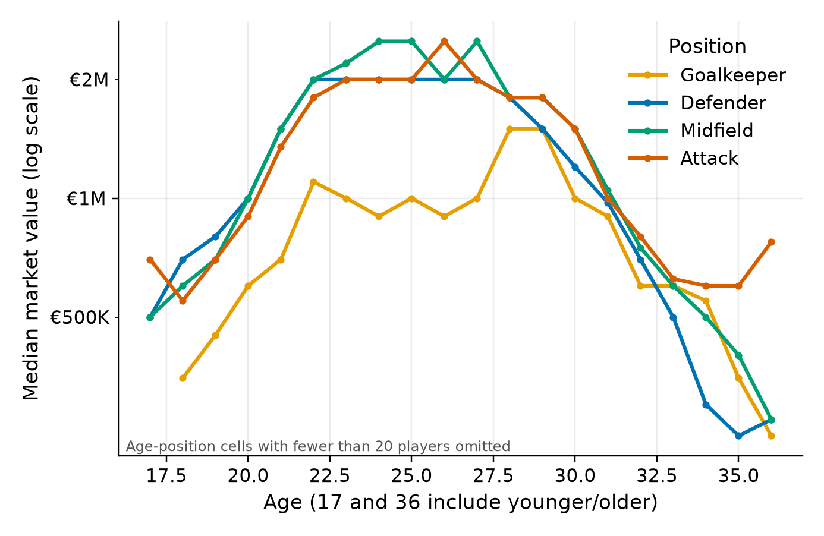
Age matters, but not in a straight line
Spearman(age, value) = -0.03
Near zero, yet age clearly matters: value rises, peaks at 24–26, then falls. A single correlation hides the hump.
Median by age, one line per position; value axis is log-scaled (each step ×10).
Notes:
Look at the lines: value rises through the early twenties, stays high from about 22 to 28, then falls after 30. The bar chart shows the age groups: under 21 is €0.8M, 21-23 €1.8M, 24-26 is the highest at €2.0M, 27-29 €1.8M, 30 and over €0.75M. Then the key point: the Spearman correlation between age and value is -0.03, basically zero, but age obviously matters. A correlation measures a steady up or down trend; here value goes up and then down, so it cancels out. This is why plotting the data matters. Mention the y-axis is log-scaled because values are so skewed.
Remember: 24-26 has the highest median (€2.0M); Spearman -0.03
Caution: Do not say 'younger players are worth more'. Under 21 is low. Also these are different players at different ages, not one player ageing.
Next: "Age applies to everyone. Performance is where position matters."

Slide 6
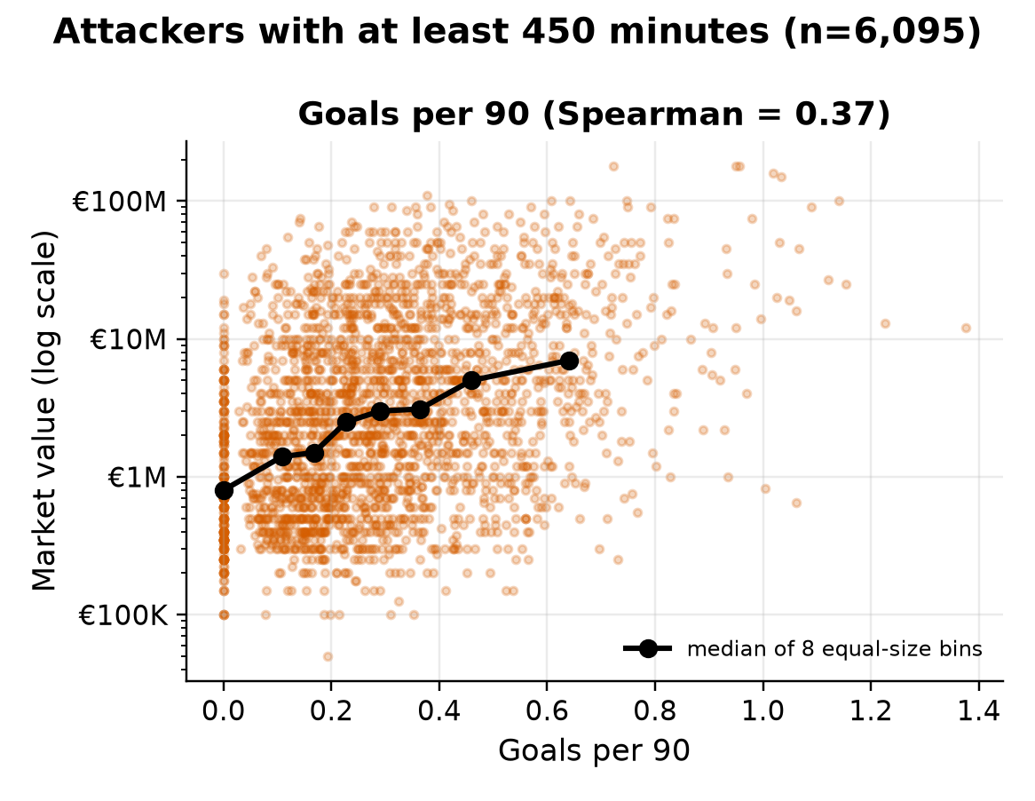
The same statistic means different things by position
Goals track value most for attackers. That does not make goals a measure of defender quality: the data has no tackles, saves or other defensive statistics.
Each dot is an attacker-season; black line = medians of 8 equal-size groups.
Notes:
Goals and assists mean different things for different jobs. For attackers with at least 450 minutes, goals per 90 has a Spearman correlation of 0.37 with value; for midfielders 0.23; for defenders 0.18. The scatter shows attackers: lots of spread, but the median line rises steadily. The caution: this does not say goals are how you judge a defender. The dataset has no tackles, interceptions or saves, so defenders and goalkeepers are under-described.
Remember: Goals/90 vs value: 0.37 attackers, 0.23 midfielders, 0.18 defenders
Caution: Moderate correlation: plenty of high scorers with modest values and the reverse.
Next: "Position and performance differ within leagues, but the biggest gaps are between leagues."

Slide 7
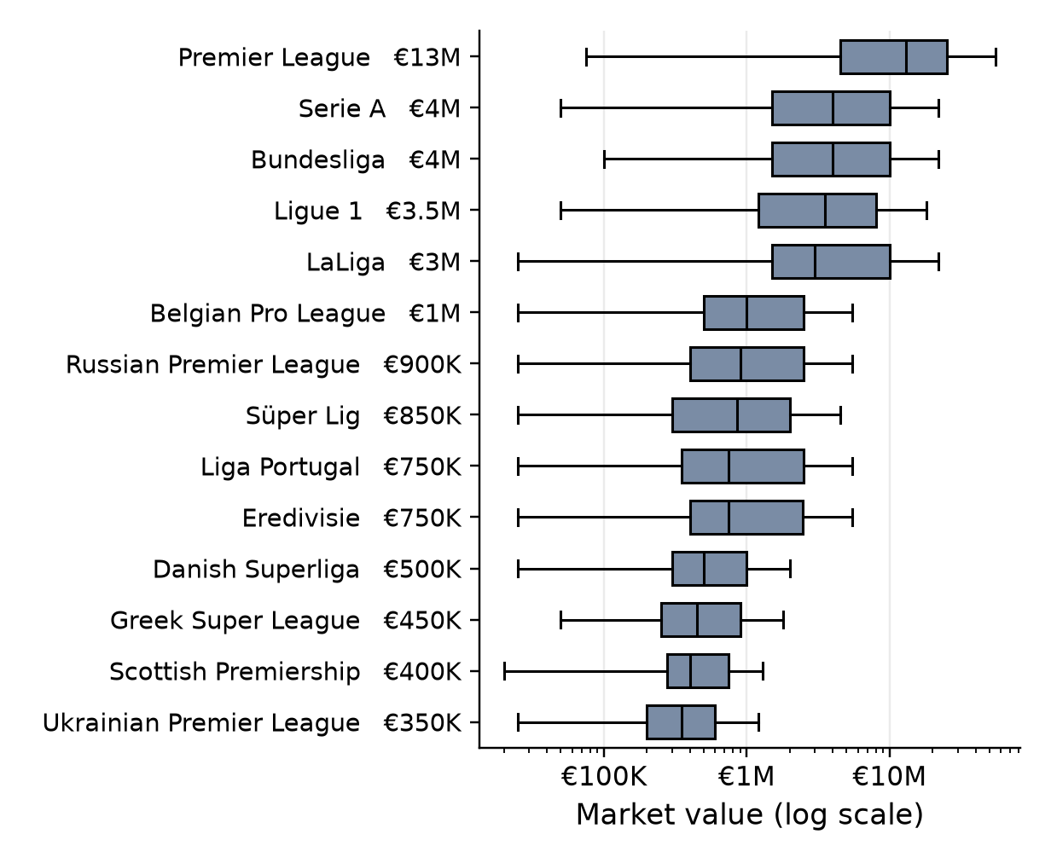
League context shows the largest group differences
€13M
Premier League median value
€4.5M vs €600K
top-five leagues vs the other nine (pooled medians)
Context, not cause
Leagues differ in money, clubs, player pool and exposure. About 35% of the variation in (log) value lies between leagues, vs about 1% between positions.
Notes:
This is the most striking chart. The Premier League median is €13M. The other big leagues: Bundesliga and Serie A €4M, Ligue 1 €3.5M, LaLiga €3M. Every other league is €1M or less, down to €350K in Ukraine. Pooled, the top-five median is €4.5M against €600K for the other nine. About 35% of the variation in log value lies between leagues, compared with about 1% between positions. But this is context, not cause: leagues differ in money, clubs, player quality and media exposure. I cannot say playing in England makes a player worth more.
Remember: Premier League €13M; top-five €4.5M vs others €600K; ~35% between leagues
Caution: Never say 'the league causes higher value'. 35% is a share of variation between groups, not a percentage influence.
Next: "Coming back to attackers: what happens if we look at age and output together?"

Slide 8
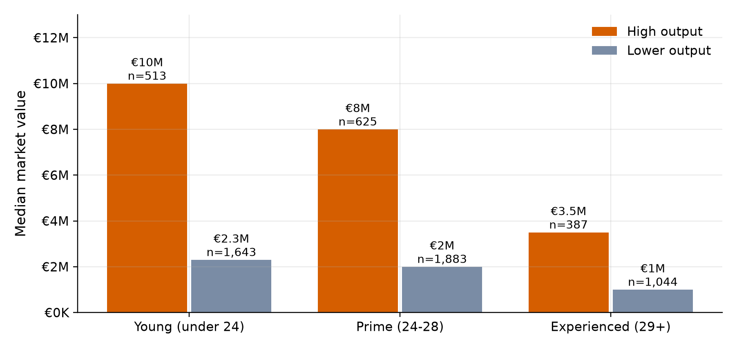
Young, high-output attackers: highest median values
€10M
young, high output
€8M
prime age, high output
€3.5M
experienced, high output
Attackers with ≥450 minutes; high output = top quarter of goals + assists per 90 (≥ 0.59). Same ordering inside the top-five leagues (€31M vs €25M) and outside them (€5M vs €4.5M). Descriptive only: potential, contracts and club level are not in the data.
Notes:
Here I split attackers with at least 450 minutes into three age bands and into high or lower output, where high output means the top quarter of goals plus assists per 90. Young high-output attackers have the highest median, €10M, then prime-age high-output €8M, then experienced high-output €3.5M. Lower-output groups sit around €1-2.3M. At the same output, younger is valued higher. I checked it is not just a league effect: the same ordering holds inside the top-five leagues (€31M vs €25M) and outside them (€5M vs €4.5M).
Remember: Young high output €10M vs prime €8M vs experienced €3.5M
Caution: Descriptive only. A plausible explanation is resale value and future potential, but the data cannot test that.
Next: "My professor suggested checking whether players fall into natural groups, so I tried clustering."

Slide 9
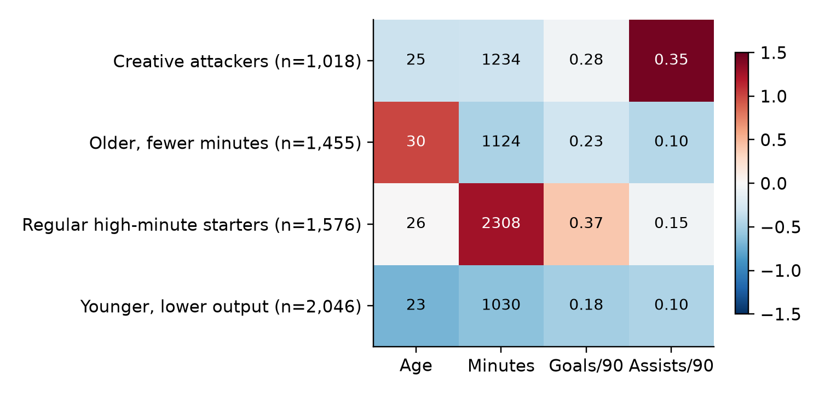
Do attackers form distinct player types?
K-means groups players with similar numbers.
6,095 attacker-seasons (≥450 min)
Inputs: age, minutes, goals/90, assists/90
Not used: market value, league
k = 2 to 6 tested; k = 4 kept for readability
0.21–0.22
€8M
€5M
€1.5M
€1M
silhouette score at every k: weak separation. Profiles overlap; a continuum, not four true types.
Regular high-minute starters
Creative attackers
Younger, lower output
Older, fewer minutes
Notes:
K-means puts players with similar numbers into the same group. I used 6,095 attacker-seasons with at least 450 minutes and four inputs: age, minutes, goals per 90, assists per 90, scaled so each counts equally. Market value and league were not inputs, so value can be compared afterwards and the method cannot produce 'league clusters'. I tried k from 2 to 6. The silhouette score, which measures how well separated the groups are, was only about 0.21 to 0.22 at every k, which is weak. I kept k = 4 because the groups are readable: regular starters (€8M), creative attackers (€5M), younger lower-output (€1.5M), older with fewer minutes (€1M). The honest conclusion: attacker profiles form a continuum, and K-means sliced it into four readable but overlapping groups.
Remember: Silhouette ~0.21 at every k
Caution: Do not say K-means found the true types of attacker, or league groups.
Next: "Putting it together, here is what I can and cannot conclude."

Slide 10
What the analysis shows
Age
Playing time
Position
Value rises into the early/mid twenties and falls after 30: a hump, not a line.
One of the strongest simple associations (Spearman 0.51), in both directions.
Performance statistics mean different things by role; goals matter most for attackers.
League
Age × output
Clustering
€13M Premier League median; top-five €4.5M vs others €600K.
Young high-output attackers: highest median (€10M).
K-means gives readable but weakly separated attacker profiles.
All associations: none of these shows that a characteristic causes a higher value.
Notes:
Go across the six cards in order and keep each to one sentence. End by repeating that all of these are associations.
Remember: Use one number per card: €2.0M peak at 24-26, 0.51, 0.37, €13M, €10M, 0.21.
Caution: None of these is causal.
Next: "And here is what the project cannot show."

Slide 11
What this project cannot show
Estimates
No causation
Missing roles
No injuries
Transfermarkt values are estimates, not prices
Associations only; factors overlap
No defensive or goalkeeper statistics
Injury history is not in the data
League and club
Repeated players
Thresholds
Russia / Ukraine
Context overlaps; club strength not measured
The same player appears in up to five seasons
450 min, July 31, 365 days are practical choices
War conditions after 2022 affect those leagues
Notes:
Pick three or four limitations rather than reading all eight: values are estimates; no causal claims because age, minutes, league and club overlap; no defensive or goalkeeper statistics and no injury data; the thresholds are my choices. Then thank the audience and invite questions.
Next: "Thank you, happy to take questions."

