Slide 1

BanglaTech E-Commerce Platform

Slide 2
Project Objectives
Build a scalable multi-vendor marketplace
Implement role-based access control (Customer, Seller, Admin)
Create responsive and modern UI/UX
Integrate AI chatbot for product recommendations
Ensure secure authentication and payment processing
Deploy on free-tier cloud platforms

Slide 3
Technology Stack
Layer | Technology | Purpose | Market Adoption
Frontend | Next.js 14+ (React) | Server-side rendering, routing, SEO optimization | React: 40.6% ¹
Backend | Node.js + Express.js | RESTful API, business logic, middleware | Node.js: 42.7% ¹ Django: 13.4%
Database | MongoDB + Mongoose | NoSQL database for flexible schema | MongoDB: 25.4% ¹
Authentication | JWT (JSON Web Tokens) | Secure user authentication & authorization | JWT: ~70% ²
File Storage | Cloudinary | Image/media hosting and optimization | Cloudinary: 15% ³
Payment | Dummy Gateway | Payment simulation for demo | N/A (Demo)
Deployment | Vercel (Frontend) + Render/Railway (Backend) | Cloud hosting on free tier | Vercel: 18% ⁴
AI Integration | OpenAI API / Custom ML | Product recommendation & chatbot | OpenAI: 65% ⁵

Slide 4
References:
¹ Stack Overflow Developer Survey 2024
² State of JavaScript/API Authentication Survey 2024
³ Cloud Storage & CDN Market Share 2024
⁴ Jamstack Hosting Platform Statistics 2024
⁵ AI/ML API Usage Report 2024

Slide 5
Usage Statistics (2024)
Source: Stack Overflow Developer Survey 2024, GitHub Octoverse 2024
Technology | Global Usage | Web Development | Job Postings | Growth Trend
Node.js | 42.7% | 51.2% | High (↑) | Growing
React | 40.6% | 45.3% | Very High (↑↑) | Rapidly Growing
MongoDB | 25.4% | 28.1% | Medium (→) | Stable
Express.js | 19.4% | 22.8% | High (↑) | Growing
Python | 51.0% | 42.3% | Very High (↑↑) | Growing (Data Science)
Django | 13.4% | 18.7% | Medium (→) | Stable

Slide 6
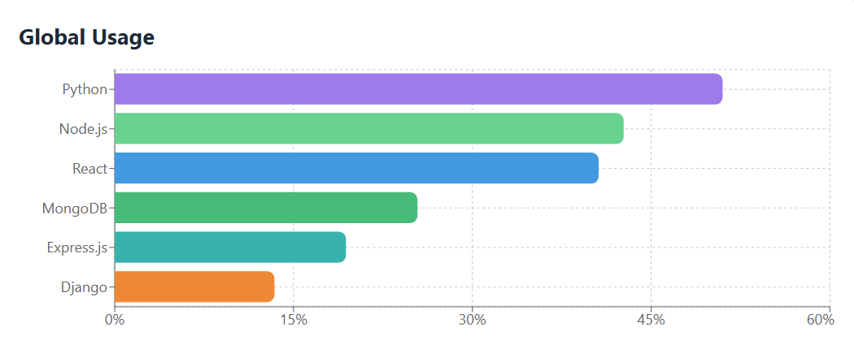
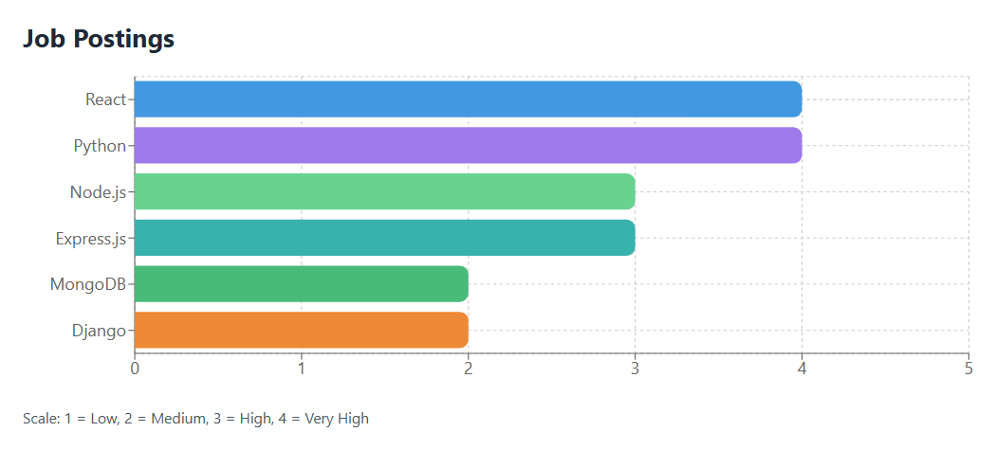
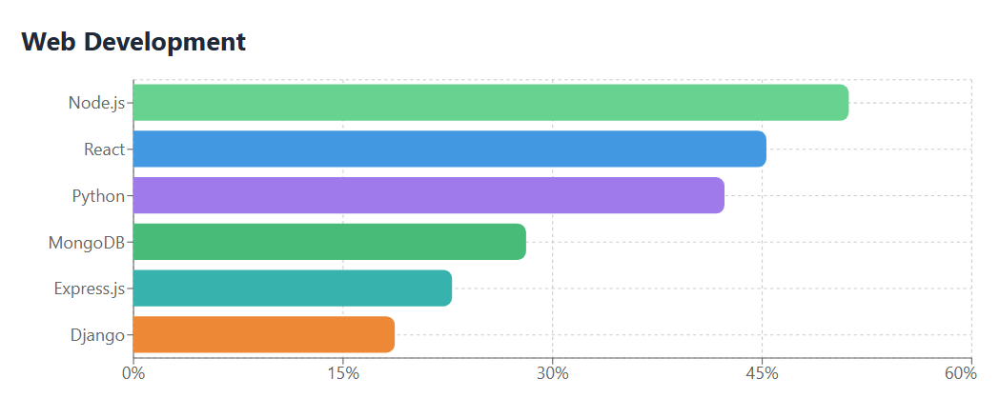
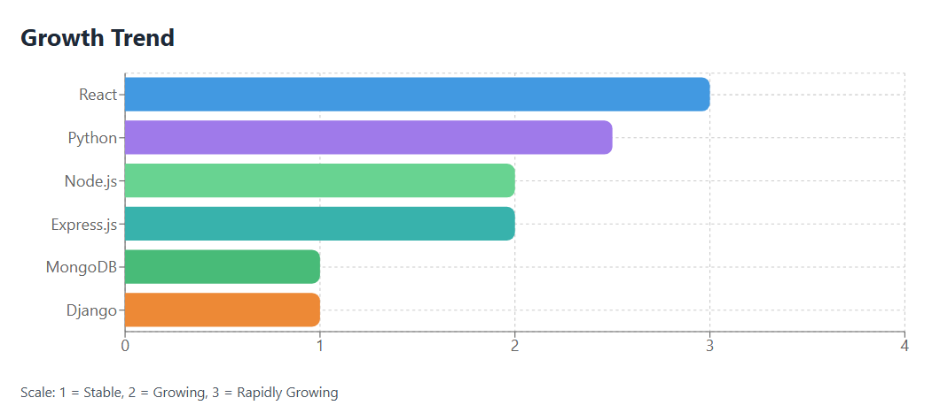

Slide 7
Project Timeline (8-10 Weeks)
Phase 1: Planning & Setup (Week 1)
Define project requirements and features
Create project architecture diagram
Set up development environment
Initialize Git repository
Create database schema design

Slide 8
Phase 2: Backend Development (Week 2-4)
Week 2: Core Backend Setup
Set up Node.js + Express server
Configure MongoDB connection
Create user, product, and order schemas
Build user registration & login APIs
Week 3: Product & Seller Management
Develop product CRUD APIs
Create seller registration & verification system
Build inventory management endpoints
Implement file upload with Cloudinary
Create search and filter APIs

Slide 9
Week 4: Order & Admin Systems
Build checkout and order creation APIs
Implement order management system
Create admin dashboard APIs
Develop seller approval workflow
Build commission calculation logic

Slide 10
Phase 3: Frontend Development (Week 5-7)
Week 5: Core UI & Authentication
Set up Next.js project structure
Create responsive layouts and navigation
Build login/registration pages
Implement authentication flow
Design homepage and product listing

Slide 11
Week 6: User & Shopping Features
Create product detail page
Build shopping cart functionality
Implement wishlist feature
Design checkout process
Create user dashboard and order history
Week 7: Seller & Admin Dashboards
Build seller product management UI
Create inventory and stock management
Design sales reports and analytics
Build admin dashboard
Implement user/seller moderation interface

Slide 12
Phase 4: Advanced Features (Week 8)
Integrate AI chatbot for recommendations
Implement product recommendation system
Add ratings and reviews functionality
Build return & refund system
Create notification system
Phase 5: Testing & Deployment (Week 9-10)
Unit testing (backend APIs)
Integration testing
UI/UX testing and refinement
Performance optimization
Deploy backend to Render/Railway
Deploy frontend to Vercel
Configure environment variables
Final bug fixes and documentation

Slide 13
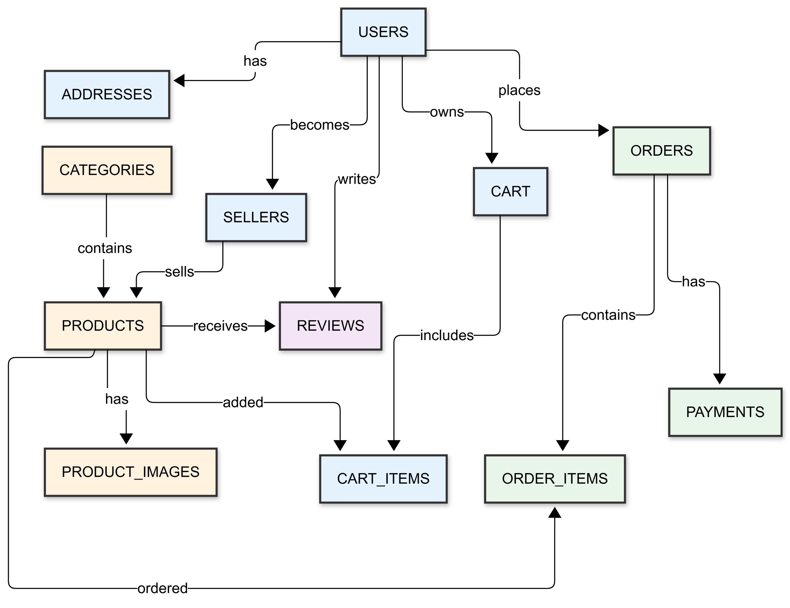
ER Diagram

Slide 14
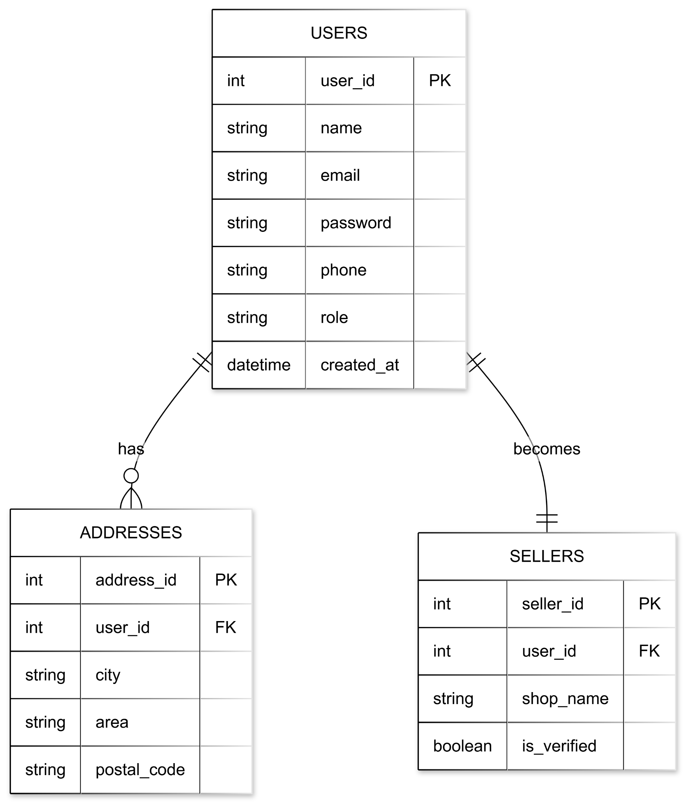
User Management

Slide 15
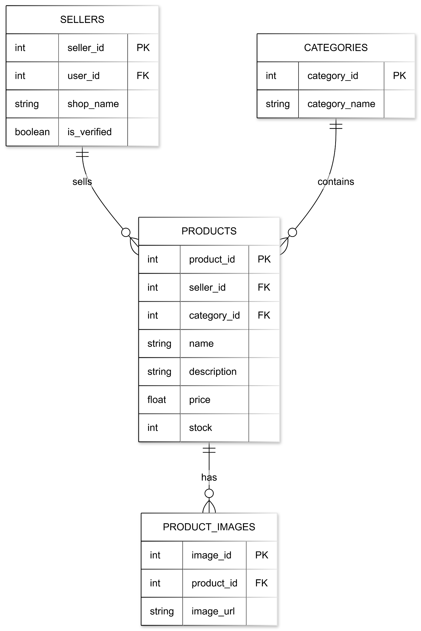
Product Catalog

Slide 16
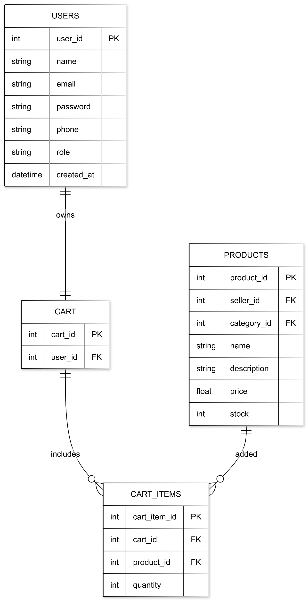
Shopping Cart

Slide 17
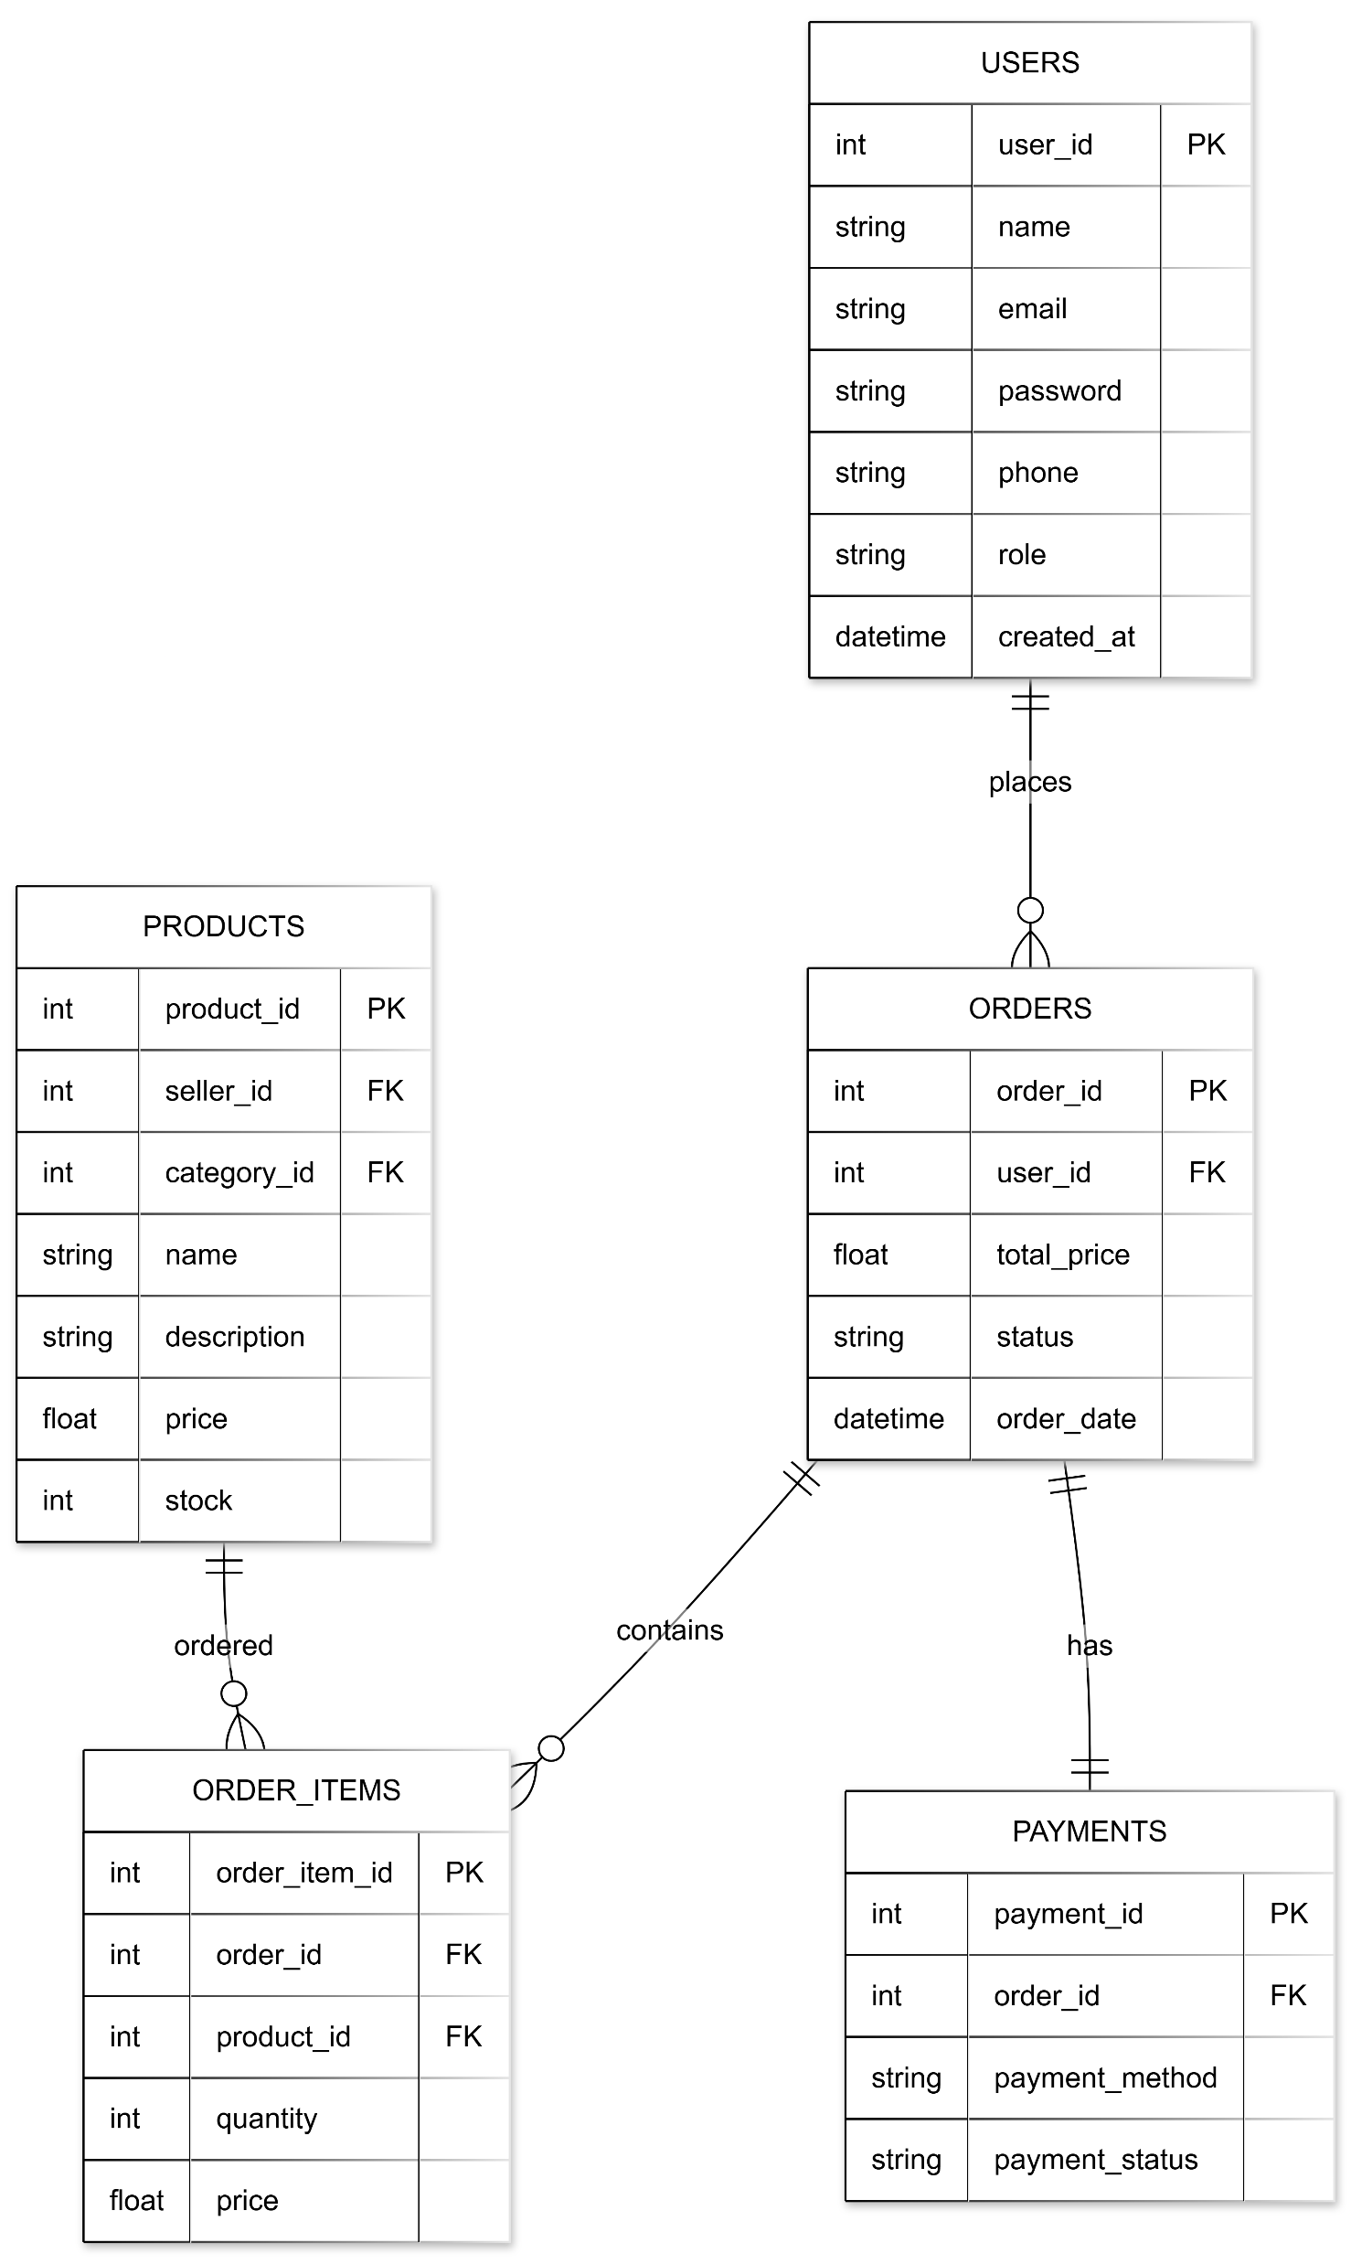
Order & Payment

Slide 18
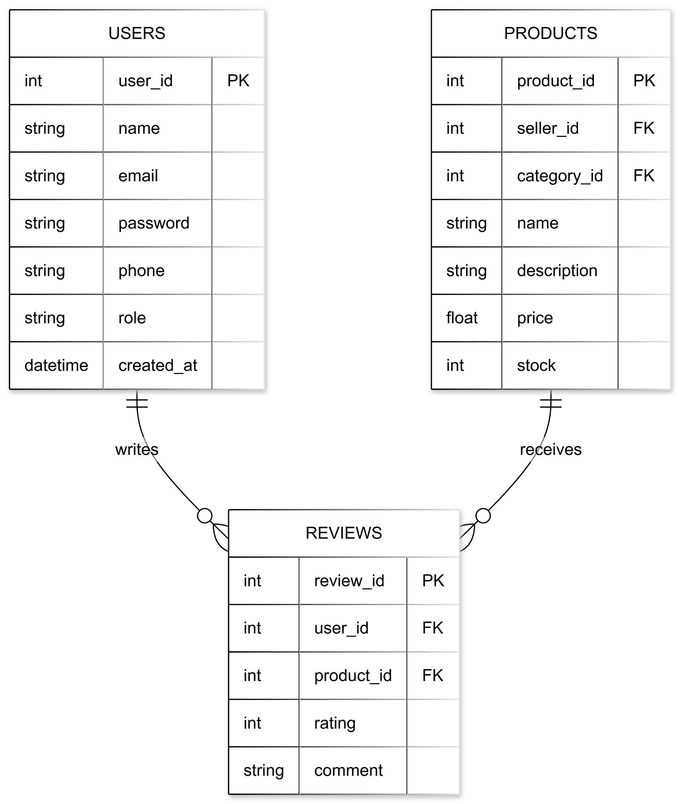
Product Reviews

Slide 19
Conclusion
BanglaTech is a planned multi-vendor e-commerce system designed using industry-standard practices.
The project includes clear module division, ER diagram, and development schedule.
This documentation provides a strong initial foundation for successful system development

Slide 20
Thank you
Presented By:
Sohaib Hasan Niloy (2107028)
Tushar Kumar Roy (2107037)

