Slide 1
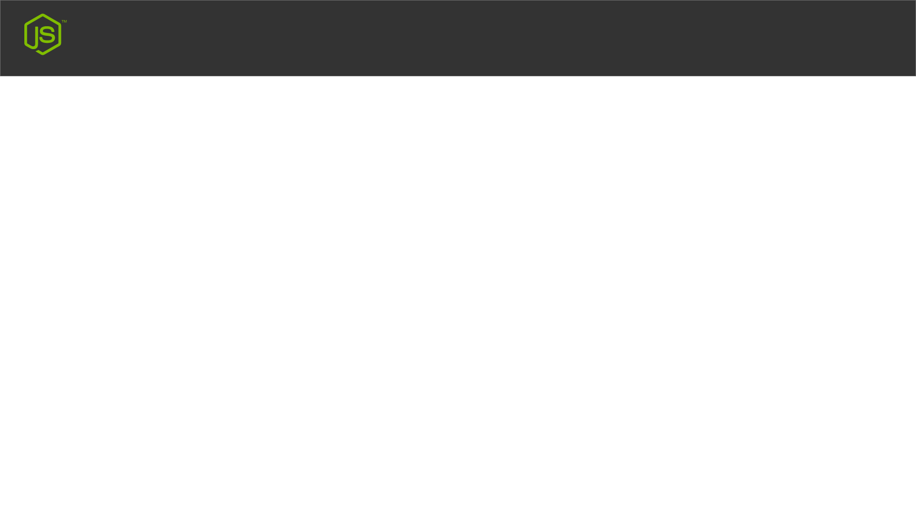
Node JS
MY FIRST NODE JS WEBSITE
Create & Deploy In Real Server

