Slide 1

Node.js fs module
Node.js includes fs module to access physical file system.
The fs module is responsible for all the asynchronous or
synchronous file I/O operations.
Synchronous: Loading…. Loading… you wait for it to finish….After finish you can move.
Asynchronous: No Loading… No Loading … no need to wait…. you can move.

Slide 2
Node.js fs module essentials operation Asynchronous
Method | Description
fs.readFile(fileName [,options], callback) | Reads existing file.
fs.writeFile(filename, data[, options], callback) | Writes to the file. If file exists then overwrite the content otherwise creates new file.
fs.rename(oldPath, newPath, callback) | Renames an existing file.
fs.exists(path, callback) | Determines whether the specified file exists or not.
fs.unlink(path, callback); | File delete
fs.appendFile(file, data[, options], callback) | Appends new content to the existing file.
fs.open(path, flags[, mode], callback) | Opens file for reading or writing.
fs.mkdir(path[, mode], callback) | Creates a new directory.
fs.rmdir(path, callback) | Renames an existing directory.
fs.readdir(path, callback) | Reads the content of the specified directory.

Slide 3
Node.js fs module essentials operation Synchronous
Method | Description
fs.readFileSync(fileName [,options]) | Reads existing file.
fs.writeFileSync (filename, data[, options]) | Writes to the file. If file exists then overwrite the content otherwise creates new file.
fs.renameSync(oldPath, newPath) | Renames an existing file.
fs.existsSync (path) | Determines whether the specified file exists or not.
fs.unlinkSync (path); | File delete
fs.appendFileSync (file, data[, options]) | Appends new content to the existing file.
fs.openSync (path, flags[, mode]) | Opens file for reading or writing.
fs.mkdirSync (path[, mode]) | Creates a new directory.
fs.rmdirSync (path) | Renames an existing directory.
fs.readdirSync (path) | Reads the content of the specified directory.

Slide 4
Synchronous Asynchronous
Understanding Synchronous Asynchronous Theory
Real Example For Clear Concept

Slide 5
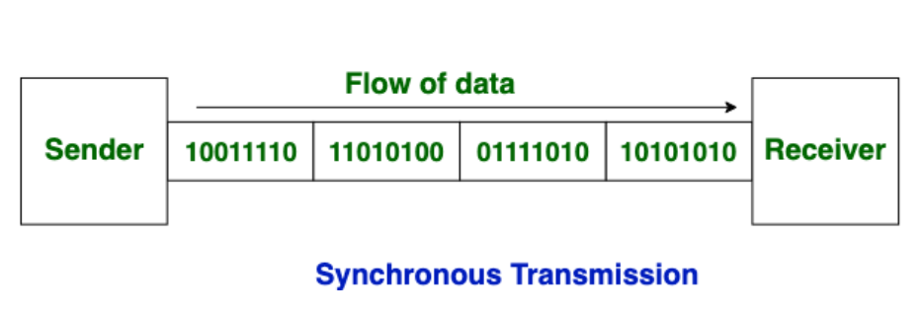
Synchronous Theory
Data is sent in form of blocks or frames.
This transmission is the full duplex type.
There is no gap present between data
Synchronous transmission is fast.
More efficient and more reliable for large amount of data.

Slide 6
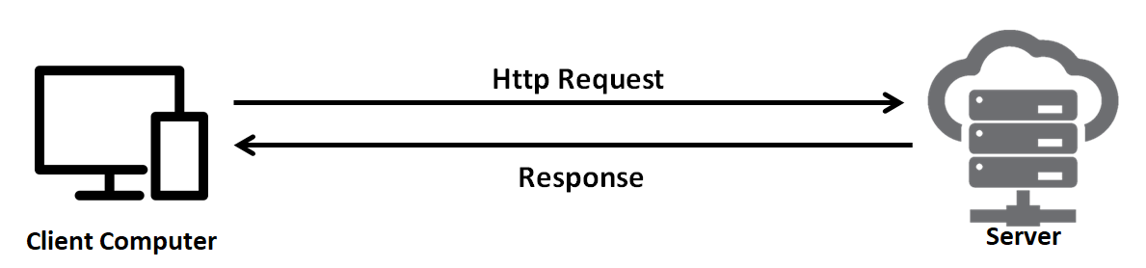
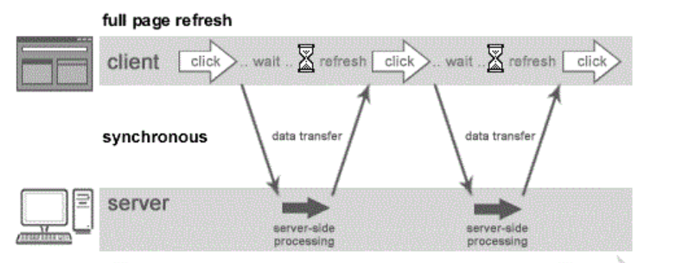
Synchronous Theory
Loading Loading…..
You wait for it to finish
After finish you can move.

Slide 7
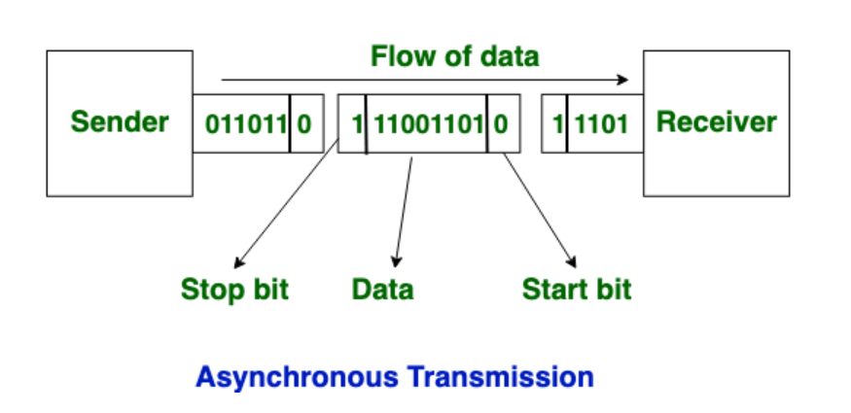
Asynchronous Theory
This transmission is the half duplex type transmission
Start bits and stop bits are added with data.
Data is sent in form of byte or character.
Asynchronous transmission is slow.
There is present gap between data.

Slide 8
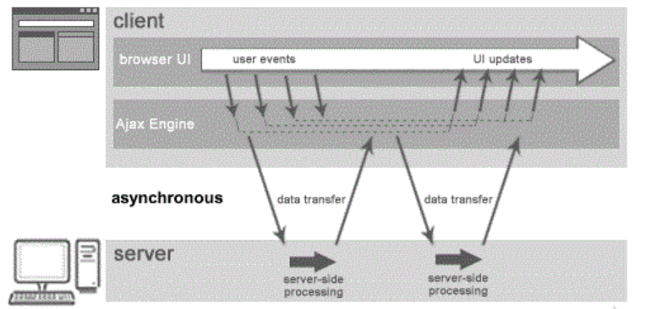
Asynchronous Theory
No Loading… No Loading …
No need to wait….
You can move.

Slide 9
Synchronous Asynchronous
কখন কোনটি

Slide 10


Synchronous is Suitable
Request
Simple Server
Site Process
Response

Slide 11
Asynchronous is Suitable
Say YouTube Video Upload
Compress
Formatting
Request
Upload
Response
Copyright

Slide 12
Node js website

