Slide 1

MonArch: Network Slice Monitoring Architecture for Cloud Native 5G Deployments
Niloy Saha, Nashid Shahriar, Raouf Boutaba and Aladdin Saleh
David R. Cheriton School of Computer Science, University of Waterloo and Rogers Communications, Canada
IEEE/IFIP NOMS 2023, Miami, FL, USA, May 08, 2023
Notes:
Hello, everyone, my name is Niloy Saha from the University of Waterloo, and I am pleased to present our work on network slice monitoring architecture for 5G networks, alongside my esteemed colleagues Nashid Shahriar, Raouf Boutaba, and Aladdin Saleh. Our presentation will cover the topic of network slice KPI monitoring, which is a crucial aspect of ensuring optimal performance in 5G networks. With the growing demand for diverse and complex services, it is essential to monitor network slices to ensure that they are meeting the required KPIs. We believe that our proposed architecture, 5G MonArch, can address the challenges of network slice monitoring and provide a scalable solution for monitoring network slices at different levels, including network functions and infrastructure

Slide 2
5G Network SLICE Monitoring
Notes:
Let's start by looking at why network slice monitoring is important

Slide 3
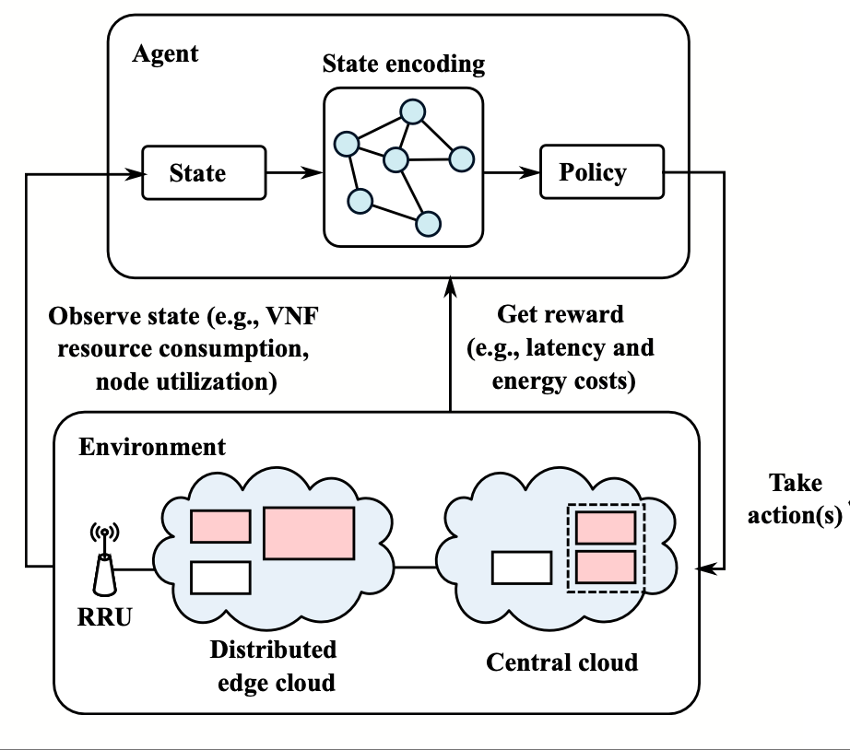
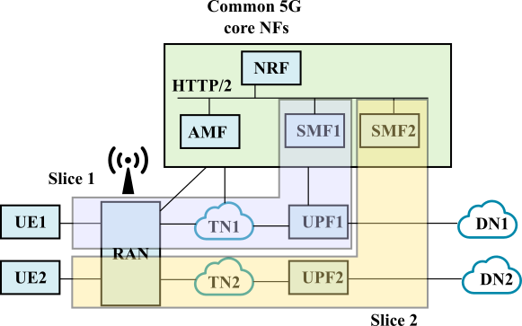
Introduction
Network slicing is a key enabler for emerging 5G and beyond applications
Network slicing allows multiple isolated end-to-end virtual networks
State-of-the-art 5G orchestration and management algorithms are data- driven
Network slicing introduces many challenges for 5G monitoring
Figure: Network Slicing
Figure: Data-driven 5G orchestration
Notes:
In 5G and beyond networks, network slicing is essential to meet the diverse requirements of emerging applications. Network slicing enables multiple isolated end-to-end (E2E) virtual networks to be created on top of a common physical infrastructure, each dedicated to different services. This flexibility comes at the cost of increased network complexity, which requires automated orchestration and management enabled by Artificial Intelligence/Machine Learning (AI/ML) techniques.
State-of-the-art algorithms for automated orchestration and management rely heavily on data-driven methods and require efficient extraction large volumes of data from the network. As such, monitoring network slice Key Performance Indicators (KPIs) is vital to ensure efficient resource allocation, provide timely network performance feedback, and enable data-driven automated service assurance
However, monitoring network slices in 5G networks introduces several challenges. The increased complexity of creating multiple virtual networks on top of a common physical infrastructure, makes it challenging to monitor and manage the entire network. Additionally, different network slices may have unique requirements in terms of bandwidth, latency, and reliability, making it essential to monitor each slice separately. The highly dynamic and constantly evolving nature of 5G networks also requires real-time monitoring to detect and respond to issues promptly

Slide 4
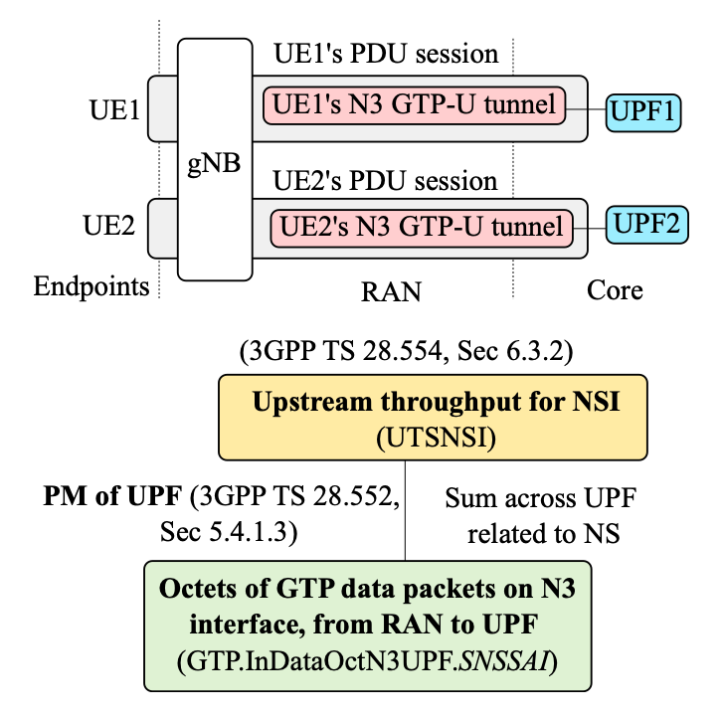
Challenges in 5G Network Slice Monitoring (1/2)
Limited Observability
Traditional monitoring solutions are piecemeal solutions
Only monitor basic performance metrics
Cannot observe ephemeral cloud-native components like containers
Composite KPIs
Network slice KPIs requires correlating multiple infrastructure and NF-related metrics
Figure: 5G composite KPI
Notes:
Existing monitoring solutions are limited in scope, focusing on particular segments of the network such as NFVI and VNF monitoring. This piecemeal approach makes it difficult to collect and correlate monitoring data from different segments of the network to compute slice Key Performance Indicators (KPIs).
Another challenge in 5G network slice monitoring is the adoption of cloud-native technologies such as containers, which requires leveraging container orchestration tools such as Kubernetes. However, traditional monitoring tools cannot easily observe ephemeral cloud-native elements such as containers.
Computing relevant KPIs that enable effective evaluation of Quality of Service (QoS) requirements for 5G services is also a significant challenge. For 5G services, the standardization bodies such as 3GPP have defined several KPIs that are composite in nature and require measuring multiple infrastructure and network function-related metrics. Computing these KPIs for end-to-end network slices is non-trivial.

Slide 5
Challenges in 5G Network Slice Monitoring (2/2)
Complex Monitoring
NFVI metrics (e.g., compute, memory) and VNFM metrics (e.g., replicas)
Performance metrics from the NF (e.g., network I/O, restarts)
Mobile specific metrics (e.g., GTP packets, number of active UEs)
E2E measurements (e.g., slice latency, per hop delay, packet loss)
Need for novel monitoring architecture
Seamless integration with cloud-native tools
Facilitates collection and correlation of metrics and slice KPI computation
Notes:
Finally, 5G and beyond networks have multiple infrastructure layers, virtual network functions, and network segments, making it challenging to provide different levels of monitoring granularity and a unified way to express monitoring requests across different levels of the network.
To address these challenges, a novel monitoring architecture is needed for 5G and beyond networks. The architecture should provide seamless integration with cloud-native orchestration tools, facilitate the collection and correlation of relevant metrics, and enable the computation of network slice KPIs. Additionally, the architecture should include abstractions that allow applications to specify monitoring requests at a high-level and focus on their business logic

Slide 6
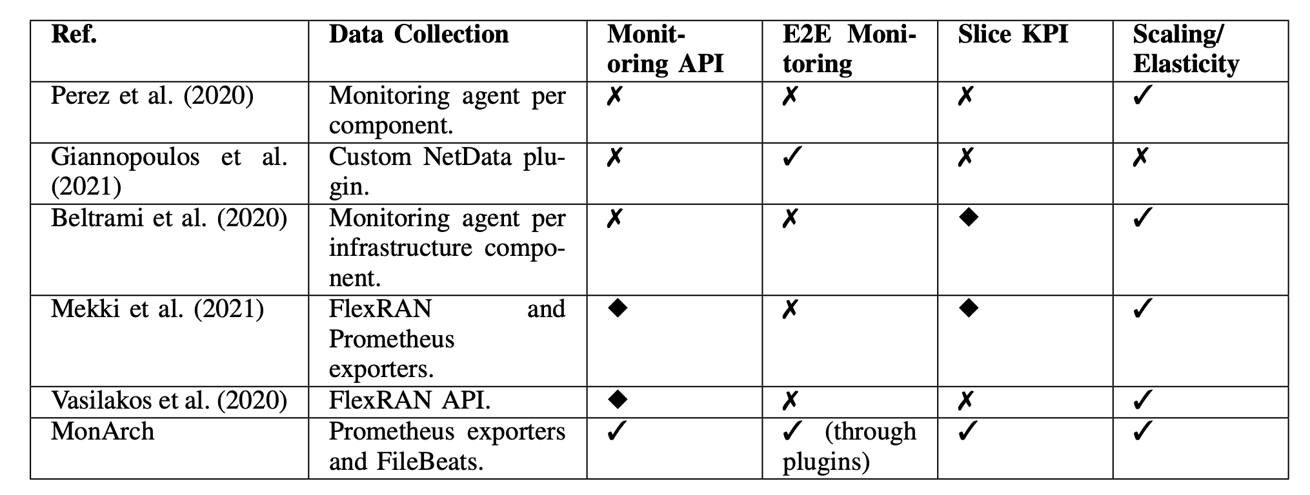
Existing Literature
Figure: Comparison of existing literature and proposed architecture (MonArch). Legends in the table represent supported (✔️), not supported (✘), and partial/limited support (◆).
Notes:
This slide shows a comparison of the existing literature on 5G monitoring. From the table, we see that the existing literature on 5G monitoring has primarily focused on scalable monitoring architecture, but lacks support for network slicing and implementation using a 5G testbed. Our work fills this gap by presenting MonArch, a scalable monitoring architecture for 5G and beyond networks, which has a specific focus on monitoring at the network slice level, slice KPI computation, and an API for specifying monitoring requests.

Slide 7
5G MonArch Architecture
Notes:
Next, let's look at our proposed solution, which we call 5G MonArch

Slide 8
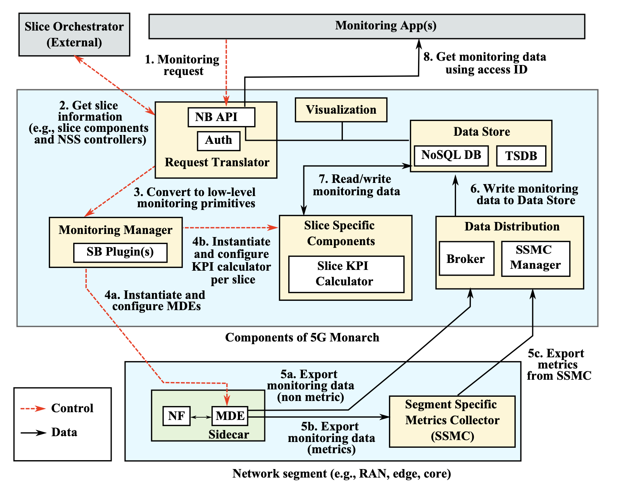
5G-MonArch Monitoring Architecture for Network Slices
5G-MonArch is a monitoring architecture designed for 5G network slices
5G-MonArch facilitates the collection of monitoring data from various network functions (NFs) that make up a network slice and helps in slice KPI computation
The architecture is made up of several key components, each with a specific role in the monitoring process
Figure: MonArch architecture overview
Notes:
To address the challenges we just discussed, we have developed the 5G-MonArch monitoring architecture, specifically designed for monitoring 5G network slices.
The purpose of 5G-MonArch is to collect and analyze monitoring data from various network functions that make up a network slice, and help in computing slice KPIs.
The 5G-MonArch architecture is composed of several key components, each with a specific role in the monitoring process. Let's take a closer look at each of these components in the next slide.

Slide 9
Key Components of 5G MonArch (1/3)
Request translator: Converts high-level monitoring requests into low-level monitoring primitives and exposes computed KPIs to the user
Monitoring manager: Installs and configures monitoring exporters to collect monitoring data from different NFs that make up a network slice
Notes:
The Request Translator is a critical component of MonArch that plays a key role in translating high-level monitoring requests into low-level monitoring primitives. This allows the user to specify various details related to the monitoring request, such as the type of data to be monitored and the level of aggregation
The second component, the Monitoring Manager, is responsible for installing and configuring monitoring exporters to collect monitoring data from different network functions (NFs) that make up a network slice
The Monitoring Manager uses a framework with southbound plugins that interact with the components in various network segments and provide a uniform interface to other components of the monitoring architecture.
In addition, the Monitoring Manager communicates with an external slice orchestrator (such as ONAP) to obtain the mapping between containerized NFs and slices, which is critical for ensuring that the correct monitoring data is collected and analyzed for each network slice.

Slide 10
Key Components of 5G MonArch (2/3)
Monitoring data exporter (MDE): Lightweight containers placed alongside each NF to collect monitoring information and send it to data stores
Slice specific components: Instantiated per network slice and contain the logic for network slice KPI computation
Notes:
In addition to the Request Translator and Monitoring Manager, there are two other important components of the monitoring architecture: the Monitoring Data Exporter and the Slice Specific Components.
The Monitoring Data Exporter (MDE) is responsible for collecting monitoring information from each NF and sending it to the data stores. MDEs are responsible for extracting data from the corresponding NF, transforming the data into the correct format, and sending it to data stores.
Additionally, the MDEs can be written to parse and interpret vendor-specific proprietary protocols and data formatting, and convert the data into a common format used by MonArch.
The Slice Specific Components are instantiated per network slice and contain the logic for network slice KPI computation.
They query the data store, compute KPIs (e.g., by correlating data from different NFs), and write the computed KPIs back to the data store.
These components contain the logic necessary for computing network slice KPIs (e.g., those standardized by the 3GPP) and can be extended via scripts to support custom KPIs.

Slide 11
Key Components of 5G MonArch (3/3)
Segment specific metrics collector (SSMC): Collects metric data from particular network segment and sends them to a central data store
Data distribution: Collects and enriches non-metric data from various network slice segments and other sources of monitoring data
Data store: An abstraction of persistent storage and is responsible for storing monitoring and configuration data
Notes:
Next, we have the Segment specific metrics collector (SSMC):
This component is used to collects metric data from various network segments and send it to a central data store.
Benefits include avoiding data collection across network segment boundaries, local persistence of monitoring data, and segment-wise labeling of collected metrics.
Next, we have the The Data distribution component, which collects non-metric data from various network slice segments and other sources.
It includes a high-performance broker (such as Apache Kafka) and components for transforming and enriching streaming data (e.g., Logstash).
Finally we have the Data store component. It Stores monitoring and configuration data, consists of a combination of NoSQL and time-series database (TSDB) to store numeric and non-numeric data respectively.

Slide 12
Advantages of 5G MonArch
Efficiently stores large volumes of numeric metric data generated by monitoring different components of a 5G network over time
Allows for custom KPIs through extendable scripts
Provides local persistence of monitoring data and provides scalability
Allows for segment-wise labelling of each collected metric to aid in KPI computation
Notes:
There are several benefits to using the 5G-MonArch monitoring architecture.
The architecture efficiently stores large volumes of numeric metric data generated by monitoring different components of a 5G network over time.
It allows for custom KPIs through extendable scripts, making it easy to customize for specific use cases.
The architecture avoids data collection across network segment boundaries, providing local persistence of monitoring data and increasing scalability through collection of aggregated metrics.
The Segment Specific Metrics Collector (SSMC) allows for segment-wise labelling of each collected metric to aid in KPI computation.
These features make 5G-MonArch a powerful architecture for monitoring 5G network slices.

Slide 13
Network Slice Monitoring using 5G MonArch
Notes:
Now that we have an understanding of the key components of 5G MonArch, let’s take a look at the flow of a network slice monitoring request.
- The first step involves monitoring apps specifying a high-level network slice monitoring request in JSON format. This request returns an access identifier to the monitoring application.
- Next, the request is passed from the request translator to the monitoring manager.The monitoring manager gathers information about the components of the requested slice by communicating with an external slice orchestrator.
- In step 3, the monitoring manager translates the high-level monitoring requests into low-level monitoring primitives. For example, a network slice throughput request would be converted to monitoring primitives for the associated session management function (SMF) and user plane function (UPF).
- Step 4 consists of two parts. In step 4a, the monitoring manager leverages the southbound plugins to instantiate and configure MDEs for all the associated NF components identified in Step 3.
- In step 4b, the monitoring manager instantiates slice specific KPI calculators (with predefined logic) for the given monitoring request.
- Step 5 consists of three parts which operate in parallel. In Step 5a, the MDEs export non-metric data to the data store through the use of data distribution module. In Step 5b, SSMC collects metric data from the MDEs at the interval specified by the monitoring manager. Subsequently, in Step 5c, the SSMC exports the metrics data (properly labelled and aggregated) to the global data store.
- Step 6: This step involves writing the data from the data distribution module to the appropriate database (NoSQL or TSDB depending on type of data) in the data store.
-In this step 7, the slice KPI calculator components that are already instantiated (Step 4b) read/write the monitoring data from the data store and perform the slice KPI computation according to the predefined logic.
- The final step involves getting access to the requested monitoring data using either the NB API or a data visualization module while using the access ID

Slide 14
IMPLEMENTATION & Evaluation

Slide 15
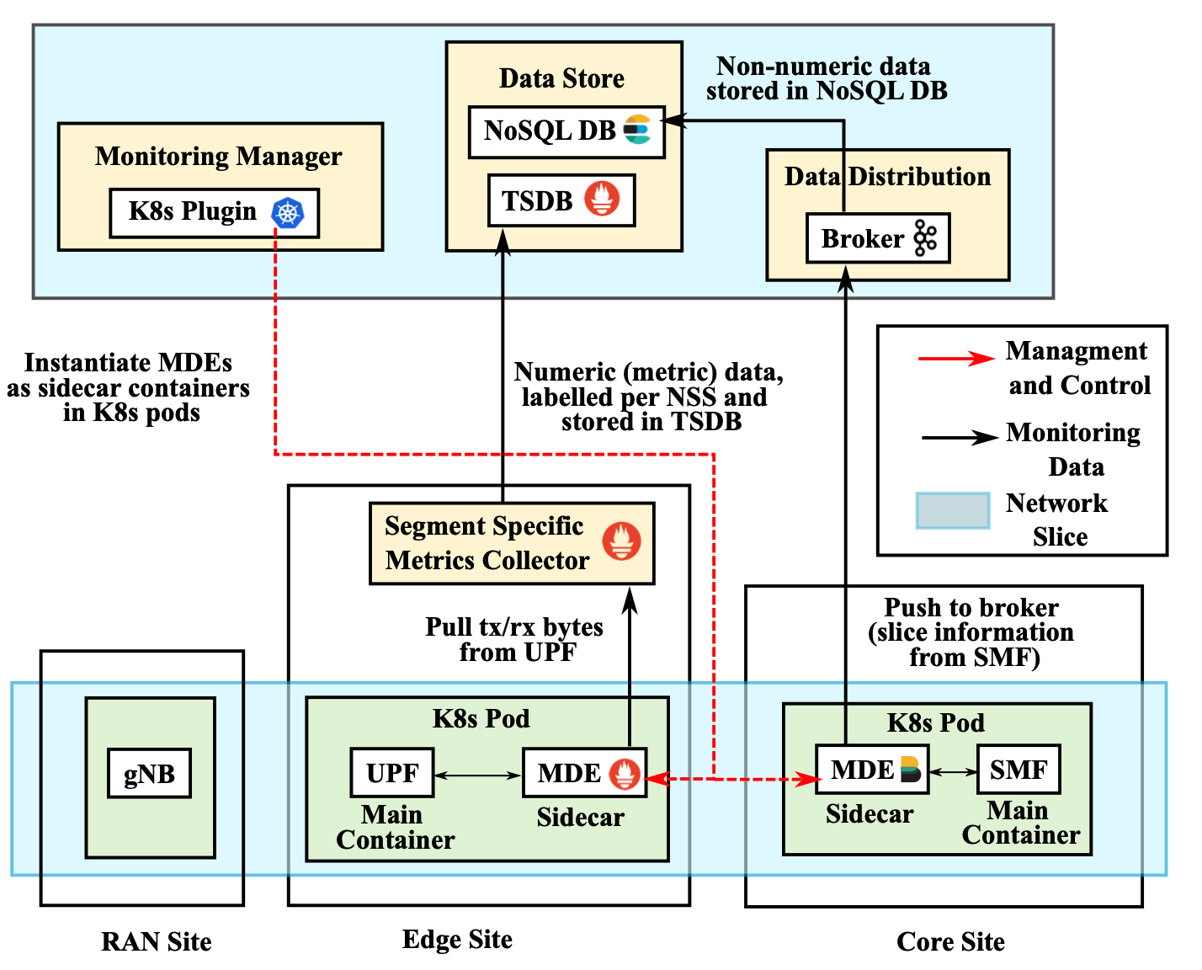
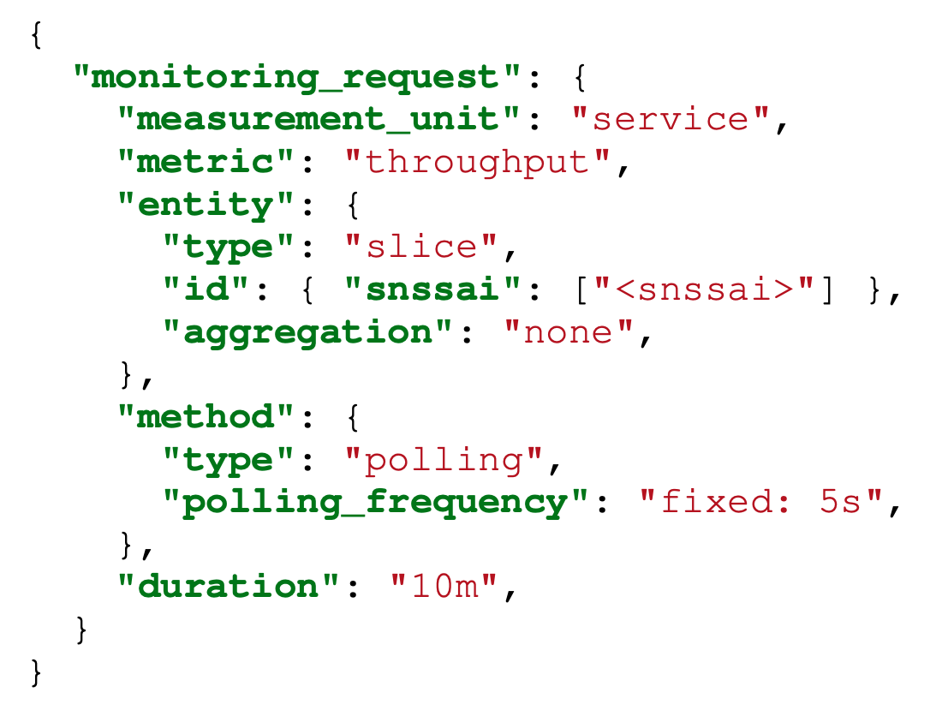
MonArch Implementation
Implemented on 5G slicing testbed built using Free5GC as core and UERANSIM as gNB and UE emulator
Figure: MonArch request API
Notes:
The figure on the left shows the validation of MonArch by implementing it on a 5G testbed at the University of Waterloo. The testbed includes a 5G mobile core based on Free5GC, and emulated gNodeB and UE based on UERANSIM. In the future, we plan to extend this architecture by interfacing it with the ORAN standard near-real-time RIC to collect metrics from the gNB.
The tools used for realizing the various components of MonArch are shown in the figure, with Kubernetes used for orchestration and management, and Prometheus used as a metrics collector. At the bottom of the figure, we can see the 5G network components, with the monitoring data exporters instantiated as sidecar containers alongside the 5G NFs in the Kubernetes pods.
On the right side of the slide, we have an example that illustrates how the MonArch northbound API can be used to specify a high-level slice KPI monitoring request. In this example, network slice throughput monitoring is specified by setting the metric to throughput and the entity type to slice, identified by its slice identifier or SNSSAI.

Slide 16
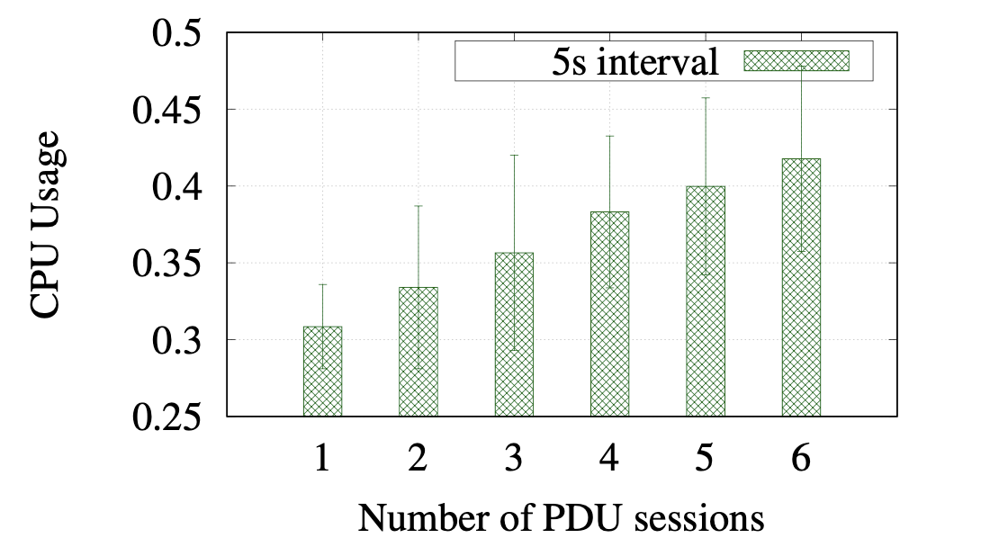
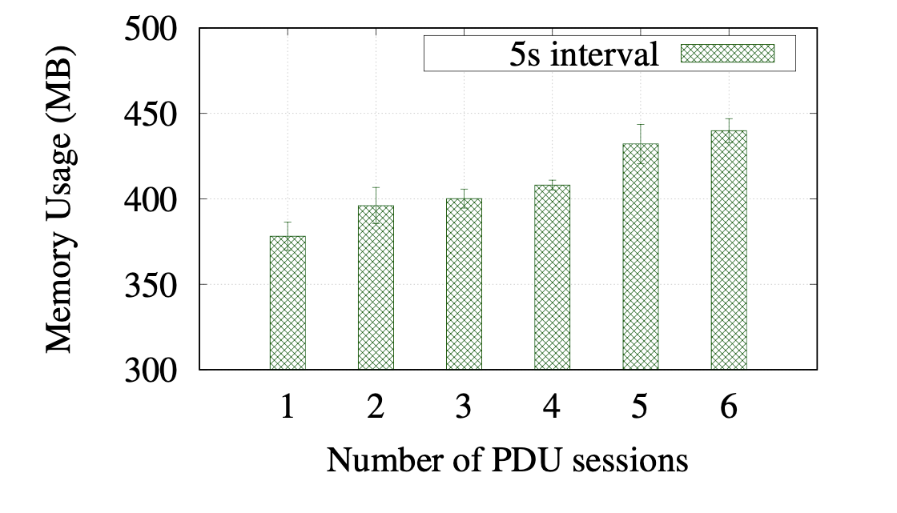
Results: Resource Usage
3 E2E network slices
2 PDU sessions per slice
Dedicated instances of SMF and UPF, all other 5G core functions common
Figure: 3x increase in slice leads to 1.4x increase in CPU usage
Figure: 3x increase in slice leads to 1.1x increase in average memory usage
Values of CPU (40%) and memory consumption (450MB) for 3 slices are within reasonable bounds
Notes:
To evaluate the performance of the MonArch architecture, we created three network slices, each with two UE-initiated PDU sessions for a total of six PDU sessions. Each slice had its own dedicated instances of SMF and UPF, while all other 5G core functions were common across all slices
Our primary focus was on the resource usage of the SSMC. The figure on the top of the slide shows that the CPU usage of the SSMC increases linearly with an increase in the number of slices. However, the increase in CPU consumption is reasonable, and a 3x increase in the number of slices resulted in a 1.4x increase in CPU usage.
The figure on the bottom of the slide shows that a 3x increase in the number of slices results in approximately a 1.1x increase in the average memory usage of the SSMC. Despite the increases, the values of CPU (40%) and memory consumption (450MB) for 3 slices are considered reasonable, indicating that the SSMC can handle a larger number of slices

Slide 17
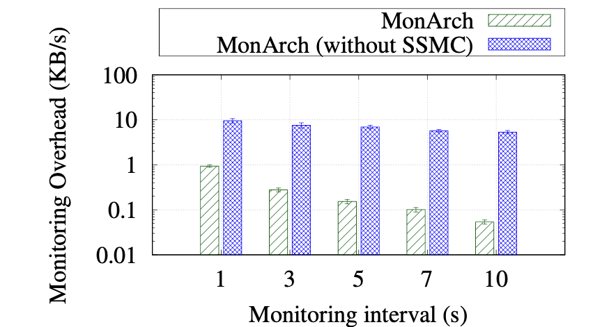
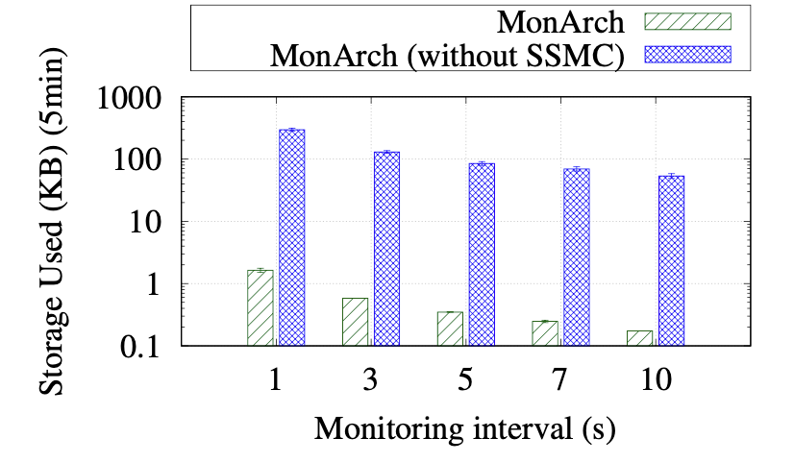
Evaluation: Overhead and Storage
MonArch uses two methods for data collection: numeric data is sent to a TSDB through the SSMC for efficient collection and storage.
This slide shows a comparison of MonArch with and without SSMC in terms of monitoring overhead and storage usage.
Figure (top) shows there is an almost 10x decrease in the monitoring overhead compared to the MonArch variant without SSMC due to the efficient storage of metric data in a compressed format in a TSDB.
Figure (bottom) shows a significant reduction in storage overhead achieved by MonArch compared to its variant without SSMC.
Figure: 10x reduction in monitoring overhead when using segment specific metrics collector (SSMC)
Figure: 10x reduction in storage due to efficient TSDB representation
Notes:
Next, we look at the monitoring overhead and storage usage of MonArch.
MonArch uses two methods for data collection: numeric data is sent to a TSDB through the Segment Specific Metrics Collector (SSMC) for efficient collection and storage, while non-metric data is collected using a high-performance broker.
This slide compares MonArch with and without SSMC in terms of monitoring and storage overhead. The figure on the left shows that using SSMC results in an almost 10x reduction in monitoring overhead due to the data aggregation and efficient time-series representation.
The figure on the right shows a significant decrease in storage overhead achieved by MonArch with SSMC. These results demonstrate that MonArch is efficient in terms of monitoring overhead and storage usage, making it a practical solution for monitoring network slices
By using SSMC, MonArch is able to avoid data collection across network segment boundaries, enabling local persistence of monitoring data and segment-wise labeling of collected metrics. Furthermore, MonArch's combination of NoSQL and time-series databases enables it to efficiently store both numeric and non-numeric monitoring and configuration data.

Slide 18
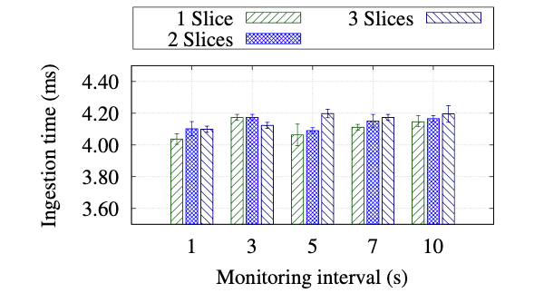
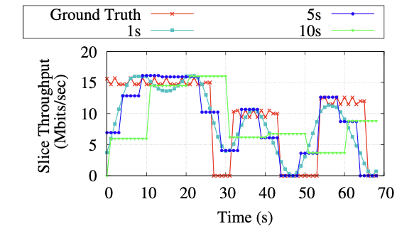
Evaluation: Ingestion time and Accuracy
MonArch has minimal impact on ingestion time
Scales effectively with the number of slices
Figure: Minimal impact on data ingestion time
Figure: 5s interval offers reasonable trade-off among accuracy and overhead
Notes:
MonArch's performance was evaluated in terms of its impact on data time and its ability to scale with the number of slices and monitoring intervals.
Our experiments showed that MonArch has a minimal impact on the data ingestion time, which makes it an efficient solution for real-time monitoring of network slices.
We also evaluated the impact of monitoring intervals on the accuracy of the monitoring results. In our time-varying traffic experiments, we compared MonArch's measured slice throughput to the ground truth and found that the monitoring interval has a significant impact on the accuracy of the results.
We found that a monitoring interval of 5 seconds offers a reasonable tradeoff between monitoring overhead and accuracy. This means that MonArch can provide accurate monitoring results while keeping the overhead to a minimum, which makes it a practical solution for monitoring network slices in 5G networks

Slide 19

Conclusion
5G MonArch is a scalable monitoring architecture that can monitor the 5G network at different levels such as network slices, network functions, and infrastructure
We implemented 5G MonArch on a 5G testbed and validated it by computing network slice throughput KPI
From the evaluation results, we see that the architecture scales well with the number of slices
The project is open-source! Please visit https://github.com/niloysh/5g-monarch.
Notes:
To sum up, in this paper, we presented MonArch, a scalable monitoring architecture for cloud-native 5G deployments that focuses on network slice monitoring.
Our experiments on a 5G testbed demonstrate the efficacy of MonArch in enabling efficient and effective monitoring of 5G networks.
By validating MonArch's implementation and using it to compute network slice throughput KPI, we showed that MonArch can scale effectively with the number of slices and monitoring intervals.
Moreover, our results demonstrate that MonArch has minimal impact on data ingestion time, and a monitoring interval of 5 seconds offers a reasonable tradeoff between monitoring overhead and accuracy.
We have open-sourced our code, which can be found on Github. Thank you for listening. If you have any questions, I will be happy to answer them

Slide 20
Thank you!

