Slide 1

Efficient High-precision Monitoring of Network Slices for 5G and Beyond Networks
Niloy Saha
PhD Thesis Defence
June 22, 2026
Examining Committee
Advisor: Raouf Boutaba
Examiners: Israat Haque, Mina Tahmasbi Arashloo,
Ali José Mashtizadeh, Tahsin Reza
Notes:
[~0:20 | running ~0:20]
Good afternoon, everyone, and thank you for being here. I'm Niloy Saha, and today I'll defend my dissertation: "Efficient, High-Precision Monitoring of Network Slices for 5G and Beyond Networks," done under the supervision of Prof. Raouf Boutaba.
-> Let me start with what a network slice is, and why monitoring one is hard.

Slide 2


What is a network slice?
An isolated logical network over shared infrastructure, with its own end-to-end service guarantee.
NF
NF
NF
NF
Radio Access
Edge Cloud
Transport
Central Cloud
Slice A: Latency-critical
e.g., remote control. SLA: very low latency and loss.
Slice B: Bandwidth-heavy
e.g., video / broadband. SLA: high throughput, moderate latency.
A slice is the unit of end-to-end service guarantees
Notes:
Target time: 0:50
I will start with what I mean by a network slice.
A slice is an isolated logical network built over shared physical infrastructure. It has its own service guarantee, even though it may share radio, transport, edge, and core resources with other slices.
For example, the blue slice represents a latency-critical service with strict latency and loss requirements. The green slice represents a bandwidth-heavy service with high-throughput requirements. The functions that realize each slice can be placed at different parts of the infrastructure, depending on the service objective.
The key point is that a slice is not just a set of resources. It is the unit at which the operator promises end-to-end service behavior.

Slide 3
Network slice management depends on monitoring
Analyze
Plan
Monitoring is a key enabler for closing the loop!
Network Intelligence
Monitor
Execute
NF
NF
Control can only optimize what it can observe -- monitoring is a crucial part of closed-loop network slice management.
NF
NF
Radio Access
Edge Cloud
Transport
Central Cloud
Notes:
Network slicing offers increased control over MANO at the cost of increased complexity
Closed loop control (e.g., MAPE) has been proposed to address this complexity
Recent advances in AI/ML provide opportunities to achieve closed loop control
State of the art algorithms are data-driven and rely on large amounts of data collected from the network
Network monitoring is a key enabler for closing the loop - it is the process of constantly monitoring network and network components by collecting data about their state and behavior
Note: Focus on the idea that monitoring is important for all parts of the MAPE loop
Target time: 0:50
Once slices become the unit of service guarantees, managing them becomes a closed-loop problem.
The operator has to monitor the network, analyze whether the slice is meeting its SLA, plan corrective actions, and execute those actions. This is the standard MAPE view of closed-loop automation.
But the loop is only as good as its observations. If monitoring misses a transient violation, aggregates away the responsible slice, or reports too slowly, then even a sophisticated controller is optimizing against the wrong view of the network.
So in this thesis, I focus on the monitoring layer as the foundation for slice automation.

Slide 4
Three requirements for practical slice monitoring
End-to-end visibility
What is the slice experiencing end-to-end?
Monitoring fidelity
How closely should each slice be monitored?
Fine-grained attribution
What caused a performance violation?
This Dissertation
This dissertation addresses slice monitoring through three complementary dimensions: architectural abstraction, SLA-aware telemetry control, and fine-grained user-plane visibility.
Performance measurements are fragmented across heterogeneous network domains.
Monitoring needs differ across slices and evolve with their SLAs and workloads.
Transient SLA-relevant events are difficult to detect and attribute in shared resources.
Notes:
So these observations determine the architecture.
At the top, applications should express monitoring intent at slice scope: for example, monitor throughput for S-NSSAI X every second.
Inside Monarch, that intent is resolved into the current monitoring scope: which sessions, network functions, and telemetry sources are relevant right now.
Telemetry collection is then executed close to the relevant segment or network function.
Finally, Monarch aggregates and correlates the collected data using KPI-specific semantics, and exposes the resulting slice KPI back to applications.
That is the core design principle: centralize slice semantics, but distribute telemetry execution.
--
Target time: 1:00
This is the Monarch architecture at the level of a monitoring request.
An application asks for a slice-scoped KPI, for example throughput for S-NSSAI X every second. Monarch resolves that request into the current scope: which control-plane functions, user-plane functions, sessions, and telemetry sources are relevant.
Then segment-level collectors execute the telemetry close to where the data is produced. For throughput, the UPF may export byte counters keyed by TEID, while the SMF provides the TEID-to-S-NSSAI binding.
Finally, Monarch correlates and aggregates using KPI-specific semantics. In this example, bytes are attributed to the slice and converted into throughput.
The architectural principle is: centralize semantics, distribute execution.

Slide 5

This dissertation
Closed-loop Network Automation (The “Why”) Analyze, Plan, Execute
Slice KPIs, Alerts
Actions
The Monitoring Stack (The “How”) – This Dissertation
Monarch (Slice Monitoring Abstraction) [NOMS’23, TNSM’25]
SliceScope (SLA-aware Telemetry Control) [SIGMETRICS’26]
Kestrel (Fine-grained Visibility) [NOMS’26 ,TNSM’26 (under review)]
Observations
NF
NF
NF
NF
Notes:
Target time: 0:40
This slide shows the structure of the dissertation.
At the bottom is the network that produces telemetry. At the top is closed-loop automation, which consumes slice KPIs and alerts to analyze, plan, and execute.
The thesis contributes the monitoring stack in between. Monarch provides the slice monitoring abstraction. SliceScope controls monitoring fidelity under SLA and budget constraints. Kestrel provides fine-grained user-plane evidence for transient anomalies.
Together, these contributions ask how to make monitoring both precise enough for SLA assurance and efficient enough to deploy.

Slide 6
Research question 1: end-to-end slice visibility
The Monitoring Stack (The “How”) – This Dissertation
Monarch (Slice Monitoring Abstraction) [NOMS’23, TNSM’25]
SliceScope (SLA-aware Telemetry Control) [SIGMETRICS’26]
Monarch (Slice Monitoring Abstraction) [NOMS’23, TNSM’25]
Kestrel (Fine-grained Visibility) [NOMS’26 ,TNSM’26 (under review)]
How can slices be exposed as first-class monitored entities with unified, end-to-end KPIs across heterogeneous domains?
Notes:
Target time: 0:40
This slide shows the structure of the dissertation.
At the bottom is the network that produces telemetry. At the top is closed-loop automation, which consumes slice KPIs and alerts to analyze, plan, and execute.
The thesis contributes the monitoring stack in between. Monarch provides the slice monitoring abstraction. SliceScope controls monitoring fidelity under SLA and budget constraints. Kestrel provides fine-grained user-plane evidence for transient anomalies.
Together, these contributions ask how to make monitoring both precise enough for SLA assurance and efficient enough to deploy.

Slide 7
Slice monitoring depends on context that keeps changing
A slice KPI is a maintained derived view over distributed, evolving network state.
Slice KPIs
Control-plane context
Telemetry sources
SMF SNSSAI → Sessions → TEID
UPF counters keyed by TEID/PDR
Throughput
SMF/PCF Session → 5QI
Data plane telemetry via SliceScope
Latency
Fragmented
Telemetry is keyed by domain-level identifiers.
Slice binding lives in different layer; depends on the KPI.
Context loss
If telemetry is aggregated before slice context is attached, slice contribution cannot be recovered.
Ephemeral
Sessions, tunnels, pods, and radio bindings churn. Each holds only for a bounded interval.
Cross-domain correlation is necessary, but it should be KPI-specific, context-preserving, and continuously maintained.
Notes:
Target time: 1:20
The basic challenge is that a slice KPI is not usually a raw measurement. It is a maintained derived view over distributed, evolving network state.
Take throughput as an example. The application wants throughput for an S-NSSAI. But user-plane counters are typically keyed by identifiers such as TEID or forwarding rules, not directly by S-NSSAI. The mapping from TEID to session and slice lives in the control plane, for example in the SMF.
Latency has a similar issue. Depending on the measurement mechanism, the telemetry may come from the data plane, but interpreting it as a slice KPI still requires slice and QoS-flow context.
This creates three problems. The state is fragmented across domains and layers. Context can be lost if telemetry is aggregated before slice binding is attached. And the mapping is ephemeral: sessions, tunnels, pods, and radio bindings churn over time.
So the principle is: attribute first, aggregate second, and continuously maintain the mapping used for each KPI.
---
The core difficulty: a slice KPI is not a number you read off a box -- it's a maintained, derived view over distributed, evolving state.
Take latency and throughput. The control-plane context lives in the SMF and PCF -- session-to-5QI, S-NSSAI-to-sessions-to-TEID. The telemetry sources are elsewhere -- UPF counters keyed by TEID and PDR, data-plane telemetry from SliceScope.
Three properties make this hard. Fragmented: telemetry is keyed by domain-level identifiers, and the slice binding lives in a different layer depending on the KPI. Context loss: if you aggregate before attaching slice context, the slice's contribution is unrecoverable. Ephemeral: sessions, tunnels, pods, radio bindings all churn -- each binding holds only for a bounded interval.
So cross-domain correlation is necessary, but it has to be KPI-specific, context-preserving, and continuously maintained.
-> That requirement is exactly what makes this an architecture problem.

Slide 8
Slice monitoring is an architecture problem
Without a slice-native layer
With Monarch
Admission control
KPI registry: the “right” join per KPI
subscribe
map IDs
reconcile
aggregate
KPI
Context
Telemetry
Throughput
SMF NSSAI, TEID
UPF counters
Autoscaling
subscribe
map IDs
reconcile
aggregate
Latency
SMF/PCF QoS Flow Binding
Data plane INT
Monarch centralizes slice semantics: reconstruct once, expose a slice-level API, while telemetry collection and execution stay distributed.
Fault management
Reconstructed once, continuously maintained
subscribe
map IDs
reconcile
aggregate
Reconstruction cost is duplicated.
Stale or inconsistent views!
monitor(scope=slice, KPI, policy)
Consumers stop reasoning about pods, TEIDs, QFIs, tunnels, queues, cells!
Notes:
Given that challenge, the next question is: where should this reconstruction happen?
One option is to push it downstream to every application. For example, admission control, autoscaling, and fault management could each subscribe to control-plane events, maintain identifier mappings, reconcile state, and aggregate telemetry into slice KPIs.
But that duplicates the same logic across consumers. It also creates the risk that different applications have slightly different or stale views of the slice state, especially when the network is changing.
This is why slice monitoring is an architecture problem, not just a query problem.
Monarch moves this semantic reconstruction into the monitoring layer. The monitoring layer maintains the slice-level view, applies the appropriate KPI-specific reconstruction logic, and exposes the result through a slice-level API.
The important phrase here is “reconstruct once,” meaning the reconstruction logic is implemented once as a shared monitoring function, not that the computation happens only once in time. In practice, the view is continuously maintained as the network evolves.
At the same time, Monarch does not centralize all raw telemetry collection. The architecture centralizes slice semantics, while telemetry collection and execution remain distributed.
This leads directly to the Monarch design.
--
Target time: 1:10
Given that challenge, where should reconstruction happen?
Without a slice-native monitoring layer, every consumer has to rebuild the same state. Admission control, autoscaling, and fault management each need to subscribe to events, map identifiers, reconcile churn, and aggregate telemetry into slice KPIs.
That duplicates logic and also creates inconsistent views. Two applications may make decisions using slightly different mappings or stale context.
Monarch moves this reconstruction into the monitoring layer. A KPI registry captures the correct reconstruction path for each KPI: what telemetry is needed, what context must be joined, and how the KPI should be aggregated.
The important point is not that Monarch centralizes all raw telemetry. It centralizes slice semantics. Telemetry collection and execution remain distributed.

Slide 9
Monarch: how does it work?
Monitoring request
“Monitor throughput for S-NSSAI X every second”
Resolve request and coordinate scope
Slice request → monitoring scope, targets, and policy.
Execute segment telemetry
Collect, filter, enrich, and export telemetry.
Aggregate, correlate and expose KPIs
KPI-specific correlation and aggregation.
Architectural principle: centralize semantics, distribute execution.
S-NSSAI X + throughput
→ SMF_X, UPF_X
→ throughput KPI module
UPF: bytes{TEID}
SMF: TEID → S-NSSAI
exported in uniform format
bytes{TEID} ⋈ (TEID → S-NSSAI)
→ bytes{S-NSSAI X}
→ throughput = Σ Δbytes / Δt
Request decoupled from infrastructure
Segment-local collection
KPI semantics implemented once
Notes:
So these observations determine the architecture.
At the top, applications should express monitoring intent at slice scope: for example, monitor throughput for S-NSSAI X every second.
Inside Monarch, that intent is resolved into the current monitoring scope: which sessions, network functions, and telemetry sources are relevant right now.
Telemetry collection is then executed close to the relevant segment or network function.
Finally, Monarch aggregates and correlates the collected data using KPI-specific semantics, and exposes the resulting slice KPI back to applications.
That is the core design principle: centralize slice semantics, but distribute telemetry execution.
--
Target time: 1:00
This is the Monarch architecture at the level of a monitoring request.
An application asks for a slice-scoped KPI, for example throughput for S-NSSAI X every second. Monarch resolves that request into the current scope: which control-plane functions, user-plane functions, sessions, and telemetry sources are relevant.
Then segment-level collectors execute the telemetry close to where the data is produced. For throughput, the UPF may export byte counters keyed by TEID, while the SMF provides the TEID-to-S-NSSAI binding.
Finally, Monarch correlates and aggregates using KPI-specific semantics. In this example, bytes are attributed to the slice and converted into throughput.
The architectural principle is: centralize semantics, distribute execution.
? Let me trace one request through Monarch. A request comes in: "monitor throughput for S-NSSAI X every second." Three stages.
First, resolve and coordinate scope -- the Request Translator. It resolves the slice request into monitoring scope, targets, and policy: S-NSSAI X plus throughput becomes SMF_X, UPF_X, plus the throughput KPI module. This decouples the request from the infrastructure -- the "what."
Second, execute segment telemetry -- the Monitoring Manager picks the mechanism and builds the per-segment configuration: the UPF exports bytes keyed by TEID, the SMF exports the TEID-to-S-NSSAI mapping, all in a uniform format. Collection stays segment-local -- the "how."
Third, aggregate and correlate -- bytes-by-TEID joined with the TEID-to-S-NSSAI mapping gives bytes for slice X, and throughput is delta-bytes over delta-t. The KPI semantics are implemented exactly once.
The principle in one line: centralize semantics, distribute execution.
-> Now -- does making slices first-class actually scale

Slide 10
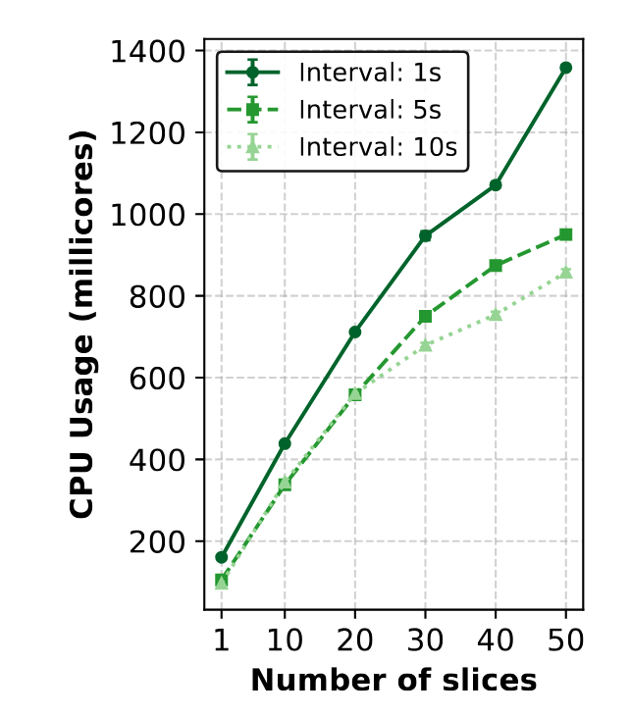
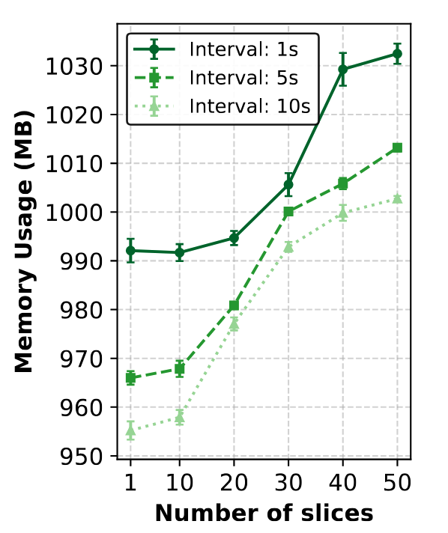
Does slice-native monitoring scale?
CPU increases predictably as slice count grows. 8.5–9x CPU increase from 1→50 slices
Memory remains nearly flat. Only ~1.05x memory increase from 1→50 slices
Making slices first-class entities does not create a large memory footprint
Notes:
This slide asks the first evaluation question for Monarch: if we make slices first-class monitored entities, does that introduce excessive overhead?
On the left, CPU usage increases as we increase the number of monitored slices from 1 to 50. This is expected because more slices generate more telemetry work: more metrics need to be collected, processed, and exported.
The important observation is on the right. Memory remains almost flat, increasing by only about 1.05 times across the same range. So the slice abstraction itself is not creating a large per-slice memory footprint.
The takeaway is that slice-native monitoring is feasible from a state-management perspective. The cost is not dominated by maintaining slice semantics; the scaling pressure comes mainly from telemetry work.
That leads to the next question: if telemetry work is the main cost, can Monarch’s distributed execution keep ingestion bounded?
---
Target time: 0:45
The first evaluation question is whether making slices first-class monitored entities creates excessive overhead.
As the number of monitored slices increases from 1 to 50, CPU increases predictably, about 8.5 to 9 times. That is expected because more slices generate more telemetry work.
The memory result is more important for the abstraction. Memory increases by only about 1.05 times. So the slice abstraction itself does not create a large state footprint.
The scaling pressure is mainly telemetry processing, not maintaining slice semantics.

Slide 11
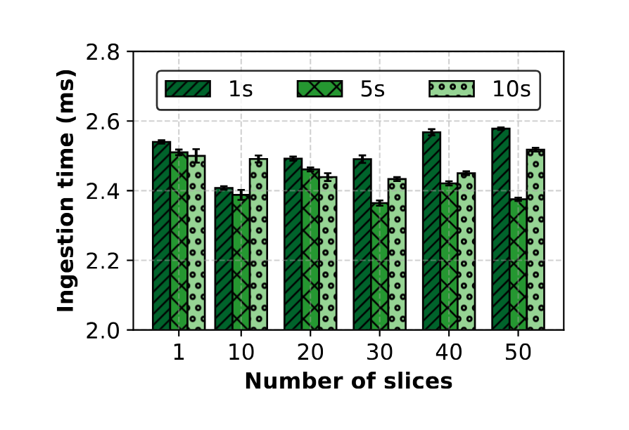
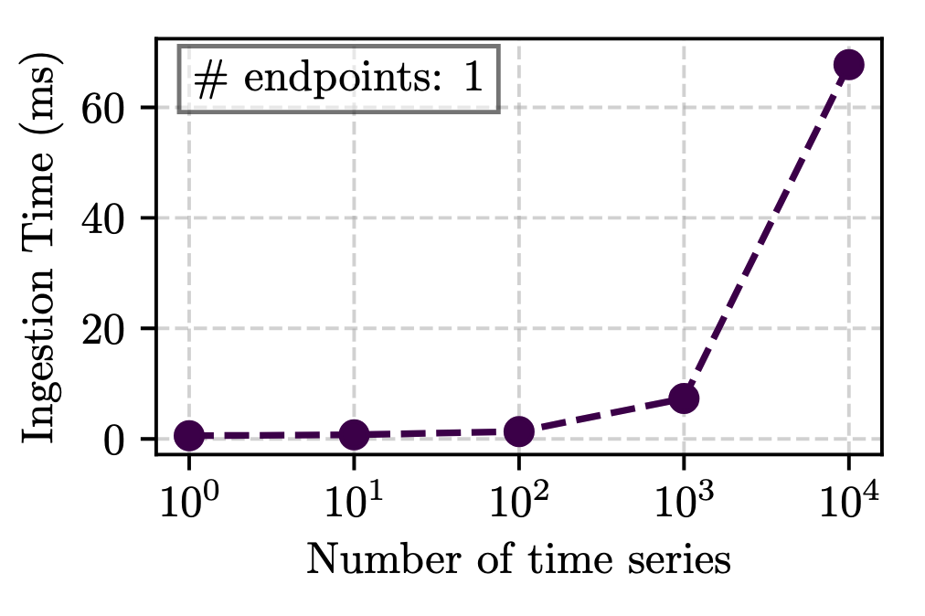
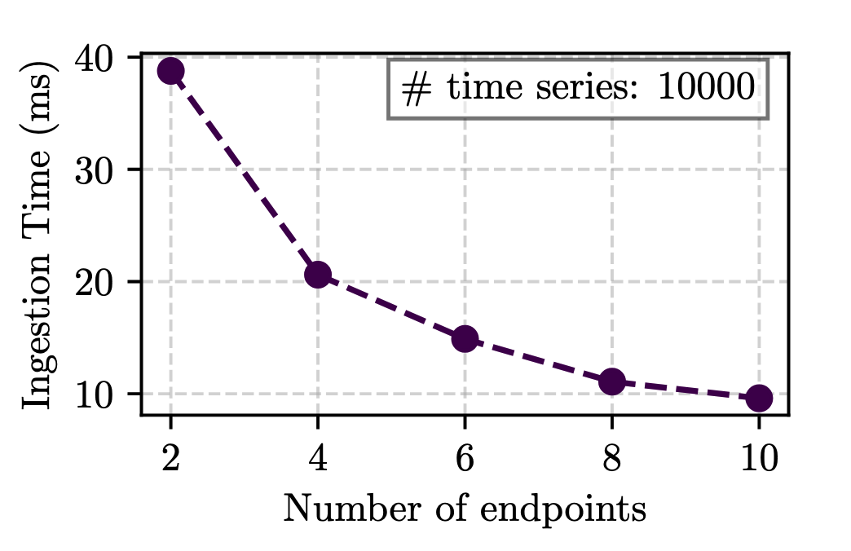
Does distributed collection keep ingestion bounded?
Stable ingestion: ~2.4–2.6 ms from 1→50 slices
One endpoint becomes a bottleneck at high cardinality. More endpoints reduce ingestion latency.
Distributed MDEs in Monarch keep raw telemetry ingestion scalable!
Notes:
On the left, we measure ingestion latency as the number of slices increases. Even up to 50 slices, ingestion remains stable at roughly 2.4 to 2.6 milliseconds. This shows that slice scaling does not destabilize ingestion in the Monarch setup.
The two plots on the right explain why. When a large number of time series is concentrated behind a single endpoint, ingestion latency increases sharply. But when the same high-cardinality telemetry is distributed across more endpoints, ingestion latency drops.
This directly validates the design choice in Monarch: telemetry collection is executed by distributed MDEs and segment-level collectors, rather than by one centralized exporter.
The takeaway is that Monarch centralizes slice semantics, but it does not centralize raw telemetry collection. Distributed collection prevents high-cardinality telemetry from becoming a single-endpoint bottleneck.
The next concern is the other side of the architecture: even if ingestion is distributed, does centralized KPI computation become a bottleneck?
---
Target time: 0:45
The next question is whether distributed collection keeps raw ingestion bounded.
On the left, ingestion latency remains stable at roughly 2.4 to 2.6 milliseconds as slice count grows. On the right, the reason becomes clear: concentrating high-cardinality telemetry behind one endpoint creates a bottleneck, while distributing telemetry across more endpoints reduces ingestion latency.
This validates a key Monarch design choice. The monitoring layer can provide a unified slice API without forcing all raw telemetry through a single exporter.

Slide 12
Research question 2: SLA-aware telemetry control
The Monitoring Stack (The “How”) – This Dissertation
Monarch (Slice Monitoring Abstraction) [NOMS’23, TNSM’25]
SliceScope (SLA-aware Telemetry Control) [SIGMETRICS’26]
Monarch (Slice Monitoring Abstraction) [NOMS’23, TNSM’25]
Kestrel (Fine-grained Visibility) [NOMS’26 ,TNSM’26 (under review)]
How can monitoring fidelity be dynamically allocated across slices to meet heterogeneous SLAs under a global resource budget?
Notes:
Target time: 0:40
This slide shows the structure of the dissertation.
At the bottom is the network that produces telemetry. At the top is closed-loop automation, which consumes slice KPIs and alerts to analyze, plan, and execute.
The thesis contributes the monitoring stack in between. Monarch provides the slice monitoring abstraction. SliceScope controls monitoring fidelity under SLA and budget constraints. Kestrel provides fine-grained user-plane evidence for transient anomalies.
Together, these contributions ask how to make monitoring both precise enough for SLA assurance and efficient enough to deploy.

Slide 13
How much monitoring error is acceptable?
Is a 0.5 ms monitoring error acceptable? Consider the same 5% error tolerance for our two example slices:
Latency-critical slice
SLA ≤ 5 ms, tolerance 0.25 ms (5%)
Too coarse: 0.5 ms exceeds tolerance.
Broadband / video slice
SLA ≤ 50 ms, tolerance 2.5 ms (5%)
Fine: 0.5 ms is well within tolerance.
The monitoring precision a slice needs depends on how critical it is
Notes:
Target: 1:30
Now, what does it mean to monitor a slice? At a high level, we are asking two questions: are the slice’s SLA metrics being met, and how precisely do we know that?
The second part is important. Suppose we have two slices. The latency-critical slice has an SLA of at most 5 milliseconds. If we allow a 5 percent monitoring error, the tolerance is only 0.25 milliseconds. A monitoring error of 0.5 milliseconds is already too coarse.
Now compare that with a broadband or video slice with a 50 millisecond latency target. The same 5 percent tolerance is 2.5 milliseconds, so a 0.5 millisecond monitoring error is perfectly acceptable.
So the same measurement error has very different consequences depending on the slice. This is the first key idea: monitoring precision should be SLA-aware. A strict slice needs tighter monitoring; a relaxed slice can tolerate coarser monitoring. Treating every slice the same wastes resources on some slices and under-monitors others.

Slide 14
Slice monitoring is a closed-loop control problem
Three key challenges:
CONTROL PLANE - RE-RUNS EVERY EPOCH
SLA
Targets
Learn trade-offs
…but we only get to watch one setting at a time
Multi-slice allocation Slices compete for shared budget; can’t tune one by one
Learn
estimate accuracy & cost of each setting
Optimize
split the budget across slices
Feedback:
telemetry observations
Deploy
knobs
DATA PLANE
Telemetry primitive
the mechanism we tune
The “right” telemetry primitive
What capabilities must it provide?
Notes:
Target: 1:30
There are three challenges in making this loop work.
First, we need to learn the trade-off between accuracy and overhead. But we only get to observe the data plane under the setting that is currently deployed. The controller still needs to reason about many other possible settings before choosing one.
Second, we need the right telemetry primitive. Not every monitoring mechanism gives the controller a useful knob. A primitive must be tunable per slice, adjustable at runtime, and still preserve meaningful end-to-end semantics.
Third, we need multi-slice allocation. Slices compete for the same telemetry budget, so we cannot tune each slice independently. If one slice has a strict SLA and rapidly changing latency, it may deserve more budget than a relaxed slice with stable behavior.
These three challenges correspond to the three main pieces of the design: the telemetry primitive contract, the change-triggered INT data plane, and the optimization-based control plane.

Slide 15
What must the data plane expose?
We define the Telemetry Primitive Contract (TPC).
R1 Per-slice, per-metric tunability
Different slices and metrics need different operating points
R2
Run-time tunability
The control plane should be able to change knobs each epoch without recompiling the data plane
R3
Composable end-to-end semantics
Local telemetry decisions must produce predictable end-to-end error and overhead
The contract decouples the monitoring-control problem from any specific telemetry mechanism.
Notes:
Target: 1:45
To make the control loop independent of one specific telemetry mechanism, we define what we call the Telemetry Primitive Contract, or TPC.
The first requirement is per-slice, per-metric tunability. Different slices need different operating points, and even within a slice, latency, jitter, and loss may need different treatment.
The second requirement is runtime tunability. The controller should be able to change the knob every epoch without recompiling or redeploying the data plane. Otherwise, we do not really have a closed loop.
The third requirement is composable end-to-end semantics. This is crucial. SLAs are end-to-end, but switches make local telemetry decisions. The primitive must ensure that those local decisions combine into predictable end-to-end error and overhead.
So the contract is the interface between the control plane and data plane. The controller does not need to know every implementation detail of the primitive. It needs a knob, and it needs models that map that knob to expected error and overhead.

Slide 16
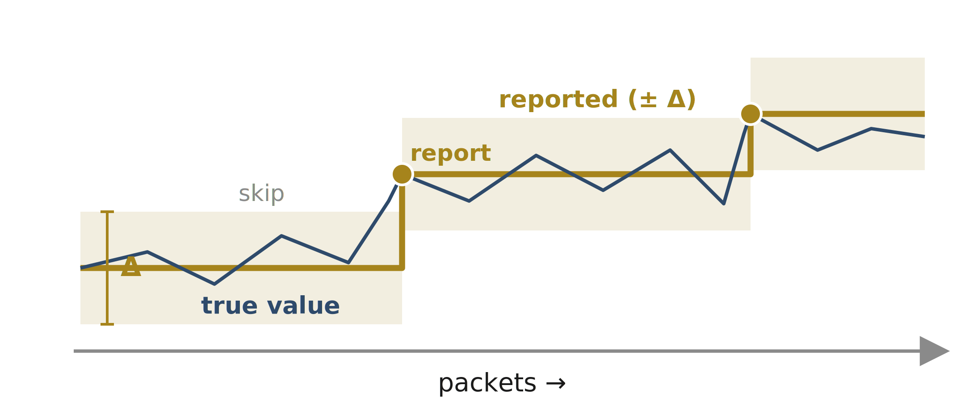
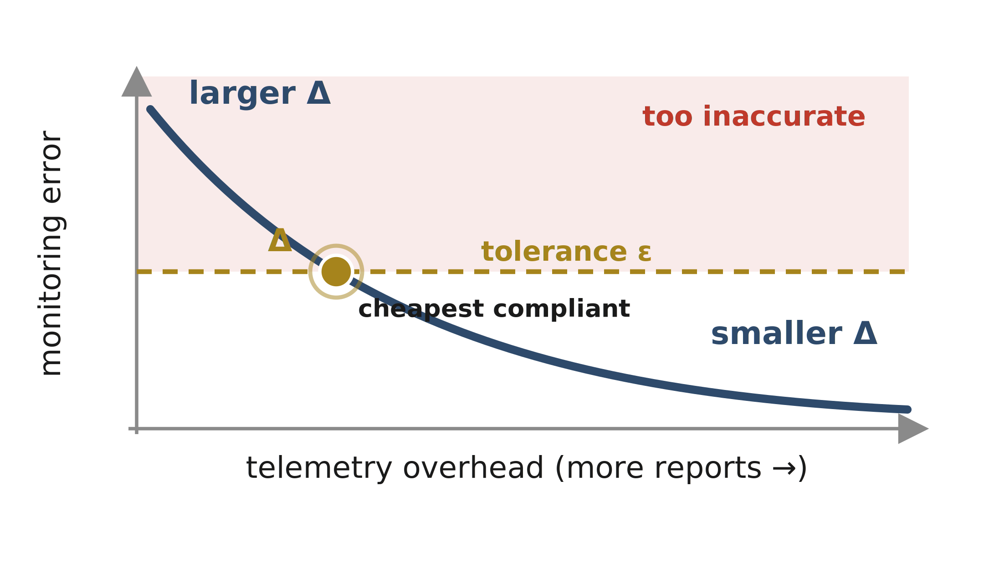
A tunable knob: change-triggered INT
Report only when a metric changes by more than the slice’s threshold Δ. The key idea is to skip on small changes and report on “significant” changes.
R1 Per-slice, per-metric Δ
R2 Change Δ at runtime
R3 Bounded end-to-end error
Notes:
Target: 1:15
SliceScope realizes this contract using change-triggered INT.
The idea is simple. Instead of adding telemetry to every packet, a switch reports only when the monitored metric changes by more than a threshold, which we call Δ. Small changes are skipped; significant changes are reported.
This threshold gives us exactly the kind of knob we need. If Δ is small, the switch reports more often, giving higher accuracy but higher overhead. If Δ is large, the switch suppresses more reports, reducing overhead but increasing error.
SliceScope extends this idea in three ways. First, Δ is per slice and per metric, not global. Second, Δ can be changed at runtime by the control plane. Third, the data plane maintains enough state so that skipped telemetry still leads to bounded end-to-end error.
That is how change-triggered INT becomes a concrete realization of the telemetry primitive contract.

Slide 17
Why is modeling Δₛ,ₘ hard?
We need β(Δ) = P(change > Δ) for any candidate Δ. But change (δ) itself depends on the deployed Δ.
Change is defined by its own past
The Consequence?
δ accumulates
current value − last reported
Data under Δ = 2 describes δ only under Δ = 2.
A different Δ changes when resets happen. The whole distribution of δ changes with it.
And trying candidate Δ values live risks SLA violations during exploration.
δ crosses the deployed Δ
telemetry report
report resets “last reported”
δ starts over from here
the distribution of δ depends on which Δ is deployed
Notes:
The controller needs β of Δ: the probability that a switch inserts telemetry for a given threshold. But the hard part is that the thing we want to model, δ, is not independent of Δ.
δ is the change between the current value and the last reported value. But the last reported value exists only because some previous δ crossed the currently deployed threshold. So changing Δ changes when reports happen, which changes when resets happen, which changes the distribution of δ itself.
That means data collected under Δ equals 2 only tells us how δ behaves under Δ equals 2. It does not directly tell us what would happen under Δ equals 5 or Δ equals 0.5.
And we cannot simply try every candidate threshold live, because bad exploration choices could under-monitor critical slices and cause SLA violations to go undetected.
So the modeling problem is: how do we evaluate thresholds we have not deployed?

Slide 18
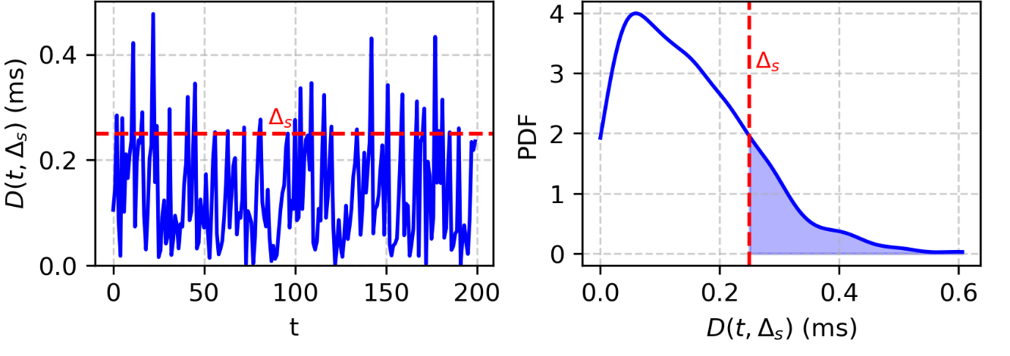
Sidestepping the cycle: learn d, simulate β
Learn the distribution of per-packet metric differences d at each switch
Simulate how d accumulates until it crosses Δ: a proxy for the real change δ
Derive β(Δ) = P(change > Δ) i.e., the shaded tail of that distribution
Accumulate d until it crosses Δ
Now the control plane can explore the accuracy–overhead trade-off offline. For any Δ, without deploying it.
β(Δ) = shaded tail = P(change > Δ)
Notes:
The way we avoid this circular dependency is to model a more primitive signal: the packet-to-packet metric difference, d.
Unlike δ, d does not depend on the deployed threshold. It simply captures how the metric changes from one packet to the next at a switch. For example, how much did latency change between consecutive packets of this slice?
Once we learn the distribution of d, the control plane can simulate what would have happened under any candidate Δ. It accumulates these differences, and whenever the accumulated change crosses Δ, it counts that as a telemetry insertion and resets the accumulator.
This gives us β of Δ: the insertion probability for a threshold that may never have been deployed.
The important point is that we are not exploring risky thresholds in the live network. We are using observations from the current configuration to reconstruct the accuracy-overhead trade-off offline, then deploying only the selected threshold.

Slide 19
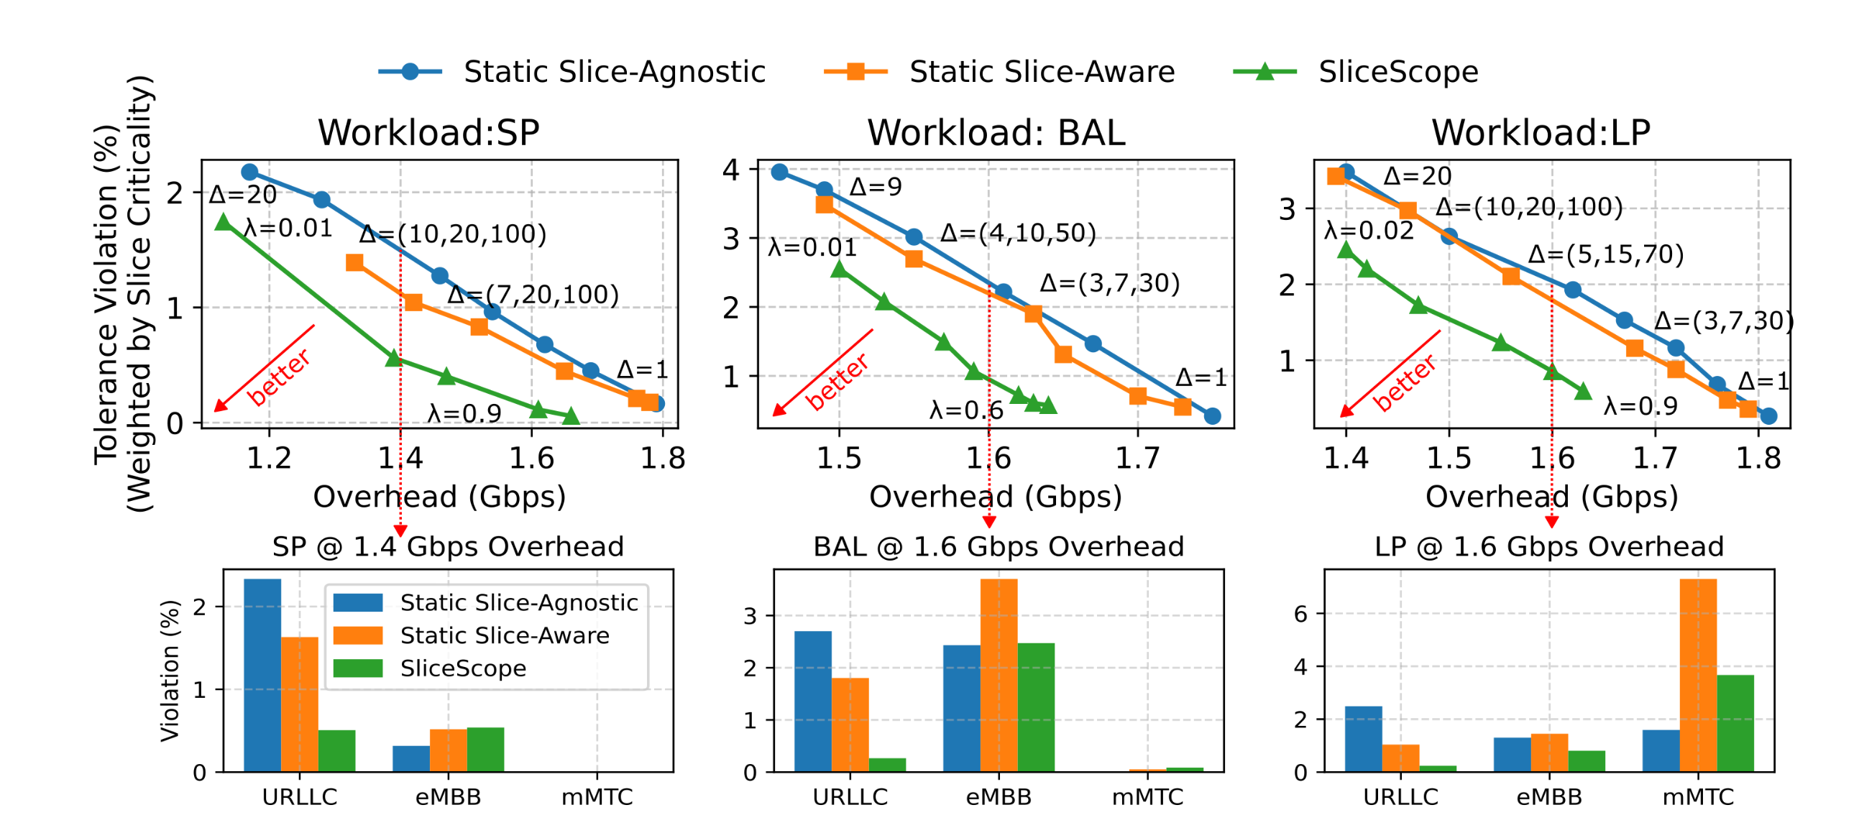
Does SLA-aware allocation improve the tradeoff?
SliceScope’s adaptive control plane outperforms static baselines across workloads, cutting tolerance violations for critical slices (e.g., URLLC) by up to 4.5x at similar or lower overhead.
Notes:
The main result is that adaptive, per-slice control gives a better accuracy-overhead trade-off than static thresholds.
The plot should be read as a Pareto frontier: lower and further left is better, because we want fewer tolerance violations and lower overhead. Static slice-agnostic can reduce overhead by increasing Δ, but that causes more tolerance violations, especially for strict slices. Static slice-aware improves over that by giving different slice types different thresholds, but it still cannot respond to changing traffic and active slices.
SliceScope does better because it continuously moves budget toward the slices and metrics that need it most. In the balanced workload, it reduces tolerance violations by about 2.3 times at similar or slightly lower overhead. Looking specifically at latency-sensitive URLLC slices, the reduction reaches up to 4.5 times in the slice-type breakdown.
The interpretation is important: SliceScope is not uniformly improving every slice. It intentionally prioritizes critical slices and spends less precision on less sensitive ones when the budget is limited.

Slide 20
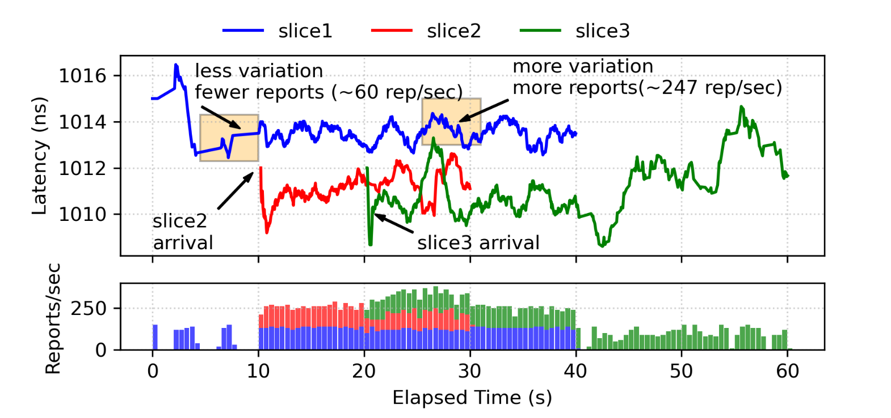
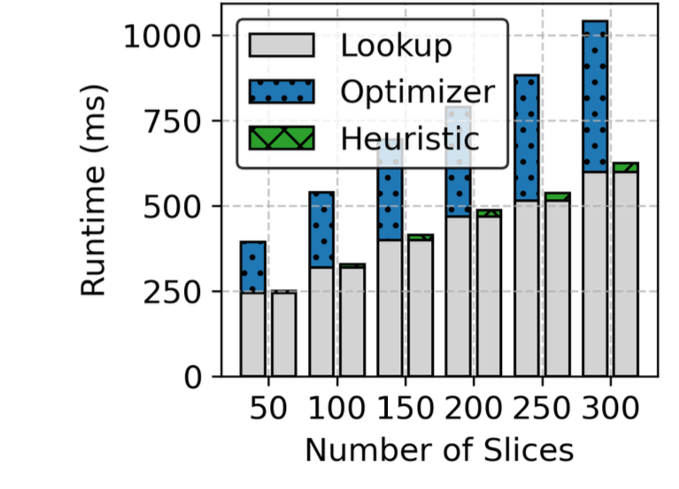
Does it work in practice?
Control Plane Scalability
Timeline from Intel Tofino deployment
Heuristic threshold selection completes in under 600 ms for 300 slices.
Runs on 5G testbed, adapting per slice reporting rate as slices join
Low hardware overhead (~13% hash, ~27% SALU, ~10% SRAM).
Notes:
Target: 1:45
Finally, we look at practicality.
On the control-plane side, the heuristic threshold selection completes in under 600 milliseconds for 300 slices. This is well within the epoch times we consider and supports real-time adaptation.
On the data-plane side, SliceScope runs on Intel Tofino. The testbed timeline shows that as slices join and network dynamics increase, SliceScope raises the reporting rate. This is exactly the behavior we want: reporting rate should not be fixed; it should respond to SLA-relevant variation.
In terms of hardware resources, the implementation is modest. The selected configuration uses roughly 13 percent of hash units, 27 percent of SALUs, and 10 percent of SRAM. It also adds only a small amount of processing delay per switch.
So the main message is that the closed loop is not just a conceptual framework. It can run at realistic slice counts, adapt over time, and fit on programmable hardware.

Slide 21
Research question 3: fine-grained visibility
The Monitoring Stack (The “How”) – This Dissertation
Monarch (Slice Monitoring Abstraction) [NOMS’23, TNSM’25]
SliceScope (SLA-aware Telemetry Control) [SIGMETRICS’26]
Monarch (Slice Monitoring Abstraction) [NOMS’23, TNSM’25]
Kestrel (Fine-grained Visibility) [NOMS’26 ,TNSM’26 (under review)]
How can transient QoS anomalies be detected and attributed to specific slices without the overhead of per-packet monitoring?
Notes:
Target time: 0:40
This slide shows the structure of the dissertation.
At the bottom is the network that produces telemetry. At the top is closed-loop automation, which consumes slice KPIs and alerts to analyze, plan, and execute.
The thesis contributes the monitoring stack in between. Monarch provides the slice monitoring abstraction. SliceScope controls monitoring fidelity under SLA and budget constraints. Kestrel provides fine-grained user-plane evidence for transient anomalies.
Together, these contributions ask how to make monitoring both precise enough for SLA assurance and efficient enough to deploy.

Slide 22



Why are user-plane anomalies hard to attribute?
QFI 3 (Video Stream)
QFI 1 (Gaming)
Q1 – Streaming
5G Fixed Wireless Access
GTPU Tunnel (TEID B)
Anomaly in Q2… but was it the smartphone or the FWA? Counters can’t tell.
Q2 – Gaming
Data Network
QFI 1 (Gaming)
QFI 2 (Background Sync)
Q3 – Best-effort
5G Smartphone
GTPU Tunnel (TEID A)
User Plane Function (UPF)
Notes:
Target time: 1:10
This slide shows why user-plane anomalies are hard.
A 5G user plane carries traffic through GTP-U tunnels identified by TEIDs. Within those tunnels, QoS flows identified by QFIs receive different treatment. These flows are eventually mapped to shared queues and policers in the UPF or programmable data plane.
The problem is that anomalies can appear at different granularities. A queue-level counter may show congestion, but not which TEID or QFI caused it. A QFI aggregate may look normal while one tunnel is abusing policy. A short microburst may disappear in a one-second average.
So the monitoring system must preserve the right evidence: distributional signals, QoS-flow context, and per-tunnel attribution.

Slide 23
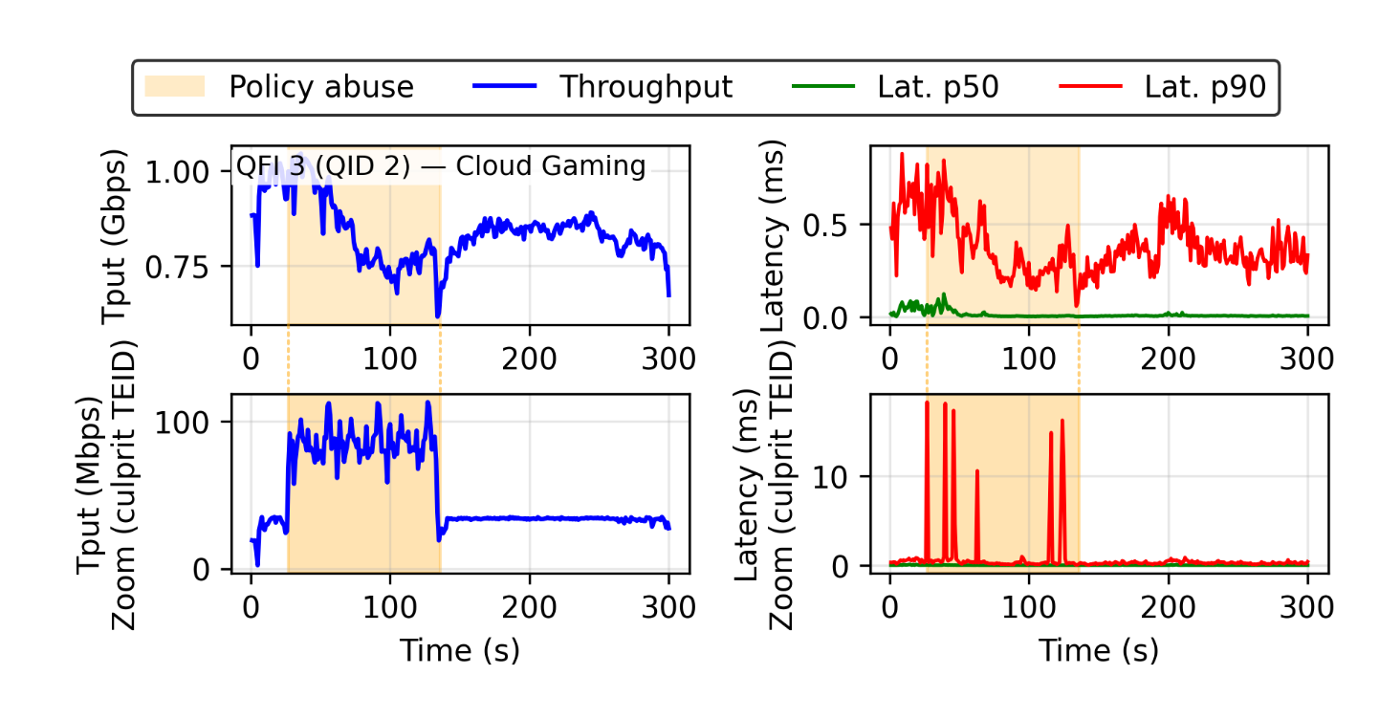
What signal must telemetry preserve?
QoS anomalies require TEID+QFI granularity, and distributional metrics
Congestion → sustained tail latency
Policy abuse → benign in aggregates, visible in culprit TEID
Microbursts → vanish in 1s averages, emerge at sub-second bins
Contention → distributed oscillations in IAT across flows
Per-TEID metrics clearly show the misbehavior
How can we capture these fine-grained signals in practice?
Notes:
Target time: 1:20
The empirical characterization in Kestrel shows that different anomalies have different signatures.
Congestion appears as sustained tail-latency inflation for particular QFIs. Policy abuse may be invisible at the QFI aggregate but visible at TEID granularity. Microbursts disappear in coarse windows but emerge at sub-second resolution. Contention can appear as oscillations in inter-arrival time.
This tells us that counters alone are not enough. We need telemetry that preserves fine-grained distributional structure: latency histograms, IAT histograms, color or drop behavior, and the TEID/QFI context needed for attribution.
At the same time, exporting every packet is too expensive, so the design question becomes: what evidence can the data plane preserve locally, and what can be exported once per window?

Slide 24

Fine-grained evidence is expensive to export
Postcards
TEID=A QFI=1, QID=2 Lat=50 ms T=23.458 Color=Y
TEID=B QFI=1, QID=2 Lat=2.3 ms T=23.457 Color=G
TEID=B QFI=2, QID=1 Lat=2.3 ms T=23.456 Color=G
High Overhead
Every packet generates a postcard (metadata report).
At 10 Gbps with 200 B packets → >3 Gbps postcard traffic (>30% overhead).
Scales linearly with line rate, infeasible at carrier-grade 100+ Gbps UPFs.
We need a telemetry design that preserves per-TEID anomaly signals while staying lightweight at scale
Q1 – Streaming
Postcard Collector
Q2 – Gaming
Data Network
Data packets
Q3 – Best-effort
Telemetry postcards allow fine-grained anomaly detection. But …
User Plane Function (UPF)
Notes:
Target time: 1:00
The straightforward solution is to export per-packet evidence, such as postcards. That gives excellent visibility, but it moves a large volume of telemetry to collectors and analytics.
For high-speed user-plane traffic, that overhead is not a side detail; it becomes the bottleneck. It also creates a tension with deployability, because the monitoring system itself must not consume the resources needed by the slice.
This motivates Kestrel’s design point: update telemetry at packet rate inside the programmable data plane, but export compact summaries per time window.

Slide 25

Kestrel: per-packet updates, per-window summaries
Compact summaries exported every 1s
Q1 – Streaming
Kestrel Collector
Data Network
Data packets
Q2 – Gaming
Kestrel keeps packet-level evidence in the fast path, but exports only compact distributional summaries.
Enriched Sketch (counters + latency/IAT/color histograms) Updated every packet on the fast path
Q3 – Best-effort
Per-QID Sketches
User Plane Function (UPF)
Notes:
Target time: 1:00
Kestrel’s core idea is per-packet updates and per-window summaries.
Packets are processed by the UPF data plane as usual. For each packet, Kestrel updates a sketch indexed by TEID, QFI, and queue identifier. The sketch records packet and byte counts, latency histograms, inter-arrival-time histograms, and policer color or drop information.
At the end of each window, only the compact sketch summary is exported. The detector then extracts features from these summaries and identifies anomalous TEID/QFI pairs.
So Kestrel avoids per-packet export while retaining enough distributional evidence for detection and attribution.

Slide 26
What does each sketch bucket preserve?
TEID=A QFI=1, QID=2 Lat=25 µs IAT=15 µs Color=Y
T=23.453
Counters Pkts: 146 ⟵ +1 Bytes: 29268 ⟵ +pkt. len
Colors Green: 120 Yellow: 26 ⟵ +1
Packet Metadata
Lat. Histogram Bin 0 (0.5 µs] : ▇▇▇▇▇▇ (1241) Bin 1 (0.5, 6.3] : ▇▇ (512)
Bin 2 (6.3, 82] : ▇ (18) ⟵ + 1 (25 µs)
Key = (TEID, QFI)
IAT Histogram Bin 0 (11.5 µs] : ▇▇ (321) Bin 1 (11.5, 16.2] : ▇▇▇▇ (801) ⟵ + 1 (15 µs)
Bin 2 (16.2, 22.9] : ▇ (18)
H₁ (Key)
H₂ (Key)
H₃ (Key)
Last Timestamp: 23.453 ⟵ Update
Notes:
Target time: 1:10
Each sketch bucket is designed to preserve the signals needed for user-plane anomalies.
For an arriving packet, the data plane hashes the TEID/QFI key into the sketch, then increments packet and byte counts. It updates latency and IAT bins using queue-specific bin edges, and updates color or drop counters.
This is different from a plain counter sketch. The bucket is a compact, distribution-preserving summary of the traffic mapped to that key.
The sketch introduces collisions, so individual estimates can include noise. Kestrel therefore has to be parameterized around detectability: the anomaly signal must remain larger than the collision noise floor.

Slide 27
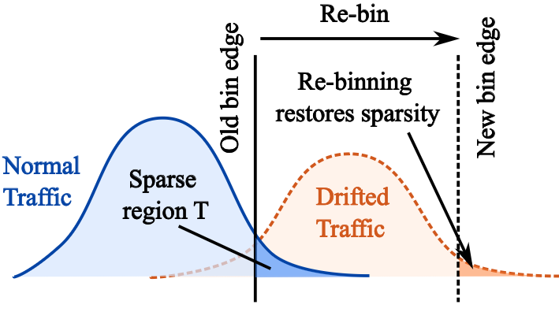
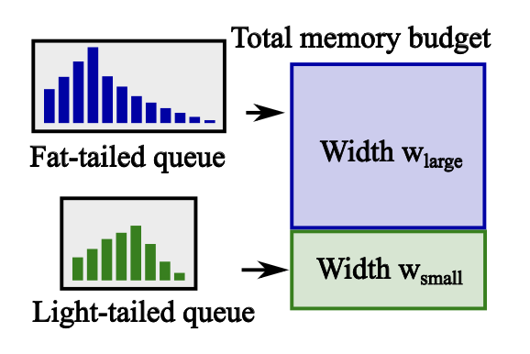
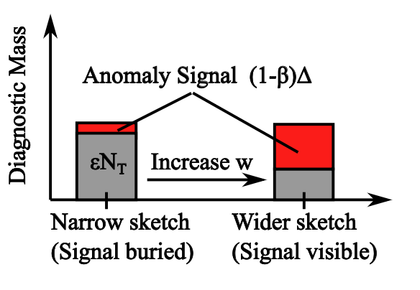
How do we parameterize Kestrel for detectability?
Detectability
Drift adaptation
Budgeted allocation
Signal must exceed collision noise
(1−β)∆ > εN_{T}
Keep the diagnostic region sparse
N_{T} ≤ρN
Queues differ in tail mass and traffic volume
Allocate width w_{q}
Kestrel turns sketch configuration into a principled detectability problem: choose bins to preserve signal, and allocate width to suppress collision noise.
Choose width w to lower ε
Re-bin when normal traffic drifts
Spend memory where noise floor is highest
Notes:
The key condition is that an anomaly must create enough lift in the diagnostic region to rise above sketch collision noise. So the question becomes: what determines that noise floor? For each QID, it depends on how much traffic the QID carries, how much of its normal traffic already falls into the diagnostic region, and how much sketch width we allocate to that QID. A heavy queue, or a queue with naturally persistent tail occupancy, creates more background collisions, so the same anomaly is harder to see.
That gives us the mechanism. During a bootstrap period, Kestrel estimates each QID’s normal load and diagnostic-region occupancy. If the diagnostic bins stop being sparse, Kestrel re-bins: the sketch tells us that the bins have drifted, and a small sampled buffer gives the recent raw feature values needed to choose new bin edges.
Finally, Kestrel allocates sketch width per QID. If there is enough memory, each QID gets the width required by the analytical condition. If memory is limited, the control plane solves a small allocation problem that spends more SRAM on the QIDs with the highest collision noise floor, instead of assigning the same width everywhere.
---
Target time: 1:20
Kestrel parameterizes the sketch using a detectability condition.
An anomaly is detectable when the lift it creates in the diagnostic region exceeds the collision noise. The diagnostic region is the part of the histogram where anomalous behavior should appear, such as the latency tail or unusually small IAT bins.
The noise floor depends on the total traffic volume, how much normal traffic already falls into the diagnostic region, and the sketch width allocated to the queue.
This leads to three mechanisms. Choose bin edges so the diagnostic region is sparse under normal traffic. Re-bin when drift makes that region too crowded. And allocate sketch width per queue, because different queues have different traffic volumes and tail behavior.
The design is therefore not just “use a sketch.” It is a detectability-driven sketch configuration.

Slide 28
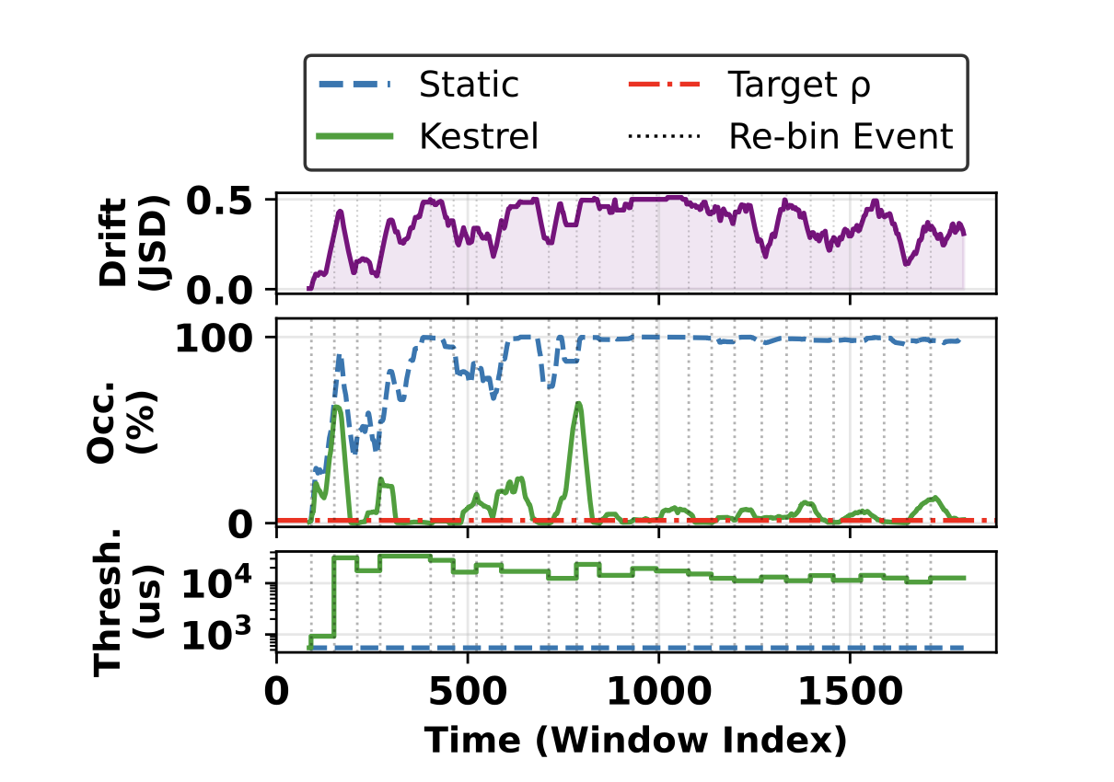
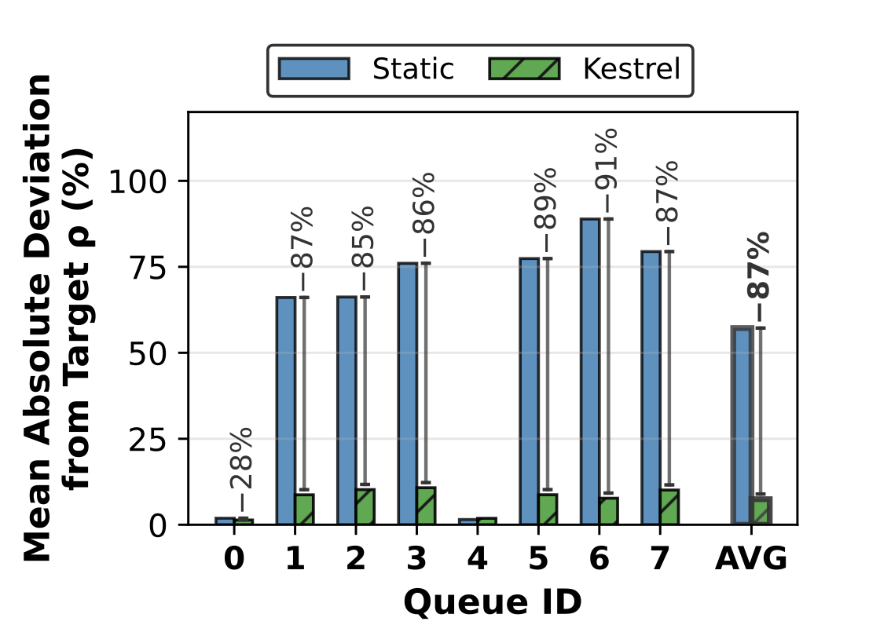
Does detectability survive traffic drift?
Rebin events shift thresholds as traffic distribution changes
87% reduction in deviation from target occupancy ⍴
Adaptive re-binning keeps diagnostic regions sparse, preserving detectability over time.
Notes:
“Now we ask whether this detectability condition survives traffic drift.
The issue is that Kestrel’s diagnostic bins are chosen from a baseline distribution. But traffic is not stationary. As the distribution drifts, normal traffic can start moving into the region that was supposed to be sparse. If that happens, the diagnostic region becomes crowded, the sketch noise floor increases, and anomalies become harder to distinguish.
On the left, the top plot shows the traffic distribution drifting over time. The middle plot shows diagnostic-region occupancy. With static bin edges, shown in blue, occupancy quickly rises and stays high, meaning the diagnostic region is no longer sparse. Kestrel, in green, detects this using sketch occupancy and triggers re-binning events. Those events shift the threshold, shown in the bottom plot, so that the diagnostic region is restored to the target occupancy.
The right plot summarizes this across queues. Static binning deviates substantially from the target occupancy for most queues, while Kestrel keeps the deviation much lower. On average, adaptive re-binning reduces the deviation from the target by 87%.
So the key result is that Kestrel does not assume a fixed traffic distribution. It continuously checks whether the diagnostic region remains sparse, and when it does not, it re-bins to preserve detectability over time.”
---
Target time: 1:00
This slide evaluates whether detectability survives traffic drift.
With static bin edges, normal traffic can gradually move into the diagnostic region. That raises the background occupancy and increases sketch collision noise, making anomalies harder to distinguish.
Kestrel monitors diagnostic occupancy. When sustained normal traffic makes the diagnostic region too dense, it triggers re-binning and shifts the thresholds to restore sparsity.
The result is an 87 percent reduction in deviation from the target occupancy across queues. This means Kestrel does not rely on a fixed traffic distribution. It maintains the conditions needed for detection as traffic evolves.

Slide 29
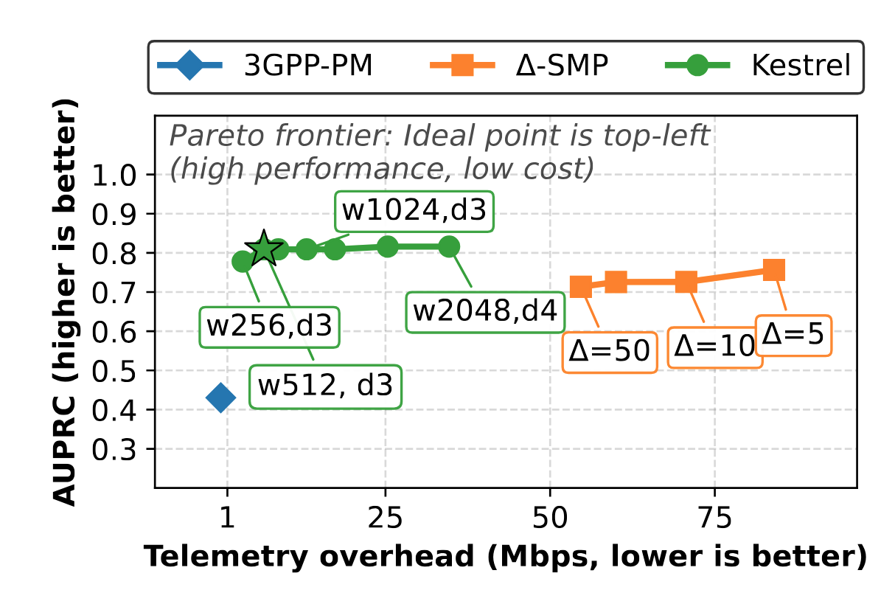
Does Kestrel improve the cost-accuracy frontier?
Kestrel reaches a better cost–accuracy operating point: 10% better accuracy than Δ-SMP at 10x lower cost, and 2x more accurate than counters.

Slide 30
Summary
Monarch — slice monitoring abstraction
SliceScope — SLA-aware telemetry control
Kestrel — fine-grained user-plane visibility
Problem: slice KPIs are fragmented across domains and identifiers.
Problem: slices need different monitoring precision under a shared budget.
Problem: transient QoS anomalies are hidden in shared user-plane resources.
Efficient, high-precision slice monitoring becomes practical by combining slice-level visibility, SLA-aware control, and fine-grained user-plane telemetry.
Contribution: exposes slices as first-class monitored entities behind a unified API.
Contribution: formulates fidelity as closed-loop, SLA-aware resource allocation.
Contribution: preserves per-TEID/QFI anomaly evidence in compact distributional summaries.
Outcome: slice-level monitoring at scale.
Outcome: fewer error-tolerance violations on critical slices.
Outcome: fine-grained attribution at orders-of-magnitude lower overhead.
NOMS’23,TNSM’25
SIGMETRICS’26
NOMS’26 , TNSM’26 (review)
Notes:
Target time: 1:00
To summarize, the thesis makes three contributions.
Monarch shows that slices can be treated as first-class monitored entities. It reconstructs slice KPIs once in the monitoring layer and exposes a slice-level API while keeping collection distributed.
SliceScope shows that monitoring fidelity should be SLA-aware. It learns accuracy-overhead trade-offs and jointly allocates telemetry budget across slices.
Kestrel shows that fine-grained user-plane visibility can be achieved without per-packet export, by using detectability-driven sketches.
Together, these contributions show that high precision and efficiency are not opposing goals if monitoring is designed across the architecture, control plane, and data plane.

