Slide 1

API conference 2025 | Berlin, October, 22. | https://graphql.schule
NILS HARTMANN
https://nilshartmann.net
GraphQL
a critical review

Slide 2


https://nilshartmann.net
NILS HARTMANN
nils@nilshartmann.net
Software Developer, Architect and Coach from Hamburg
Java, Spring, GraphQL, TypeScript, React
https://graphql.schule/video-tutorial
https://reactbuch.de

Slide 3
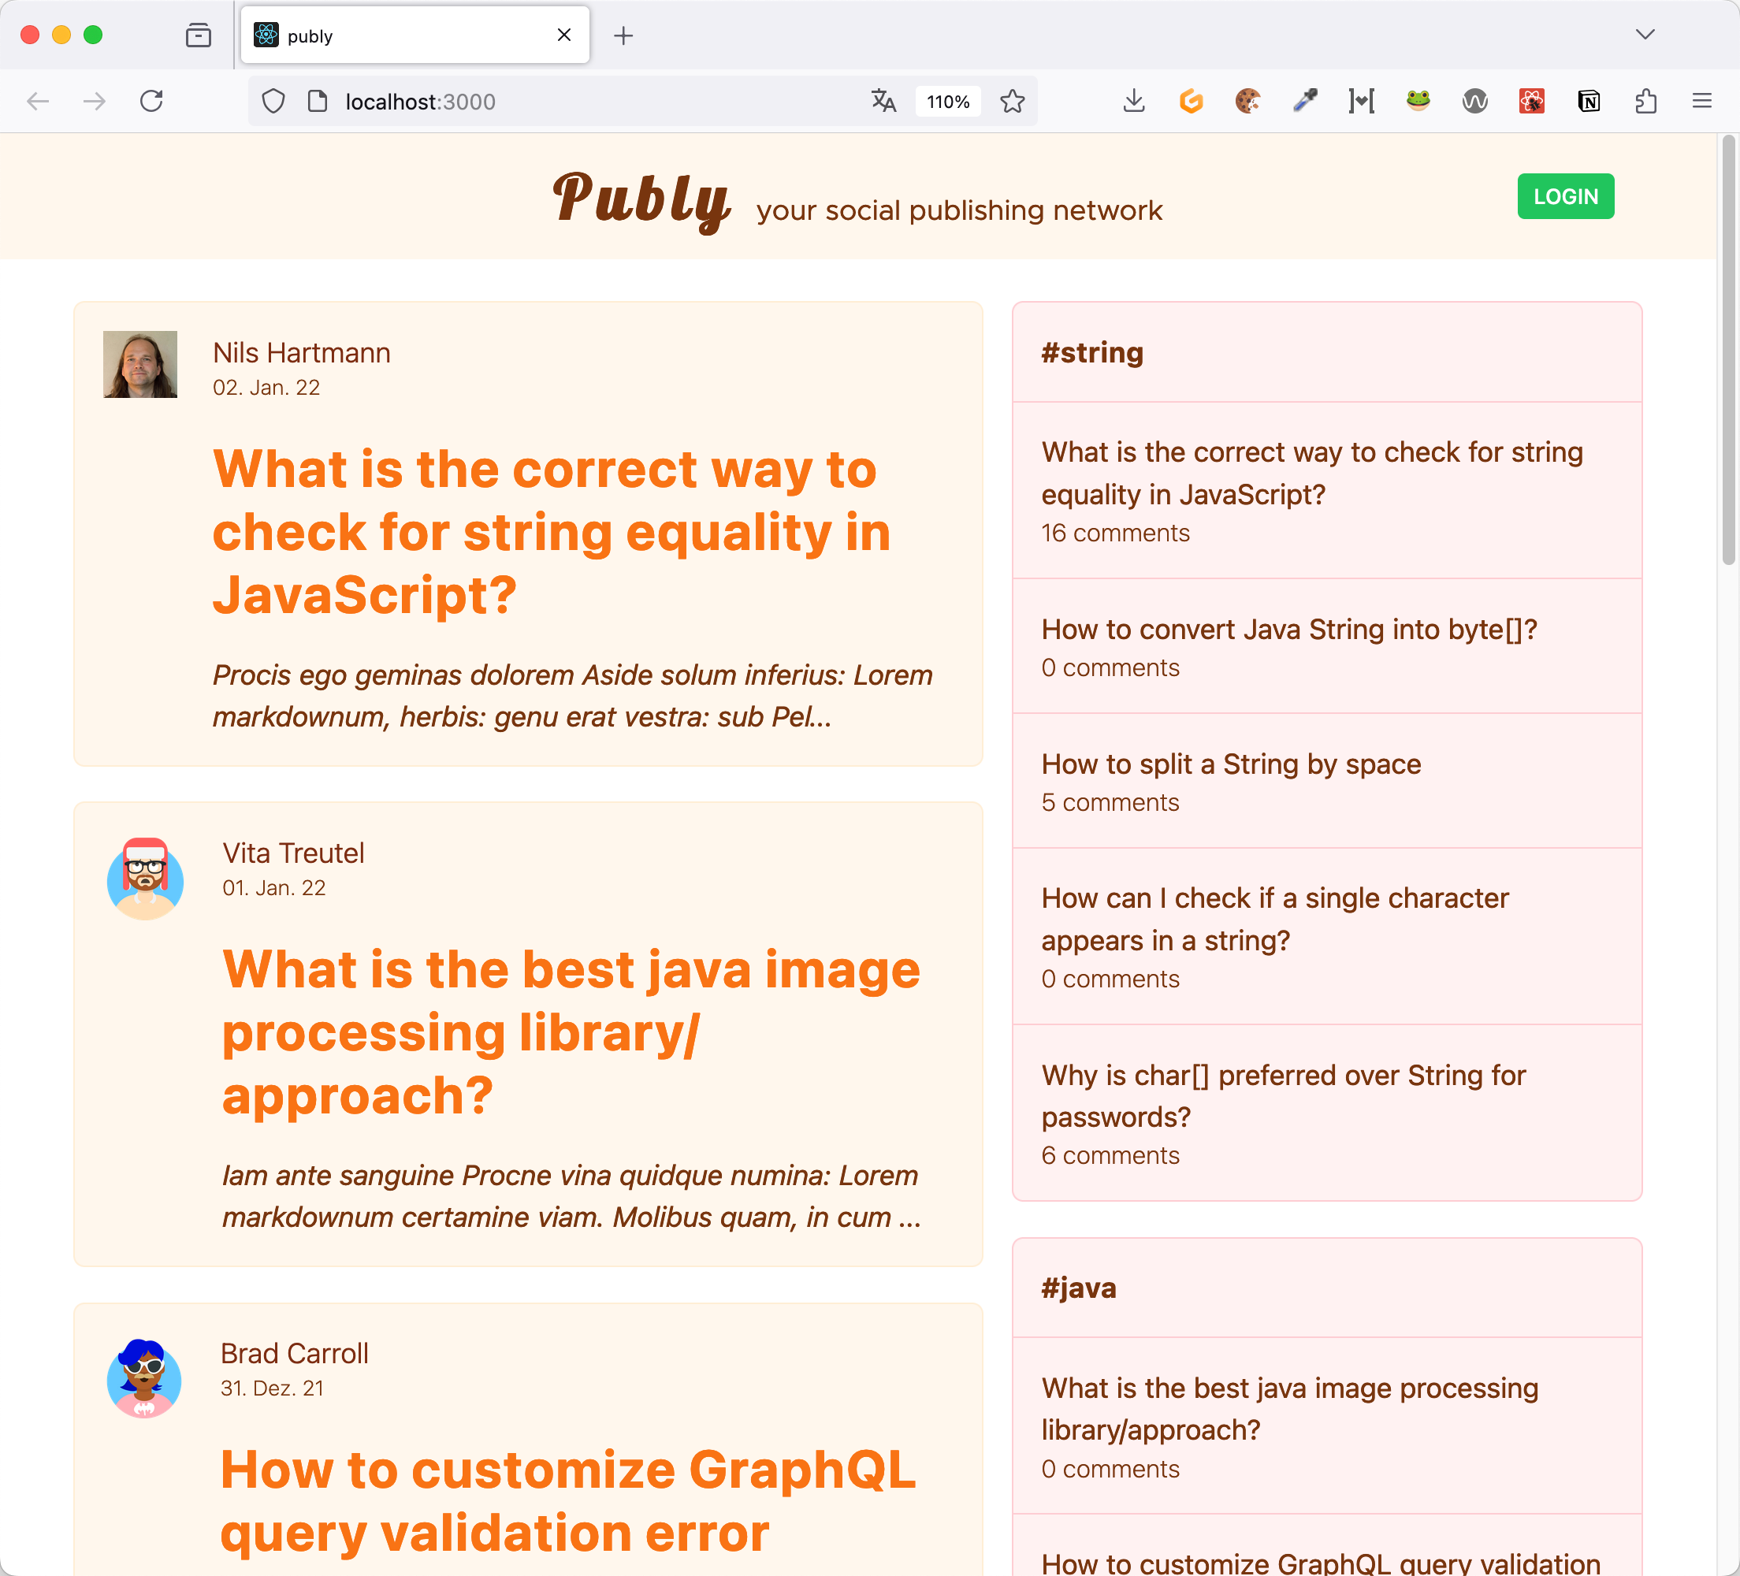
One application, 3 views...

Slide 4
View #1
User
username
Story
title
excerpt

Slide 5
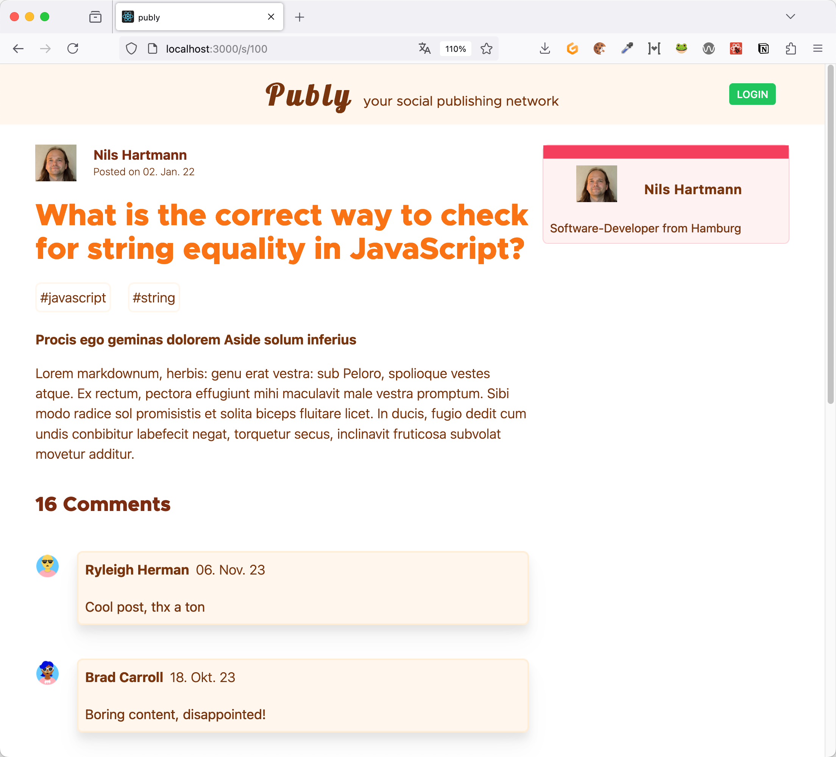
View #2
User
username
bio
location
Story
title
tags
body
Comment
writtenBy
content

Slide 6
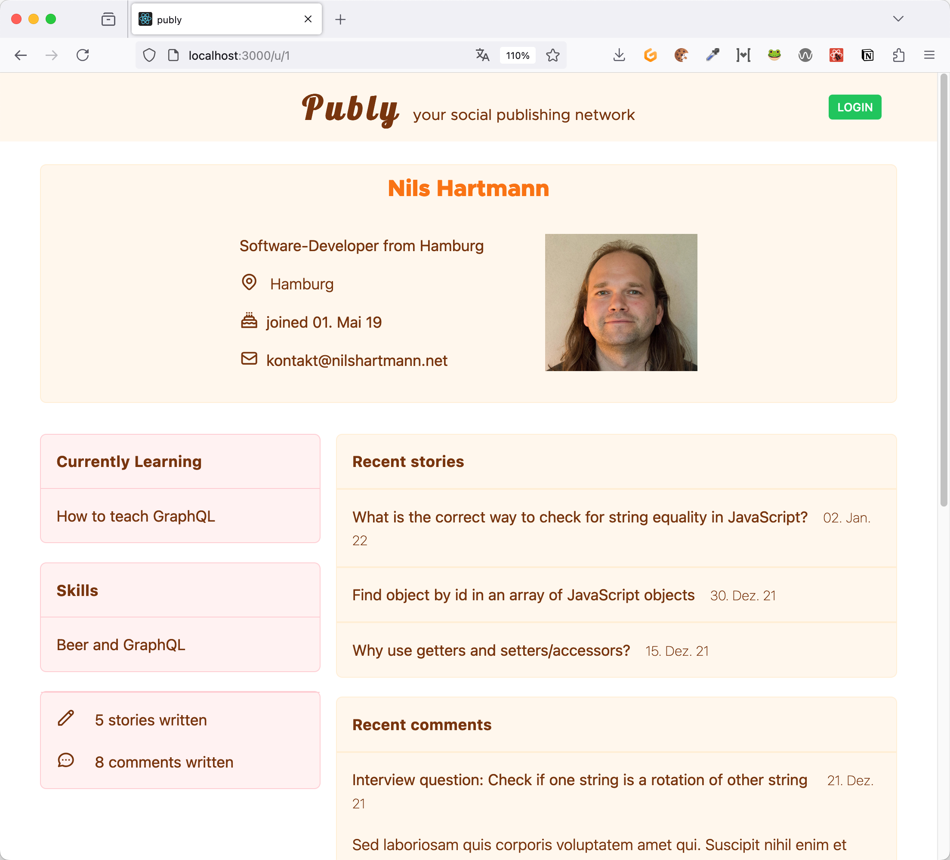
View #3
User
username
bio
location
joined
contact
Story
title
Comment
content

Slide 7
An API for this example App …

Slide 8



An Api for the example app
Approach 1: Backend defines the API / data
/api/story
/api/comment
/api/user

Slide 9
An Api for the example app
Approach 1: Backend defines the API / data
REST / HTTP APIs
/api/story
/api/comment
/api/user

Slide 10



An Api for the example app
Approach 2: Client defines the API based on its requirements, views, use-cases, ...
/api/feed
/api/story-view
/api/user-detail

Slide 11
An Api for the example app
Approach 2: Client defines the API based on its requirements, views, use-cases, ...
Backend for Frontend (BfF)
/api/feed
/api/story-view
/api/user-detail

Slide 12
An Api for the example app
Approach 3: GraphQL...

Slide 13
An Api for the example app
Approach 3: GraphQL...
As approach 1: Server defines the data model

Slide 14
An Api for the example app
Approach 3: GraphQL...
As approach 1: Server defines the data model
...but the client can select in every request the data it wants to read from the model

Slide 15
An Api for the example app
Approach 3: GraphQL...
As approach 1: Server defines the data model
...but the client can select in every request the data it wants to read from the model
{ stories { title excerpt { user { fullname } } } }

Slide 16
"GraphQL is a query language for APIs and a runtime for fulfilling those queries with your existing data"
- https://graphql.org
GraphQL

Slide 17
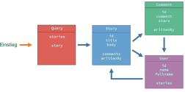
GraphQl schema
A GraphQL API provides a graph of Objects with Fields
Objekte
Felder

Slide 18
GraphQl schema
A GraphQL API provides a graph of Objects with Fields
The API is described in a Schema
Objekte
Felder

Slide 19
GraphQl schema
A GraphQL API provides a graph of Objects with Fields
The API is described in a Schema
To make the API typesafe, it has an own Typesystem
Objekte
type Story {
id: ID!
title: String!
body: String!
comments: [Comment!]
writtenBy: User
}
type Story { ... }
type User { ... }
Felder

Slide 20
GraphQl schema
A GraphQL API provides a graph of Objects with Fields
The API is described in a Schema
To make the API typesafe, it has an own Typesystem
Objekte
type Story {
id: ID!
title: String!
body: String!
comments: [Comment!]
writtenBy: User
}
type Story { ... }
type User { ... }
Felder
👉 You can think of a Field as a Function that returns a value

Slide 21
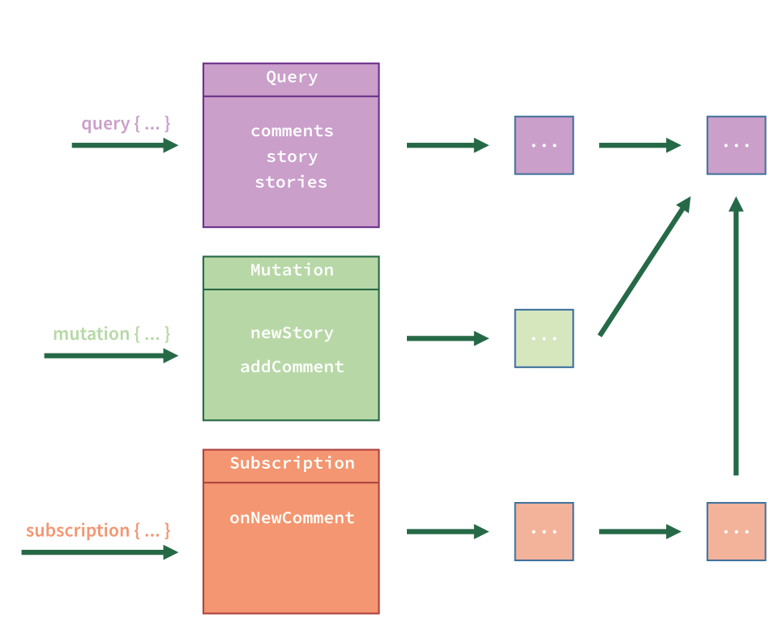
GraphQl schema
A GraphQL API provides a graph of Objects with Fields
The Graph starts at a Root Object
Root-Objekte

Slide 22
GraphQl schema
A GraphQL API provides a graph of Objects with Fields
The Graph starts at a Root Object
There are up to three different Root objects: query, mutation und subscription
Root-Objekte

Slide 23
GraphQl schema
A GraphQL API provides a graph of Objects with Fields
The Graph starts at a Root Object
There are up to three different Root objects: query, mutation und subscription
Each Root object defines an Entrypoint in to the Graph (and thus your API)
Root-Objekte

Slide 24
GraphQl schema
A GraphQL API provides a graph of Objects with Fields
The Graph starts at a Root Object
There are up to three different Root objects: query, mutation und subscription
Each Root object defines an Entrypoint in to the Graph (and thus your API)
A Query has to start at one of the Root objects
Root-Objekte

Slide 25
The
Query
Language

Slide 26
Query Language
A client uses the Query Language to select Fields from the graph
query { }

Slide 27
Query Language
A client uses the Query Language to select Fields from the graph
The Query starts at a Root object...
query { stories }

Slide 28
Query Language
A client uses the Query Language to select Fields from the graph
The Query starts at a Root object...
...and then follows the paths, that are defined in the Schema
query { stories { comments { id comment } } }

Slide 29
Query Language
A client uses the Query Language to select Fields from the graph
The Query starts at a Root object...
...and then follows the paths, that are defined in the Schema
Other paths („Joins“) are not possible
⚡️
query { comments { id } }

Slide 30
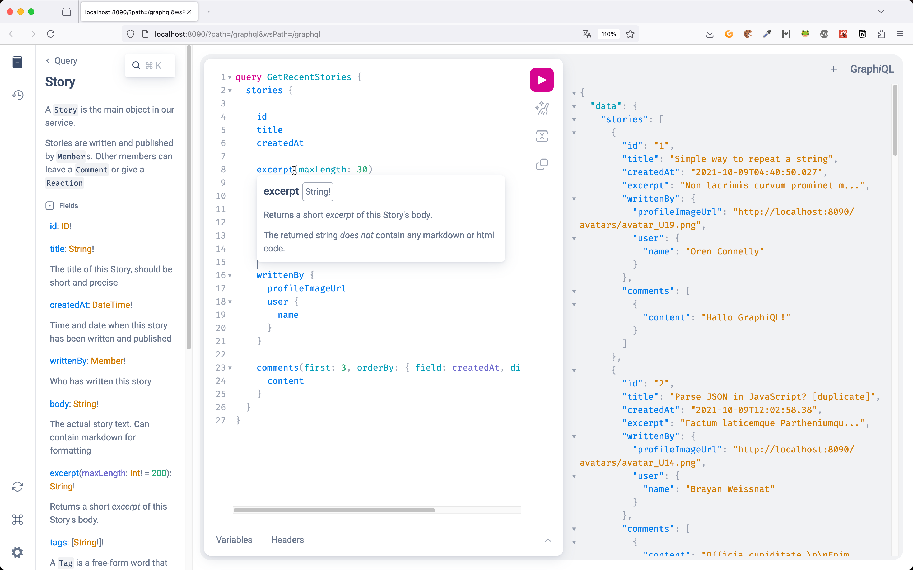
http://127.0.0.1:8080
🕵️‍♂️ Ein Query
🕵️‍♂️ Response
🕵️‍♂️ Dokumentation
🕵️‍♂️ Netzwerkverkehr (evtl.)
Demo: Query-Language

Slide 31
Implementing
a GraphQL API

Slide 32
implementation
Implementing GraphQL APIs
Usually you have to implement the „data fechting“ logic yourself
There are frameworks for almost all programming languages

Slide 33
Implementation
The spec outlines how GraphQL Server should behave
Almost all frameworks work somehow identically

Slide 34
Implementation
Request processing workflow (simplified)
Server recieves HTTP Request with a Document containing an Operation

Slide 35
Implementation
Request processing workflow (simplified)
Server recieves HTTP Request with a Document containing an Operation
Server validates the Document (Syntax and Schema)

Slide 36
Implementation
Request processing workflow (simplified)
Server recieves HTTP Request with a Document containing an Operation
Server validates the Document (Syntax and Schema)
For all fields in the operation, a Resolver Functionen is invoked

Slide 37
Implementation
Request processing workflow (simplified)
Server recieves HTTP Request with a Document containing an Operation
Server validates the Document (Syntax and Schema)
For all fields in the operation, a Resolver Functionen is invoked
The Resolver Function is responsible for getting the Data for the field

Slide 38
Implementation
Request processing workflow (simplified)
Server recieves HTTP Request with a Document containing an Operation
Server validates the Document (Syntax and Schema)
For all fields in the operation, a Resolver Functionen is invoked
The Resolver Function is responsible for getting the Data for the field
The framework validates the collected data

Slide 39
Implementation
Request processing workflow (simplified)
Server recieves HTTP Request with a Document containing an Operation
Server validates the Document (Syntax and Schema)
For all fields in the operation, a Resolver Functionen is invoked
The Resolver Function is responsible for getting the Data for the field
The framework validates the collected data
The response is sent back to the client

Slide 40
Implementation
Request processing workflow (simplified)
Server recieves HTTP Request with a Document containing an Operation
Server validates the Document (Syntax and Schema)
For all fields in the operation, a Resolver Functionen is invoked
The Resolver Function is responsible for getting the Data for the field
The framework validates the collected data
The response is sent back to the client
👉 Implementing the Resolver Functionen is our task

Slide 41
Resolver functions
Resolver functions determine the value for a requested field
👉 A resolver function is a regular Function in your programming language

Slide 42
Resolver functions
Resolver functions determine the value for a requested field
👉 A resolver function is a regular Function in your programming language
👉 It can can do what ever it needs to do to get the requested data
(Read database, call other services, compute data)

Slide 43
Resolver functions
Resolver functions determine the value for a requested field
👉 A resolver function is a regular Function in your programming language
👉 It can can do what ever it needs to do to get the requested data
(Read database, call other services, compute data)
👉 Think of a Controller method in REST APIs
👉 Think of a requested GraphQL field as a remote method invocation

Slide 44
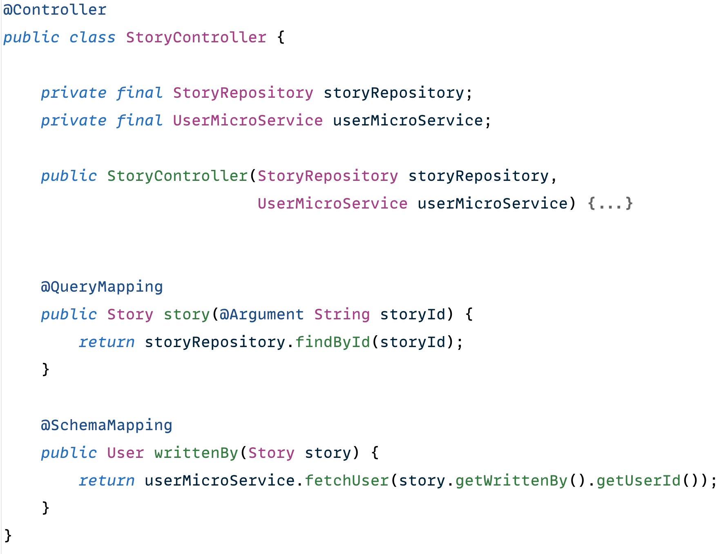
Implementation
Example
Java with Spring Boot
query {
story(storyId: "1")
{
writtenBy
{
name
}
}
}

Slide 45
Claims
about
GraphQL

Slide 46
Claims about GraphQL
"GraphQL APIs are more complex to develop then REST APIs"

Slide 47
Claims about GraphQL
"GraphQL APIs are more complex to develop then REST APIs"
REST APIs are somehow “simple": Each endpoint returns its own Ressource
The returned resource is already known at Development time

Slide 48
Claims about GraphQL
"GraphQL APIs are more complex to develop then REST APIs"
REST APIs are somehow “simple": Each endpoint returns its own Ressource
The returned resource is already known at Development time
GraphQL kann return multiple objects
What needs to be returned is only known at Runtime

Slide 49
Claims about GraphQL
"GraphQL APIs are more complex to develop then REST APIs"
REST APIs are somehow “simple": Each endpoint returns its own Ressource
The returned resource is already known at Development time
GraphQL kann return multiple objects
What needs to be returned is only known at Runtime
👉 Optimizations (performance for example) are more complicated as in REST APIs

Slide 50
GraphQL in der Praxis
"GraphQL APIs are more complex to develop then REST APIs"
Complexity of developlemnt depends on various criterias:
Size and complexity of your schema (domain!)
Number and type of datasources
Complexity and structure of your input data
  do they fit the schema more or less?
  Legacy data?

Slide 51
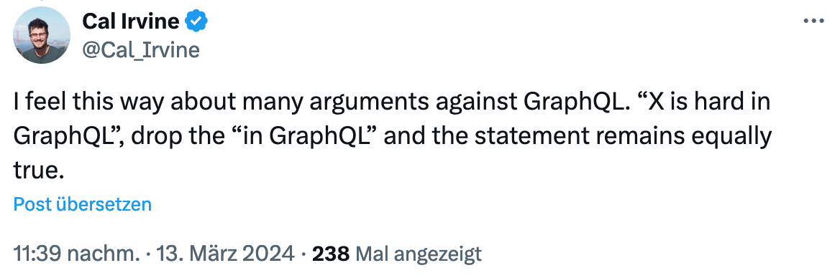
GraphQL in der Praxis
"GraphQL APIs are more complex to develop then REST APIs"
Summary
https://x.com/Cal_Irvine/status/1768044262124323175

Slide 52
Claims on graphql
"GraphQL is SQL, but for the Frontend"
That‘s wrong

Slide 53
Claims on graphql
"GraphQL is SQL, but for the Frontend"
That‘s wrong
SQL is way more powerful than the GraphQL language
  We do not have ORDER BY, LIMIT, JOIN
  We do not have „generic“ queries

Slide 54
Claims on graphql
"GraphQL is SQL, but for the Frontend"
That‘s wrong
SQL is way more powerful than the GraphQL language
  We do not have ORDER BY, LIMIT, JOIN
  We do not have „generic“ queries
GraphQL does not return whole databases back to the client
Data must not even contained in a database

Slide 55
Claims on graphql
"GraphQL is SQL, but for the Frontend"
That‘s wrong
SQL is way more powerful than the GraphQL language
  We do not have ORDER BY, LIMIT, JOIN
  We do not have „generic“ queries
GraphQL does not return whole databases back to the client
Data must not even contained in a database
Data and its structure is determined by our schema and our resolver functions

Slide 56
Claims on graphql
"GraphQL is for lazy people that do not like to design APIs"
That is wrong

Slide 57
Claims on graphql
"GraphQL is for lazy people that do not like to design APIs"
That is wrong
Suggests that with graphql all your data is exposed unstructured to the client

Slide 58
Claims on graphql
"GraphQL is for lazy people that do not like to design APIs"
That is wrong
Suggests that with graphql all your data is exposed unstructured to the client
But schema design is as important as with other technologies

Slide 59
Claims on graphql
"GraphQL is for lazy people that do not like to design APIs"
That is wrong
Suggests that with graphql all your data is exposed unstructured to the client
But schema design is as important as with other technologies
How our API looks like and how good or bad it fits its needs is up to us

Slide 60
Claims on graphql
"GraphQL is for lazy people that do not like to design APIs"
That is wrong
Suggests that with graphql all your data is exposed unstructured to the client
But schema design is as important as with other technologies
How our API looks like and how good or bad it fits its needs is up to us
You can take care… or not… as with all technologies

Slide 61
Claims on graphql
“Caching with GraphQL is impossible"
That‘s… difficult
Claim normally refers to GraphQL requests over HTTP

Slide 62
Claims on graphql
“Caching with GraphQL is impossible"
Problems with caching #1
HTTP Post Requests not cacheable
  The new spec „GraphQL over HTTP“ describes GET as request method

Slide 63
Claims on graphql
“Caching with GraphQL is impossible"
Problems with Caching #2
When a client requests multiple objects, the shorted cache time must „win“

Slide 64
Claims on graphql
“Caching with GraphQL is impossible"
Problems with Caching #2
When a client requests multiple objects, the shorted cache time must „win“
Example: Story and User
  User is probably more or less "stable", good candidate for caching
  Story probably not, cause things can change (Likes, corrections, …)

Slide 65
Claims on graphql
“Caching with GraphQL is impossible"
Problems with Caching #2
When a client requests multiple objects, the shorted cache time must „win“
Example: Story and User
  User is probably more or less "stable", good candidate for caching
  Story probably not, cause things can change (Likes, corrections, …)
In REST each Resource can be cached individually

Slide 66
Claims on Graphql
"GraphQL saves data (traffic) compared to REST APIs"
Only partly correct
Correct is: network requests and thus latency can be better with a one-fit‘s-it-all-Query

Slide 67
Claims on Graphql
"GraphQL saves data (traffic) compared to REST APIs"
Only partly correct
Correct is: network requests and thus latency can be better with a one-fit‘s-it-all-Query
But: data will not de-duplicated or normalized
  A query of X Stories with the same publisher returns X publishers (even when they‘re them same for some stories)
  Can be more efficent then with REST API but does not have to

Slide 68
Claims on Graphql
"GraphQL saves data (traffic) compared to REST APIs"
Only partly correct
Correct is: network requests and thus latency can be better with a one-fit‘s-it-all-Query
But: data will not de-duplicated or normalized
  A query of X Stories with the same publisher returns X publishers (even when they‘re them same for some stories)
  Can be more efficent then with REST API but does not have to
An "unmodified“ response in REST does not return any data at all

Slide 69
Claims on graphql
“I can do the same with REST..."
Offen correct

Slide 70
Claims on graphql
“I can do the same with REST..."
Offen correct
With search params its possible to limit requested attributes of a resource

Slide 71
Claims on graphql
“I can do the same with REST..."
Offen correct
With search params its possible to limit requested attributes of a resource
A schema can be defined with OpenAPI/Swagger

Slide 72
Claims on graphql
“I can do the same with REST..."
Offen correct
With search params its possible to limit requested attributes of a resource
A schema can be defined with OpenAPI/Swagger
With REST it‘s possible to return „sub-objects“

Slide 73
Claims on graphql
“I can do the same with REST..."
Offen correct
With search params its possible to limit requested attributes of a resource
A schema can be defined with OpenAPI/Swagger
With REST it‘s possible to return „sub-objects“
With HATEOS a server can guide a client to the related data of a resource

Slide 74
Claims on graphql
“I can do the same with REST..."
Offen correct
With search params its possible to limit requested attributes of a resource
A schema can be defined with OpenAPI/Swagger
With REST it‘s possible to return „sub-objects“
With HATEOS a server can guide a client to the related data of a resource
But:
  all that is built into GraphQL, you get everything from one hand

Slide 75
Claims on graphql
“Why should I then use GraphQL?"
There are good reasons:

Slide 76
Claims on graphql
“Why should I then use GraphQL?"
There are good reasons:
Over-/Underfetching (overhyped in my opinion)

Slide 77
Claims on graphql
“Why should I then use GraphQL?"
There are good reasons:
Over-/Underfetching (overhyped in my opinion)
Esp. in frontends you often have the need to query data in various forms

Slide 78
Claims on graphql
“Why should I then use GraphQL?"
There are good reasons:
Over-/Underfetching (overhyped in my opinion)
Esp. in frontends you often have the need to query data in various forms
Schema evolution allows steady improvements of the API

Slide 79
Claims on graphql
“Why should I then use GraphQL?"
There are good reasons:
Over-/Underfetching (overhyped in my opinion)
Esp. in frontends you often have the need to query data in various forms
Schema evolution allows steady improvements of the API
Tools and typesafety have very good developer experience

Slide 80
Claims on graphql
“Why should I then use GraphQL?"
There are good reasons:
Over-/Underfetching (overhyped in my opinion)
Esp. in frontends you often have the need to query data in various forms
Schema evolution allows steady improvements of the API
Tools and typesafety have very good developer experience
APIs are good self explorable and discoverable

Slide 81
Claims on graphql
“Why should I then use GraphQL?"
There are good reasons:
Over-/Underfetching (overhyped in my opinion)
Esp. in frontends you often have the need to query data in various forms
Schema evolution allows steady improvements of the API
Tools and typesafety have very good developer experience
APIs are good self explorable and discoverable
Error handling more explizit as in REST

Slide 82
GraphQL in der Praxis
“Why should I then use GraphQL?"
There are some reasons against it:

Slide 83
GraphQL in der Praxis
“Why should I then use GraphQL?"
There are some reasons against it:
REST is mainstream, well understood and widely used

Slide 84
GraphQL in der Praxis
“Why should I then use GraphQL?"
There are some reasons against it:
REST is mainstream, well understood and widely used
Consumers and developers know how REST works

Slide 85
GraphQL in der Praxis
“Why should I then use GraphQL?"
There are some reasons against it:
REST is mainstream, well understood and widely used
Consumers and developers know how REST works
Caching on HTTP level is easy

Slide 86
GraphQL in der Praxis
“When should I use GraphQL?"
it depends...
(as always 😇)

Slide 87


NILS HARTMANN
https://nilshartmann.net
Thank you!
Slides: https://graphql.schule/api-conference
Questions and contact: nils@nilshartmann.net
My GraphQL Workshops: https://graphql.schule

