Slide 1

REACT MEETUP Hamburg | NOVEMBER 2016
v4
@NILSHARTMANN
REACT ROUTER
http://bit.ly/react-rr4

Slide 2
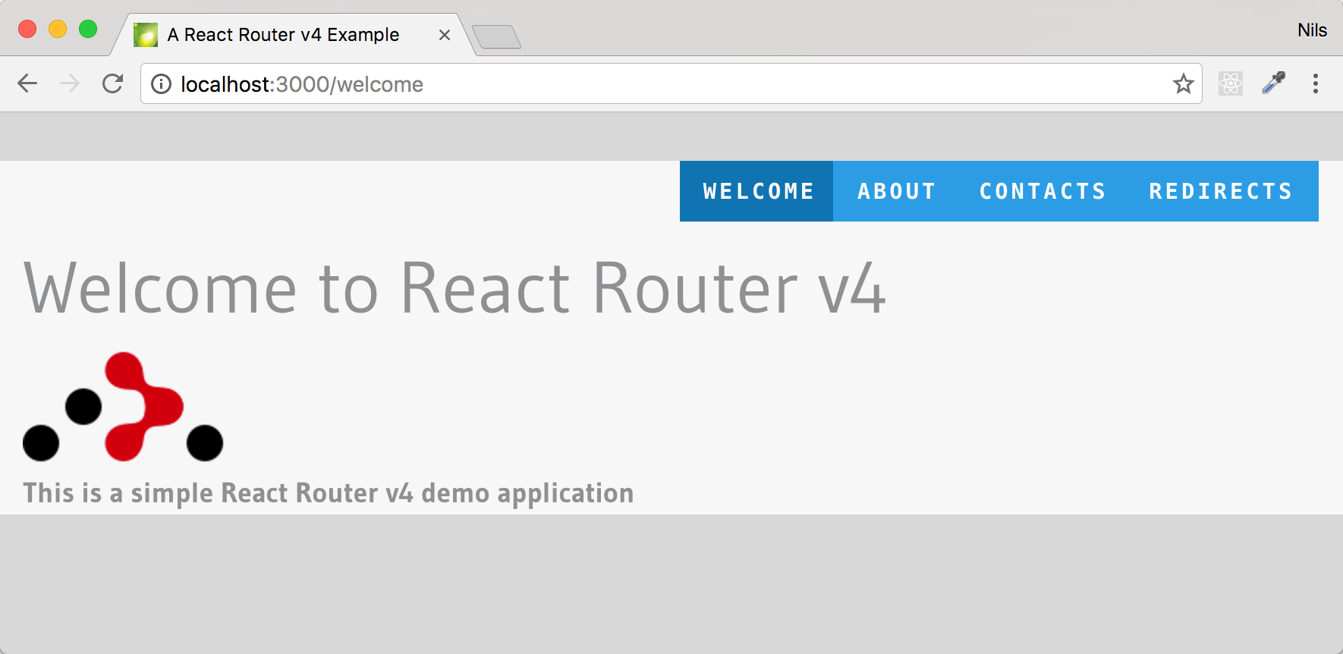
https://github.com/nilshartmann/react-rr4-example

Slide 3
Recap: React Router v2 / v3
Explicit history object
import
{Router, Route, browserHistory, ...} from 'react-router';

Slide 4
Recap: React Router v2 / v3
Global (central) route config
import
{Router, Route, browserHistory, ...} from 'react-router';
const routes = <Router history={browserHistory}>
<Route component={App}>
</Route>
</Router>;

Slide 5
Recap: React Router v2 / v3
Nested routes
import
{Router, Route, browserHistory, ...} from 'react-router';
const routes = <Router history={browserHistory}>
<Route component={App}>
<Route path='/about' component={AboutPage}>
<Route path='more' component={More} />
<Route path='why' component={Why} />
</Route>
<Route path='*' component={NotFound} />
</Route>
</Router>;

Slide 6
Recap: React Router v2 / v3
Links
import { Link } from 'react-router';
const AboutPage = () => (
<div>
<Link to='/about/why'>Why</Link>
<Link to='/about/source'>Source</Link>
<Link to='/about/more'>More</Link>
</div>
);

Slide 7
npm install --save react-router@next
v4
REACT ROUTER

Slide 8
React Router v4
Current state: Alpha Version
Version 4.0.0-alpha6 (Released: yesterday...)
Be careful! Use at your own risk!
Docs and sources
https://react-router.now.sh/
https://github.com/ReactTraining/react-router/tree/v4
Notes:
Beim Starten unserer Anwendung erzeugen wir die Root-Komponente (hier CheckLabel) und hängen sie mit der render-Methode in den echten DOM.

Slide 9
React Router v4: Router
import BrowserRouter from 'react-router/BrowserRouter';
import App from './App';
ReactDOM.render(
<BrowserRouter>
<App />
</BrowserRouter>,
document.getElementById('... ')
);
Router as new top-level component
No centralized route config anymore!
Instead of History use appropriate Router component:
BrowserRouter, HashRouter, MemoryRouter, ServerRouter (new!)
Notes:
Beim Starten unserer Anwendung erzeugen wir die Root-Komponente (hier CheckLabel) und hängen sie mit der render-Methode in den echten DOM.

Slide 10
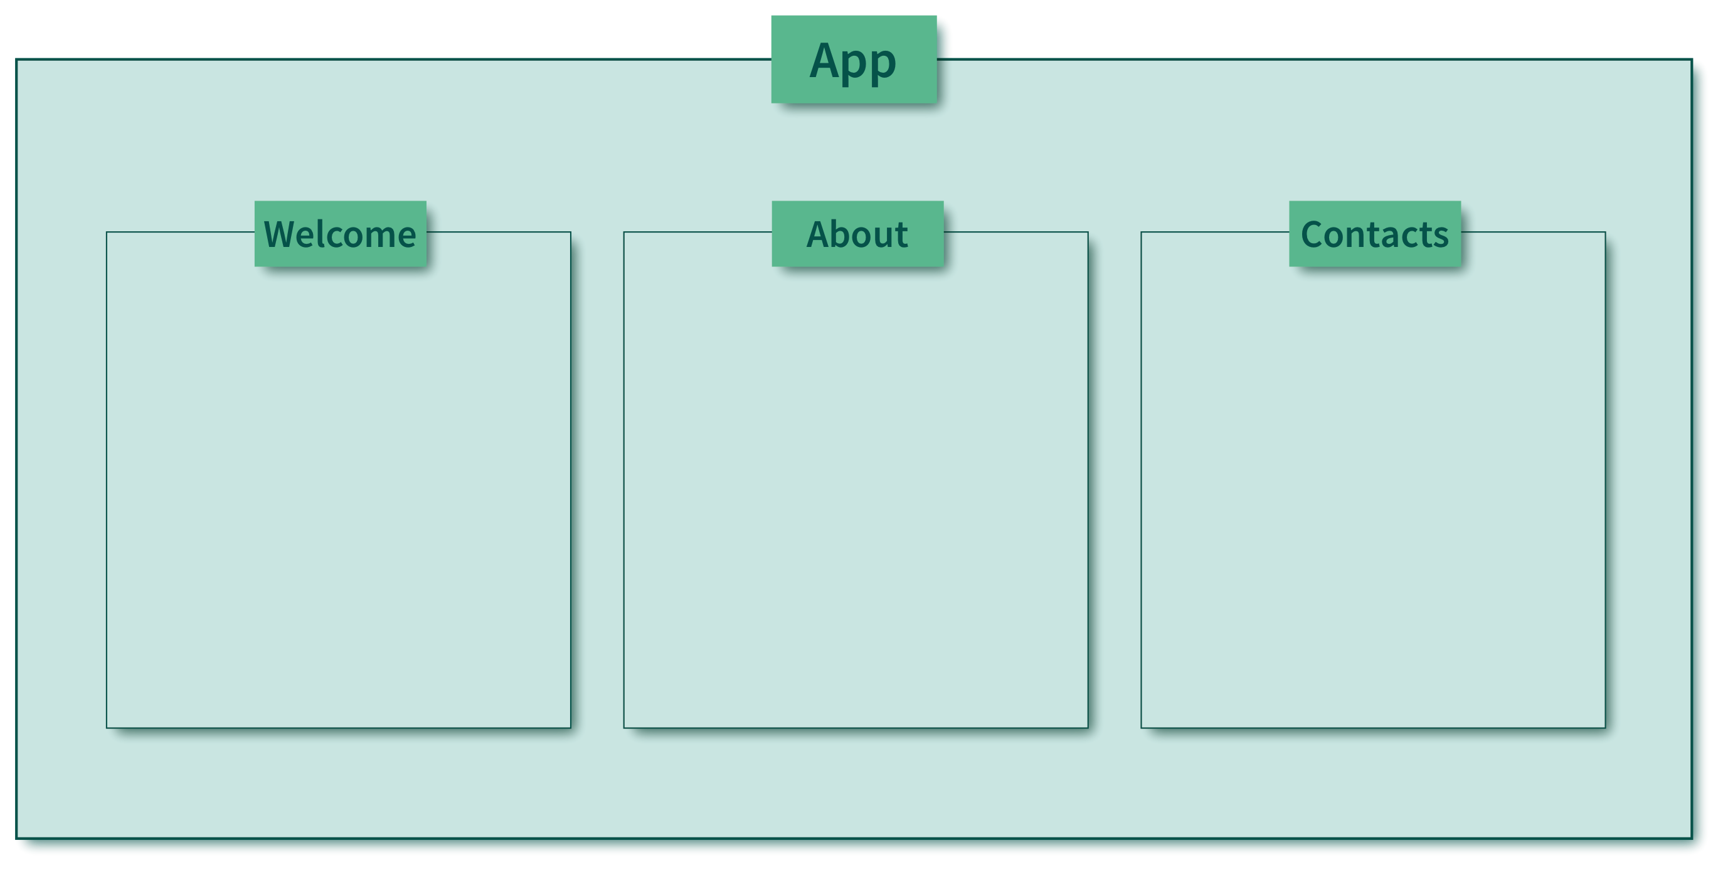
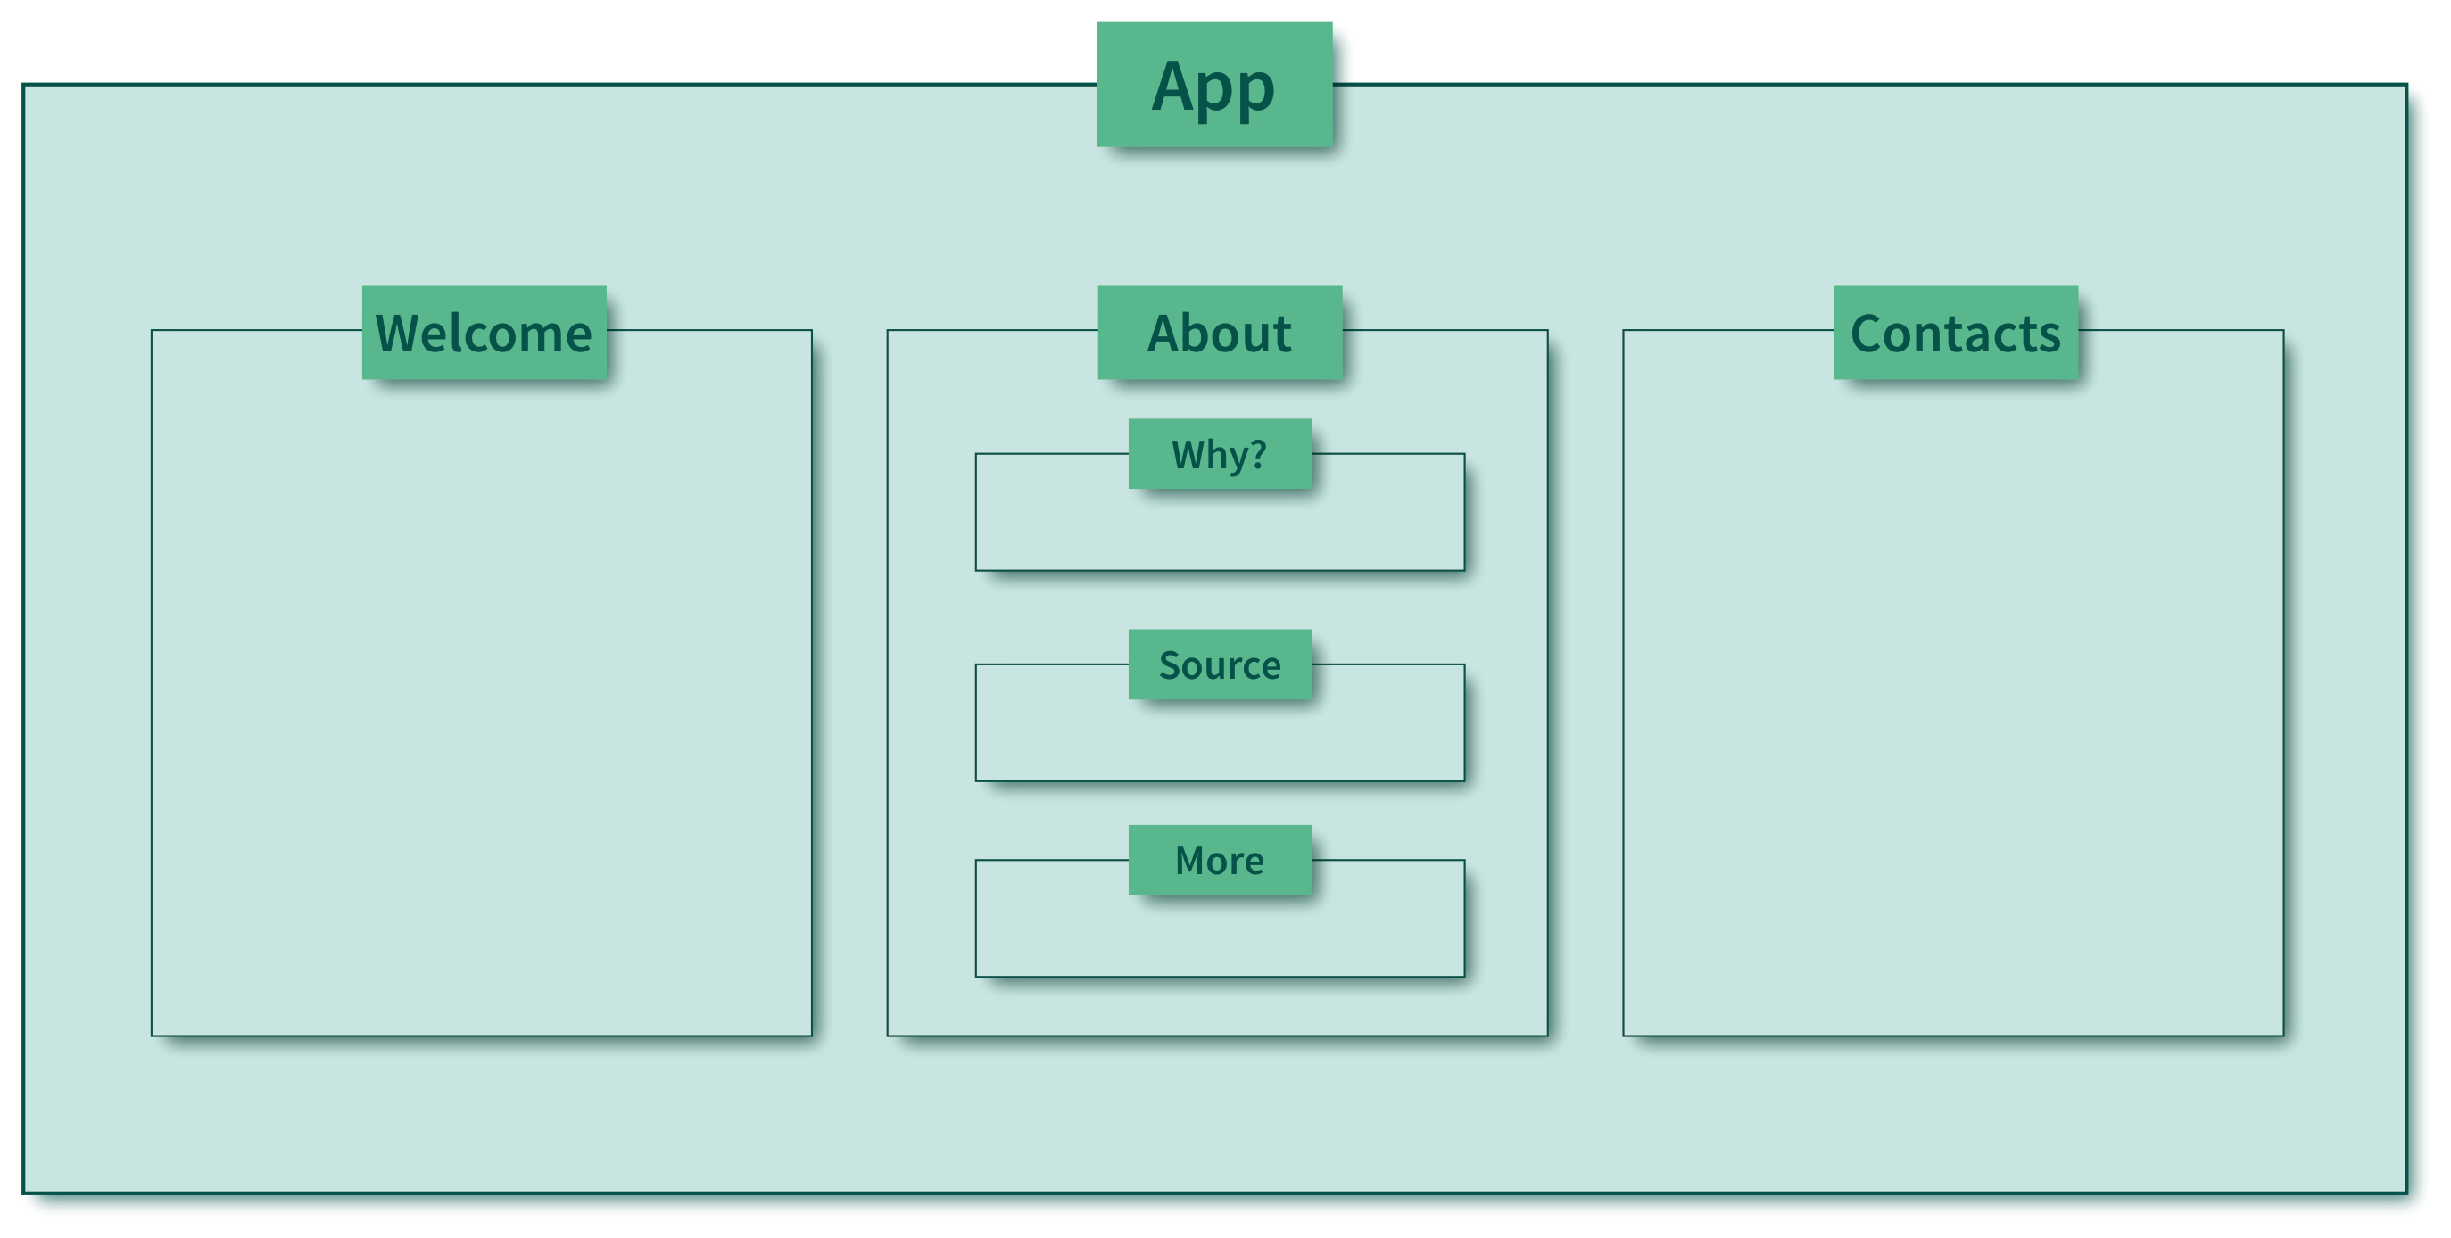
Matching
Notes:
Beim Starten unserer Anwendung erzeugen wir die Root-Komponente (hier CheckLabel) und hängen sie mit der render-Methode in den echten DOM.

Slide 11
Matching 1
App.jsx
// 'regular' component
const App = () => (
<main>
<header>. . .</header>
// add components here according to current route
...
</main>
);
Notes:
Beim Starten unserer Anwendung erzeugen wir die Root-Komponente (hier CheckLabel) und hängen sie mit der render-Methode in den echten DOM.

Slide 12
Matching - 2
App.jsx
import Match from 'react-router/Match';
// 'regular' component
const App = () => (
<main>
<header>. . .</header>
// add components here according to current route
<Match pattern='/welcome' component={ <Welcome /> } />
<Match pattern='/about' component={ <About/> } />
<Match pattern='/secret' component={ <Secret /> } />
</main>
);
Notes:
Beim Starten unserer Anwendung erzeugen wir die Root-Komponente (hier CheckLabel) und hängen sie mit der render-Methode in den echten DOM.

Slide 13
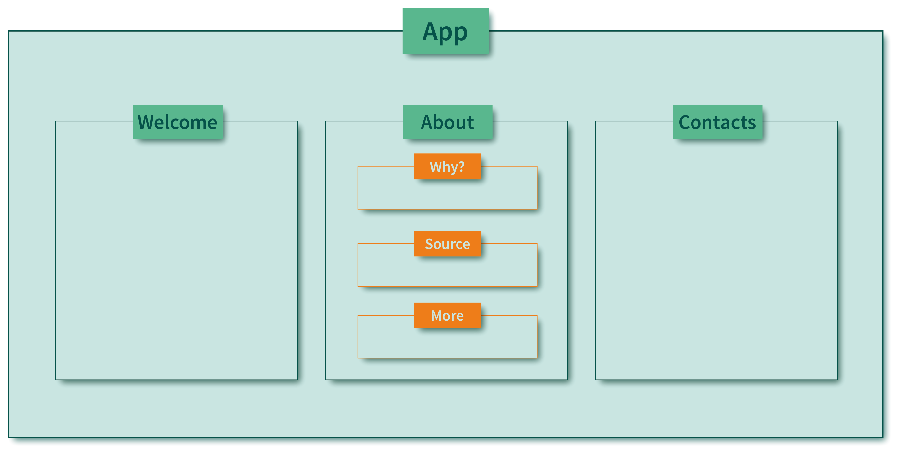
Matching – "SUB ROUTES"
Notes:
Beim Starten unserer Anwendung erzeugen wir die Root-Komponente (hier CheckLabel) und hängen sie mit der render-Methode in den echten DOM.

Slide 14
Matching - "Sub routes"
About.jsx
import Match from 'react-router/Match';
// 'regular' component
const About = ({pathname}) => (
<div>
<h1>About</h1>
<div>
<Match pattern={`${pathname}/why`} component={Why} />
<Match pattern={`${pathname}/more`} component={More}/>
</div>
</div>
);

Slide 15
Matching – Multiple Matches
Page.jsx
import Match from 'react-router/Match';
const Layout = () => (
<div>
<aside>
<Match pattern='/about' component={ContactBlock} />
<Match pattern='/source' component={GitHubLogo} />
</aside>
<main>
<Match pattern='/about' component={AboutPage} />
<Match pattern='/source' component={SourcePage} />
</main>
</div>
);

Slide 16
Matching - Examples
Matches for /:
<Match pattern='/' exactly component={ ... } />
Matches for /about, NOT for /about/:
<Match pattern='/about' exactly component={ ... } />
Matches for /about, /about/, /about/me, /about/react/router/v4:
<Match pattern='/about' component={ ... } />
Dynamic Segments
Matches for /contacts/1, /contacts, contacts/1/a:
<Match pattern='/contacts/:id?' component={ ... } />
Matches for /contacts/1, /contacts, NOT for /contacts/:
<Match pattern='/contacts/:id?' exactly component={ ... } />
Notes:
Beim Starten unserer Anwendung erzeugen wir die Root-Komponente (hier CheckLabel) und hängen sie mit der render-Methode in den echten DOM.

Slide 17
Matching - properties
<Match /> passes properties to rendered component, e.g:
pathname: The path that has been matched ('/about/why')
pattern: The pattern that has been matched ('why')
location: The location object (from History project)
params: Values from the dynamic segments in pattern ('.../:id')
Notes:
Beim Starten unserer Anwendung erzeugen wir die Root-Komponente (hier CheckLabel) und hängen sie mit der render-Methode in den echten DOM.

Slide 18
Matching – Render function
<Match render = { (props) => { . . . } />:
Specifies a function rather than a component
Function receives same parameters as component
Returned component is rendered
Notes:
Beim Starten unserer Anwendung erzeugen wir die Root-Komponente (hier CheckLabel) und hängen sie mit der render-Methode in den echten DOM.

Slide 19
Matching – Render function
Example 1: Conditional rendering
<Match pattern='/secret' render={ () => {
if (!loggedIn) {
return <LoginForm />;
}
return <SecretPage />;
} } />
Notes:
Beim Starten unserer Anwendung erzeugen wir die Root-Komponente (hier CheckLabel) und hängen sie mit der render-Methode in den echten DOM.

Slide 20
Matching –Render function
Example 2: Pass properties to component
const Page = ({allContacts}) => (
<div>
<header>...</header>
<main>
<Match pattern='/contacts' render={ props => (
<ContactsPage contacts={allContacts}
currentContactId={props.params.id} />
) />
</main>
</div>
);
Notes:
Beim Starten unserer Anwendung erzeugen wir die Root-Komponente (hier CheckLabel) und hängen sie mit der render-Methode in den echten DOM.

Slide 21
Redirect
<Redirect to='/some/path' />
Redirect to a specified path (or location)
Works like a "regular component"
Example 1: Use in <Match />-function
import Redirect from 'react-router/Redirect';
const App = () => (
<main>
<header>. . .</header>
<Match pattern='/' render={() => <Redirect to='/index'/> } />
<Match pattern='/index' component={ IndexPage } />
</main>
);

Slide 22
Redirect
<Redirect to='/some/path' />
Redirect to a specified path (or location)
Works like a "regular component"
Example 2: Use in "regular" render function
import Redirect from 'react-router/Redirect';
class Login extends React.Component {
render() {
const { loginSuccessful } = this.state;
const { redirectAfterLogin } = this.props;
return loginSuccessful ?
<Redirect to={redirectAfterLogin} /> : <LoginForm />;
}
}
Notes:
Beim Starten unserer Anwendung erzeugen wir die Root-Komponente (hier CheckLabel) und hängen sie mit der render-Methode in den echten DOM.

Slide 23
Redirect - imperative
Alternative: Redirect via API call
Access to router via React Context (key: router)
Specifies two functions: transitionTo and replaceWith
Example
import { routerContext } from 'react-router/PropTypes';
class Login extends React.Component {
static contextTypes = { router: routerContext };
doRedirectAfterLogin() {
this.context.router.transitionTo('/...');
}
render() { . . . }
}

Slide 24
Matching – No hit: Miss
<Miss component={ . . . }/>
<Miss render={ (params) => { . . . } }/>
Is rendered when no <Match /> hits
Takes either a component or a function (as in <Match />)
Receives a location object with unmatched path
http://localhost:3000/not-there?name=klaus
location:
hash:""
key:undefined
pathname:"/not-there"
query:
name:"klaus"
search:"?name=klaus"
state:null
Notes:
Beim Starten unserer Anwendung erzeugen wir die Root-Komponente (hier CheckLabel) und hängen sie mit der render-Methode in den echten DOM.

Slide 25
Matching – No hit: Miss
Example: <Miss />
import Miss from 'react-router/Miss';
const NoMatch =
({location}) => <b>Not found: {location.pathname}</b>;
const App = () => (
<main>
<Match pattern='/index' component={ IndexPage } />
<Match pattern='/welcome' component={ Welcome } />
<Miss component={ NoMatch } />
</main>
);
Notes:
Beim Starten unserer Anwendung erzeugen wir die Root-Komponente (hier CheckLabel) und hängen sie mit der render-Methode in den echten DOM.

Slide 26
Links
<Link to='...' />:
Renders a link (<a href='...'>...</a>) to specified path
Properties almost identical to React Router v3
to, activeClassName, activeStyle
import Link from 'react-router/Link';
const About = () => (
<span>
Click here <Link
to='/about/more'
activeClassName='active'
activeStyle={{fontWeight: 'bold'}}>for info</Link>
</span>
);
Notes:
Beim Starten unserer Anwendung erzeugen wir die Root-Komponente (hier CheckLabel) und hängen sie mit der render-Methode in den echten DOM.

Slide 27
Links – active link
<Link to='/...' isActive={(params) => {...} }/>
Callback function to determine if Link should be 'active'
location, to: Current and target (as location-object)
props: All properties passed to Link component
import Link from 'react-router/Link';
<Link to='/contact' data-alias='/address'
isActive={ (location, to, props)} => (
location.pathname === to.pathname
|| location.pathname === props['data-alias']
)}
/>
Notes:
Beim Starten unserer Anwendung erzeugen wir die Root-Komponente (hier CheckLabel) und hängen sie mit der render-Methode in den echten DOM.

Slide 28
Links: Custom component
<Link>{(params) => { . . . } }</Link>: Render custom component
Function as (the only) child to <Link />
Render and return an own component instead of <a>...</a>
Useful for menus, buttons etc
Receives parameters needed to build the component
isActive, location, href, onClick ...
Notes:
Beim Starten unserer Anwendung erzeugen wir die Root-Komponente (hier CheckLabel) und hängen sie mit der render-Methode in den echten DOM.

Slide 29
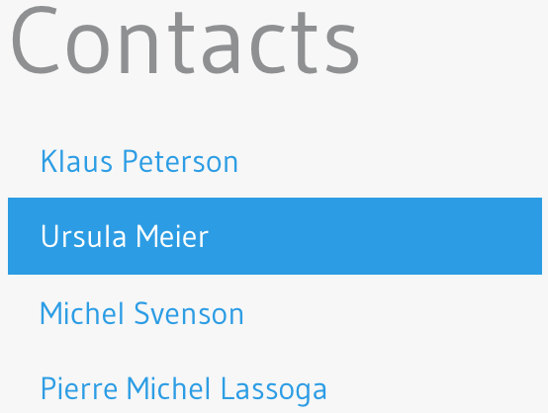
Links: Custom component
Example: A Menu Entry
const MenuEntry = ({ label, to }) => (
<Link to={to}>{params => (
<li className={params.isActive ? 'menu active' : 'menu}>
<a href={params.href} onClick={params.onClick}>{label}</a>
</li>
)}
</Link>
);
<MenuEntry to='/contacts/1'
label='Klaus Peterson' />
<MenuEntry to='/contacts/2'
label='Ursula Meier' />
...
Notes:
Beim Starten unserer Anwendung erzeugen wir die Root-Komponente (hier CheckLabel) und hängen sie mit der render-Methode in den echten DOM.

Slide 30
Relative Paths
Relative paths should be avoided
"tricky to handle"
Not (fully) implemented currently
Workaround: use 'pathname'
const About = ( { pathname } ) => (
<header>
<Link to={`${pathname}`/more}>More...</Link>
<header>
<main>
<Match pattern={`${pathname}/more`} component={More} />
</main>
);
Notes:
Beim Starten unserer Anwendung erzeugen wir die Root-Komponente (hier CheckLabel) und hängen sie mit der render-Methode in den echten DOM.

Slide 31
Summary
Still alpha!
Expect to find bugs
Not that much documentation (but looks promising)
Good improvements over v2/v3
Decentraliced matching
Custom link components
Matching with functions rather than components
Could be better?!
No 'router' as component properties
Custom link components
Relative links and matching
Notes:
Beim Starten unserer Anwendung erzeugen wir die Root-Komponente (hier CheckLabel) und hängen sie mit der render-Methode in den echten DOM.

Slide 32
@nilshartmann
Thank you and happy routing!
http://bit.ly/react-rr4
Questions?

