Slide 2
NILS@NILSHARTMANN.NET

Slide 3

http://reactbuch.de

Slide 4
A JAVASCRIPT LIBRARY FOR BUILDING
USER INTERFACES
React

Slide 5
SINGLE PAGE APPLICATIONS
React

Slide 6
OPEN SOURCE VON FACEBOOK
https://facebook.github.io/react
React

Slide 7
Aktuelle Version
0.3
05 | 2013 – OPEN SOURCE
0.14.7
v 15.0

Slide 8
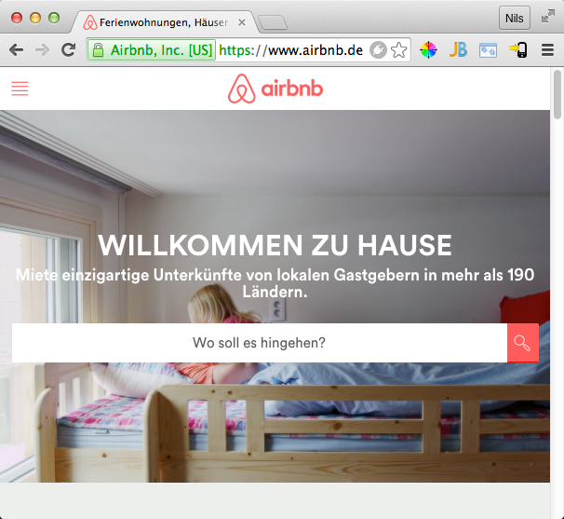
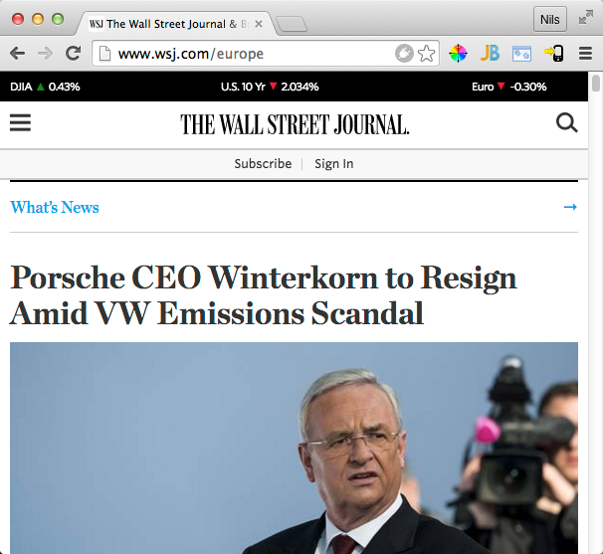
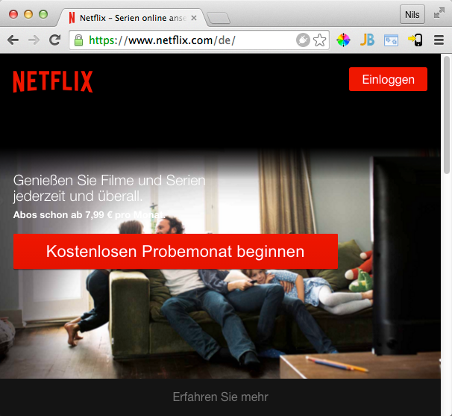
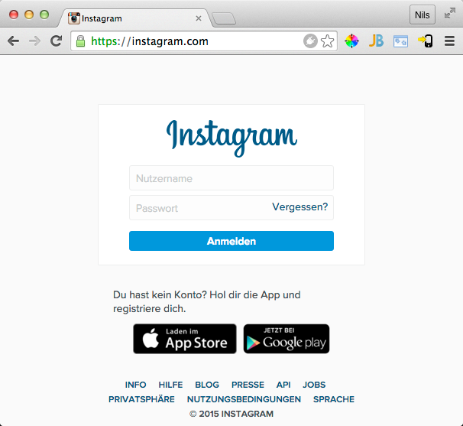
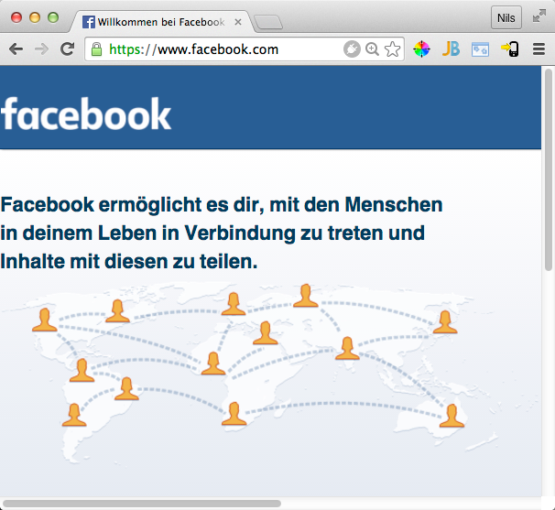
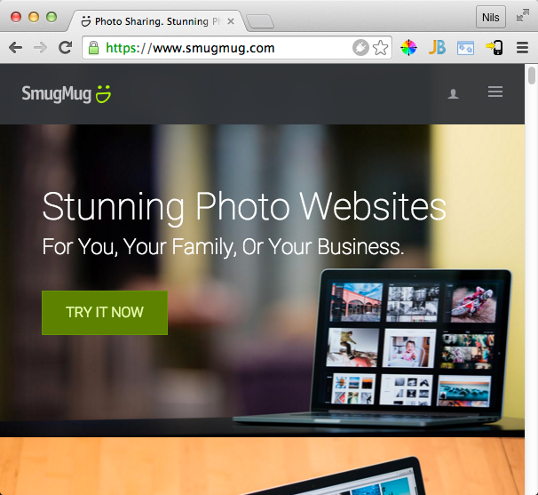
Built with React

Slide 9
V in MVC

Slide 10
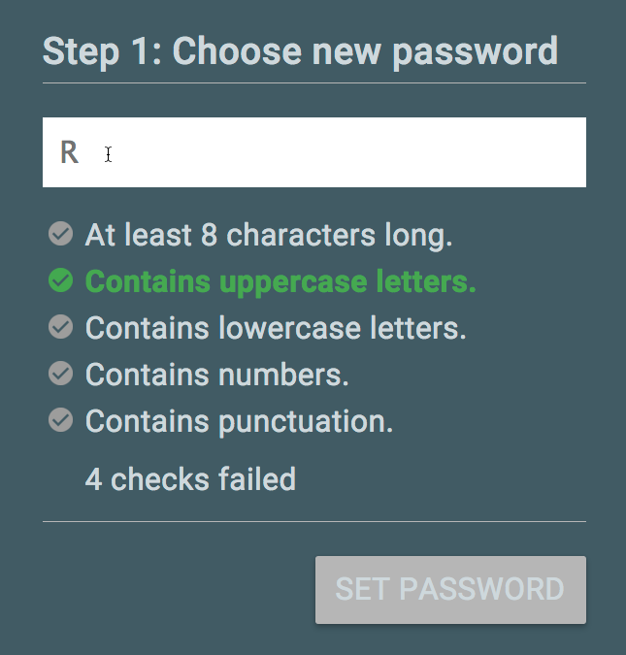
Wiederverwendbare Komponenten
<PasswordView>
<PasswordForm>
<input />
<CheckLabelList>
<CheckLabel />
<CheckLabel />
</CheckLabelList>
<Label />
<Button />
</PasswordForm>
</PasswordView>

Slide 11
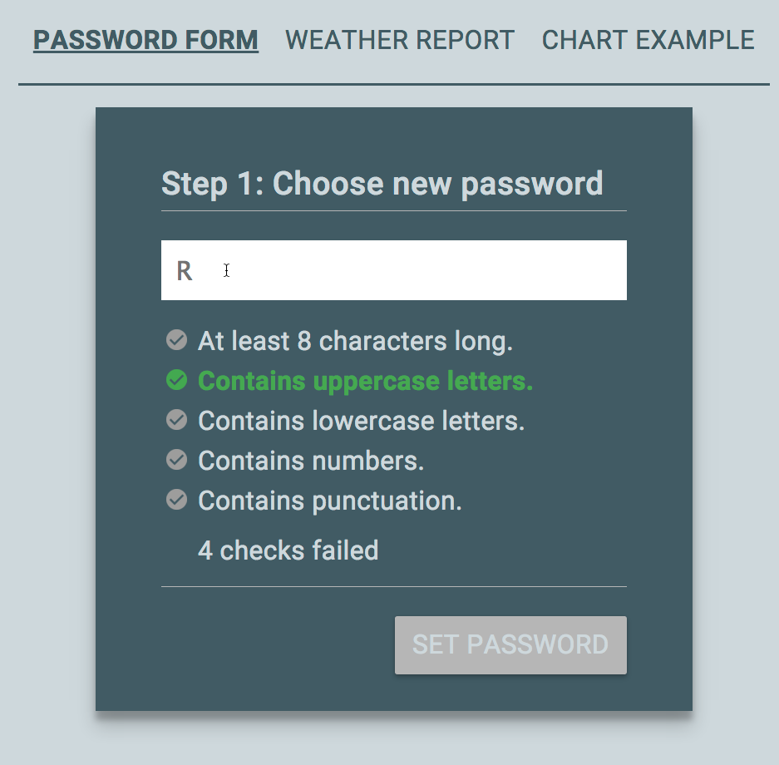
Anwendungen
<Application>
<Navigation />
<ViewContainer>
<PasswordView>
. . .
</PasswordView>
</ViewContainer>
</Application>

Slide 12

Eine React Komponente
function CheckLabel() {
return <div
className="CheckLabel-unchecked">
At least 8 characters long.
</div>;
}

Slide 13
Hallo React

