Slide 1
birdhouse
Back-end Solutions for climate model data
UN GIS Initiative - Workshop
Nils Hempelmann
Birdhouse Developer Group
9

Slide 2
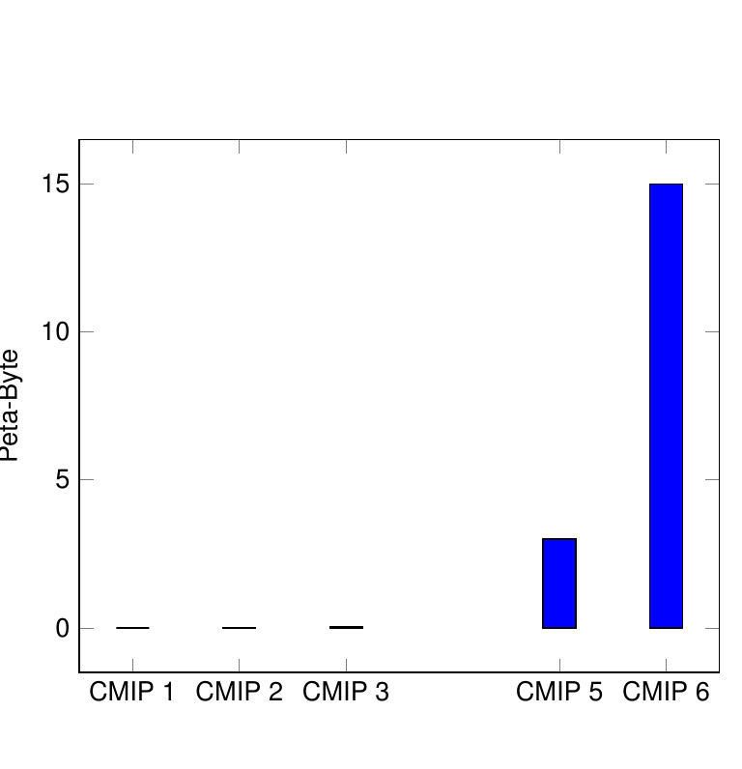
Growing Amount of Data (Example Climate Model data)
CMIP 1 | 1 GB | IPCC AR 1 1990
CMIP 2 | 500 GB | IPCC AR 2 1995
CMIP 3 | 35 TB | IPCC AR 3 2001
 | Not existing | IPCC AR 4 2007
CMIP 5 | 3,5 PB | IPCC AR 5 2014
CMIP 6 | 10-20 PB (in ESGF) | IPCC AR 6 12-16 April 2021
CMIP = Coupled Model Inter-comparison Project
IPCC = Intergovernmental Panel of Climate Change
ESGF = Earth System Grid Federation
9

Slide 3
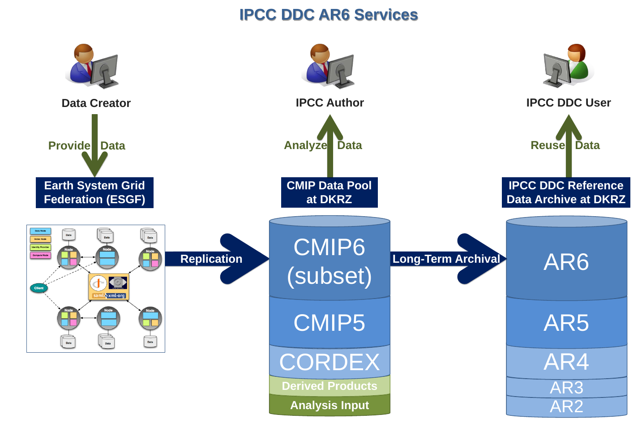
IPCC Data Distribution Center for AR6

Slide 4

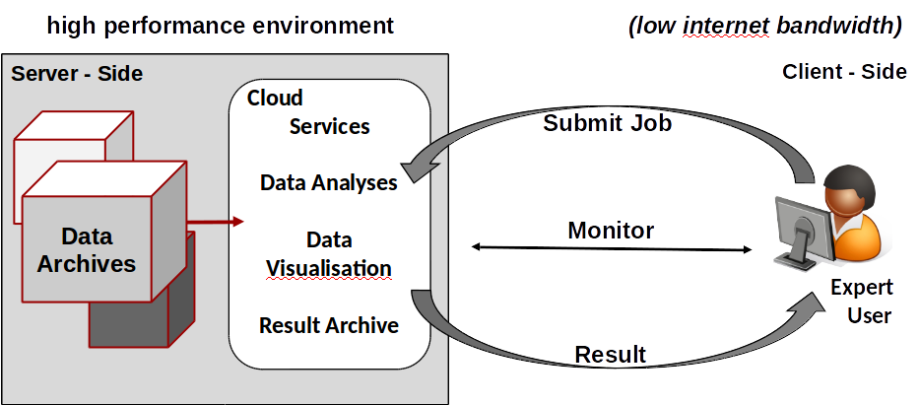
Web Processing Service

Slide 5
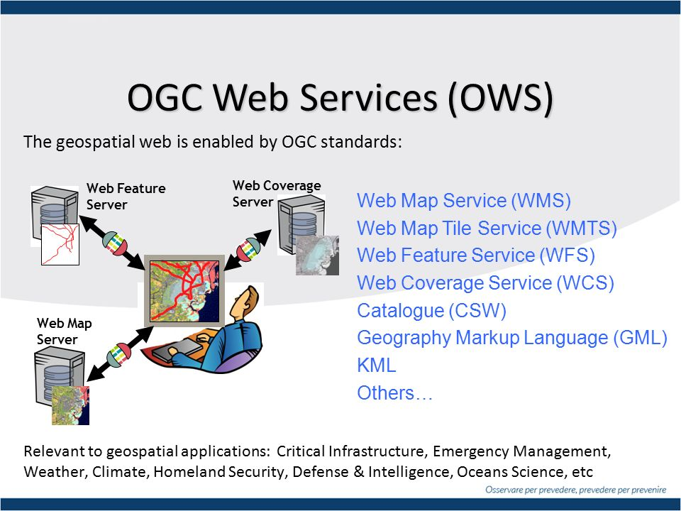



Open Geospatial Consortium

Slide 6
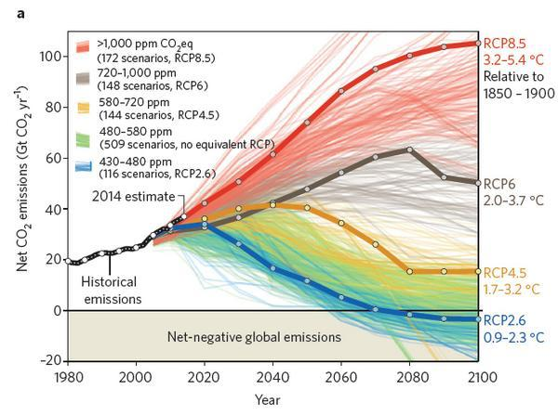
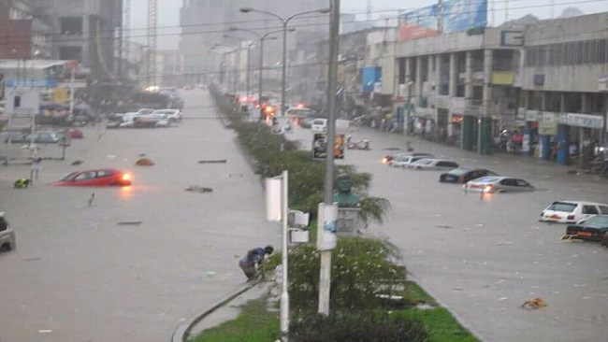

Advantage of Server-Side Services
Avoiding of double work
Decrease difficulties for accessing raw / processed data
Improved quality (continuous testing by the user community)
Increased visibility of Developers/Researchers
Sharing:
  methods
  compute resources
  storage space
  result data
Standardized way of producing results (Monitoring)
Enable multidisciplinary projects with synergies between groups
low cost
Notes:
Maybe a picture for motivation and just a few text keywords?

Slide 7

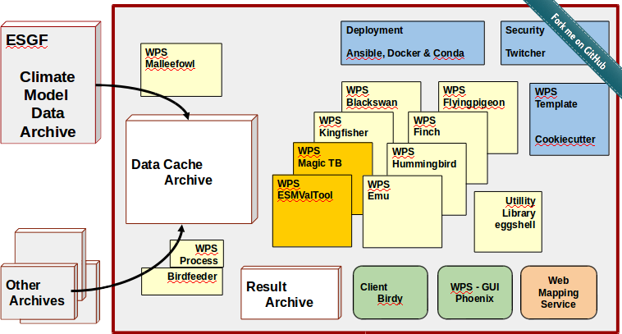
Birdhouse Ecosystem
Notes:
We are using PyWPS … though not restricted to it (Zoo, 52North, ....)

Slide 8





Server Side: Deployment
Web Processing Services
Software
Repository
Deployment
Solution
Setup and administration
WPS Project
Notes:
You can use the “Birdhouse WPS Setup” to create your own WPS project (Finch, Kingfisher, …) and using the same deployment solution (Conda, Ansible, Docker).

Slide 9
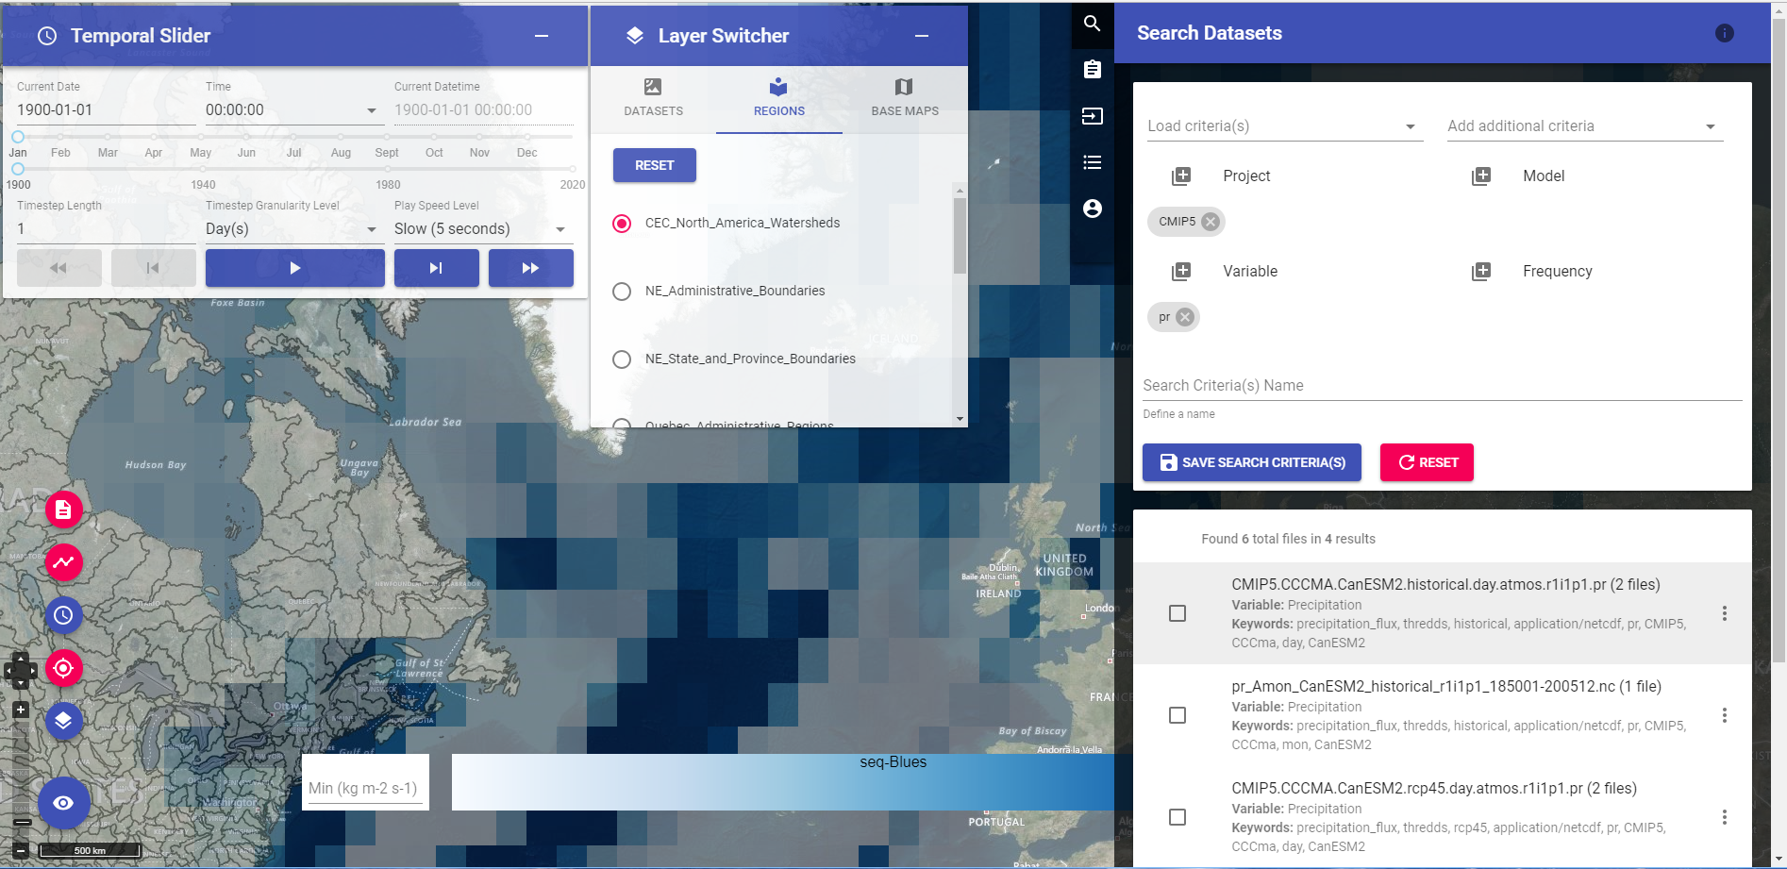
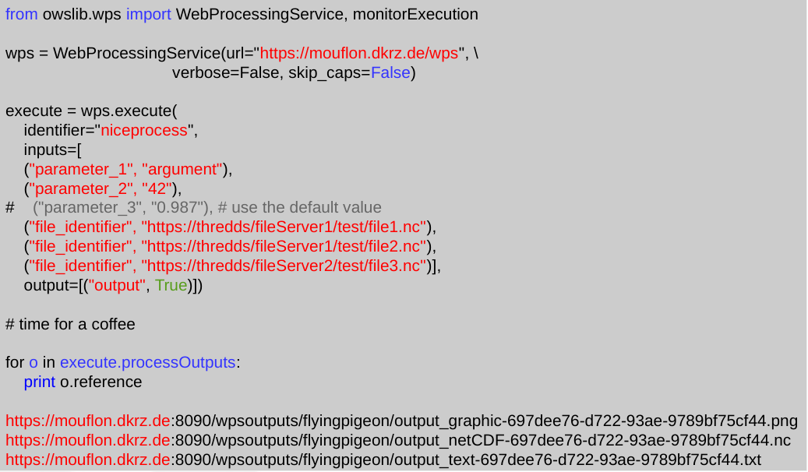
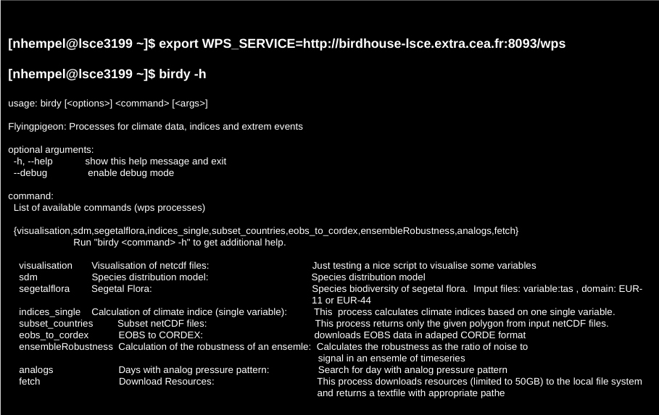
Client Side: User friendly :-)
Authentication with
OAuth or OpenID
Token authentication
Notes:
You can use the “Birdhouse WPS Setup” to create your own WPS project (Finch, Kingfisher, …) and using the same deployment solution (Conda, Ansible, Docker).

Slide 10
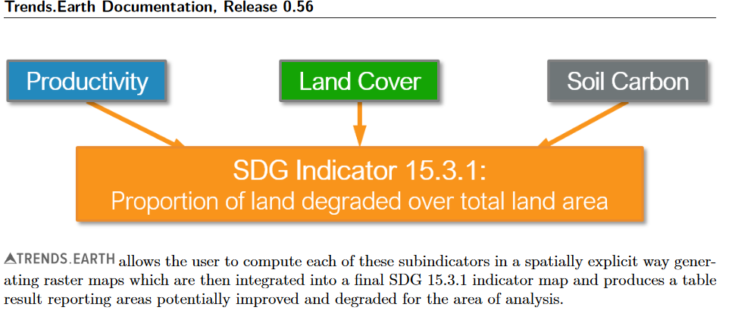

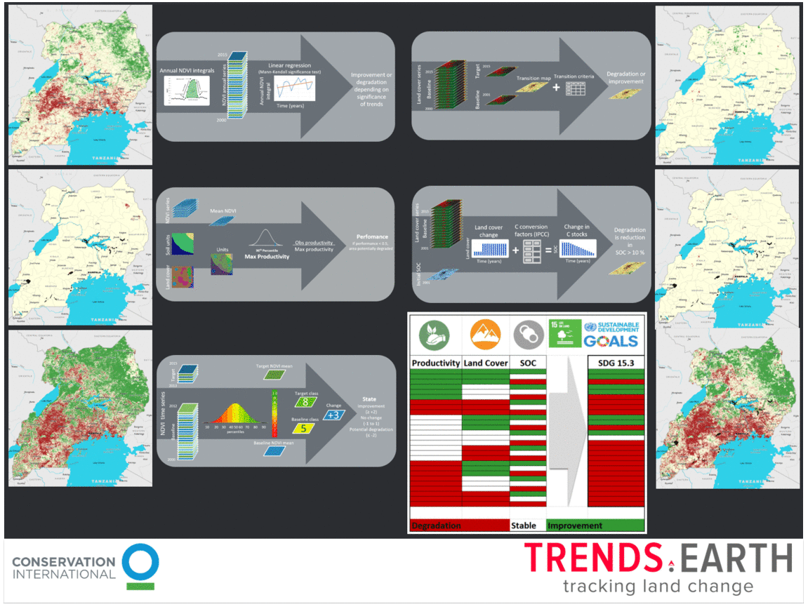
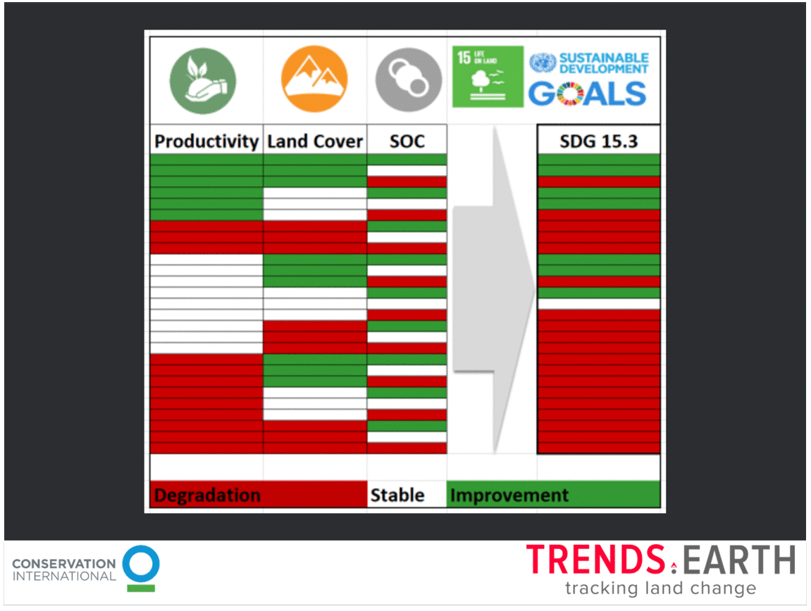
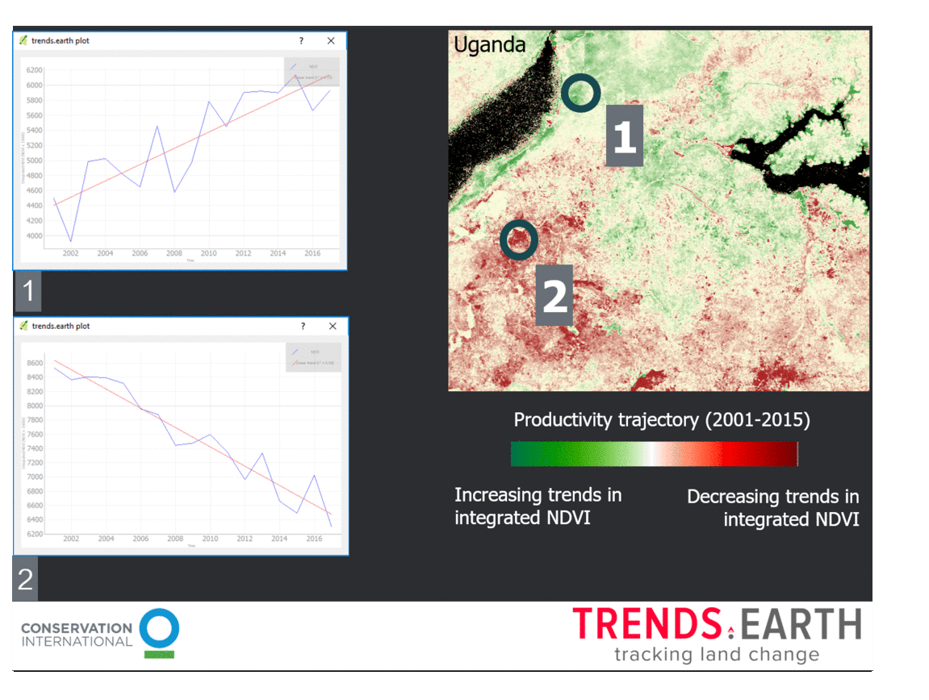
Land degradation neutrality (UNCCD SDG 15.3.1)

Slide 11
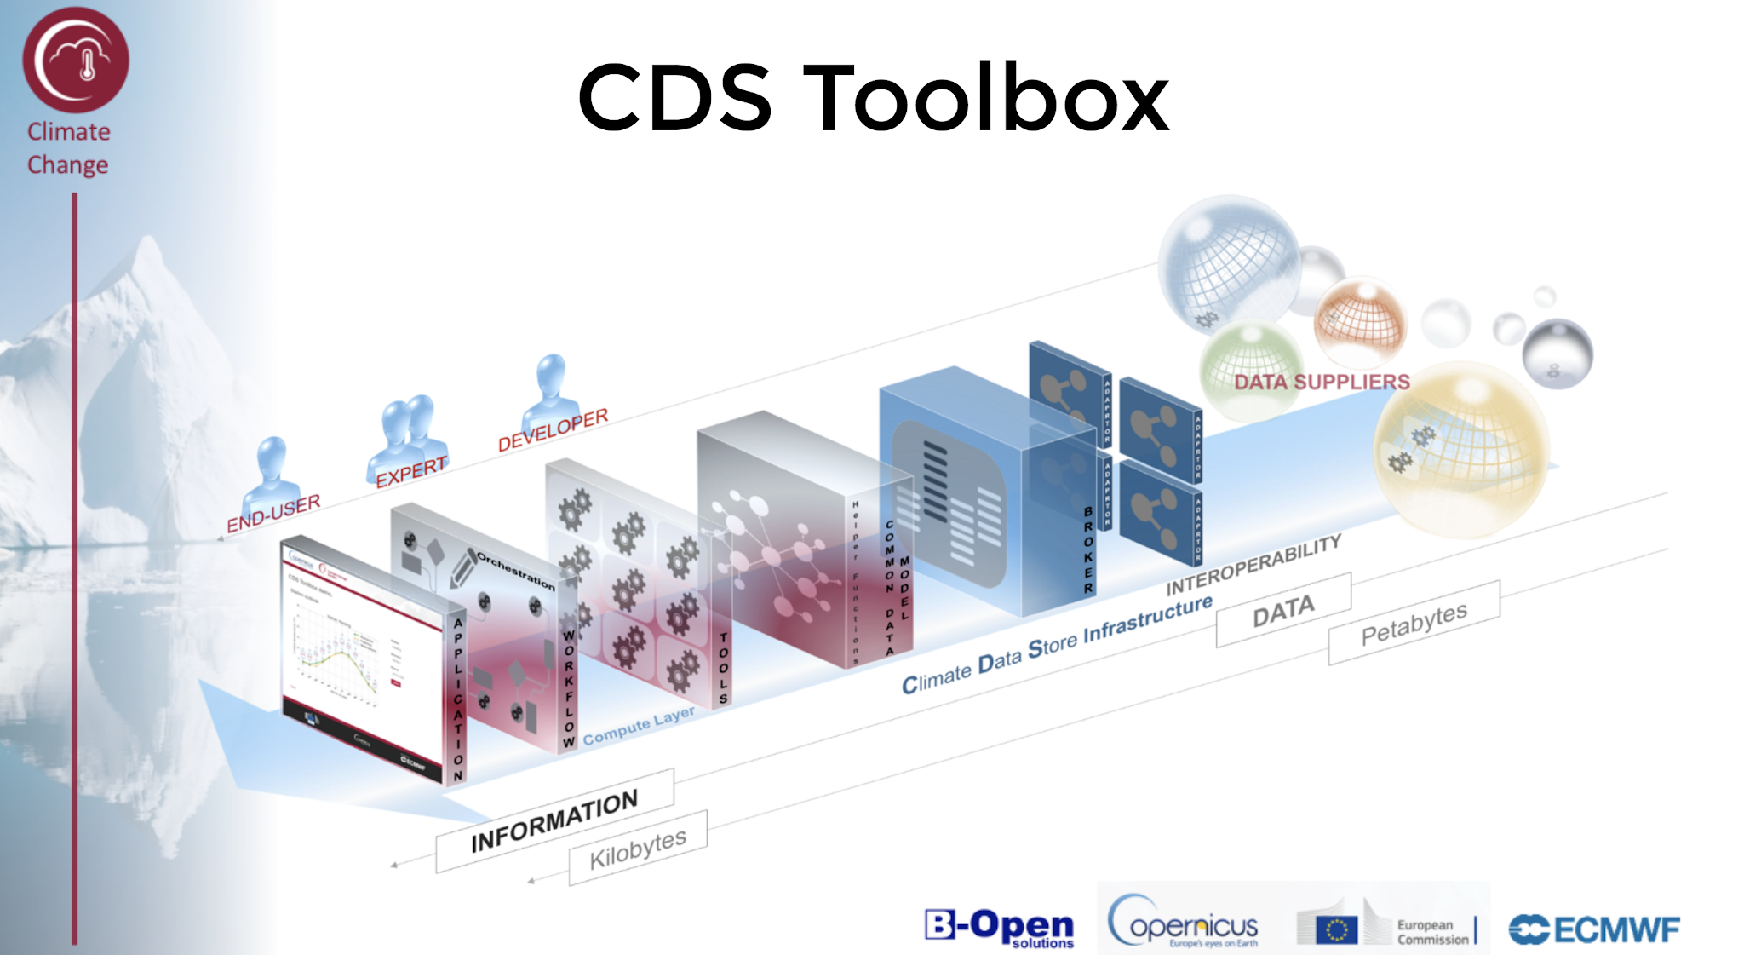
Project: Copernicus Climate
CP4CDS
ESGF Data-Node
(CMIP5 Model Data)
WPS
(Birdhouse Setup)
CDS: Climate Data Store
C3S: Copernicus Climate Change Service
CP4CDS: Climate Projections for Climate Data Store
Notes:
CP4CDS is data supplier for model data (CMIP5, etc) and remote processing on this data pool (WPS).
Birdhouse: provides setup and deployment for remote processing (WPS).
Describe architecture of CP4CDS
Identify Birdhouse role
Describe CP4CDS nodes
Introduce ESGF data nodes

Slide 12
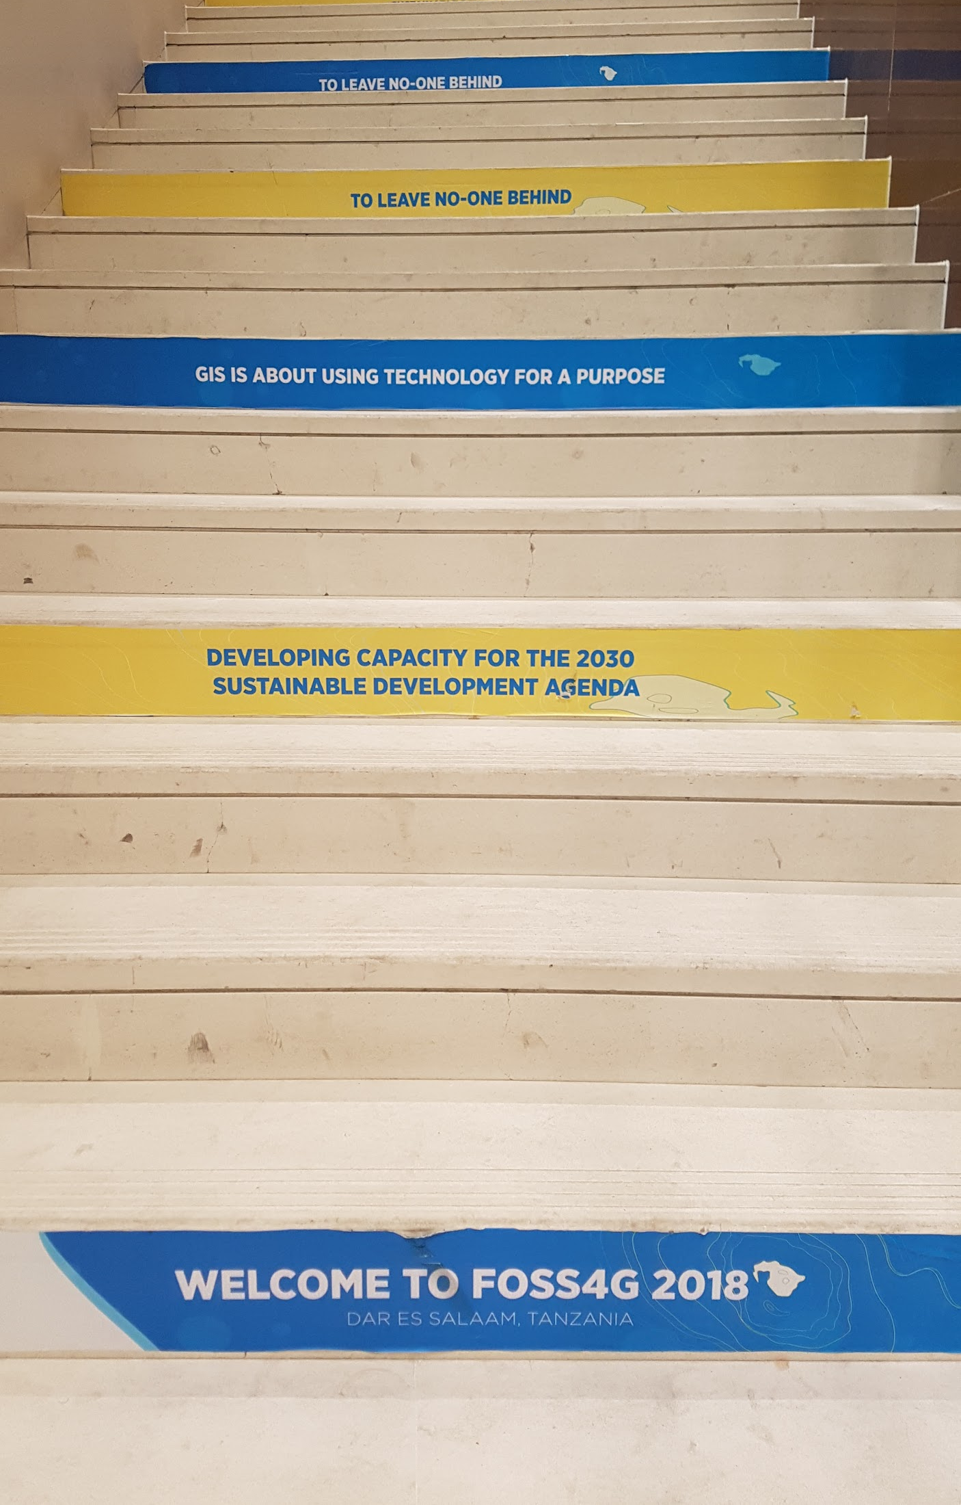
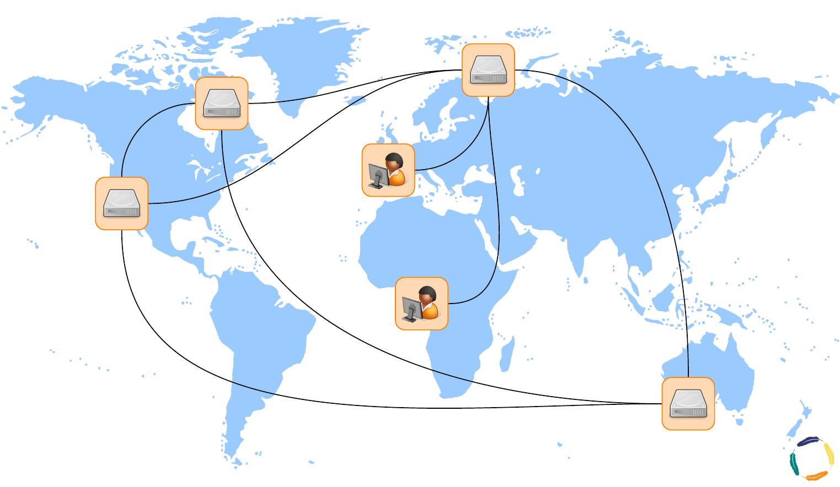
Harnessing SDI for Sustainable Development
Leave no one behind

Slide 13
Outlook
Canada
  Govt of Canada: Canadian Center for Climate Services (CCCS)
  Pan-Canadian federated cyberinfrastructure
  Earth Observation support, integration of ML/DL
EU COPERNICUS
  C3S with CP4CDS ready for production use in 2019.
(based on CMIP5 data)
  extended for CORDEX (regional model data) in 2019/2020
  extended for CMIP6 … ?
  Extended functionality (polygon subset etc.)
International:
  Web Processing Services on ESGF Nodes
http://bird-house.github.io/

