Slide 1





















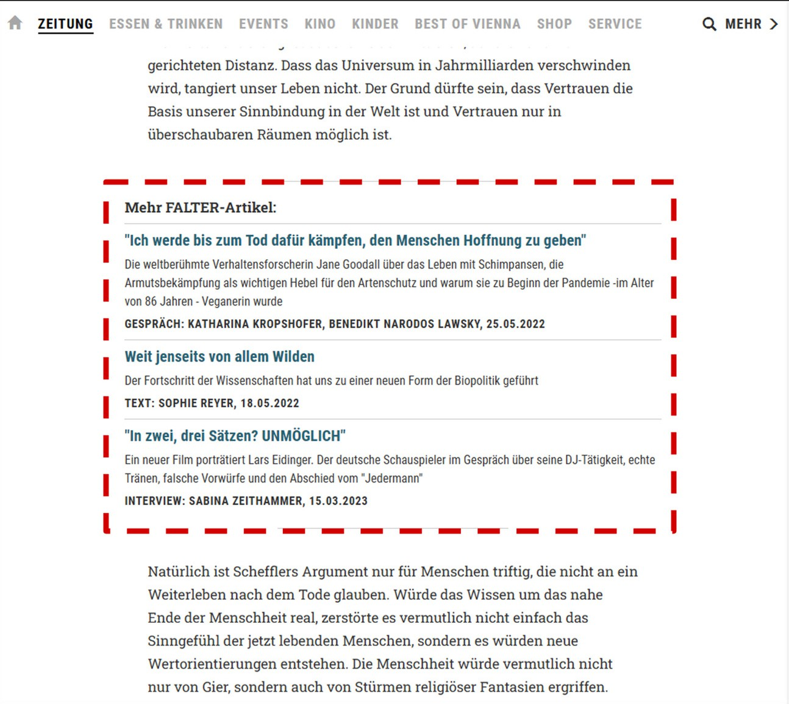


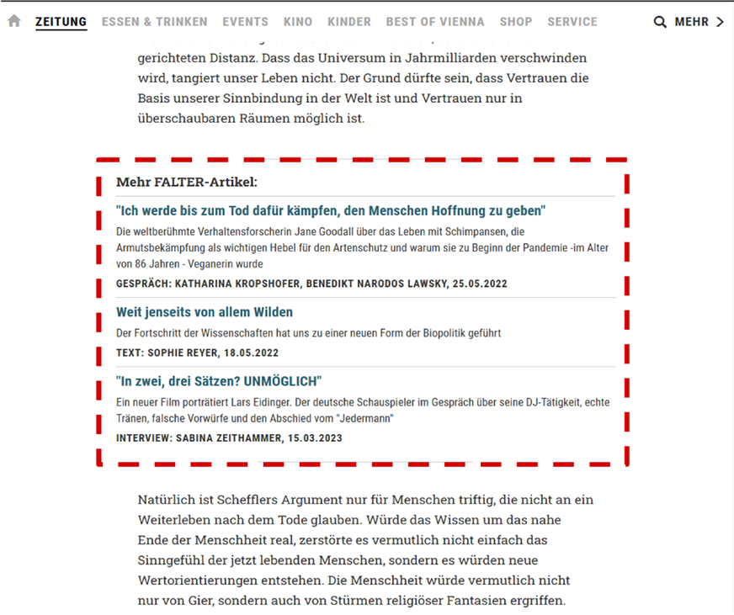
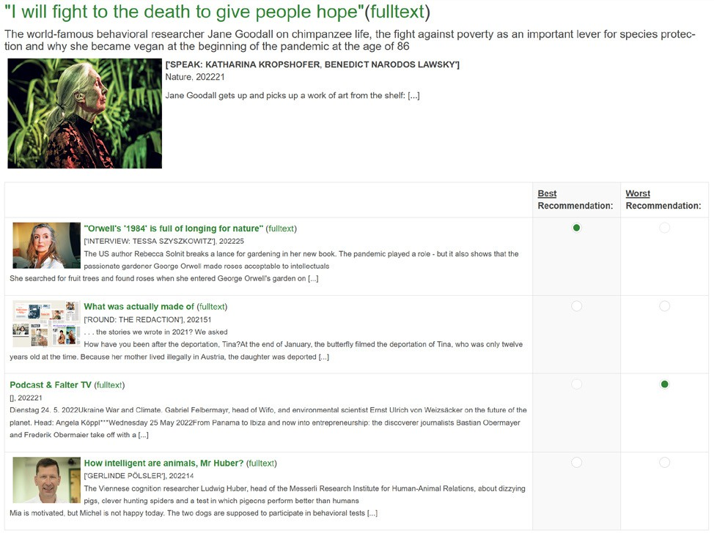
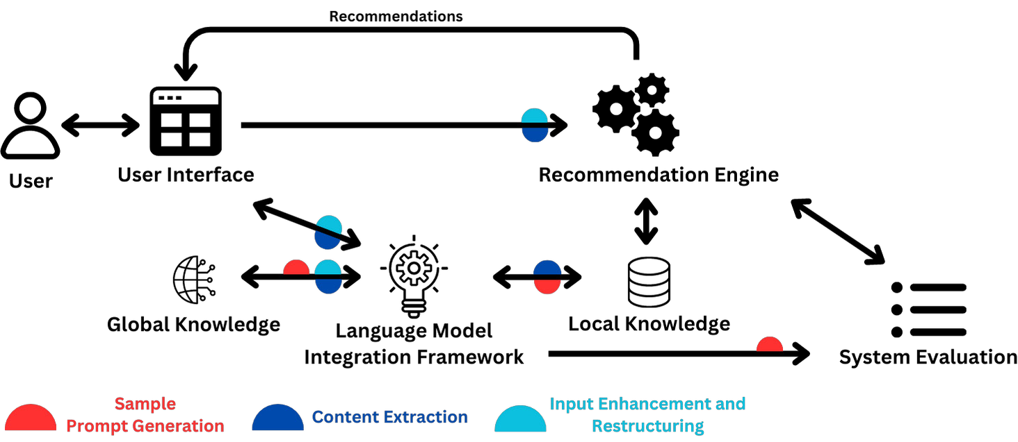






18th ACM Conference on Recommender Systems | Bari, Italy, 14-18 October 2024
Enhancing Cross-Domain Recommender Systems with LLMs: Evaluating Bias and Beyond-Accuracy Measures
Thomas E. Kolb, PhD Student & Project Assistant
TU Wien Informatics
Institute of Information Systems Engineering
Research Unit: Data Science Supervisor: Assistant Prof. Dr. Julia Neidhardt
Generative AI (LLMs)
What Is This All About?
Beyond Accuracy
Cross-Domain
Long-Running A/B Test
Aim of This Work
Phase 1
Methodology & Experiments
Investigate Traditional vs. LLM-Enhanced Cross-Domain Recommender Systems
Detect and Mitigate Bias
Evaluate Beyond Accuracy
Applied within a real-world setting in the domain of news, books, and various lifestyle areas.
Research Questions
Phase 2
RQ1: To what extent do LLM-based recommendation methods improve cross-domain recom- mender systems, and which aspects like user personalization and relevance benefit the most?
RQ2: To what extent do beyond-accuracy metrics (novelty, diversity, serendipity) impact fairness and accuracy in cross-domain news and lifestyle recommender systems, and how do these im- pacts differ between traditional and LLM-based systems?
RQ3: To what extent can bias in cross-domain recommender systems be identified, measured, and reduced with LLM-based methods compared to traditional methods, and what evaluation strategies can be developed to handle challenges like decreased diversity and hallucination?
Phase 3
Modular recommender system framework:
Current Findings
Long-Running A/B Test
Planned Research
Developed a modular framework to analyze and improve news recommendation algorithms (Fig. 1)
What is a good reading recommendation?
Conducted a editor and user study (Kolb et al. [1], Fig. 2)
Investigated news bias during COVID-19:
Figure 1: News Recommendations (fal-
ter.at - Website)
(Kolb et al. [2], Fig. 5)
Potentials of combining local knowledge and LLMs for recommender systems (Kolb et al. [3])
Conducting a long-term A/B test on FALTER’s (Fig. 4) live website using anonymized user behavior data to investigate bias mitigation strategies and beyond-accuracy measurements.
Evaluating various recommendation algorithms and exploring cross-domain recommendations
(news-to-podcast, news-to-restaurant, news-to-book) by e.g. integrating FALTER’s book catalog.
Through an offline dataset from derStandard
Figure 2: Reading Recommendations Survey
Evaluation
Leverage LLMs to enhance feature extraction and support evalua- tion of study results.
Assess article rankings from participants to understand perceptions of a “good reading recommendation”.
Insights into the multi-stakeholder environment (editors vs. users). Investigate beyond-accuracy metrics.
Several co-supervised bachelor- and master thesis projects:
Content-based recommendations (Dante et al. [4])
Group fairness in Recommender Systems (Blake et al. [5]) User roles in online news forums (Scholz et al. [6])
User Study
Figure 3: Recommender System Architecture Incorporating LLMs by Kolb et al. [3]
Figure 4: Partner Company (Source: https://falter.at)
Figure 5: Partner Company (Source: https://derstandard.at)
Expected Outcomes
Conclusion
A modular recommendation framework enabling the integration and evaluation of various recommendation algorithms, including LLM-based approaches.
Deployment within the news ecosystem allows for real-world testing, which overcomes the problem of solely evaluating against offline data.
New insights into which aspects of traditional approaches within cross-domain recom- mender systems can be improved by LLMs.
New approaches to identify and mitigate bias, as well as to better understand fairness (e.g., the problem of decreased diversity, hallucinations of LLMs), within the interplay of traditional methods and LLMs.
Aligned with the principles of Digital Humanism (Fig. 6), this doctoral research aims to develop new methods and insights to address unfairness and bias in both traditional and LLM-based cross-domain recommender systems. While generative AI offers significant potential, it also pre- sents challenges such as hallucinations and reduced diversity. By comparing novel LLM-based approaches with traditional methods, this work seeks to enhance the quality and fairness of cross-domain recommendations, emphasizing the importance of keeping AI in the loop rather than the human.
Figure 6: Digital Humanism at TU Wien (Source: https://caiml.org/dighum/)
Dipl.-Ing. Thomas E. Kolb thomas.kolb@tuwien.ac.at https://www.linkedin.com/in/kolb-thomas/ https://recsys-lab.at/team/thomas-kolb/
Contact
Publications
funded by:
Kolb, T., Nalis-Neuner, I., & Neidhardt, J. (2023). Like a Skilled DJ -an Expert Study on News Recommendations Beyond Accuracy. In Proceedings of the International Workshop on News Recommendati- on and Analytics co-located with the 2023 ACM Conference on Recommender Systems (RecSys 2023). CEUR-WS.org.
Thomas Elmar Kolb, Irina Nalis, Mete Sertkan, and Julia Neidhardt. 2022. The Role of Bias in News Recommendation in the Perception of the Covid-19 Pandemic. FAccTRec Workshop ’22, in conjunc- tion with RecSys 2022, Seattle, WA, USA.
Kolb, T. E., Wagne, A., Sertkan, M., & Neidhardt, J. (2023). Potentials of Combining Local Knowledge and LLMs for Recommender Systems. In V. W. Anelli, P. Basile, G. De Melo, F. Donini, A. Ferrara, C. Musto, F. Narducci, A. Ragone, & M. Zanker (Eds.), Proceedings of the Fifth Knowledge-aware and Conversational Recommender Systems Workshop co-located with 17th ACM Conference on Recom- mender Systems (RecSys 2023) (pp. 61–64). CEUR-WS.org. https://doi.org/10.34726/5334
Godolja, D., Kolb, T., & Neidhardt, J. (2024). Unlocking the Potential of Content-Based Restaurant Recommender Systems. In Information and Communication Technologies in Tourism 2024 (pp. 239– 244). Springer Nature Switzerland.
Huebner, B., Kolb, T., & Neidhardt, J. (2024). Evaluating Group Fairness in News Recommendations: A Comparative Study of Algorithms and Metrics. In Adjunct Proceedings of the 32nd ACM Confe- rence on User Modeling, Adaptation and Personalization (UMAP Adjunct ‚24) (pp. 10). ACM.
Scholz, F., Kolb, T., & Neidhardt, J. (2024). Classifying User Roles in Online News Forums: A Model for User Interaction and Behavior Analysis. In Adjunct Proceedings of the 32nd ACM Conference on User Modeling, Adaptation and Personalization (UMAP Adjunct ‚24) (pp. 10). ACM.
image: “Flaticon.com”. This poster has been designed using resources from Flaticon.com

