Slide 1
PPTX Parser Fixtures
Plain paragraph
Bold text
Italic text
Underlined text
Bold and italic text

Slide 2
Lists
First bullet
Second bullet
Nested bullet
Link bullet
First number
Second number
Nested number

Slide 3
Tables
Heading A | Heading B | Heading C
A1 | B1 | C1
A2 | B2 | C2

Slide 4
Grouped elements
Grouped Heading
Grouped Body

Slide 5
Sorting and empty content
First
Second
Left |  | Right
 | Middle
Third

Slide 6
Notes:
Speaker notes

Slide 7
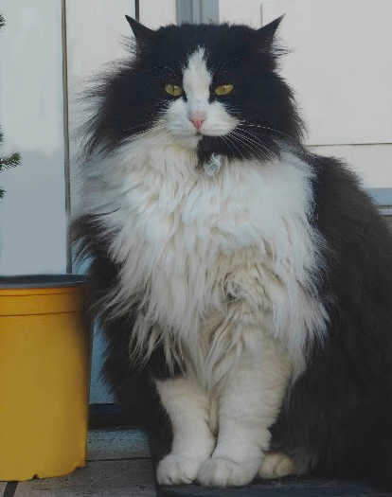
Image

