Slide 1
Confirmatory Factor Analysis in R with lavaan
OARC IDRE Statistical Consulting
https://stats.idre.ucla.edu/r/seminars/rcfa/

Slide 2
Outline 1
Introduction
Motivating example: The SAQ
Variance-covariance matrix
Factor analysis model
Model-implied covariance matrix
Path Diagram
One Factor CFA
Known values, parameters, and degrees of freedom
Three-item (one) factor analysis
Identification of a three-item one factor CFA
Running a one-factor CFA in lavaan

Slide 3
Outline 2
Model Fit Statistics
Model chi-square
Approximate fit indices
CFI (Confirmatory Factor Index)
TLI (Tucker Lewis Index)
RMSEA
Two Factor Confirmatory Factor Analysis
Correlated factors
Intermission
Exercises

Slide 4
Introduction
Motivating example: The SAQ
Variance-covariance matrix
Factor analysis model
Model-implied covariance matrix
Path Diagram

Slide 5
Overview
EFA
CFA
Exploratory Factor Analysis
CFA
SEM
Introduction to SEM

Slide 6
SAQ
N = 2571
Statistics makes me cry
My friends will think I’m stupid for not being able to cope with SPSS
Standard deviations excite me
I dream that Pearson is attacking me with correlation coefficients
I don’t understand statistics
I have little experience with computers
All computers hate me
I have never been good at mathematics
1 | 2 | 3 | 4 | 5
Strongly Disagree | Disagree | Neither Agree or Disagree | Agree | Strongly Agree

Slide 7
Preparations
install.packages("foreign", dependencies=TRUE)
install.packages("lavaan", dependencies=TRUE)
library(foreign)
library(lavaan)
dat <- read.spss("https://stats.idre.ucla.edu/wp-content/uploads/2018/05/SAQ.sav", to.data.frame=TRUE, use.value.labels = FALSE)

Slide 8
Correlation Table
> round(cor(dat[,1:8]),2)
q01 q02 q03 q04 q05 q06 q07 q08
q01 1.00 -0.10 -0.34 0.44 0.40 0.22 0.31 0.33
q02 -0.10 1.00 0.32 -0.11 -0.12 -0.07 -0.16 -0.05
q03 -0.34 0.32 1.00 -0.38 -0.31 -0.23 -0.38 -0.26
q04 0.44 -0.11 -0.38 1.00 0.40 0.28 0.41 0.35
q05 0.40 -0.12 -0.31 0.40 1.00 0.26 0.34 0.27
q06 0.22 -0.07 -0.23 0.28 0.26 1.00 0.51 0.22
q07 0.31 -0.16 -0.38 0.41 0.34 0.51 1.00 0.30
q08 0.33 -0.05 -0.26 0.35 0.27 0.22 0.30 1.00

Slide 9


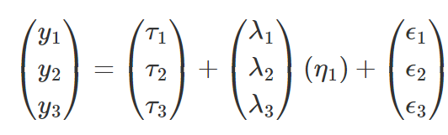
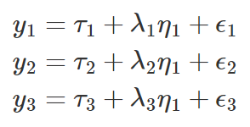
Factor Analysis Model

Slide 10


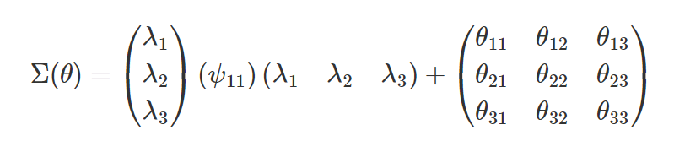
Model Implied Covariance Matrix
versus

Slide 11
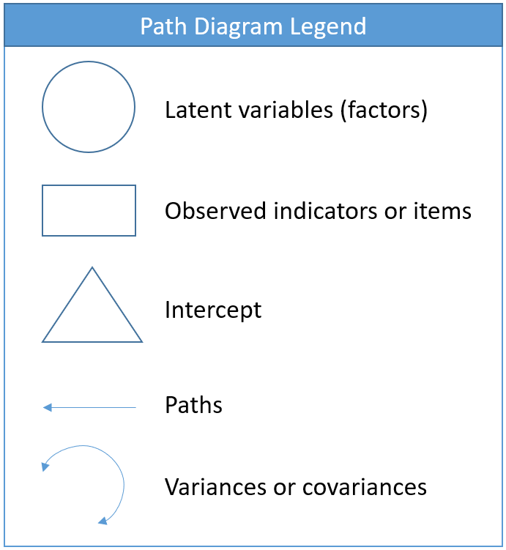
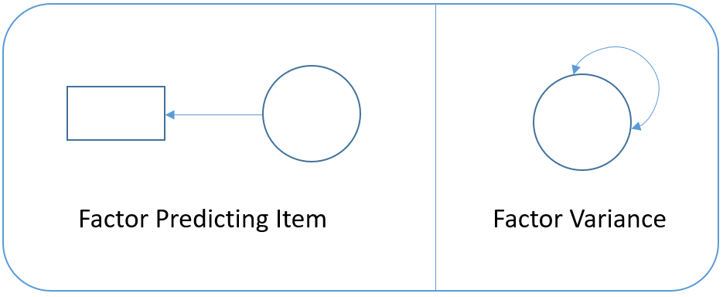
Path Diagram

Slide 12
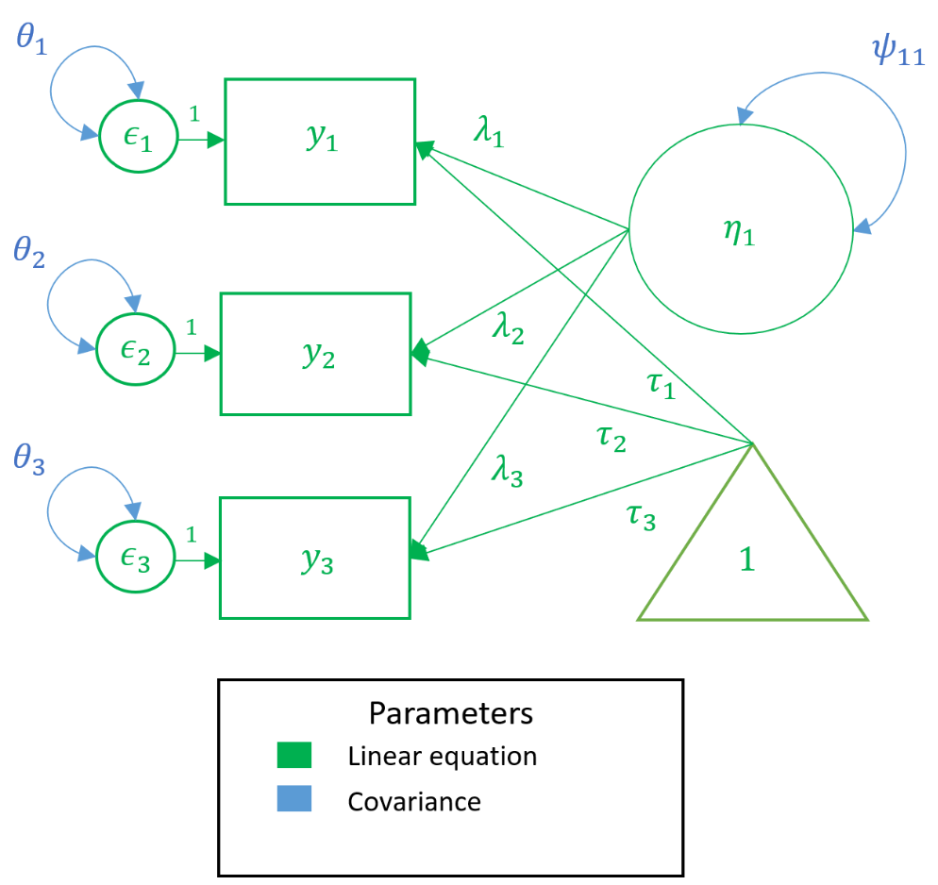
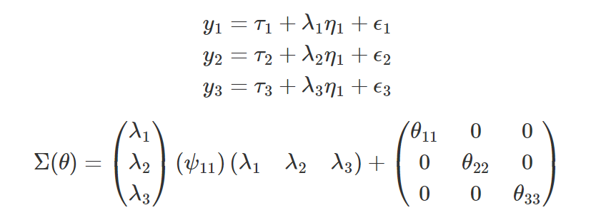
Measurement vs. Covariance Model

Slide 13
One Factor CFA
Known values, parameters, and degrees of freedom
Three-item (one) factor analysis
Identification of a three-item one factor CFA
Running a one-factor CFA in lavaan

Slide 14
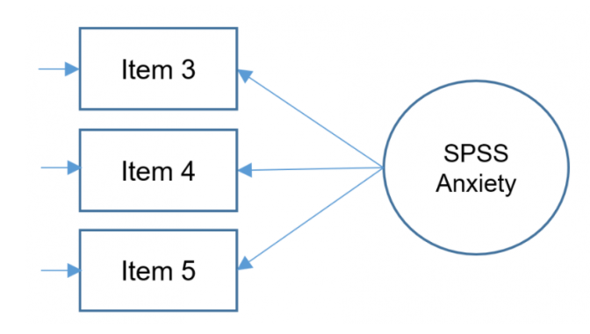


One Factor CFA

Slide 15

Sample Covariance Matrix
versus
versus
> round(cov(dat[,3:5]),2)
q03 q04 q05
q03 1.16 -0.39 -0.32
q04 -0.39 0.90 0.37
q05 -0.32 0.37 0.90

Slide 16


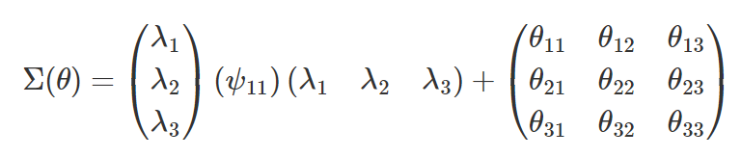
Degrees of freedom
known values: total number of parameters
For three items
Highlight the unique parameters. Count 10.

Slide 17
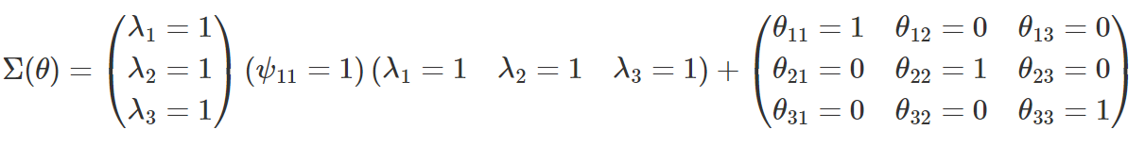
Fixed vs. free parameters
fixed parameters pre-determined to have a specific value
free parameters

Slide 18
Degrees of freedom
Calculate the degrees of freedom for our model. Should be 6.
df negative, known < free (under-identified, cannot run model)
df = 0, known = free (just identified or saturated, no model fit)
df positive, known > free (over-identified, model fit can be assessed)

Slide 19
Poll 1
1. There is 1 degree of freedom in my model, which means that my model is over-identified
2. I have three items in my study. The number of known values is 6.
3. I have three items in my study. There are 6 unique parameters and no fixed parameters. My model is just-identified. ( Single Choice)

Slide 20
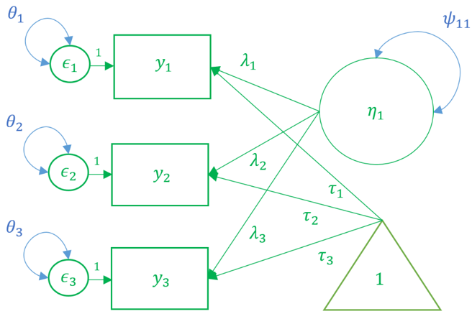
Three Item CFA
Intercepts sometimes not estimated

Slide 21
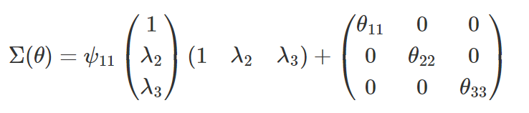
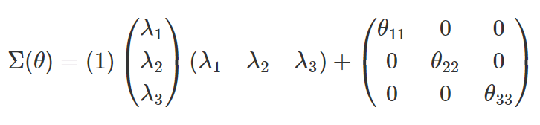
Identification of Three-Item
marker method fixes the first loading of each factor to 1
variance standardization method fixes the variance of each factor to 1 but freely estimates all loadings.

Slide 22
Lavaan syntax
~ predict regression
=~ indicator factor analysis
~~ covariance
~1 intercept
1* fixes parameter
NA* frees parameter useful to override default marker method
a* labels the parameter ‘a’, model constraints

Slide 23
Marker Method in lavaan
#one factor three items, default marker method
m1a <- ' f =~ q03 + q04 + q05'
onefac3items_a <- cfa(m1a, data=dat)
summary(onefac3items_a)

Slide 24
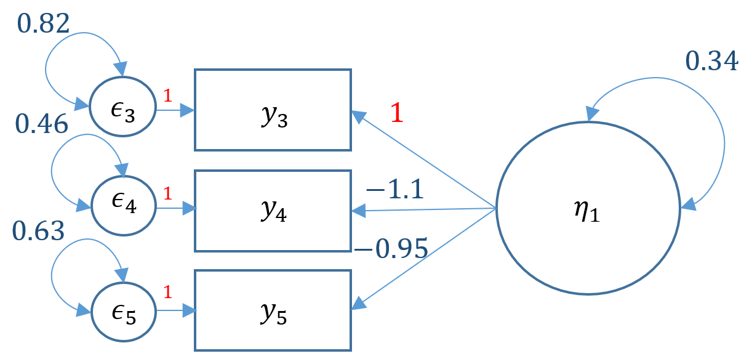
Marker Method Output
Latent Variables:
Estimate Std.Err z-value P(>|z|)
f =~
q03 1.000
q04 -1.139 0.073 -15.652 0.000
q05 -0.945 0.056 -16.840 0.000
Variances:
Estimate Std.Err z-value P(>|z|)
.q03 0.815 0.031 26.484 0.000
.q04 0.458 0.030 15.359 0.000
.q05 0.626 0.025 24.599 0.000
f 0.340 0.031 11.034 0.000
SAQ (Likert 1-5)
3. Standard deviations excite me
4. I dream that Pearson is attacking me with correlation coefficients
5. I don’t understand statistics
For a one unit (in Item 3) increase in SPSS-Anxiety, Item 4 goes down by 1.13 points.
Variance of the factor is scaled by units of Item 3.

Slide 25
Variance Std Method
#one factor three items, variance std
m1b <- ' f =~ NA*q03 + q04 + q05
f ~~ 1*f '
onefac3items_b <- cfa(m1b, data=dat)
summary(onefac3items_b)

Slide 26
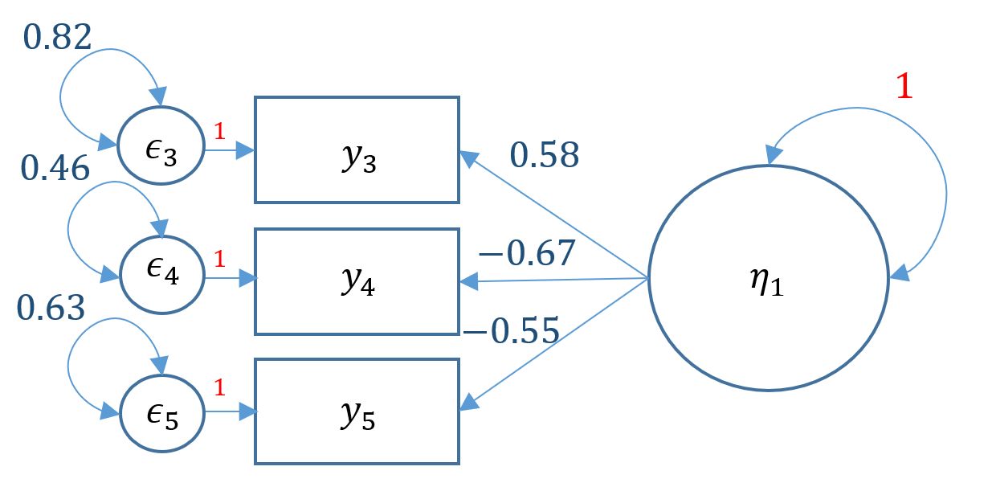
Variance Std Output
Latent Variables:
Estimate Std.Err z-value P(>|z|)
f =~
q03 0.583 0.026 22.067 0.000
q04 -0.665 0.026 -25.605 0.000
q05 -0.551 0.024 -22.800 0.000
Variances:
Estimate Std.Err z-value P(>|z|)
f 1.000
.q03 0.815 0.031 26.484 0.000
.q04 0.458 0.030 15.359 0.000
.q05 0.626 0.025 24.599 0.000
SAQ (Likert 1-5)
3. Standard deviations excite me
4. I dream that Pearson is attacking me with correlation coefficients
5. I don’t understand statistics
For one standard deviation increase in SPSS-Anxiety, Item 4 goes down by 0.665 points.
Variance of the factor is scaled to 1.

Slide 27
Automatic Standardization in lavaan
For one standard deviation increase in SPSS-Anxiety, Item 4 goes down by 0.701 standard deviation units .
Variance of the factor is scaled to 1.
> summary(onefac3items_a,standardized=TRUE)
Latent Variables:
Estimate Std.Err z-value P(>|z|) Std.lv Std.all
f =~
q03 1.000 0.583 0.543
q04 -1.139 0.073 -15.652 0.000 -0.665 -0.701
q05 -0.945 0.056 -16.840 0.000 -0.551 -0.572
Variances:
Estimate Std.Err z-value P(>|z|) Std.lv Std.all
.q03 0.815 0.031 26.484 0.000 0.815 0.705
.q04 0.458 0.030 15.359 0.000 0.458 0.509
.q05 0.626 0.025 24.599 0.000 0.626 0.673
f 0.340 0.031 11.034 0.000 1.000 1.000

Slide 28
Full Model
f =~
q01 0.485 0.017 28.942 0.000 0.485 0.586
q02 -0.198 0.019 -10.633 0.000 -0.198 -0.233
q03 -0.612 0.022 -27.989 0.000 -0.612 -0.570
q04 0.632 0.019 33.810 0.000 0.632 0.667
q05 0.554 0.020 28.259 0.000 0.554 0.574
q06 0.554 0.023 23.742 0.000 0.554 0.494
q07 0.716 0.022 32.761 0.000 0.716 0.650
q08 0.424 0.018 23.292 0.000 0.424 0.486

Slide 29
Model Fit Statistics
Model chi-square
Approximate fit indices
CFI / TLI / RMSEA

Slide 30
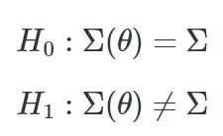


Hypothesis
accept-support test
versus
reject-support test
versus
versus
residual covariance matrix

Slide 31
Poll 2
1. T/F The residual covariance matrix is defined as the population covariance matrix minus the model implied covariance matrix. It will never approach zero but can approximate zero.
2. T/F The goal of SEM is the recreate the population covariance matrix using model parameters. Therefore, we want to REJECT the null hypothesis.
3. T/F The larger the sample size the more likely we will reject the null hypothesis in SEM.

Slide 32
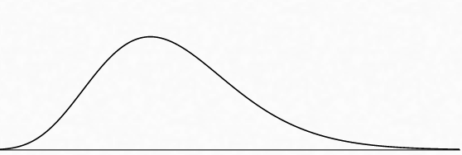
Model Chi-square
#Three Item One-Factor CFA (Just Identified)
Number of free parameters 6
Model Test User Model:
Test statistic 0.000
Degrees of freedom 0
#Eight Item One-Factor CFA (Over-identified)
Number of free parameters 16
Model Test User Model:
Test statistic 554.191
Degrees of freedom 20
P-value (Chi-square) 0.000
But we often reject the null hypothesis for large samples!
Notes:
Introduction to Structural Equation Modeling (SEM) in R with lavaan (ucla.edu)

Slide 33
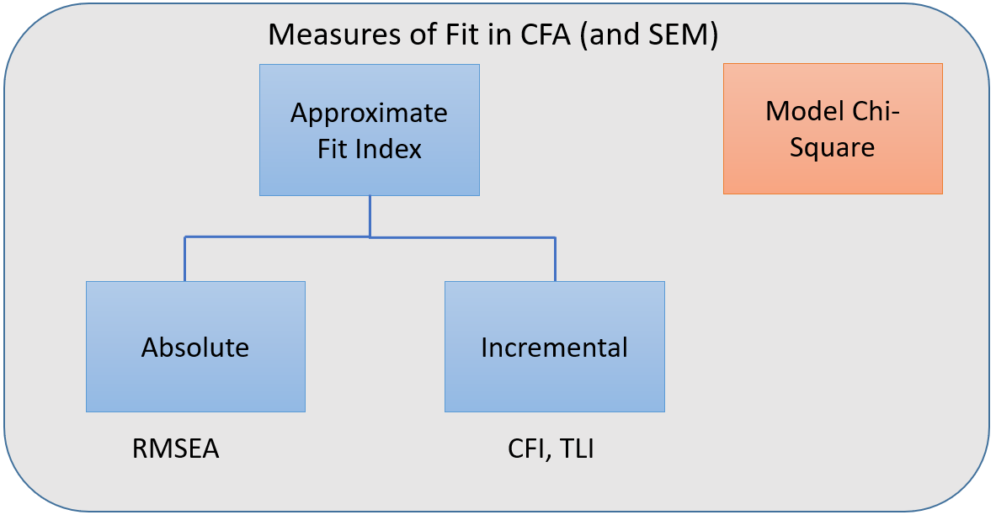
Measures of Fit in CFA
Exact Fit

Slide 34
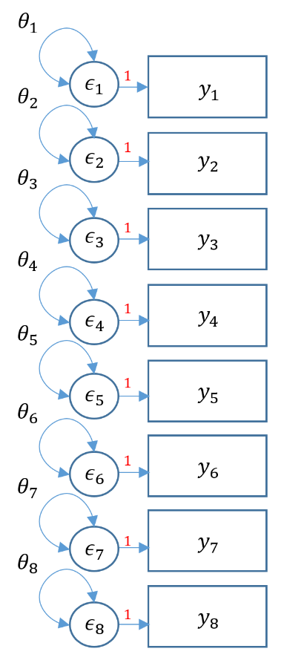
Baseline Model
How many free parameters? Count 8.
How many degrees of freedom? Count 28.
8(9)/2 – 8.
Worst model.
Compare with saturated model.

Slide 35
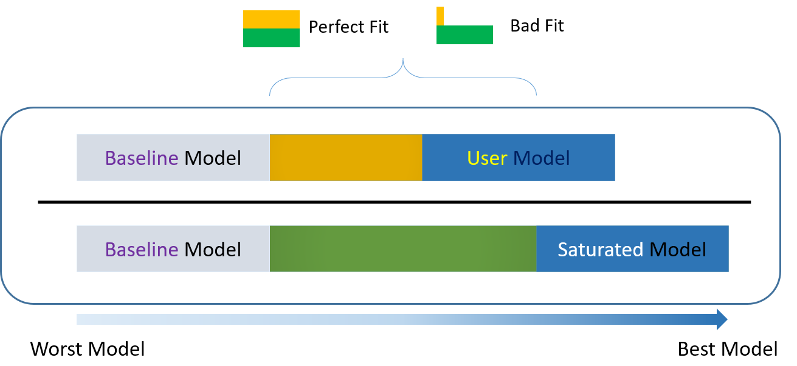
Baseline

Slide 36

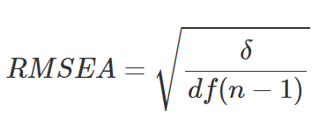
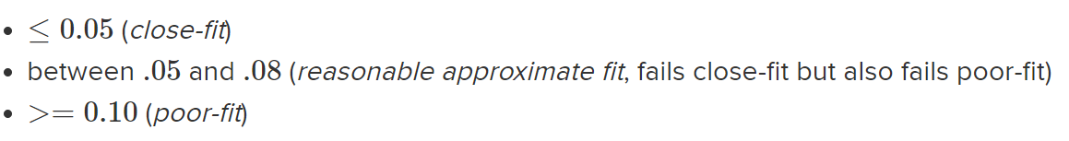
RMSEA

Slide 37
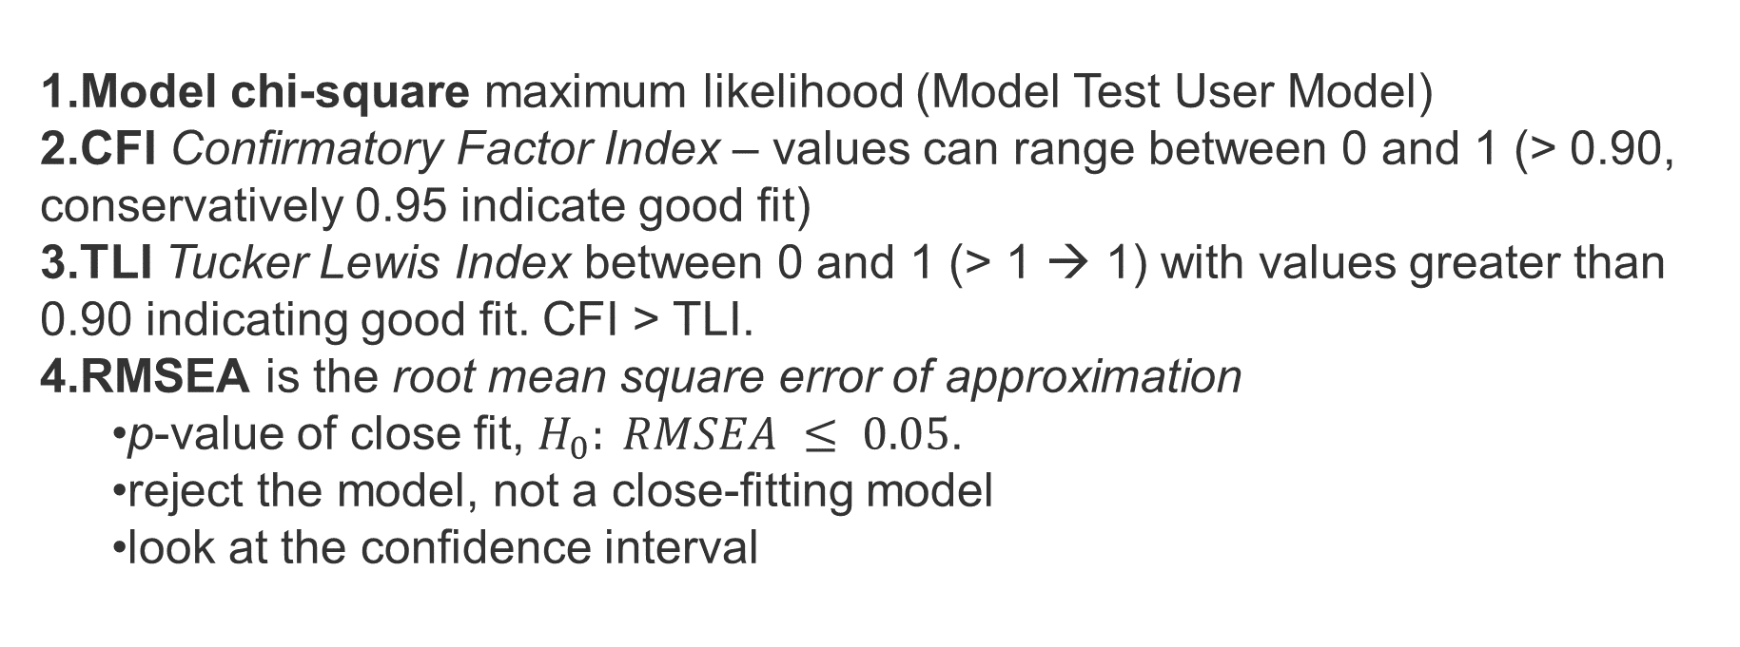
Criteria for fit
Model chi-square maximum likelihood (Model Test User Model)
CFI Confirmatory Factor Index – values can range between 0 and 1 (> 0.90, conservatively 0.95 indicate good fit)
TLI Tucker Lewis Index between 0 and 1 (> 1 → 1) with values greater than 0.90 indicating good fit. CFI > TLI.
RMSEA is the root mean square error of approximation
p-value of close fit, $H_{0}: RMSEA ≤ 0.05$.
reject the model, not a close-fitting model
look at the confidence interval

Slide 38
Fit Statistics 1
summary(onefac8items_a, fit.measures=TRUE, standardized=TRUE)
lavaan 0.6-5 ended normally after 15 iterations
Number of free parameters 16
Number of observations 2571
Model Test User Model:
Test statistic 554.191
Degrees of freedom 20
P-value (Chi-square) 0.000
Model Test Baseline Model:
Test statistic 4164.572
Degrees of freedom 28
P-value 0.000

Slide 39
Fit Statistics 2
User Model versus Baseline Model:
Comparative Fit Index (CFI) 0.871
Tucker-Lewis Index (TLI) 0.819
Root Mean Square Error of Approximation:
RMSEA 0.102
90 Percent confidence interval - lower 0.095
90 Percent confidence interval - upper 0.109
P-value RMSEA <= 0.05 0.000
Standardized Root Mean Square Residual:
SRMR 0.055

Slide 40
Two Factor Confirmatory Factor Analysis
Correlated factors
Uncorrelated factors

Slide 41
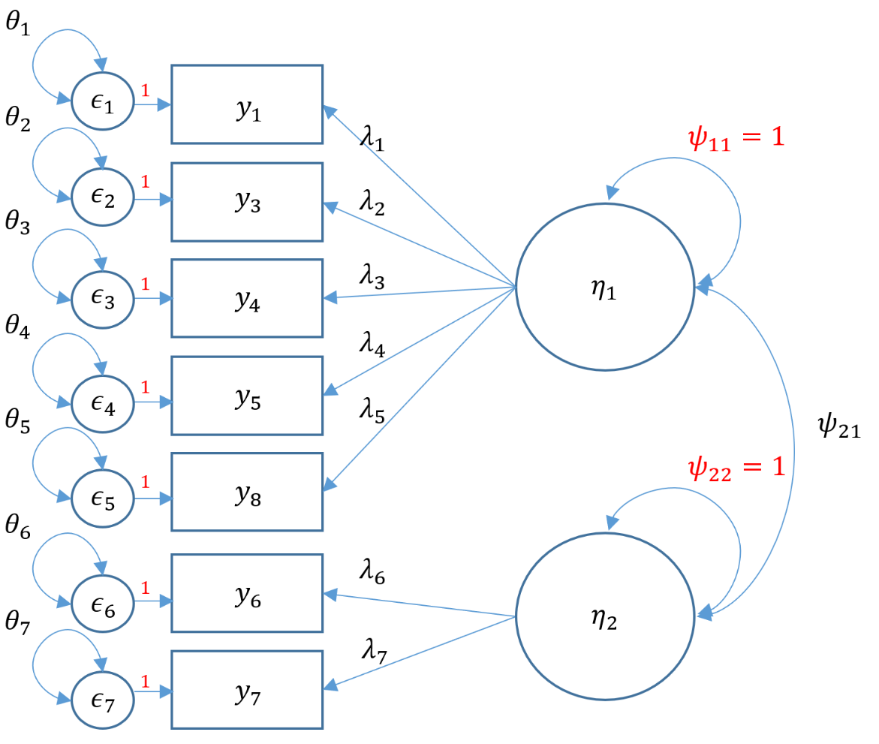
Path Diagram
What standardization method are we using here?

Slide 42
Correlated Factors
#correlated two factor solution, marker method
m4b <- 'f1 =~ q01+ q03 + q04 + q05 + q08
f2 =~ q06 + q07'
twofac7items_b <- cfa(m4b, data=dat,std.lv=TRUE)
summary(twofac7items_b,fit.measures=TRUE,standardized=TRUE)

Slide 43
Output 1
Latent Variables:
Estimate Std.Err z-value P(>|z|) Std.lv Std.all
f1 =~
q01 0.513 0.017 30.460 0.000 0.513 0.619
q03 -0.599 0.022 -26.941 0.000 -0.599 -0.557
q04 0.658 0.019 34.876 0.000 0.658 0.694
q05 0.567 0.020 28.676 0.000 0.567 0.588
q08 0.435 0.018 23.701 0.000 0.435 0.498
f2 =~
q06 0.669 0.025 27.001 0.000 0.669 0.596
q07 0.949 0.027 35.310 0.000 0.949 0.861

Slide 44
Output 2
Covariances:
Estimate Std.Err z-value P(>|z|) Std.lv Std.all
f1 ~~
f2 0.676 0.020 33.023 0.000 0.676 0.676
Variances:
Estimate Std.Err z-value P(>|z|) Std.lv Std.all
.q01 0.423 0.014 29.157 0.000 0.423 0.617
.q03 0.796 0.026 31.025 0.000 0.796 0.689
.q04 0.466 0.018 25.824 0.000 0.466 0.518
.q05 0.608 0.020 30.173 0.000 0.608 0.654
.q08 0.572 0.018 32.332 0.000 0.572 0.752
.q06 0.811 0.030 27.187 0.000 0.811 0.644
.q07 0.314 0.040 7.815 0.000 0.314 0.258
f1 1.000 1.000 1.000
f2 1.000 1.000 1.000

Slide 45
Uncorrelated Factors
#uncorrelated two factor solution
m4a <- 'f1 =~ q01+ q03 + q04 + q05 + q08
f2 =~ q06 + q07
f1 ~~ 0*f2 '

Slide 46
Output
Warning message:
In lav_model_vcov(lavmodel = lavmodel, lavsamplestats = lavsamplestats, :
lavaan WARNING:
Could not compute standard errors! The information matrix could
not be inverted. This may be a symptom that the model is not
identified.

Slide 47
Poll 3
1. T/F By default, lavaan correlates the factors in a two-factor CFA.
2. T/F Either marker or variance standardization methods can be used for two factor CFA
3. T/F Turning off the factor covariance is an assumption; it doesn’t mean that there actually is no factor covariance in my sample.

Slide 48

Intermission
This concludes the lecture portion of the seminar.
We will go over three exercises in the following section.

Slide 49
Exercise 1
1. Fit a CFA with all 8 items in the SAQ
A) marker method
B) variance standardization method
C) all standardized
2. Interpret the loadings
3. Assess the fit of the model using Chi-square, CFI/TLI, and RMSEA. If your fit fails the standard criteria, name some reasons for the poor fit.

Slide 50
Exercise 2
Fit the first 4 items to Factor 1 and second 4 items to Factor 2
A) Choose any standardization method
B) Remove the items with the lowest loadings. How does the fit compare?
C) Now fit an uncorrelated two factor model
Compare the fit of the uncorrelated model to the correlated model
Which one do you choose?

Slide 51
(Advanced) Exercise 3
1. Reproduce the baseline model for SAQ8 based on the one factor model in Exercise 1
2. Reproduce the saturated model
Hint: you need all variances and covariances and you can use the + operator to add multiple covariances in one line
Manually compute the CFI using 1 and 2 (see next slide for formula)

Slide 52
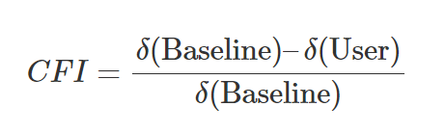
CFI
Answer: CFI =((4164.572-28)-(562.790-21))/(4164.572-28)=(4136.572-541.79)/4136.572 = 0.869

Slide 53
More Advanced Topics
Two-item factor analysis
Uncorrelated factor analysis with two items
Second order factors

Slide 54
Thank you!
Any questions?

