Slide 1


Causal Inference - Gamification Case
Kirtesh Patel, Nils Marthiensen, Neelesh Bhalla, Chia-Jung Chang

Slide 2
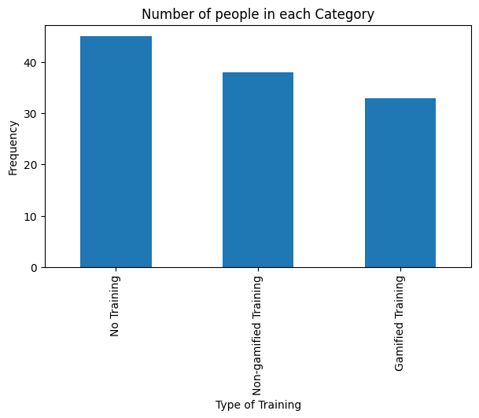
Frequency Distribution
Causal Inference - Gamification Case
At first glance, we see distribution of people within the three categories
The distribution seems to be fairly balanced

Slide 3
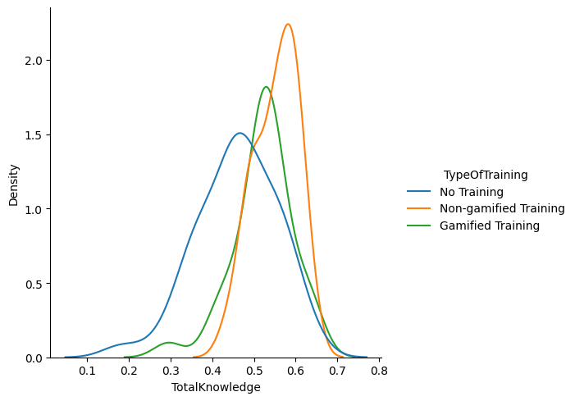
Normal distribution
Causal Inference - Gamification Case
Amongst the three categories, mean 'TotalKnowledge' is the highest for Non-Gamified training.
Low standard deviation for the Non-Gamified training category also highlights low overall variation in TotalKnowdge amongst the people sampled.
People sampled under 'No Training' category had the lowest mean 'TotalKnowledge' score

Slide 4
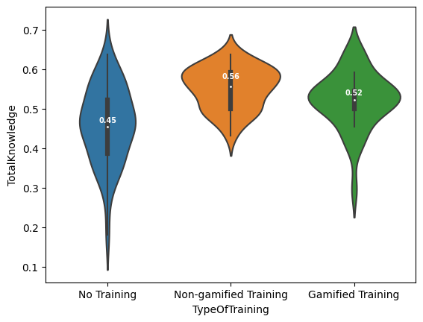
Violin plots
Causal Inference - Gamification Case
Non-Gamified Training category has the highest median score with high concentration around the median (depicted by the width)
Category 'No Training' shows high range of score variation.
Category 'Gamified Training' performs somewhere between these two categories.
Almost everyone in Non-Gamified category (except a few exceptions) scored more than the median score of 'No Training' category
Just looking at these plots, the overall performance can be ranked as below (top to bottom):
Non-Gamified Training
Gamified Training
No Training

Slide 5
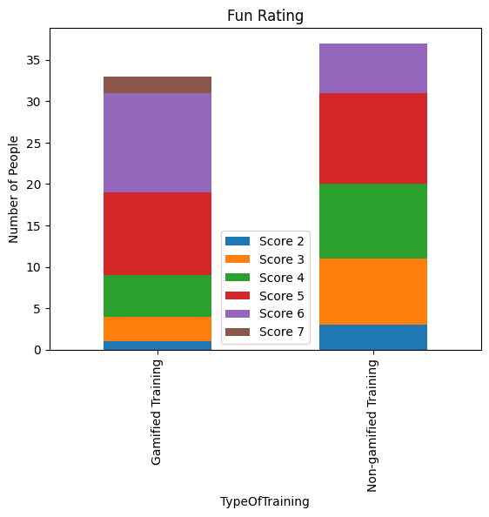
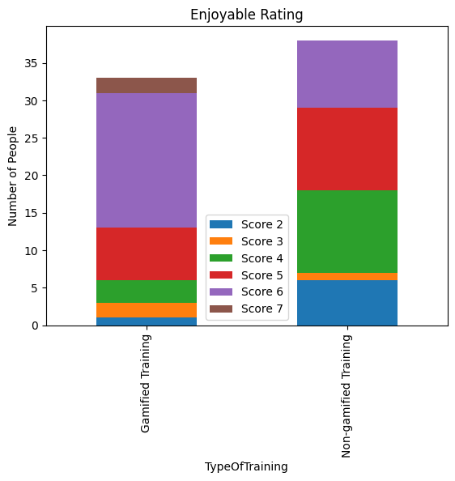
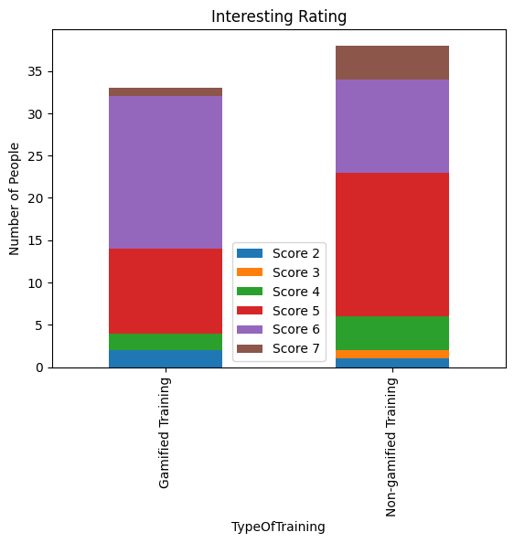
Stacked BAR PLOTS (1)
Causal Inference - Gamification Case

Slide 6
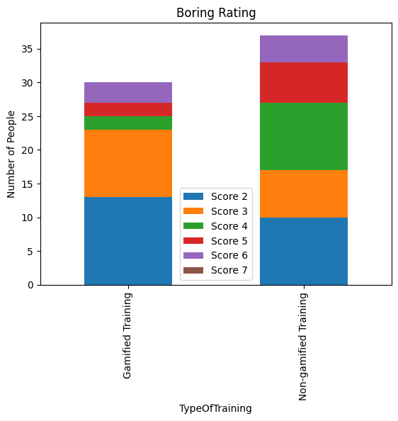
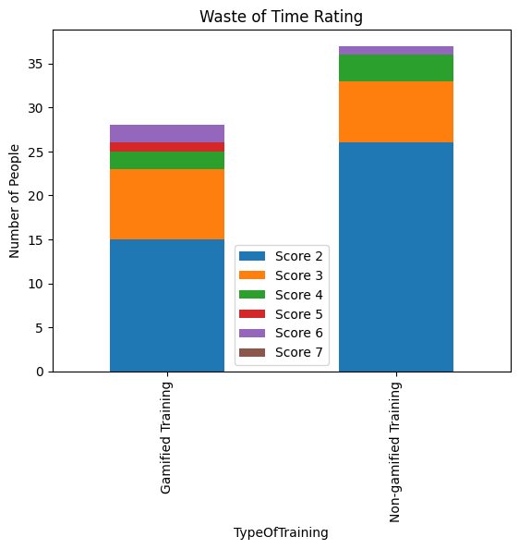
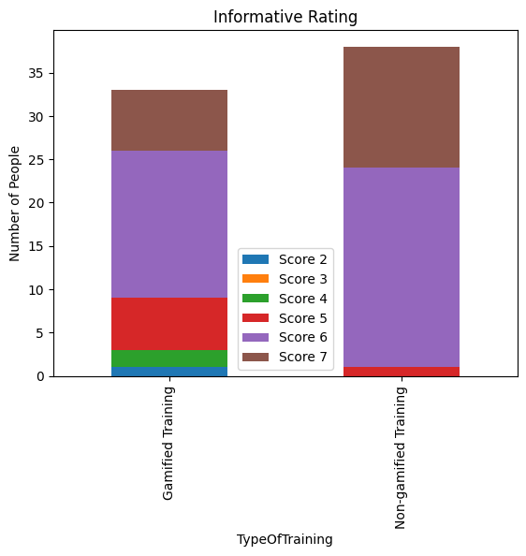
Stacked BAR PLOTS (2)
INTRODUCTION

Slide 7
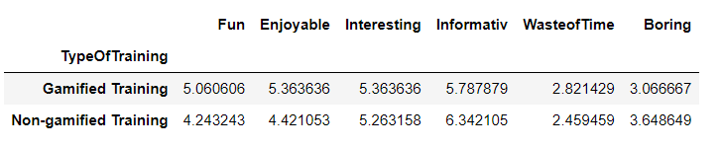
Shown on the top are different 'weighted average scores' of people in the 'gamified' v/s 'non-gamified' training
'Gamified training' was reviewed better by people on the following ratings:
Fun
Enjoyable
Interesting
'Non gamified training' fared better in terms of
Informative rating
'Non gamified training' is rated more boring, while 'Gamified training' is rated more waste of time

Slide 8
Both data suggest that employees enjoy Gamified training more
At the same time, experimental data suggests that 'Gamified' training was scored more of a waste of time as compared to 'Non-Gamified' training.
Experimental data suggests better performance score for 'Non-Gamified' trainings than 'Gamified' trainings in contrast to that suggested by Survey data
Experimental data is more convincing because in the Survey data, there was a clear bias introduced when the results were compared between two different size of survey population. In Experimental data however, the randomness of sorting people in the 3 cohorts made it a more robust study.
Recommendation: Since major purpose of training is to upskill employees, reinforce awareness and promote learning, adoption of Non-gamified training is recommended.
Limitation: As is clear from the violin plot, a small proportion of people under 'no training' cohort performed exceptionally well than with people in the other two categories (who underwent some sort of trainings). This makes you think if the proportion of 'average prior general IT awareness' of people in the three categories was balanced.
This can be addressed by some information on IT specific background of people for instance 'years of technical IT experience' can be a good indicator.

