Slide 1
New estimates of the strength and variability of the AMOC at 11°S Total Transport Feb 10, 2022 Nils Niebaum
ClimAPOTHERM: Thermohaline Circulation – Group Project

Slide 2
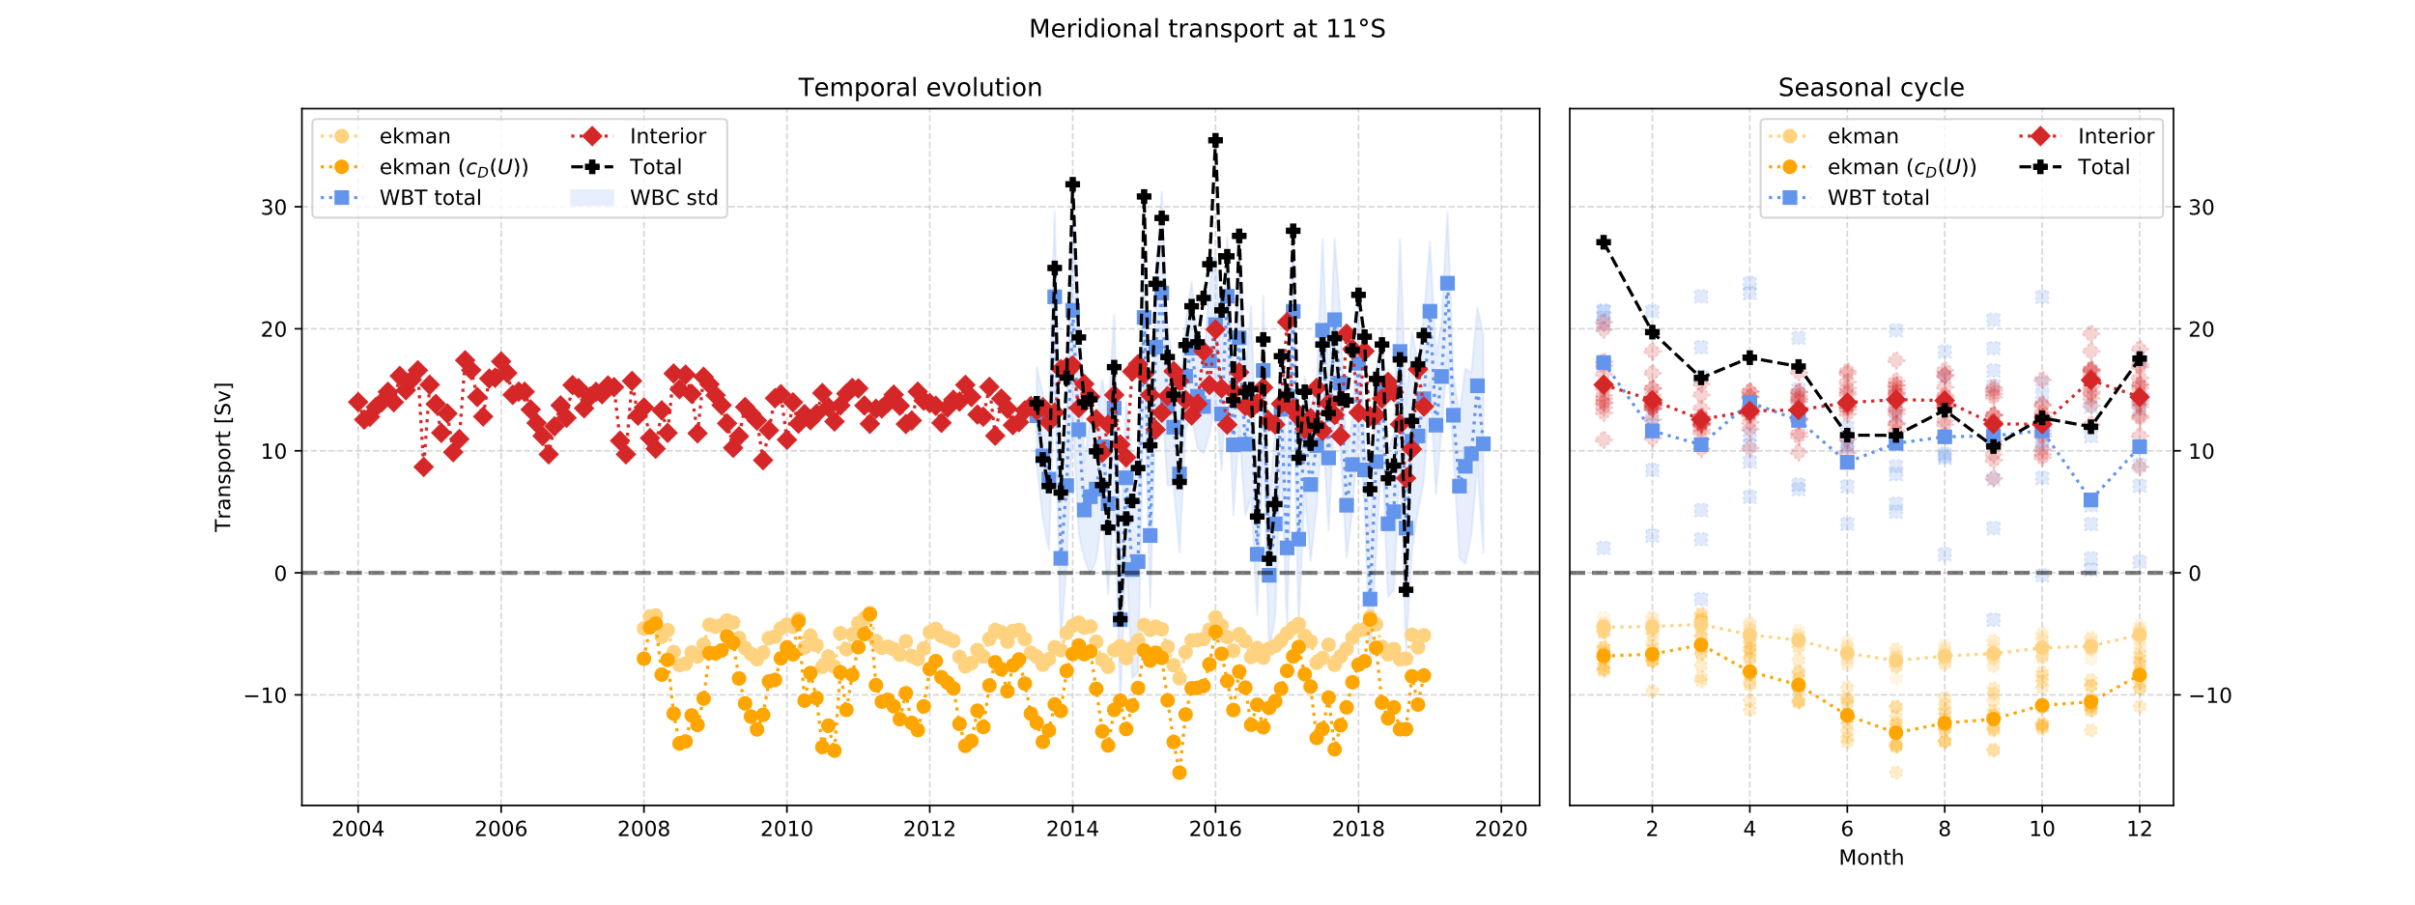
Data
Data from all groups
Monthly mean for Western Boundary Transport (also standard deviation)
Interior : Mean value + variability (group 1 + group 2)
Total Transport =
Ekman Transport +
Western Boundary Transport +
Interior Transport

Slide 3
Timeseries and Seasonal cycle
Total Transport northwards
No seasonal cycle visible <-- by Western Boundary Transport
Strong intra-annual variability in Total Transport --> Smooth timeseries

Slide 4
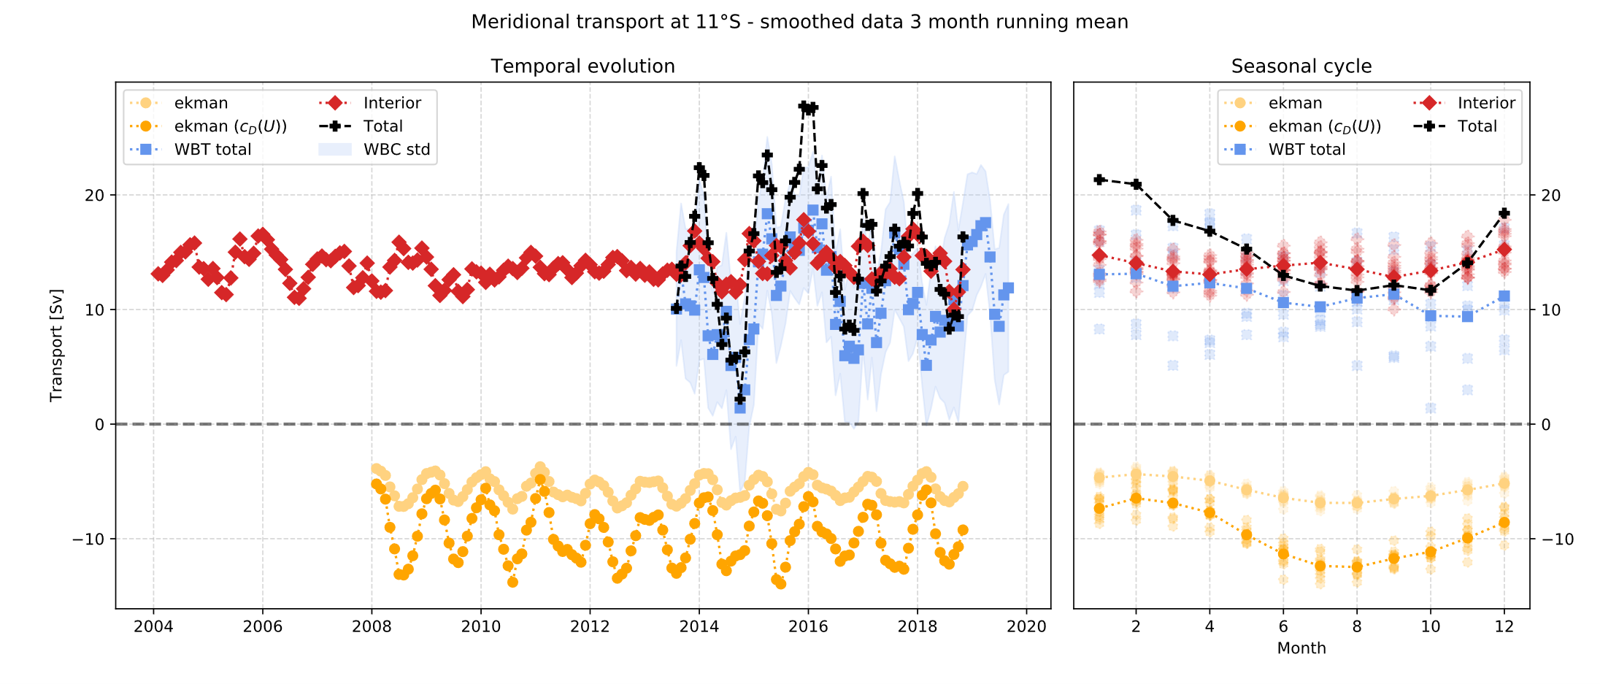
Timeseries and Seasonal cycle
6 month running mean

Slide 5
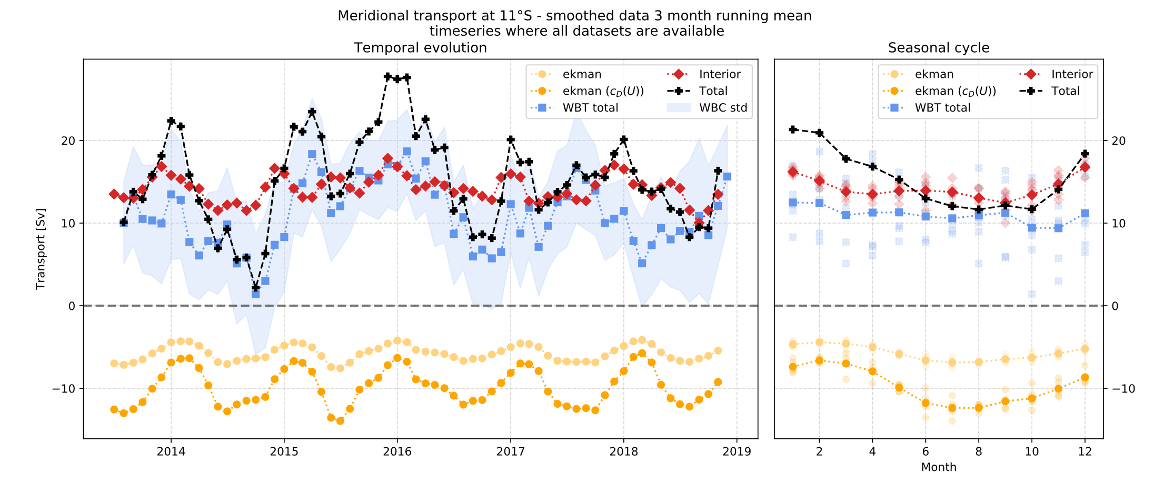
Timeseries and Seasonal cycle
Total Transport 5Sv – 25Sv northwards
Strong seasonal cycle ← by Ekman Transport
Strong interannual variability even for smoothed data

Slide 6
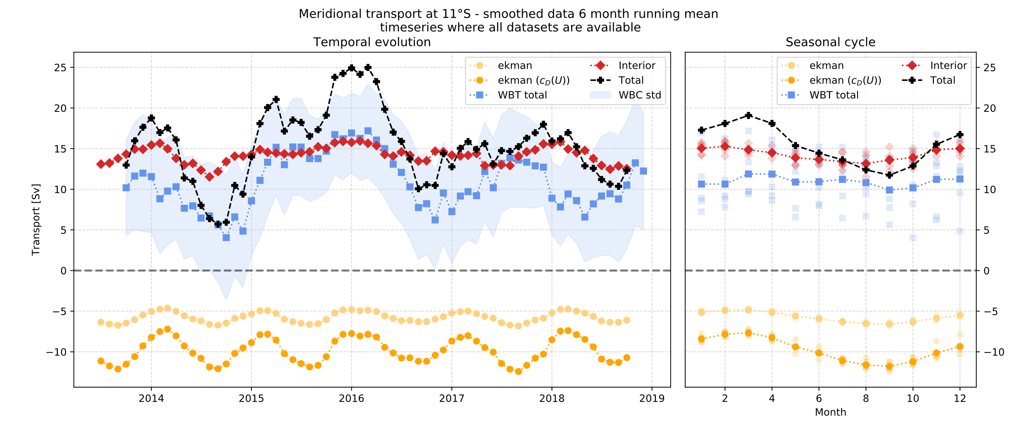
Timeseries and Seasonal cycle
Total Transport 5Sv – 25Sv northwards
Strong seasonal cycle ← by Ekman Transport
Strong interannual variability even smoothed (similar to Bottom Pressure)

