Slide 1
Wilcoxon signed-rank test
Two uses:
Compare the central tendency of a sample with a certain value
Compare the central tendencies of two paired samples
When:
When data is not normally distributed but symmetrical
Also good for: small sample size
How:
Assign ranks to absolute values of differences, determine the probability of the sum of ranks (of positive differences) under H0

Slide 2

Wilcoxon signed-rank test
Real Life Example (two paired samples):
New medication, pilot testing in mice
Only 10 mice available because of costs and ethics
Outcome of interest: weight of the mice (as indicator of health)
Very early stage: unsure if medication works at all → two-sided test
Two timepoints:
Measure weight before and after treatment

Slide 3
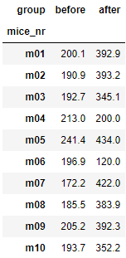

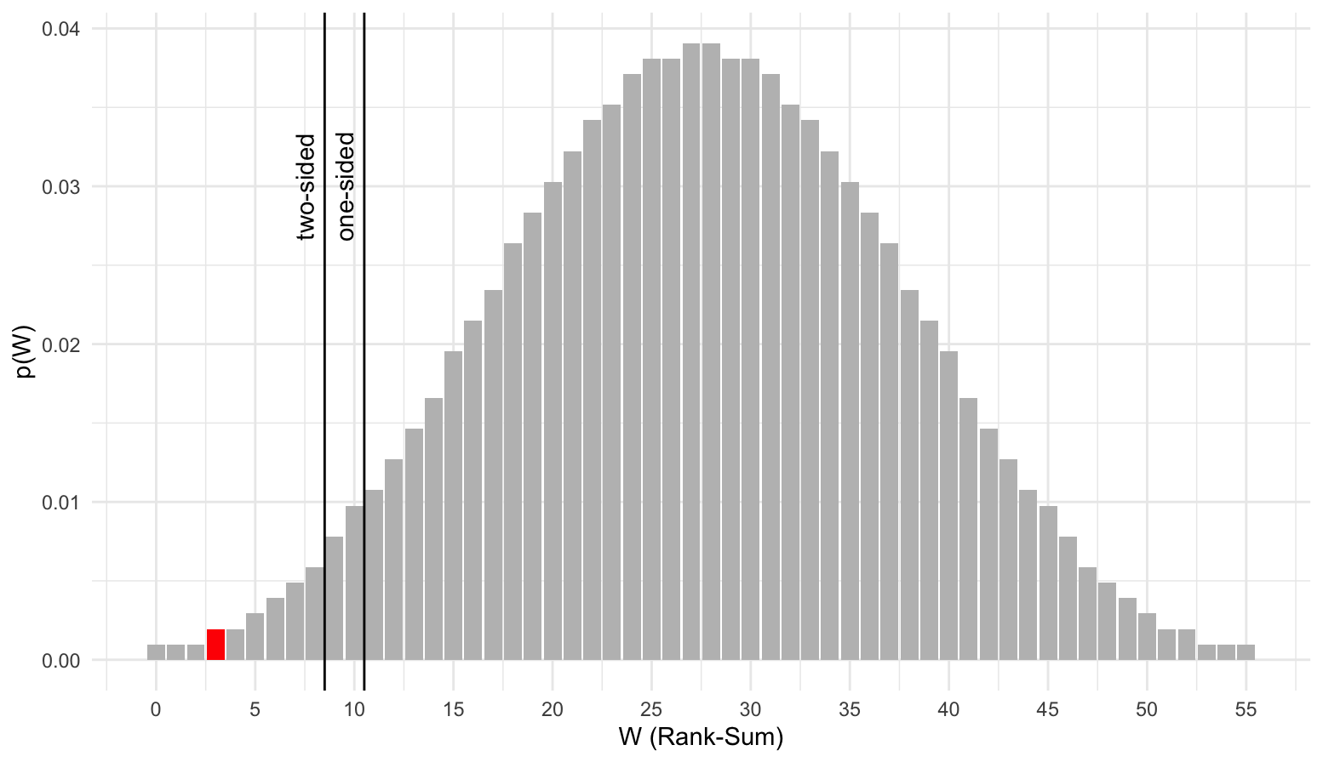
Wilcoxon signed-rank test
Data
Code:
Result:
Distribution under H₀
Interpretation
Mice became significantly heavier (with some exceptions)
Very low statistic because of mostly negative differences

