Slide 1
Causalıty between Unemployment and ınflatıon ın US economy
Nil Taşpınar
January 12, 2024
Notes:
A fiscal policy designed to remedy a recession will result in inflation.
A fiscal policy designed to combat inflation will result in declines in output and possibly a recession.
The idea that inflation and unemployment moving in opposite directions was first noticed by a British economist, A. W. Phillips. (Phillips Curve)

Slide 2
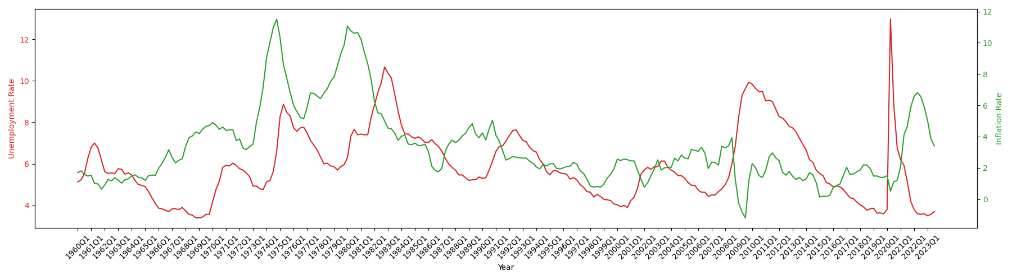
DATA
For inflation: FRED, seasonally adjusted quarterly Personal Consumption Expenditures (PCE): Chain-type Price Index (Percent Change from Year Ago)
For unemployment: FRED, seasonally adjusted quarterly Unemployment Rate (Percent).
Notes:
the study relies on the time-series data from 1960-Q1 to 2023-Q3.
During 1960s, there appears to be an inverse relationship between inflation and unemployment. (due to the shifts of AD),
In the first half of 1970s, the inflation and unemployment rate increase at the same time (stagflation – when AS shifts left)
Starting from mid-70s till the end of 1990s, there is no obvious relationship between two variables
In the last 20 years, the relation between inflation and unemployment rate shows that there is a dynamic similar to the Phillips curve.

Slide 3
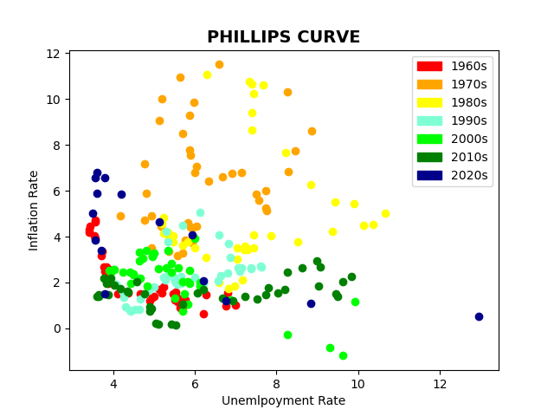
PHILLIPS CURVE
The inverse relationship between inflation rate and unemployment rate is more apparent in 1960s, 2000s and 2020s.
Does knowing the inflation is useful for predicting the unemployment level or vice versa?
Notes:
inflation and unemployment rate combinations of each decade using different colors on a single scatter plot
where y-axis presents the inflation rate and x-axis shows the unemployment rate
To see if there is resemblance with the original Phillips Curve
there is no specific relationship that can be deducted for these two variables according to their historical time series data.
Previous studies show varying results regarding the relationship between inflation and unemployment in different countries,
such as one-way causality, two-way causality, and no causal relationship between inflation and unemployment.
So, we ask the following question:
Does knowing the inflation is useful for predicting the unemployment level or vice versa?

Slide 4
CAUSALITY ANALYSIS
Optimal Lag Determination: Bayesian Information Criterion (BIC)
We calculate the BIC for each lag, the optimal lag will be the one with the lowest BIC value.
We apply Granger-Causality Test and Vector Autoregression Model for causality analysis.
BIC values for each lag length:
Lag 1: 0.687713974366396
Lag 2: 6.280029169049655
Lag 3: 15.455398372124996
Lag 4: 26.0727336921494
Lag 5: 36.85497168419078
Lag 6: 42.930993145717494
Lag 7: 54.23739227682361
Lag 8: 65.8594328455003
Lag 9: 75.61471920550193
Lag 10: 81.37808090784482
Optimal BIC value: 0.687713974366396
Optimal lag determined by BIC: 1
Notes:
The aim of the study is the analyze the causal relationship between inflation and unemployment.
In order to observe the causal relation and analyze the data, we use Granger causality test and Vector Autoregression model.
Before running the Granger Causality and Vector Autoregression model, we initially need to determine the optimal lag length.
There are various approaches to select the optimal lag length, the Akaike Information Criterion (AIC) and Bayesian Information Criterion (BIC) are commonly used for this purpose.
We prefer BIC because:
it tends to select a simpler model with fewer lags
helps to prevent overfitting
it is consistent (as the sample size increases, the probability of selecting the correct model converges to 1)
We choose the lag with the lowest BIC value. The optimal lag length for the causality analysis is 1.

Slide 5
1) Granger-Causality Test
GRANGER-CAUSALITY TEST
Null Hypothesis (H0): “unemployment” time series does not granger-cause “inflation” time series
Alternative Hypothesis (HA): “unemployment” time series granger-cause “inflation” time series
The p-value is greater than 0.05, we can't reject the null hypothesis of the test. We conclude that unemployment time series doesn’t granger-causes inflation time series.
GRANGER-CAUSALITY TEST IN REVERSE
Null Hypothesis (H0): “inflation” time series does not granger-cause “unemployment” time series
Alternative Hypothesis (HA): “inflation” time series granger-cause “unemployment” time series
Since the p-value is less than 0.05, we reject the null hypothesis of the test. We can say that inflation time series does Granger-causes unemployment time series.
Granger Causality
number of lags (no zero) 1
ssr based F test: F=2.7931 , p=0.0959 , df_denom=251, df_num=1
ssr based chi2 test: chi2=2.8265 , p=0.0927 , df=1
likelihood ratio test: chi2=2.8108 , p=0.0936 , df=1
parameter F test: F=2.7931 , p=0.0959 , df_denom=251, df_num=1
Granger Causality
number of lags (no zero) 1
ssr based F test: F=5.1889 , p=0.0236 , df_denom=251, df_num=1
ssr based chi2 test: chi2=5.2509 , p=0.0219 , df=1
likelihood ratio test: chi2=5.1974 , p=0.0226 , df=1
parameter F test: F=5.1889 , p=0.0236 , df_denom=251, df_num=1
Notes:
The granger causality test is a statistical hypothesis test used to determine whether one time series can be used to predict another.
First, we check whether past values of unemployment time series can predict the future inflation time series.
Second, a reverse causality is performed.
THUS, KNOWING THE INFLATION RATE IS USEFUL FOR PREDICTING THE FUTURE UNEMPLOYMENT RATE

Slide 6

2) Vector Autoregression Model
We form a VAR(1) model as follows:
${UNEM}_{t} = ∝_{1 }+ {UNEM}_{t−1}+ {INF}_{t−1}+ε_{t,1}$
${INF}_{t} = ∝_{2 }+ {INF}_{t−1}+ {UNEM}_{t−1}+ε_{t,2}$
For the 1st equation:
Both p-values < 0.05
Lagged inflation rate affects unemployment rate
For the 2nd equation:
P-value of lagged unemployment rate > 0.05
Lagged unemployment rate has no influence
on inflation rate
Summary of Regression Results
==================================
Model: VAR
Method: OLS
Date: Tue, 02, Jan, 2024
Time: 08:58:22
--------------------------------------------------------------------
No. of Equations: 2.00000 BIC: -1.82917
Nobs: 254.000 HQIC: -1.87911
Log likelihood: -471.904 FPE: 0.147677
AIC: -1.91273 Det(Omega_mle): 0.144250
--------------------------------------------------------------------
Results for equation unemployment_rate
=======================================================================================
coefficient std. error t-stat prob
---------------------------------------------------------------------------------------
const 0.430553 0.167464 2.571 0.010
L1.unemployment_rate 0.903219 0.026486 34.102 0.000
L1.inflation 0.041773 0.018338 2.278 0.023
=======================================================================================
Results for equation inflation
=======================================================================================
coefficient std. error t-stat prob
---------------------------------------------------------------------------------------
const 0.296543 0.132649 2.236 0.025
L1.unemployment_rate -0.035062 0.020980 -1.671 0.095
L1.inflation 0.975269 0.014526 67.140 0.000
=======================================================================================
Correlation matrix of residuals
unemployment_rate inflation
unemployment_rate 1.000000 -0.251068
inflation -0.251068 1.000000
Notes:
Vector autoregression (VAR) model is a statistical method used to capture the joint dynamics and interdependencies among multiple time series variables.
Since the lag length is equal to 1, we form a VAR(1)
Both GRANGER CAUSALITY TEST and VAR show that the direction of causality is from unemployment rate to inflation rate.

Slide 7
Possible Suggestions for Further Research
Two-Stage Least Sqaures Regression
For national defense expenditures: FRED, seasonally adjusted quarterly Federal Government: National Defense Consumption Expenditures and Gross Investment (Percent Change from Year Ago).
Two conditions:
Relevance condition: instrumental variable is strongly correlated with the explanatory variable of interest (The condition is satisfied)
Exogeneity condition: instrumental variable is independent of the error term and does not affect the outcome variable, through other channels (National defense can be a valid instrument that may satisfy the exogeneity condition, when the necessary control variables are added to the regression,since that national defense expenditures are not decided according to economic conditions, they are mainly driven by political and strategic factors)
Notes:
However, our aim is not to predict the true effect of inflation on unemployment but to understand the causal effect’s direction.
When we run OLS, omitted variables cause biased results.
Using 2SLS will not solve the endogeneity problem as well because the exclusion of control variables will cause the omitted variable problem.
But we aim to propose a relevant instrument to use instead of inflation rate for further research aiming to find the true effect of inflation on unemployment by using all necessary control variables.
The infsturment should satisfy 2 conditions:
Relevance condition: instrumental variable is strongly correlated with the explanatory variable of interest (The condition is satisfied)
Exogeneity condition: instrumental variable is independent of the error term and does not affect the outcome variable, through other channels
The reason why we think that national defense can be a valid instrument that may satisfy the exogeneity condition, when the necessary control variables are added to the regression,is that national defense expenditures are not decided according to economic conditions, they are mainly driven by political and strategic factors.
IN CONCLUSION, we achieve to obtain the direction of causality between inflation rate and unemployment rate for the US economy using the quarterly time series data from 1960 to 2023.
We can say that KNOWING THE INFLATION RATE IS USEFUL FOR PREDICTING THE FUTURE UNEMPLOYMENT RATE

