Slide 1
What is an anagram?
An anagram is a word formed by rearranging the letters of a different word.
For example, “lilmcg” is an anagram of “mcgill”
//In our exercise, words do not have to be valid English words

Slide 2
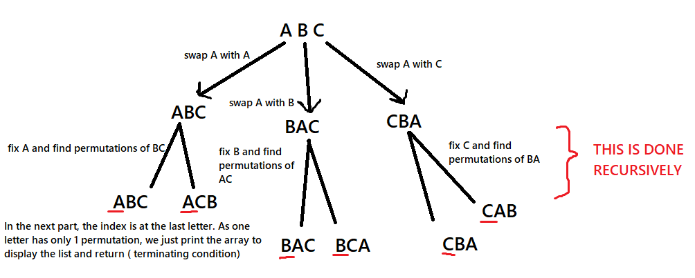
Approach:

Slide 3
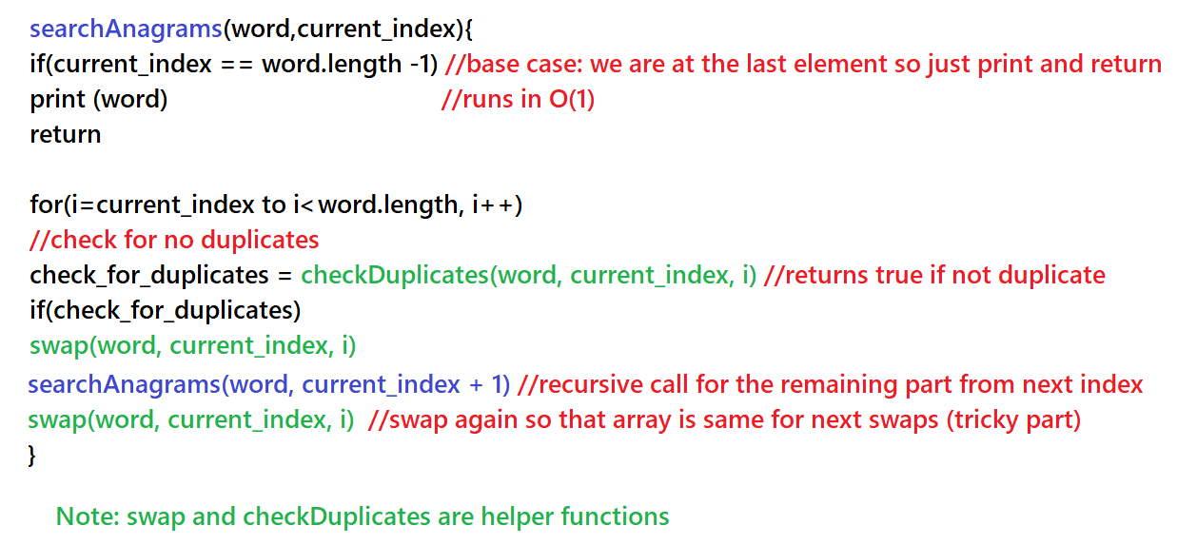
Pseudocode for my method:

Slide 4
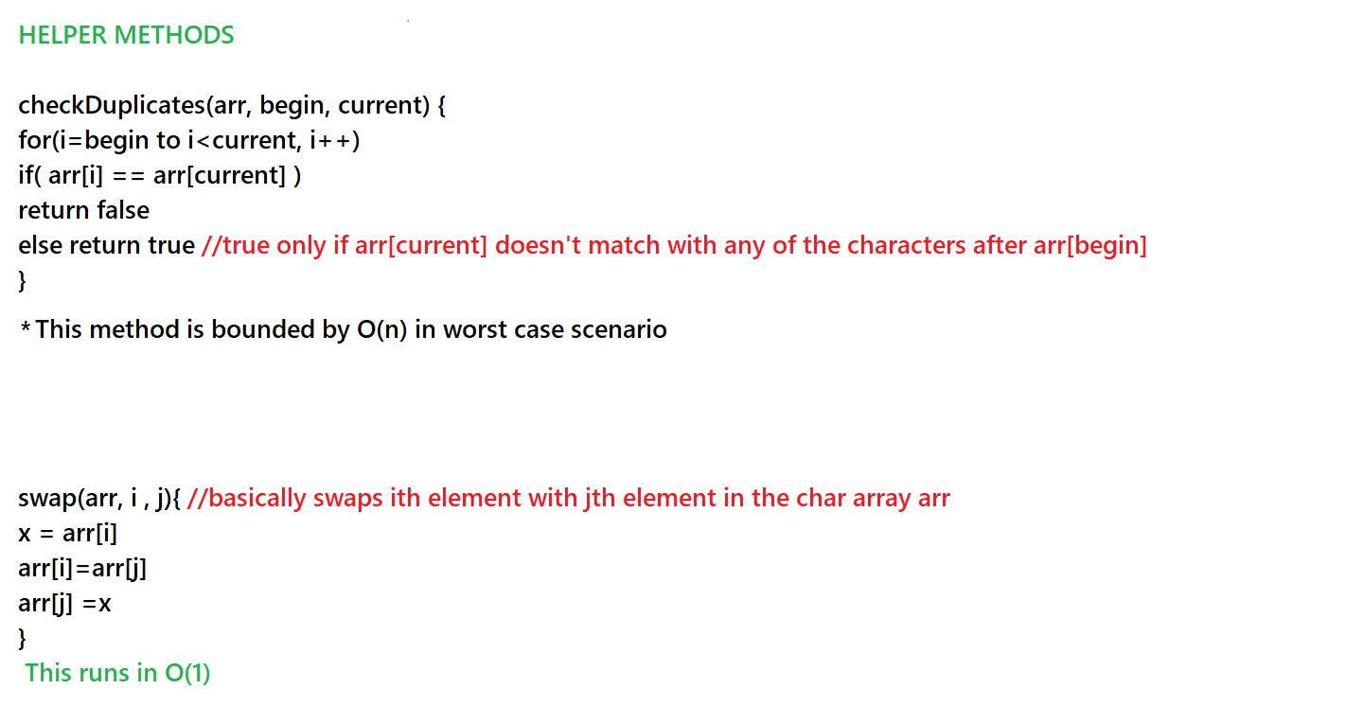
Pseudocode for my helper functions:

Slide 5
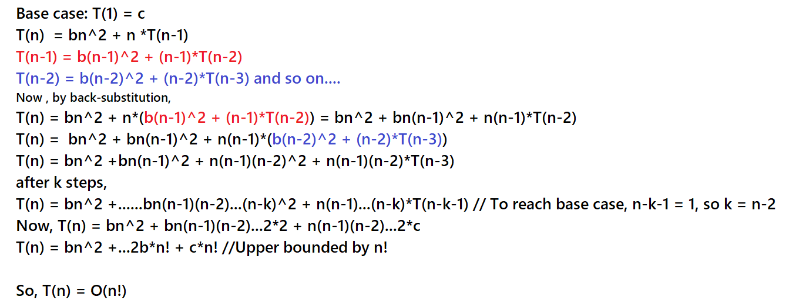
Solving the recurrence:
bn^2 is runtime for the helper functions
b
Note: n(n-1)(n-2)…2 = n!

