Slide 1

DEPARTMENT OF COMPUTER SCIENCE AND ENGINEERING
Title: IoMT-Based Smart Health Monitoring and Early Disease Alert System
BATCH ID : 23MPCS-F4
S. No | Roll. No | Student Name
1 | 23881A05AU | Mohd Husamuddin
2 | 24885A0541 | Karmankar Nilvana
3 | 23881A05Z7 | Jakkani Vishnuvardhan
Guide Details
Mr. Nagashetty B Kolar
Assistant Professor
Department of CSE

Slide 2
Mini Project Outlines
Introduction
Existing System Vs Proposed
Research Gaps
Problem Statement
Proposed Project Objectives
Proposed Project Outcomes
Software and Hardware Requirements
Architectural Diagram
Proposed Methods and Algorithms
Results
Research Paper (Acceptance Proofs)
Conclusion

Slide 3
Introduction
The rapid growth of healthcare technology has led to the development of smart systems that can monitor patient health efficiently. The Internet of Medical Things (IoMT) plays an important role in connecting healthcare devices and enabling real-time data analysis. In this project, an IoMT-based smart health monitoring and early disease alert system is developed using Artificial Intelligence and web technologies.
The system analyzes health-related data such as heart rate, oxygen level, and temperature using machine learning algorithms to detect abnormal conditions. A Node.js-based backend processes the data, and a web dashboard is used to display the results in an easy-to-understand format. This helps doctors and caregivers monitor patient health remotely.

Slide 4
Existing System Vs Proposed
Aspect | Existing system | Proposed system
Monitoring | Health parameters checked manually in hospitals | Continuous real-time monitoring
Accessibility | Requires patients to visit hospitals | Remote monitoring from home
Data analysis | Manual analysis by doctors | Automated analysis using ML algorithms
Alert mechanism | No immediate alerts | Automated alerts during abnormal conditions
Data storage | Limited record keeping | Cloud based data storage
Efficiency | Time consuming and less efficient | Faster and intelligent monitoring
DEPARTMENT OF CSE : MINI PROJECT

Slide 5
Research Gaps
Existing health monitoring systems mainly focus on basic data collection and lack intelligent analysis.
There is limited use of machine learning algorithms for early disease prediction.
Most systems do not provide real-time analysis and quick detection of abnormal health conditions.
Lack of user-friendly web dashboards for clear visualization of health data.
Poor integration between AI models and web-based applications.
Many systems do not support efficient decision-making for doctors and caregivers.
DEPARTMENT OF CSE : MINI PROJECT

Slide 6
Problem Statement
In today’s healthcare systems, monitoring patient health and detecting diseases at an early stage remains a major challenge. Most existing systems rely on manual observation and basic data recording, which are often time-consuming and may lead to delays in diagnosis. These systems lack the ability to analyze large amounts of health data efficiently and do not provide intelligent insights for early detection of health risks.
Additionally, there is limited use of machine learning techniques in existing solutions to predict abnormal health conditions. Many systems also do not offer proper visualization tools or user-friendly interfaces for doctors and caregivers to monitor patient data effectively. This results in reduced efficiency in decision-making and increases the risk of late diagnosis.
DEPARTMENT OF CSE : MINI PROJECT

Slide 7
Proposed Project Objectives
To design an IoMT-based system that continuously monitors vital health parameters using biomedical sensors.
To collect and transmit real-time physiological data (heart rate, SpO₂, temperature, etc.) using a cloud-connected microcontroller.
To develop a Machine Learning model that predicts early signs of health risks such as fever, low oxygen levels, or abnormal heart rate.
To generate automated alerts to patients or caregivers when abnormal health conditions are detected.
To create a visual dashboard for monitoring live health data, trends, and risk analytics.
DEPARTMENT OF CSE : MINI PROJECT

Slide 8
Proposed Project Outcomes
A functional IoMT-based health monitoring device capable of capturing real-time health parameters.
AI-powered early disease alert system that predicts abnormal patterns from sensor data.
A web-based dashboard to visualize health trends, vitals, and prediction results.
Automatic notification/alert mechanism for emergency health conditions.
A research-backed system showcasing the potential of IoMT and ML in remote healthcare monitoring.
DEPARTMENT OF CSE : MINI PROJECT

Slide 9
Software and Hardware Requirements
Node.js – Used to develop the backend server for handling requests and processing health data.
Express.js - Framework used to build REST APIs for communication between frontend and backend.
Python – Used for implementing machine learning algorithms and data analysis.
Frontend Technologies – HTML, CSS, JavaScript
Database – MongoDB for storing patient health data and prediction results.
Development Tools – VS Code , Git for version control
DEPARTMENT OF CSE : MINI PROJECT

Slide 10
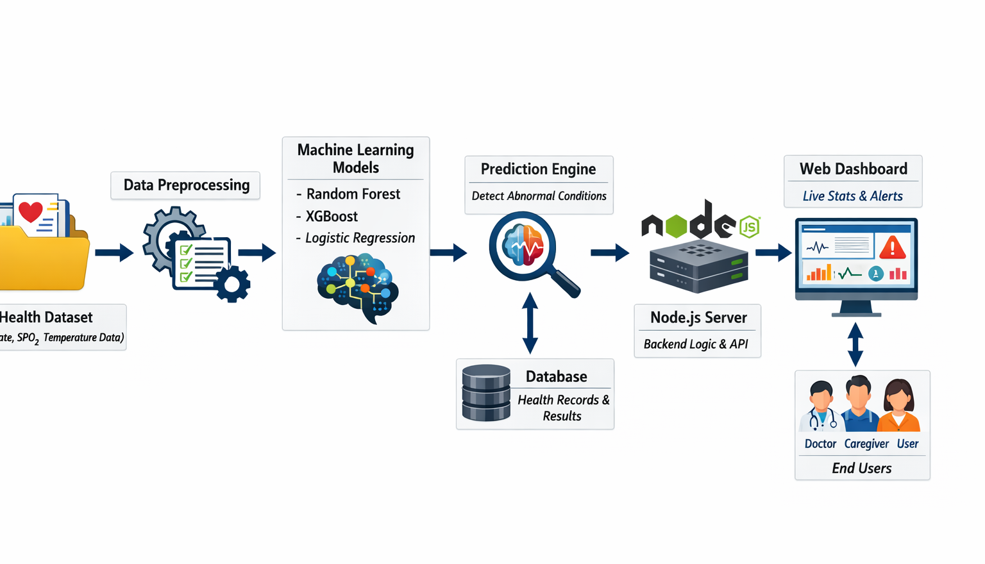
Architectural Diagram
DEPARTMENT OF CSE : MINI PROJECT

Slide 11
PROPOSED METHOD AND ALGORITHMS
Proposed Methods
Collect and clean the health dataset.
Train machine learning models using the data.
Analyze the data to detect abnormal health conditions.
Send results to the Node.js backend.
Display predictions on the web dashboard.
Algorithms Used
Random Forest – Used to classify health condition (normal or abnormal).
XGBoost – Used for better and accurate prediction.
Logistic Regression – Used to predict risk (yes or no).
DEPARTMENT OF CSE : MINI PROJECT
DEPARTMENT OF CSE : MINI PROJECT

Slide 12
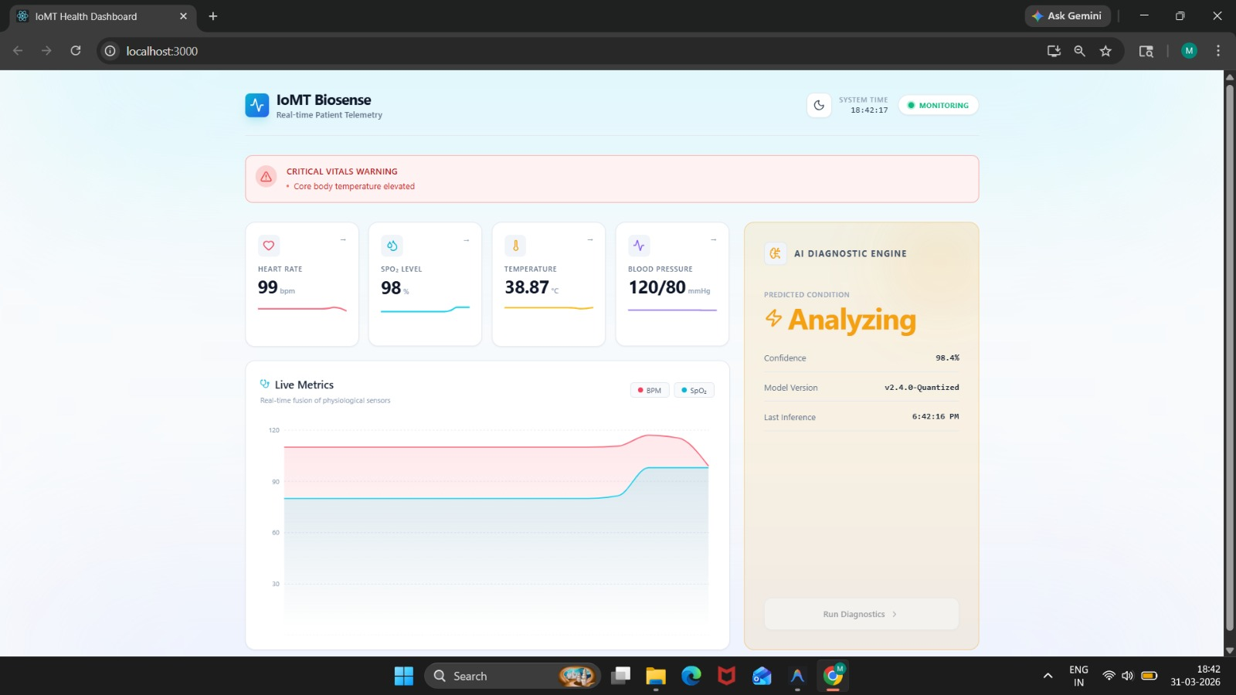
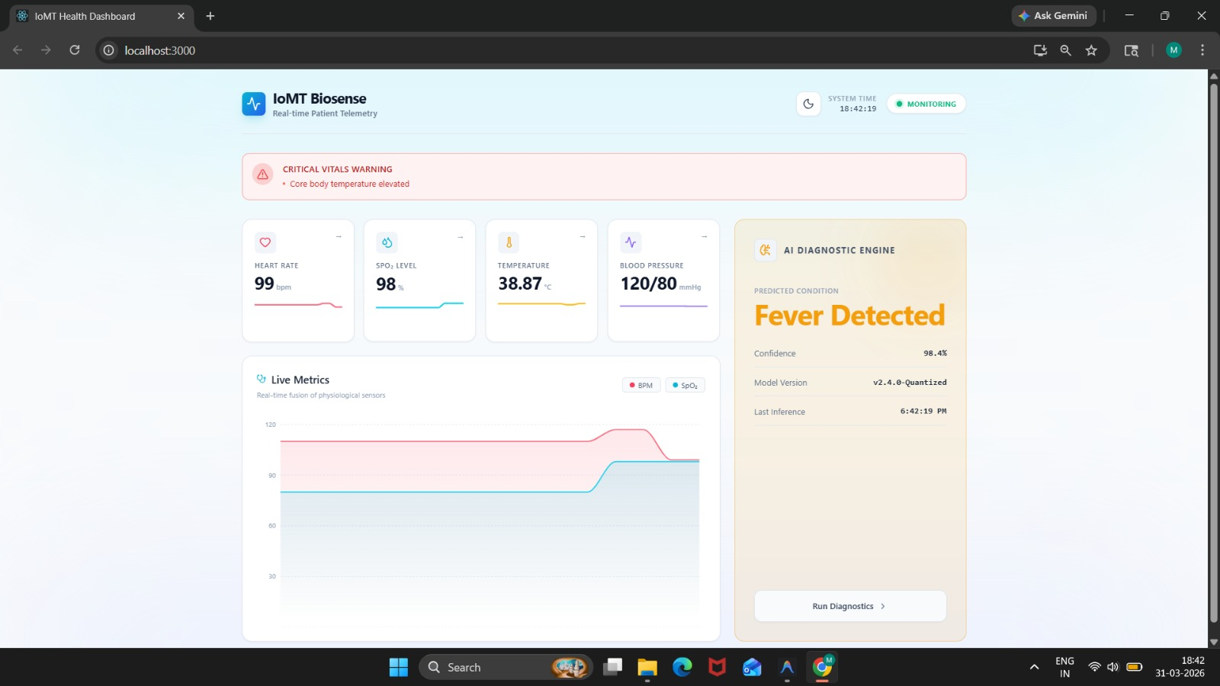
Results
The system successfully displays real-time health parameters such as heart rate, SpO₂, temperature, and blood pressure on the dashboard.
The AI Diagnostic Engine analyzes the data and shows different states like Analyzing, Stable, and Fever Detected.
In abnormal conditions, the system generates alerts such as “Critical Vitals Warning”, indicating possible health risks.
The dashboard provides clear visual graphs and live metrics, making it easy to monitor patient health.
The system demonstrates accurate prediction with high confidence levels (~98%), helping in early detection of diseases.
DEPARTMENT OF CSE : MINI PROJECT

Slide 13
Conclusion
The project successfully developed an AI-based smart health monitoring and early disease alert system that analyzes health data and predicts possible health risks. By using machine learning algorithms, the system can identify abnormal conditions such as fever and provide accurate results with high confidence.
The integration of a Node.js backend and web dashboard makes the system efficient and user-friendly, allowing easy visualization of health data through graphs and live metrics. The system also generates alerts for critical conditions, helping in quick response and better decision-making.
Overall, this project demonstrates how Artificial Intelligence can be effectively used in healthcare for continuous monitoring and early diagnosis. It highlights the importance of smart systems in improving patient care and supporting preventive healthcare solutions.
DEPARTMENT OF CSE : MINI PROJECT
DEPARTMENT OF CSE : MINI PROJECT

Slide 14
Thank You
DEPARTMENT OF CSE : MINI PROJECT

