Slide 1
How to Factory Staging Project work
Max Lin
mlin@suse.com

Slide 2
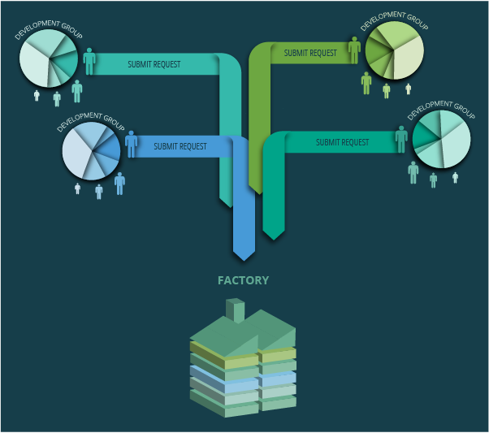
Factory development

Slide 3
Problem
Sometimes the package fails to build
Sometimes it caused the other package fails to build
Sometimes the package is uninstallable
Sometimes the package does not work
Hard to address the problem and debugging

Slide 4
The workflow
Pre-Integration
Testing
Submit Request
Automatic
Review
Manual
Review
Factory
Tumbleweed
QA

Slide 5
The workflow(cont.)
Pre-Integration
Testing
Submit Request
Automatic
Review
Manual
Review
Factory
Tumbleweed
QA

Slide 6
Review process
Submit Request
Factory-Auto
Legal-Auto
Repo-Checker
Manual Review
Security/Legal Check
openQA Testing
Staging Project
Factory

Slide 7
Review process
Factory-Auto: checks basic rules and adds additional reviewers
Legal-Auto: checking if the license of the package is in the permitted license database
Review Team: human check of the request
Repo-Checker: a more deeper automatic check
Factory-Staging: review by Staging Master (manual check and assisted by repochecker and openQA)

Slide 8
In-Ring vs. Non-Ring
Submit Request
In-Ring
Non-Ring
Standard Staging Project
Adi Staging Project

Slide 9
Rings
 | Description | Packages
Ring-0 | The bootstrap cycle of factory | 108
Ring-1 | Packages to generate the minimal-X DVD | 1119
Ring-2 | A pretty much complete DVD | 1069

Slide 10
Standard Staging Project
Inherited all packages from Rings
Staging1 – Ring-0 + Ring-1
  i586/ppc64le/x86_64 build enabled
Staging2(:DVD) – sub-project of Staging1 + Ring-2
  ppc64le/x86_64 build enabled
Will rebased at some point.

Slide 11
Adi Staging Project (Ad-Interim)
For non-ring packages
Ensure the package can built against Factory/x86_64
Repo-Checker has involved
It can not handle delete request!

Slide 12
Repo-Checker
Build result verification, including sub-package
The binary files is installable
Checks the conflicts with other packages
Detects new build cycle
Checks the validation of delete request as far as possible
Commenting on the request if found the problem

Slide 13
Generate staging DVD
Mirrored the binary files from build service
Execute rpm2solv against all binaries and generate the solv file
There is the testcase file represents package requirements to build a image
Execute testsolv against testcase then get the packages list(or detects the error)
Parse the packages list and add it to the kiwi file
Generated DVD according to that kiwi file

Slide 14
openQA testing
Normal installation
Installation on RAID partition(software RAID)
Installation with cryptlvm enabled
Installation on UEFI environment
Boot into rescue system
Console tools test
Minimal-X/GNOME/KDE environment work
Update system to current staging from Leap 42.1 or old staging
Only test the stuff were in the staging DVD

Slide 15
Acceptable?
No build failures
All reviews were accepted
Passed openQA testing
The current Tumbleweed snapshot is built and moved to openQA*

Slide 16
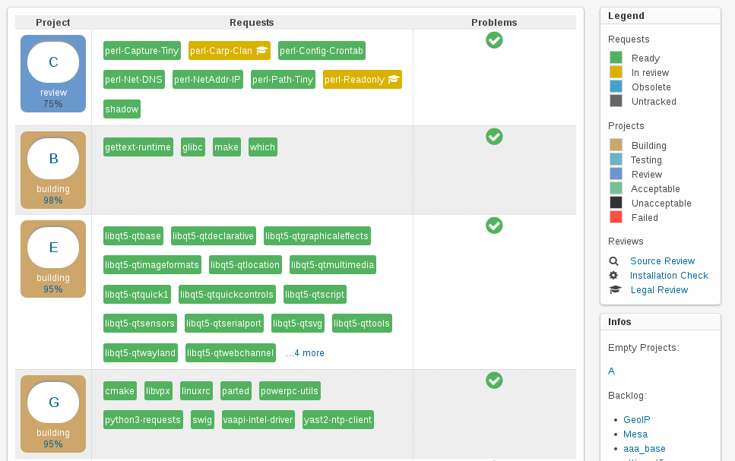
Staging Dashboard
* https://build.opensuse.org/project/staging_projects/openSUSE:Factory

Slide 17
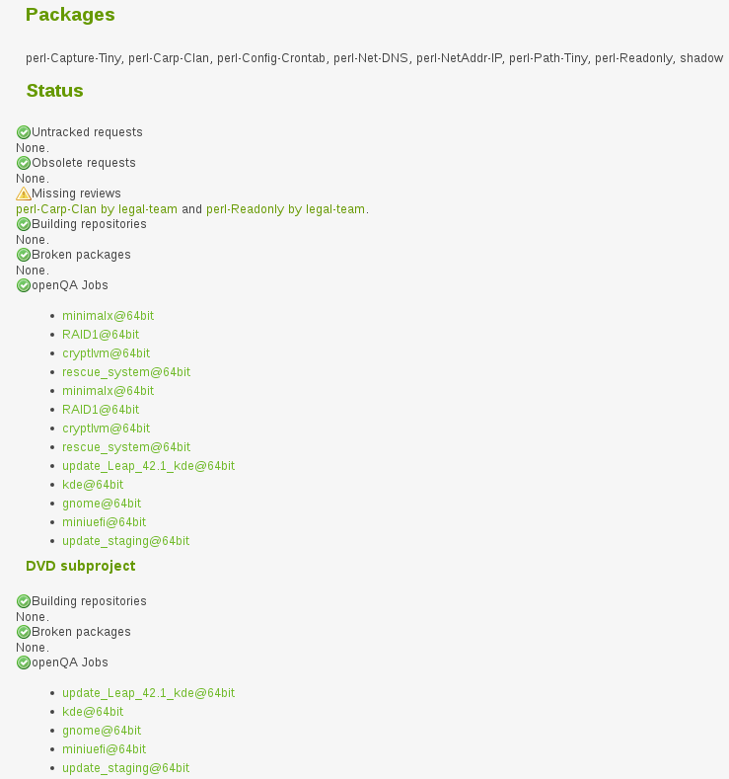
Why blocked?
* https://build.opensuse.org/project/staging_projects/openSUSE:Factory/$PRJ_LETTER

Slide 18
Not for Intel archs
Make sure package is built on specific architecture.
The rest of architecture must be excluded than disabled.
Repo-Checker can not handle it properly, human review is required!

Slide 19
Repo-Checker log
Example:
> Check group [#[401381](lrzip)] - Execution plan for ('openSUSE:Factory:Staging:adi:11', 'standard') failed ---------------------------------------- found conflict of lrzip-0.630-6.2.x86_64 with rzsz-0.12.20-1002.2.x86_64: - /usr/share/man/man1/lrz.1.gz - /usr/bin/lrz ---------------------------------------- - Execution plan for ('Archiving', 'openSUSE_Factory') failed ---------------------------------------- found conflict of lrzip-0.630-5.1.x86_64 with rzsz-0.12.20-1002.2.x86_64: - /usr/share/man/man1/lrz.1.gz - /usr/bin/lrz ---------------------------------------- found conflict of lrzip-0.630-6.2.x86_64 with rzsz-0.12.20-1002.2.x86_64: - /usr/share/man/man1/lrz.1.gz - /usr/bin/lrz
https://build.opensuse.org/package/view_file/openSUSE:Factory:Staging/dashboard/check_repo?expand=1

Slide 20
Behavior of accepting
The submissions in standard staging project will merge to Factory directly.
The submissions in Adi staging project have to wait until any standard staging project is ready and merging together.
Yes! We have a way force to merge submissions and no needs to wait any standard staging project is acceptable.

Slide 21
What is next?

Slide 22
TODO
A better way to ensure Ring-0 is safe after a merge
Better the delete request handling
Better the renaming submission handling, esp. for non-ring package
Dashboard for Adi staging or at least a better visual view way
More tickets in progress.opensuse.org

Slide 23
Contact us
Ask on #opensuse-factory IRC channel
Leave the comment on the request
Ping me on IRC or mail me :)

Slide 24
Questions?

Slide 25
Join the conversation,
contribute & have a lot of fun!
www.opensuse.org

Slide 27
License
This slide deck is licensed under the Creative Commons Attribution-ShareAlike 4.0 International license. It can be shared and adapted for any purpose (even commercially) as long as Attribution is given and any derivative work is distributed under the same license.
Details can be found at https://creativecommons.org/licenses/by-sa/4.0/
Credits
Template
Richard Brown
rbrown@opensuse.org
Design & Inspiration
openSUSE Design Team
http://opensuse.github.io/branding-guidelines/

