Slide 1
Get something new everyday
- Staging Project for openSUSE
Max Lin
Software Engineer
mlin@suse.com

Slide 2
Agenda
Basic workflow
Staging Project setup
Dashboard
Tools
Case study

Slide 3
Basic Workflow

Slide 4
Factory development model
Pre-Integration
Testing
Submission
Automatic
Review
Manual
Review
Factory
Tumbleweed
QA

Slide 5
Factory development model
Pre-Integration
Testing
Submission
Automatic
Review
Manual
Review
Factory
Tumbleweed
QA

Slide 6
The review process
Factory-Auto: checks basic rules and adds additional reviewers
Legal-Auto: checking if the license of the package is in the permitted license database
Review Team: human check of the request
Repo-Checker: a more in depth automatic check
Factory-Staging: review by Staging Master (manually and assisted by repochecker and openQA)

Slide 7
Pre-Integration testing: RepoChecker
Build result verification of submission
The binaries installable
Check the conflicts with other packages
Check the build cycle in Factory
Check the validation of deletereq request
osc check_repo command

Slide 8
Pre-Integration testing: openQA
Currently the test plan covering...
Normal installation
Installation on RAID partition(software RAID)
Installation with cryptlvm enabled
Installation on UEFI environment
Boot succeeded after the system installed by above way
MinimalX/GNOME/KDE environment work
Update system to current staging

Slide 9
The adi Staging (Ad-Interim)
Mainly for non-rings packages submission
Ensure the package can built against Factory
RepoChecker is involved
It can not handle deletereq request!

Slide 10
Staging Project Setup

Slide 11
Rings
 | Description | Packages
Ring-0 | The bootstrap cycle of factory | 102
Ring-1 | Based on bootstrap and building minimalX DVD | 1044
Ring-2 | A pretty much complete DVD | 937

Slide 12
Staging Project project setup
<link project="openSUSE:Factory:Rings:0-Bootstrap"/> # depends <link project="openSUSE:Factory:Rings:1-MinimalX"/>
<repository name="standard" rebuild="direct" linkedbuild="all"> <path project="openSUSE:Factory:Staging:A" repository="bootstrap_copy"/> ... </repository> <repository name="images" rebuild="direct" linkedbuild="all"> <path project="openSUSE:Factory:Staging:A" repository="standard"/> ... </repository> <repository name="bootstrap_copy"> <path project="openSUSE:Factory:Staging" repository="standard"/> ... </repository>

Slide 13
Staging Project project setup
<link project="openSUSE:Factory:Rings:2-TestDVD"/>
<repository name="standard" rebuild="direct" linkedbuild="all"> <path project="openSUSE:Factory:Staging:A" repository="standard"/> ... </repository> <repository name="images" rebuild="direct" linkedbuild="all"> <path project="openSUSE:Factory:Staging:A:DVD" repository="standard"/> ... </repository>

Slide 14
Support packages
Test-DVD-ppc64le: puts a .kiwi file, in order to generating the relevant ISO file.
Test-DVD-x86_64: puts a .kiwi file, in order to generating the relevant ISO file.
bootstrap-copy: aggregate the bootstrap packages from Ring-0. not in :DVD.

Slide 15
Dashboard

Slide 16
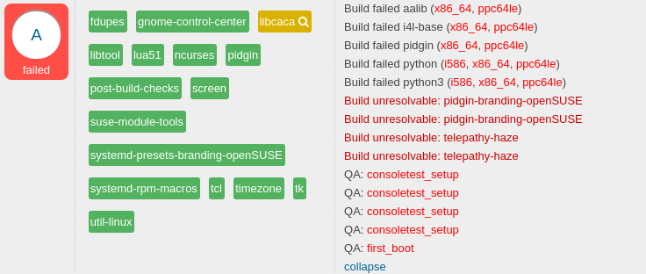
Adding request to staging
osc staging select LETTER REQUESTS

Slide 17
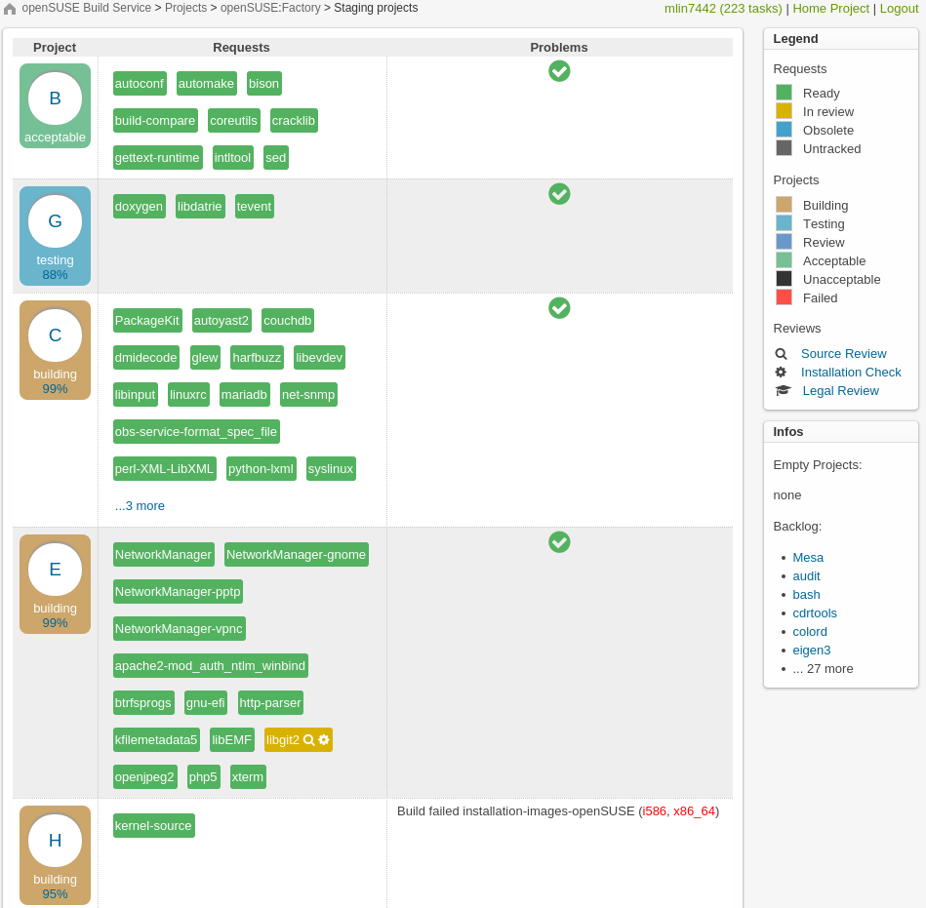
Staging Dashboard

Slide 18
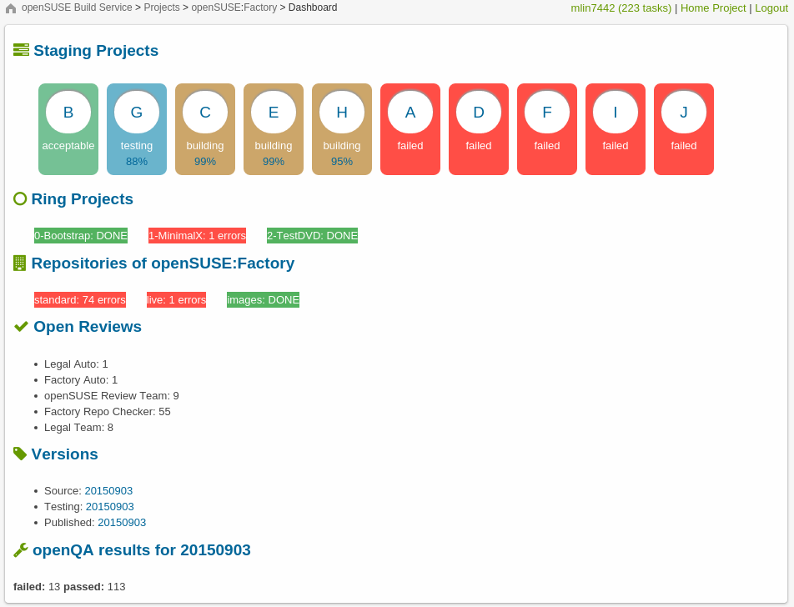
Factory Dashboard

Slide 19
Tools

Slide 20
osc staging command
accept: accept all requests in Staging:<LETTER>
check: shows all staging projects status
cleanup_rings: try to cleanup rings content and print out problems
freeze: rebase the sources of the project's links
list: dump the requests what open review by factory-staging
select: add requests to the project
unselect: remove requests from the project ie. pushing them back to the backlog
https://github.com/openSUSE/osc-plugin-factory

Slide 21
osc check_repo command
Behind of RepoChecker
Download the needed binaries
Execute installcheck against binaries
Execute findfileconflicts against binaries
Build result in devel project verification
Check new cycle created
Can force skip review by –-skip argument
Can force skip cycle check by –-skipcycle argument

Slide 22
ISO file generating
Mirrored the binaries from OBS project
Execute rpm2solv against all binaries and generate the solv file
There are 2 testcase files as template represents the basic requirement of packages
Adds the declare statement of solv file to the correspond testcase
Execute testsolv against testcase then get the packages list(or detect the problem)
Parsing the packages list above and add to kiwi file
Update the kiwi file back to Test-DVD-{$arch} on OBS

Slide 23
openQA

Slide 24
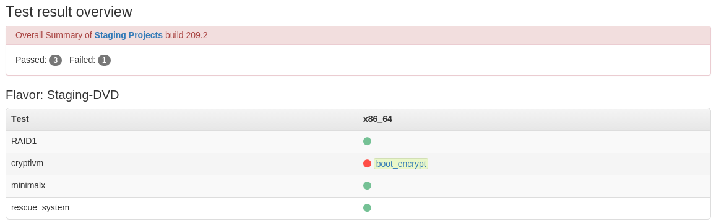
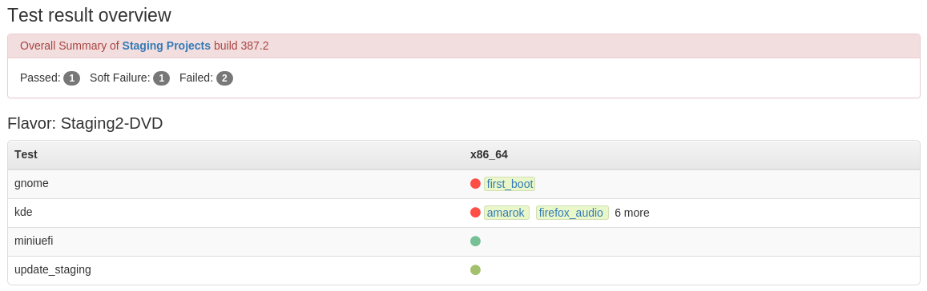
Testing on openQA

Slide 25
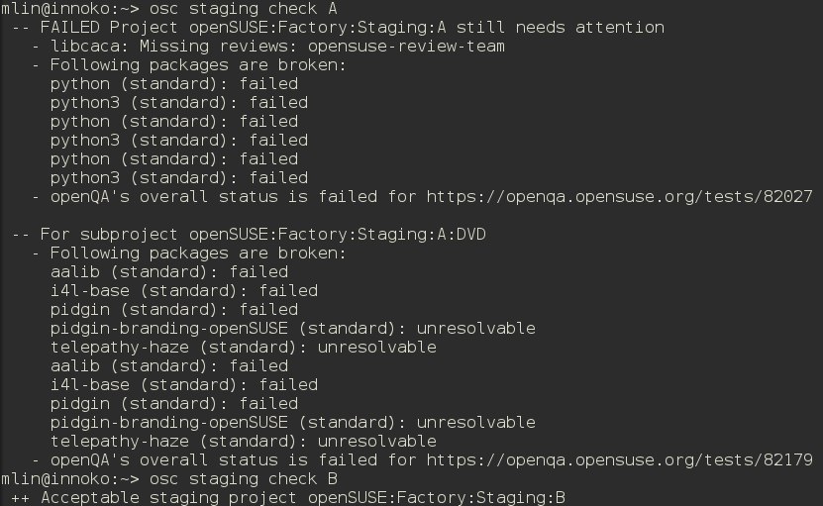
Check the status

Slide 26
Case Study

Slide 27
Case 1

Slide 28
Case 2

Slide 29
Case 3

Slide 30
Q&A

Slide 31
Thank you!

