Slide 1
Staging Project in openSUSE
Max Lin
SUSE Labs

Slide 2
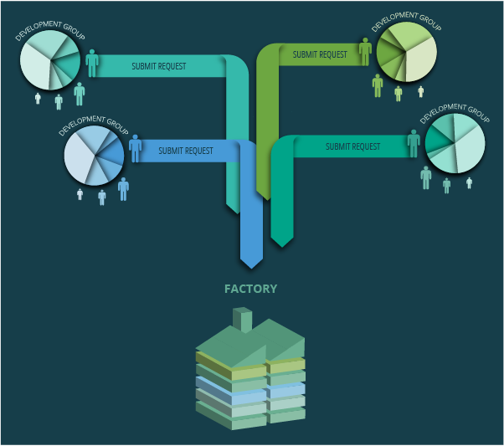
openSUSE Factory?

Slide 3
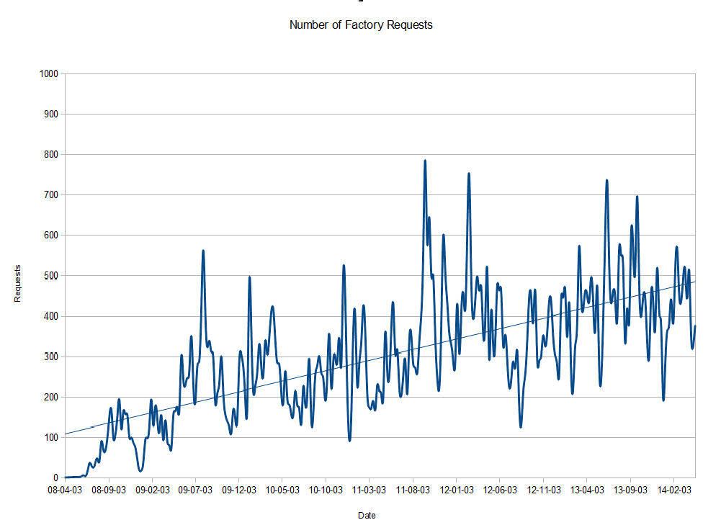
Changes every week
With > 500 changes a week

Slide 4
The Problem
Sometimes it fails to build itself
Sometimes other packages fails to build
Sometimes it's impossible to install
Sometimes it's buggy itself
Sometimes you don't know what's going wrong, just a mess!
Hard to address the problem and debugging

Slide 5

* https://flic.kr/p/5Q1khd (CC BY-NC-SA 2.0)

Slide 6
Process
Request
Factory-Auto
Legal-Auto
Repo-Checker
Review Team
Manual Security/Legal Check
openQA Testing
Staging Projects
Factory

Slide 7
Rings
Ring-0
  bootstrap packages
  96 packages
Ring-1
  minimal X installation packages
  990 packages
Ring-2
  almost whole DVD packages
  includes main desktop environment ie. GNOME, KDE
  867 packages

Slide 8
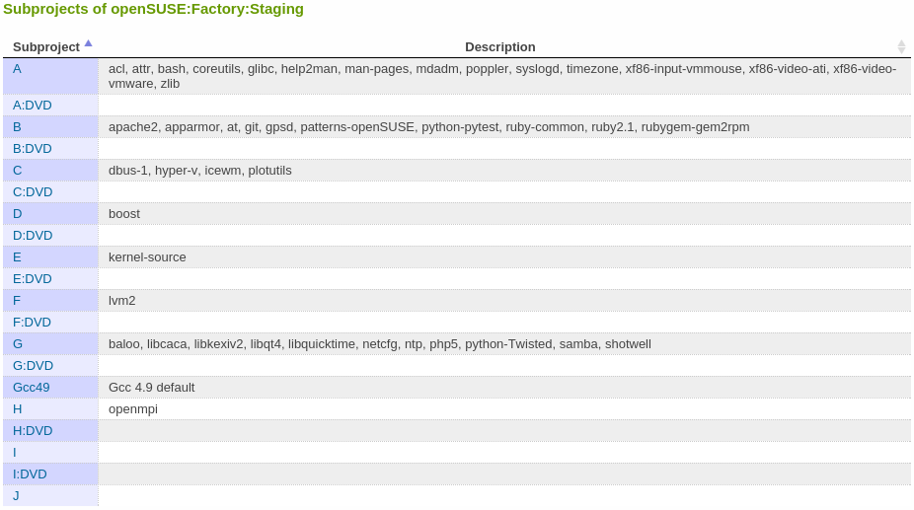
Stagings

Slide 9
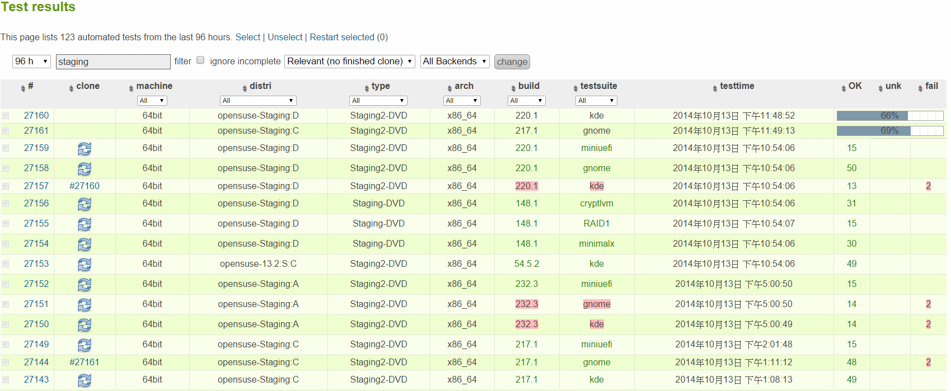
openQA

Slide 10
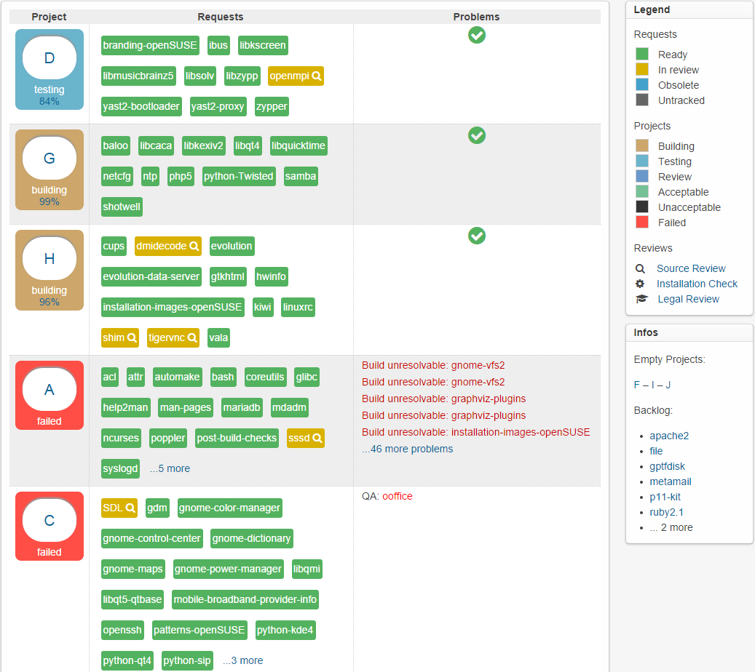
Staging Dashboard

Slide 11
What is Staging Project good for?
Catch the problem before checked in
To avoid main packages breaks Factory
Integrated with automated testing(openQA)
Have a dashboard to know the overview status

Slide 12
Questions?

Slide 13
Thank you!

