Slide 1
openSUSE Tumbleweed development process
Max Lin – Software Engineer
mlin@suse.com

Slide 2

What is Tumbleweed
A pure rolling release version of openSUSE project
Tumbleweed contains the latest stable applications
Tumbleweed is based on Factory, openSUSE's main development codebase
The core system packages receive automated testing via openQA

Slide 3
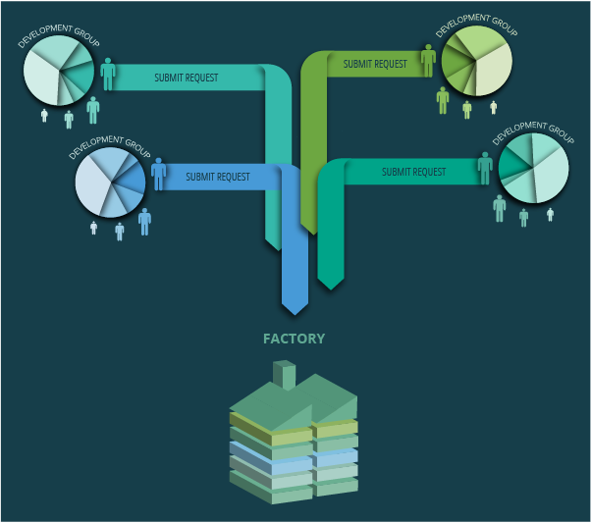
Development workflow

Slide 4
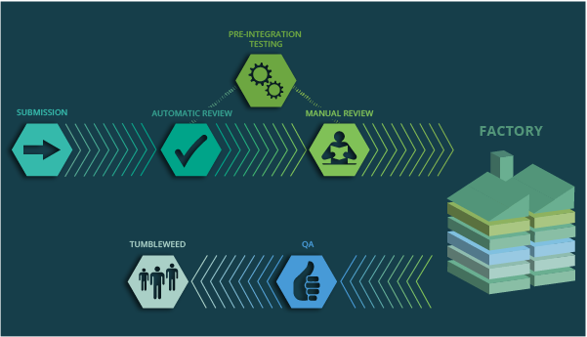
Process

Slide 5
Reviews
Creating
Devel-Project
Submit Request
Factory-Auto
Legal-Review
Repo-Checker
Manual Review
Security Check*
Staging Mgr
openQA Testing
Staging Project
Release Mgr
Factory
download.o.o

Slide 6
Reviews(cont.)
Factory-Auto: checks basic rules and adds additional reviewers
Legal-Review: checking if the license of the package is in the permitted license database
Review Team: human to check the request
Repo-Checker: a more deeper automatic check
Factory-Staging: review by Staging Manager (manual check and assisted by repochecker and openQA)

Slide 7
Rings and Staging Project
Rings:0-Bootstrap : bootstrap packages (105 packages)
Rings:1-MinimalX : everything for minimal X environment (1115 packages)
Rings:2-TestDVD : a pretty much complete DVD (1362 packages)
Staging:A-O : staging for ring 0/1 packages
Staging:A-O:DVD : staging for ring 2 packages
Staging:adi:* : staging for others package not in Rings

Slide 8
Repo-Checker
The binary files are installable
Checks the file conflicts with other packages
Detecting new build cycle
Checks the validation of delete request as far as possible
Commenting on the project if found the problem

Slide 9
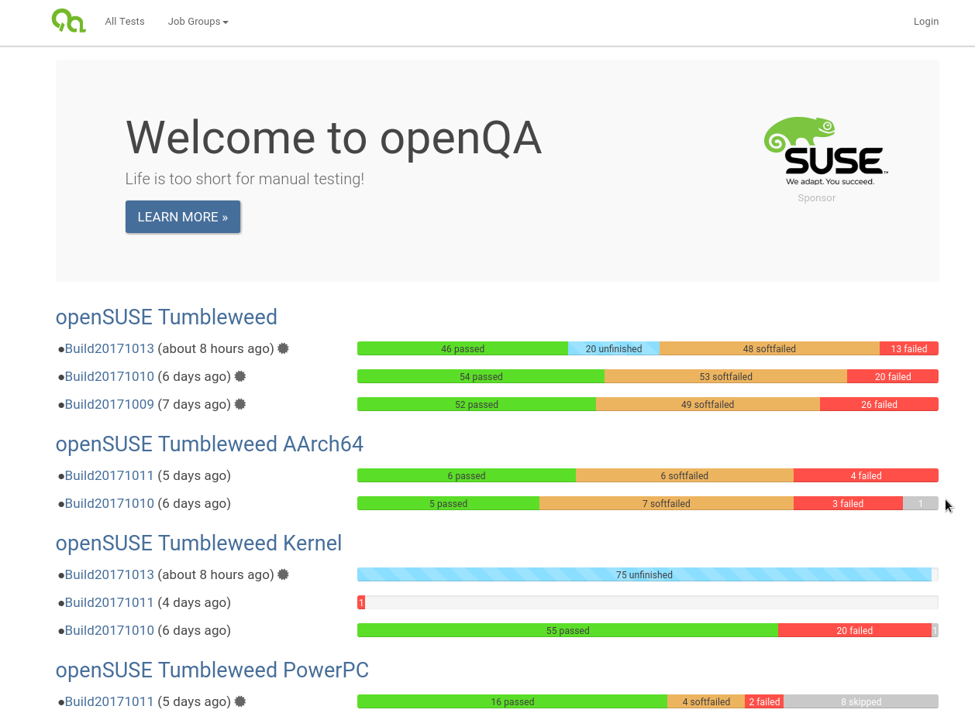
openQA

Slide 10
openQA Tests in Staging Project
Normal installation
Installation on RAID partition(software RAID)
Installation on UEFI environment
Boot into rescue system
Console tools test
MinimalX/GNOME/KDE environment works
Update system to current staging from old openSUSE version and old staging system
Only test the stuff were in the staging DVD

Slide 11
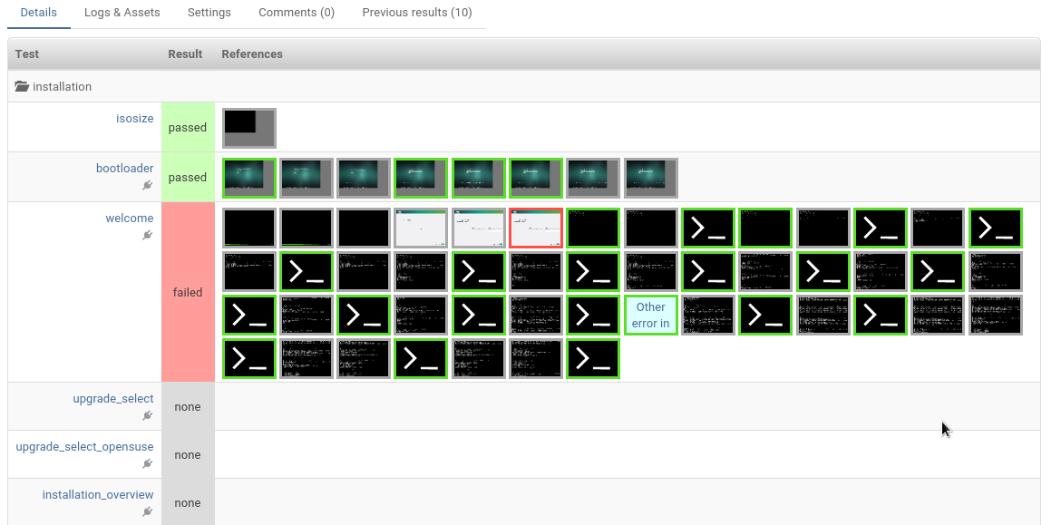
Test result on openQA(red)

Slide 12
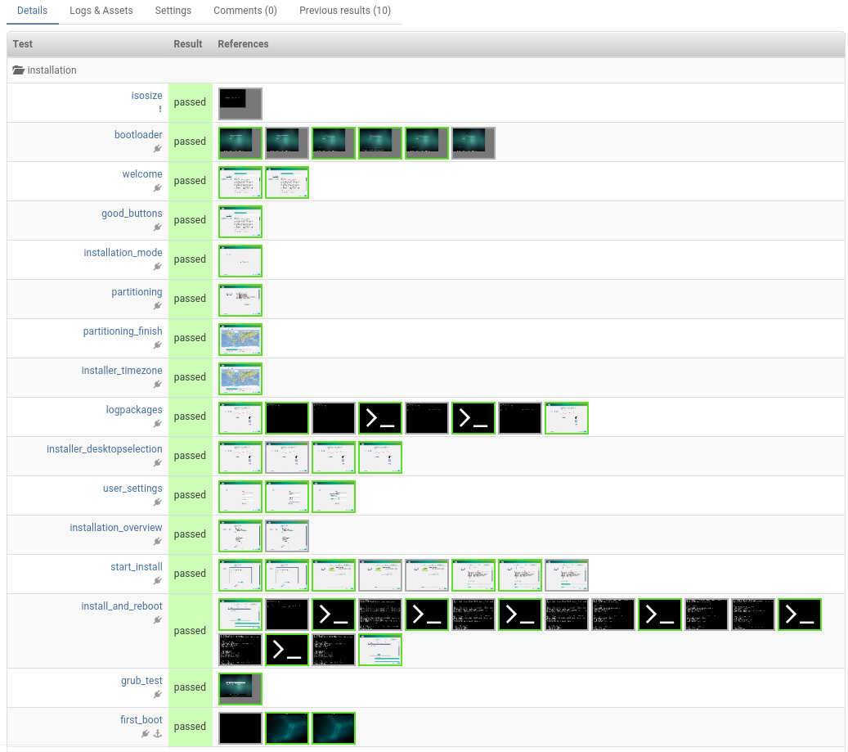
Test result on openQA(green)

Slide 13
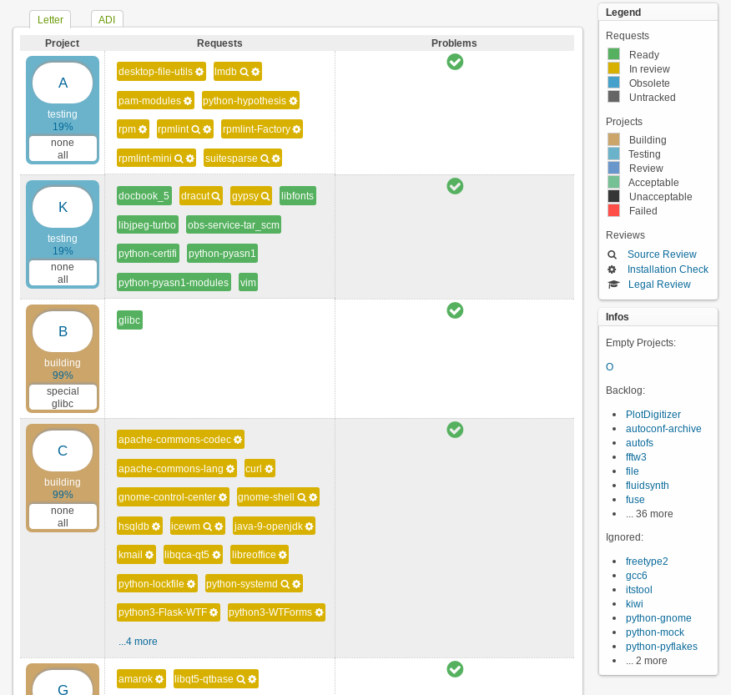
Staging Dashboard

Slide 14
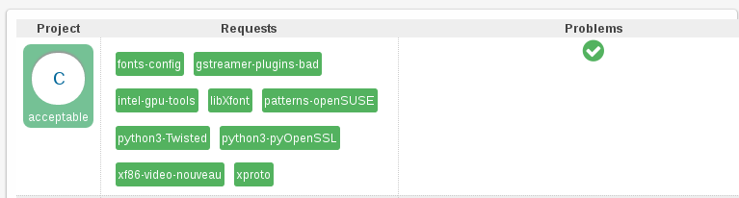
Acceptable
No build failures
All reviews were accepted
Passed openQA testing

Slide 15
After an check-in
Rebuilding the changes in openSUSE:Factory
Generate an new snapshot DVD
The online repository is in a consistent state
More openQA testing! A lot of testing!
^ When everything is done – publish the new Tumbleweed snapshot and sync the repository to the download mirrors.

Slide 16
Working together
opensuse-factory@opensuse.org mailing list
opensuse-packaging@opensuse.org mailing list
#opensuse-factory IRC channel
File bug report to openSUSE bugzilla
James Berry
Dominique Leuenberger
Ludwig Nussel
Max Lin

Slide 17
Questions?

Slide 18
Join the conversation,
contribute & have a lot of fun!
www.opensuse.org

